Slide 1
The Instructions
“Instruction does much, but encouragement everything."
― Johann Wolfgang von Goethe

Slide 2

Simple Math Perspective
Train ~10,000 laypersons = 1 bystander CPR
Notes:
Community training is important but is not the single answer. Estimates are that 1 out of every 10,000 trained will perform CPR.

Slide 3
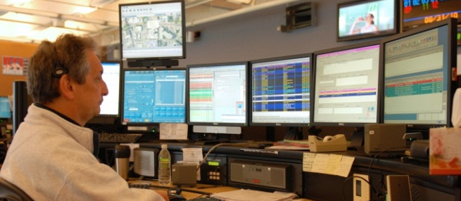
Simple Math Perspective
Train 1 communicator (well) = 2 bystander CPR
Notes:
Contrast the reality of the telecommunicator. In King County, each telecommunicator will have an active role in 2 CPRs every year. It’s a highly efficient and complimentary approach.

Slide 4
Getting to Compressions
Identify cardiac arrest
    Two-Question Model
Start CPR Instructions for quality CPR
When call is transferred from PSAP:
THERE IS NO NEED TO CONFIRM ARREST JUST START
What will happen if they are not in arrest??

Slide 5
CPR Instructions
Adult
Adult Respiratory cause
Children over 8 years old
Children (1-8 years old)
Neonate (Field Delivery)
Infant (0-12 months)
Pregnant Women (3rd trimester)
Tracheostomy/Laryngectomy (Stoma)
Not in Cardiac Arrest
Which instruction do you think we will use most???

Slide 6
Selecting the Right Script
Majority will be hands-only adult
How to begin:
Hello, my name is ____. Help is on the way. I am going to tell you what to do until they arrive.
Actively listen to the story the caller and PSAP dispatcher are telling you:
  If they say how old the patient is go directly to the appropriate script. If the patient is an adult and you suspect the arrest is secondary to respiratory arrest (e.g., drown, choking) go to page 3
  ***based on what PSAP/caller tells you – do not ask questions***
  If they say the patient is pregnant in third trimester go to page 8
  If they say the patient is a neonate (field delivery) go to page 7
  If they say the patient has a Tracheostomy/Laryngectomy Patients (Stoma) page 9
  If you suspect the patient is not in arrest (e.g., you hear the patient talking/crying, hear someone say they are breathing at a normal rate, or have a blood pressure), confirm the patient is in cardiac arrest:
    Is the patient awake?
    Is the patient breathing normally?
      Any Yes: Go to page 10
      Both No: Go to correct script for age and situation*
    **If in your judgment the patient is unlikely to be in cardiac arrest go to page 10**

Slide 7

Getting the Age
Is the person an adult or a child?
Adult: go to Adult CPR script page 2
Child: Is the child older than 8?
Yes: go to Child Over 8 Years Old CPR script page 4
No: Is the child older than 1 year?
Yes: go to Child 1-8 CPR script page 5
No: go to infant CPR script page 6
Why don’t we ask for age?
Notes:
Time is important
Deals with not know victims

Slide 8
CPR/Adults – Page 2
Get the phone NEXT to the person -- if possible put your phone on speaker.
Listen carefully. I’ll tell you what to do.
Get them FLAT on their back on the floor.
KNEEL by their side.
Put the HEEL of your HAND on the CENTER of their CHEST, right BETWEEN the NIPPLES.***can instruct to bare chest if needed
Put your OTHER HAND ON TOP of THAT hand.
With your arms straight PUSH DOWN FIRMLY, ONLY on the HEELS of your hands, as hard and fast as you can.
Do it 50 times, just like you’re PUMPING the chest. Count OUTLOUD 1-2-3.... ***(correct rate if needed)

Slide 9
CPR/Adults- Page 2 Continued
Great job, keep going, PUMP the chest as hard and fast as you can another 50 times. Count OUTLOUD 1-2-3.... ***(correct rate if needed, can restart counting at lower numbers if needed)
Great job, keep going, PUMP the chest as hard and fast as you can another 50 times. Count OUTLOUD 1-2-3.... ***(correct rate if needed, can restart counting at lower numbers if needed)
Great job, keep going, PUMP the chest as hard and fast as you can another 50 times. Count OUTLOUD 1-2-3.... ***(correct rate if needed)
If help has not arrived after ~600 compressions go to page 3 Breathing bullet 8
***If rescuer becomes too tired to continue instruct them to rest a short time then continue compressions as soon as possible.***
4. Keep doing it until help takes over. I‘ll stay on the line.
NOTE: IF CALLER REPORTS VOMITING, INSTRUCT CALLER TO:
• Turn their head to one side.
• Sweep out contents with your fingers before you resume.
***Go back to step 3

Slide 10
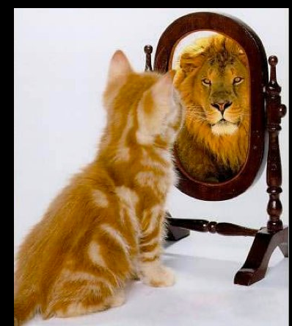
Continuous Coaching
“Keep going. Push HARD and FAST and COUNT OUT LOUD. I’ll stay on the phone. Keep going until help arrives.”
  If caller is tired, ask if they are keeping their arms straight
  If others are present have them take over
    Approximately every 2 minutes
  If alone, can suggest a short rest tell them to resume compressions as soon as possible
Remember:
Your job is to turn callers into lions!

Slide 11
Tactics and Tips
Count out rate at 100 beats/minute
  Beat set to disco classic “Stayin’ Alive”
Let caller take over counting
  Allows you to monitor speed and rate
Remind rescuer to press “hard and fast”
Don’t talk too much
If multiple willing bystanders, tell them to switch if tired
Stay with caller until EMS takes over

Slide 12

Breathing
Page 3 – only if obvious respiratory cause
30:2
(Breathing) Listen carefully. I’ll tell you what to do next.
PINCH the nose.
With your OTHER hand, LIFT the CHIN so the head BENDS BACK.
If possible choking: “Look inside mouth, remove any obvious obstruction”.
COMPLETELY COVER their mouth with your mouth.
GIVE 2 breaths of air.
***If they don’t want to give breaths continue with compression only***
THEN, COME BACK TO THE PHONE!

Slide 13
Children Over 8
Treat the same as an adult page 2
What will be the likely Challenges?

Slide 14
Children Between 1 and 8
  Page 5
    2:30
    Completely COVER their mouth with your mouth and give 2 breaths.
    Put the HEEL of ONLY ONE HAND on the CENTER of the chest, right BETWEEN the NIPPLES.
    PUSH down firmly one-half the depth of the chest.

Slide 15
Children Less than 1
  Less than 1 two fingers page 6
    2:30
    TIGHTLY COVER the baby’s MOUTH AND NOSE with your mouth.
    GIVE 2 small BREATHS of air.
    Put your FIRST AND MIDDLE fingertips of ONE HAND on the CENTER of the chest, right BETWEEN the NIPPLES.
    PUSH down one-half the depth of the chest.

Slide 16
Neonate (field delivery)
Children 1:3
  TIGHTLY COVER the baby’s MOUTH AND NOSE with your mouth.
  GIVE 1 short PUFF of air.
  Put your FIRST AND MIDDLE fingertips on the CENTER of the chest, right BETWEEN the NIPPLES.
  PUSH down one-half the depth of the chest, 3 times. Count OUTLOUD 1-2-3.

Slide 17
Pregnant Women Third Trimester
DO NOT ASK!!!
30:2
Get a pillow or folded blanket and WEDGE it under her RIGHT Side at the SMALL of the BACK.

Slide 18
CPR with Trach
Rare
Don’t need to ask any questions
If volunteer information follow trach script
If refuse breaths give compressions
30:2
COMPLETELY SEAL their MOUTH by covering it with your hand and PINCH the NOSE shut.
COMPLETELY COVER the stoma with your MOUTH and GIVE 2 BREATHS of AIR into their LUNGS.

Slide 19
Not in Cardiac Arrest
If you determine the patient is unlikely to be in cardiac arrest, use any or all of the following suggested prompts:
If the patient is lying down they can place them in the recovery position.
OK, help is on the way; while you are waiting can you turn the patient on their side?
***Note if the patient is having difficulty breathing place them in the position of comfort. Avoid placing patients who are having difficulty breathing on their backs.
Ok, help is on the way; while you are waiting help him/her get in the position that seems most comfortable for their breathing.

Slide 20
Not in Cardiac Arrest
Verify that EMS can enter the house.
OK, help is on the way; while you are waiting do you know if your house is unlocked? Please make sure your door is open so when help arrives they can get in.
Do you have a dog? Can you put them in another room so that when help arrives they can get in?
(If it’s dark) Is your front porch/door light on so that when help arrives they can easily see your house?
Is there someone else there you can send outside to show where your house is when help arrives?
Get a medication list or their medications for the EMS providers if the patient is at home.
Do you know if the patient takes any medications? Do you have a list of those medications so that when help arrives you can give it to them or can you gather the actual pill bottles?
Remind the caller not to give the patient anything to eat or drink. However, if a caller asks you if they should give a medication such as Narcan or an epi pen, you can let them give it.
Do you have that medication to use when this happens? You should follow those recommendations.

Slide 21
Medications
Callers who ask about giving medications:
  Only if the caller asks
  Examples: narcan or epi.
  Do you have that medication to use when this happens? You should follow those recommendations.

Slide 22
Not In Cardiac Arrest
Verify that the patient is still not in cardiac arrest and if you have no concern the patient will arrest prior to EMS arrival
How is the patient? Are they still awake and breathing normally? Would you like me to stay on the line until help arrives?
If they do not want to stay on the line say, “OK call 911 again if anything changes.”
If they do want to stay on the line or you have concern the patient’s condition might change say, “OK I am going to stay on the line with you. You may not hear me for a little while but I am here and will check on you, if anything changes just let me know”
***check back that the patient is still awake and breathing normally at least every 30 seconds but it is ok to remain silent.

Slide 23
Quality Improvement
“Sometimes, you have to look back in order to understand the things that lie ahead.”
― Yvonne Woon, Dead Beautiful

Slide 24
Dispatcher Feedback
100% QI for first 2 years
In-person feedback provided for first 3-5 calls
Feedback emailed to dispatcher at regular intervals after initial process
  Will meet as needed

Slide 25
QI Review Items
  Evolving
    Time intervals
    Treatment steps
    Direction conflicts

Slide 26
Specifics
Evaluation of time intervals using recordings’ time stamps
  Time to first compression
    Give averages and compare to overall average for all contacts
Treatment steps
  Tell caller what to do, offer compressions first, correct protocol for patient age
Direction conflicts
  If stop advising compressions, why
  Response to EMS delayed arrival
  Reason’s and frequency of calls placed on hold

Slide 27
Goal
Evolve and improve in the first year!
QI 100%
Change script and procedures until we are all happy and successful
Today is the first day in our partnership for this program
Give feedback, share your experiences and suggestions
No freelance, but work together for best practice!

Slide 28
Questions/Discussion

Slide 29
Practice
“You are what you practice most.”
― Richard Carlson

