Slide 1
How does NIH Work?
Jane D. Scott, ScD, MSN
Director, Office of Research Training & Career Development
Division of Cardiovascular Sciences
National Heart, Lung, and Blood Institute
HRSA PECARN EMS Research Meeting
June 14, 2016

Slide 2

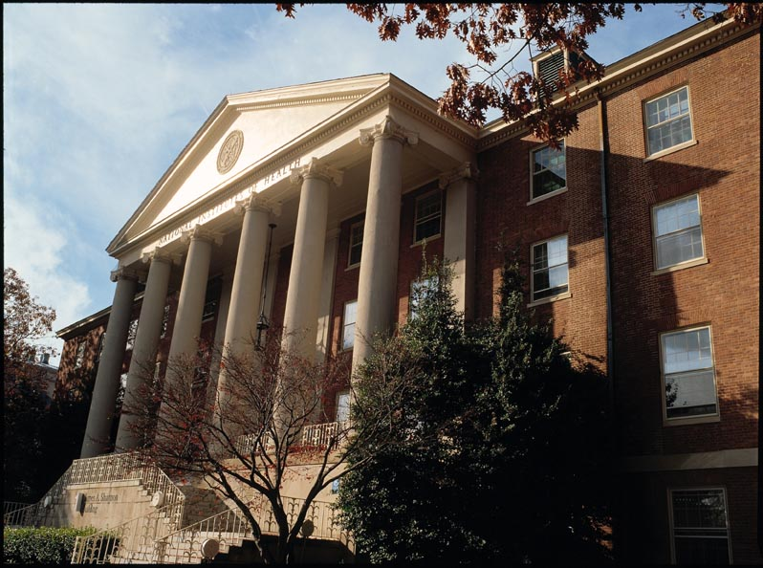
National Institutes of Health
The National Institutes of Health (NIH) is the largest source of funding for medical research in the world, making important medical discoveries that improve health and save lives.

Slide 3

National Institutes of Health
The NIH is part of the U.S. Department of Health and Human Services (HHS).
Office of the Secretary
DHHS
Administration
for Children
and Families
Administration
on
Aging
National
Institutes
of Health
Agency for
Healthcare
Research and
Quality
Agency for
Toxic Substances
and Disease
Registry
Centers for
Disease Control
and Prevention
Centers for
Medicare &
Medicaid
Services
Food and Drug
Administration
Health
Resources
and Services
Administration
Indian
Health
Service
Substance Abuse
and Mental Health
Services
Administration

Slide 4
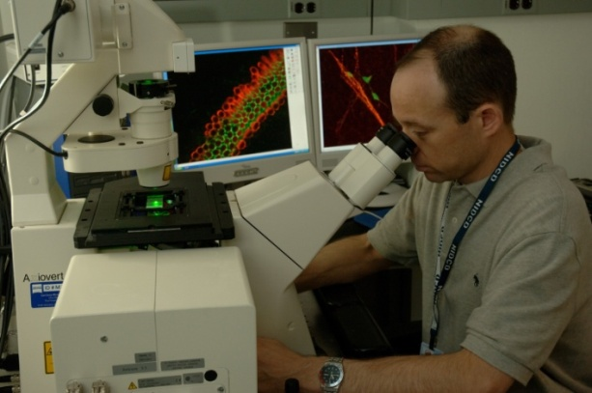

National Institutes of Health
The Nation’s Medical Research Agency
Science in pursuit of fundamental knowledge about the nature and behavior of living systems and the application of that knowledge to extend healthy life and reduce the burdens of illness and disability.
Notes:
From NIH 101 slide deck

Slide 5

What is Biomedical Research?
Biomedical research advances knowledge in biology and medicine and related fields.
Basic research improves our understanding of biological systems and behavior.
Clinical research evaluates the safety and effects of treatment and prevention approaches through clinical trials and comparative effectiveness studies.
Research leads to new methods for disease treatment, management, and prevention.

Slide 6
National Institutes of Health
NIH-funded research uncovers new knowledge that leads to better health for everyone:
Conducts research in its own laboratories
Supports research of non-federal scientists in universities, medical schools, hospitals, and research institutions throughout the United States and overseas
Translates scientific information into clinical guidelines and community programs
Trains research investigators
Fosters communication of medical information
Notes:
Adapted from NIH 101 slide set

Slide 7
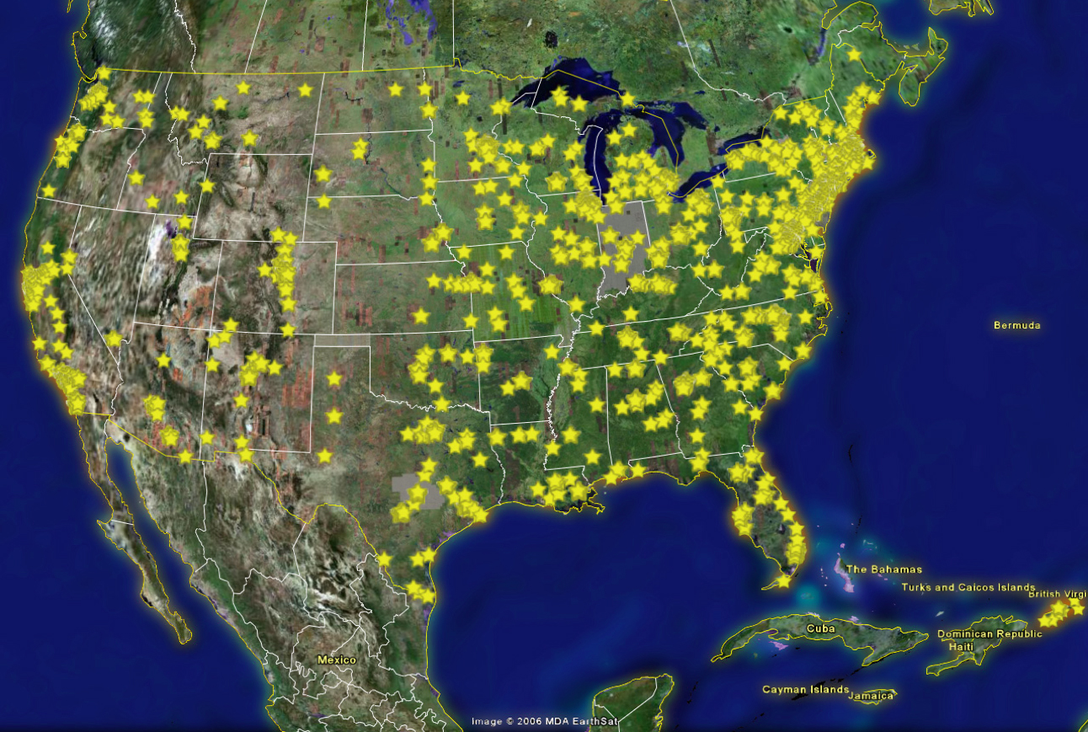
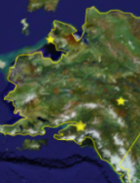
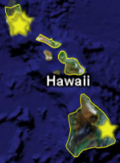
Most NIH Funds Are Spent Beyond Bethesda
NIH Budget,
FY 2010:
$30.759 B
At NIH (intramural):
$3.22 (11%)
Outside NIH (extramural):
$26.3 B (89%)
Notes:
~89% of the NIH’s budget is distributed to scientists who do research at colleges, universities, and medical centers in every state across America.
From NIH 101 slide deck
Numbers adjusted at NHLBI, August 2010

Slide 8
Structure of the NIH: 27 Institutes and Centers
NIAID
NINR
OD
NCI
NIAMS
NCCAM
NIEHS
NEI
NIMH
CIT
NIDA
NLM
NINDS
CC
NIDDK
NIBIB
NCMHD
NHLBI
NHGRI
NIDCR
NIA
NIDCD
NIAAA
NICHD
NIGMS
FIC
CSR
NCRR
= Extramural only
Notes:
From NIH 101 slide deck

Slide 9
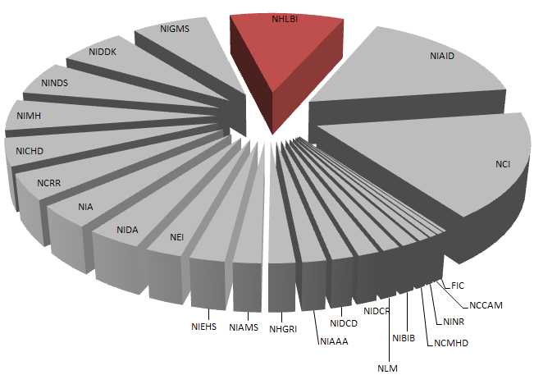
NHLBI Is the Third Largest NIH Institute
FY 2009 Enacted
NCI | $5 B
NIAID | $4.7 B
NHLBI | $3 B
NIGMS | $2 B
NIDDK | $1.8 B
Notes:
NHLBI has 10% of total NIH FY 2009 enacted budget
Numbers do not include ARRA/Recovery Act funds

Slide 10
NIH Funding: Where’s the money?
  27 Institutes & Centers (ICs), 24 can fund grants
  80% of the NIH budget supports investigators at more than 2,500 institutes world wide
  10% funds NIH Intramural research (NIH on campus research)
  Each IC has a distinct mission, so identify relevant Institutes that might fund your research
  Find and understand funding opportunities
  Program Announcements (PAs) & Funding Opportunity Announcements (FOAs)
  https://report.nih.gov/tutorial/matchmaker.aspx

Slide 11
What does NIH Look For?
NIH wants research of high scientific caliber and it must be unique
See IC specific website’s for their research priorities/strategic plan https://www.nih.gov/institutes-nih
For NHLBI, https://www.nhlbi.nih.gov/about/documents/strategic-vision
Identify your research (topic, methods)
Find out where the research could be funded
Find a funding opportunity announcement:
  grants.nih.gov/funding/index.htm
Read & understand funding opportunity

Slide 12
A Key to Funding: Program announcement (PA) & Funding Opportunity Announcement (FOA) provide:
FOA Number (required grant first page)
Sponsoring Institute(s)
Date released, date of expiration
Activity code (R01, P01)
FOA purpose
Set aside funds?
Review criteria

Slide 13
FOA table of contents
Part 1. Overview Information
Part 2. Full Text of the Announcement
  Section I. Funding Opportunity Description
  Section II. Award Information
  Section III. Eligibility Information
  Section IV. Application and Submission Information
  Section V. Application Review Information
  Section VI. Award Administration Information
  Section VII. Agency Contacts
  Section VIII. Other Information

Slide 14
Pay particular attention to……..
Section V. Application Review Information
  Critical
  Write to the review criteria
  Keep & frequently re-review evaluation criteria
Section VII. Agency Contacts
Program contact
Grant management contact
Section VIII. Other Information
  Institute specific rules for the announcement
  A must….
  NHLBI Parent K01

Slide 15
How unique is your topic?
https://www.nih.gov/
https://report.nih.gov/
https://projectreporter.nih.gov/reporter.cfm
Contains all NIH funded research
Funded years before findings published
Be sure your topic is competitive with currently funded grants
Search by IC, search terms, funding mechanism, geographic region

Slide 16
Have topic, FOA, Institute? Next step…
Timeline & list of requirements
Plan for a minimum of 6 months
Institutions submit grants not individuals
Get to know your Grants & Contracts Office (help them help you)
Notify your institute’s grant & contracts officials a minimum of six weeks before submission
Understand your Institution’s role & requirements
What do they need & when? (How long is their review?)
Share your PA or FOA

Slide 17
Program Officers/Directors
Scientific staff responsible for grant oversight
Talk with them in planning, during writing, & after review
No contact between program & PIs after submission until review is complete
Helpful in understanding summary statements & next steps
Once funded, your assigned program officer is usually with you for the remainder of your grant

Slide 18
Next, write, write, write & Submit
Call and talk with program officers at IC for guidance as to relevance & suitability of topic, methods
Talk with multiple program officers.
Find the form required for your FOA: grants.nih.gov/grants/how-to-apply-application-guide.html
Write your application
Re-write your application,
Get multiple reviews & edit, edit, edit…
Have you made a persuasive argument for your work?

Slide 19
Next, Write, write, write & Submit
Develop a budget
See guidance for biosketches, reference letters, data tables, page limits, format attachments (citations, electronic signatures, fillable PDFs, fonts)
https://grants.nih.gov/grants/how-to-apply-application-guide/video/index.htm
The first application is the hardest…..

Slide 20
Is your application ready for submission?
Is everything done to perfection including grammar, spelling, punctuation? If not, defer.
Does the budget match the scope of work?
Is the plan & scope of work feasible?
Do you have a solid research team to support your work?
Four part video series: grants.nih.gov/grants/how-to-apply-application-guide.html
Does your cover letter clearly indicate your choice of
1) institute & 2) review panel? Ask, don’t tell….

Slide 21
After submission, at NIH grant receipt, referral, and review
Center for Scientific Review (CSR) reviews & triages grants
  Grant is assigned an Institute
  Then assigned a Peer review committee that may be organized through CSR or IC
  Grant given a number that will stay with the project (1 HL number-01)
  Once assigned to a Review Committee, the Scientific Review Officer (SRO), an NIH employee, reviews applications & selects pertinent reviewers

Slide 22
Review: Scientific review officer (SRO)
SROs dedicated to high quality, fair, & objective reviews, manages conflicts of interest
Available to talk to if questions or concerns
At the meeting: SRO, Committee Chair, committee members, program and administrative staff may attend.
Standing & ad hoc members, 18-20.
Assigned 3-4 grants for in-depth review, & access to all to read

Slide 23
Peer Review Criteria
Scored Review Criteria: Significance, Investigator(s), Innovation, Approach, Environment
Scoring: 1-9 Scale, 10=Exceptional, 90=Poor
Percentile score (ranking) & priority score (raw number)
https://grants.nih.gov/grants/peer/guidelines_general/Review_Criteria_at_a_glance.pdf
Additional Review Criteria: Not scored individually, but considered in overall impact score: Protections for human subjects, inclusion of women, minorities & children, vertebrate animals, biohazards, resubmission, renewal

Slide 24
Peer Review Criteria
Additional Review Considerations: Not scored individually and not considered in overall score: Applications from foreign organizations, select agents, resource sharing plans, authentication of key biological &/or chemical resources, budget & period of support
Additional comments to Applicant
Scored vs. unscored applications
For review groups with large grant workloads: Triage
Meaning of “unscored” has changed over time
If scored, reviewed & voted on by the entire committee
If unscored, you get individual reviewer scores & comments.

Slide 25
What next?
Scores are published within days
Reviewer comments compiled into “summary statements”
If scored, paragraph provides the essence of the group discussion & key issues. Also get the scores of the primary reviewers.
If unscored, you get the primary reviewers scores & comments (usually 3 reviews)
And then?

Slide 26
And then?
Has the IC published their payline?
If well within the payline, great news!
If just below the payline, good news….
If just above the payline, revise but hope for end of year funding….
If well above the payline or unscored, revise and resubmit

Slide 27
Fiscal year impediments that slow down funding…
Federal fiscal year: October 1 to September 30
New budgets and paylines each fiscal year
Delay at the start of the fiscal year if the fiscal budget is delayed
Then subsequent decisions regarding funding within the department

Slide 28
Revise & resubmit?
Wait for the summary statements to see the critiques
Read the critique, & deep breath…..
Review summary statements, you, your mentors & with IC program directors
Make an appt & discuss the issues..
Can the criticisms be addressed & fixed, or are there fatal errors?

Slide 29
Next steps after a great score….
Two levels of review required to fund any grant
First is the scientific review group
Second is the IC National Advisory Council
Council meets 3 months following review
Before funding Grant Management Official (GMO) will contact you for revised budget & other support
GMO is assigned to your grant & responsible for administrative & budgetary issues
All official documents to NIH must be signed off & sent by the University Grants/Contracts office to your GMO & cc your program officer.

Slide 30
Notice of Grant Award (NOGA):
4-6 weeks post Council, NOGA released
Please read the NOGA.. Provides requirements for the award
Your grant annual reports (RPPR) due 4 months before the grant anniversary
Your report grant progress, findings, publications, update budget, staff, any other important findings
Reviewed by Program Director & OGM

Slide 31
Once funded:
You are on your way….
Maintain timelines for your work
Set goals for papers, pubs, & subsequent grants
Keep on track

Slide 32
Be Aware
A reminder that you are restricted to the work that was approved by the study section, & any changes require consultation & frequently written approval
“Change in scope of work”
A reminder to attribute grant support on any papers, abstracts, presentations…. And provide your grant number & funding institute
We can’t tie your work to our funding without it.

Slide 33
Office of Research Training & Career Development, Cardiovascular Division, NHLBI
301.435.0535
Li-Shin Huang, PhD
Wayne Wang, PhD
Tawanna Meadows, BS
Jane Scott, ScD, MSN

