Slide 1
Increasing Cardiac Arrest Survival through Dispatcher Assisted Bystander CPR
PSAP Training for identifying patients who are pulseless and not breathing

Slide 2
Disclosure
This work is supported by funds from Advancing a Healthier Wisconsin’s Change Maker Program

Slide 3
Training Overview
Project Vision: where we are and where we want to be
Identifying patients who need dispatcher CPR

Slide 4
Project Vision
“I'm sorry no one saved you.”
― Maggie Stiefvater, The Dream Thieves

Slide 5
To Give Every 9-1-1 Caller the Opportunity to be a First Responder
Each year 800 people have an out-of-hospital cardiac arrest in Milwaukee County and 90% die
Less than 19% have the benefit of bystander CPR
Bringing dispatcher assisted CPR to Milwaukee County will CHANGE:
      Bystander CPR rates
      Cardiac arrest survival rates
Notes:
As you likely know, every citizen in this county, has the power to save a life just by putting one hand on top of the other and pushing hard and fast on a cardiac arrest victim’s chest. Yet when faced with this high stress high emotion situation few choose to act, in Milwaukee County less than 19% of the time bystanders perform CPR. However, other communities have shown that by having 9-1-1 dispatchers prompt people into action this rate can change and more lives can be saved --- every citizen can become a first responder.
<<play recording>>
As you may have identified, this couple knew CPR, but while they had initiated the 9-1-1 call, they had not used that knowledge until prompted by the dispatcher. We want to bring these prompts to the citizens of Milwaukee and create a measurable CHANGE in our rates of bystander CPR and cardiac arrest survival. Listening to this recording it may sound simple, but make no mistake, what you heard was a complex process. The dispatchers words were carefully chosen and the result of intensive training and a quality improvement program that coached her to maintain her skills. Also, the citizens who called were caring for a stranger and the dispatcher did not have to deal with the more typical caller unable to get through their emotions to reach a state of action. What we are proposing is to train dispatchers to use the power of their voice to take charge of a total stranger’s actions and guide them to act in a time of high stress and emotion. This can not be done without significant initial and continued training as well as some change to the 9-1-1 infrastructure, and a grass routes campaign to show administrators that this service is expected by the citizens and the most cost effective way to improve our dismal 10% survival rate.

Slide 6

The Goal
Thoughts?
What did you notice about these callers?
Without the dispatcher what would have happened?
How did the dispatcher sound?
Did it work?
Notes:
The callers know CPR but they were not doing it, they needed the dispatcher
Was she asking or telling

Slide 7
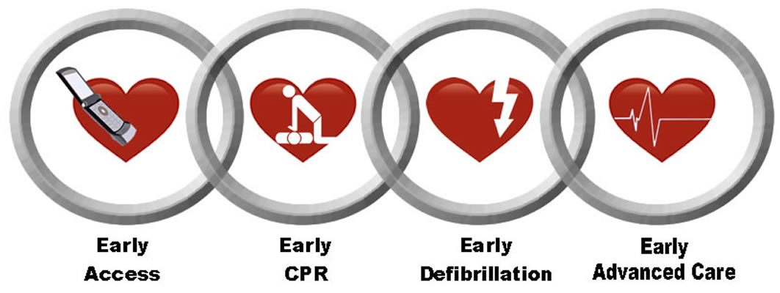
Links in the Chain of Survival
The Metaphor

Slide 8
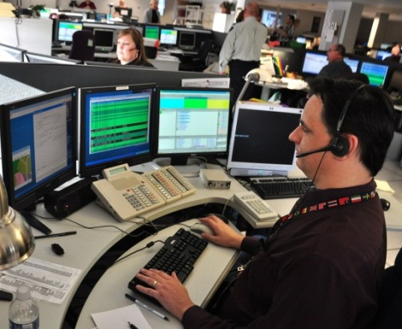
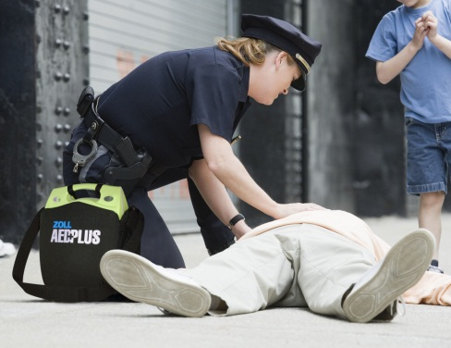
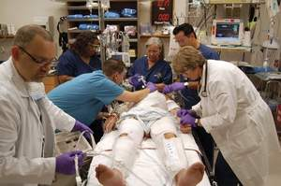



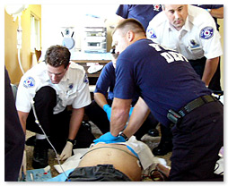
The Links => Ideal Response

Slide 9
Milwaukee County Today
Directions only
in City, W. Allis, Oak Creek
Only 19% of the time

Slide 10
Moving Our Focus to the First Two Links
Time to first shock
Time to CPR | 0-8 min | 9-12 min | 13+ min
0-4 min | 64% | 41% | 30%
5-8 min | 49% | 27% | 12%
9+min | N/A | 10% | 0%
Data on Survival from Witnessed VF Rhythm
In King County 2005-2012

Slide 11
Slope of Death
100%
90%
80%
70%
Survival
60%
50%
40%
30%
20%
10%
1
2
3
4
5
6
7
8
9
10
Minutes

Slide 12
Where we are today
100%
Turn out
90%
80%
70%
Defib
60%
Dispatch
50%
HP-CPR
40%
At scene
30%
20%
At pt. side
10%
1
2
3
4
5
6
7
8
9
10
Minutes

Slide 13
Where we are going
100%
Turn out
90%
B-CPR
80%
70%
HP-CPR
Defib
60%
Dispatch
50%
At scene
40%
35%
At pt. side
30%
20%
10%
1
2
3
4
5
6
7
8
9
10
Minutes

Slide 14
Identifying Patients Who Need CPR: Over the Phone
“Courage is not the absence of fear, but rather the judgment that something else is more important than fear.”
― Ambrose Redmoon

Slide 15
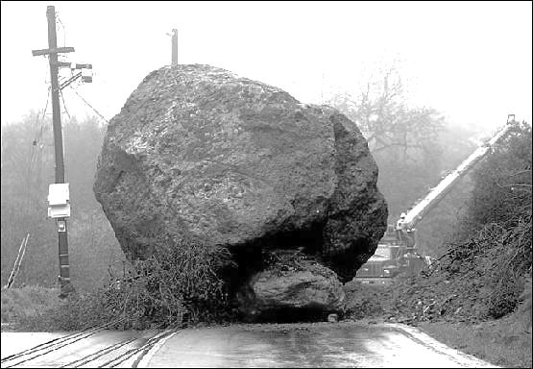
What are the roadblocks to bystander CPR?
Cardiac arrest is hard to recognize.
Rescuers do not have confidence to act.
Traditional CPR is technically too difficult.

Slide 16
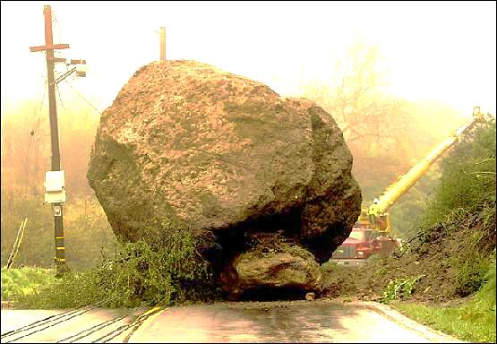
What are the roadblocks to bystander CPR?
Cardiac arrest is hard to recognize.
Rescuers do not have confidence to act.
CPR is technically too difficult.
YES YES YES
………….What to do?

Slide 17
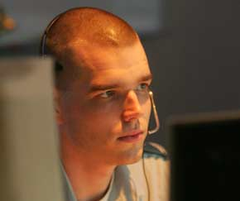
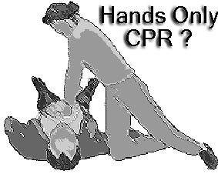
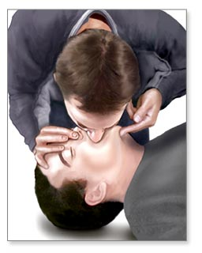
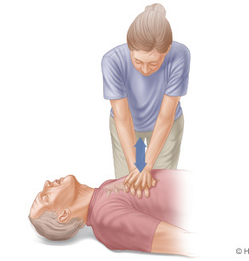
Dispatchers can:
1. Facilitate rapid identification
2. Instill bystander confidence
3. Coach competent CPR
Keep It Simple
An approach validated by randomized trials
Survivall
15% 10%
Hands Only Rescue Breathing
+ Chest Compressions

Slide 18
How Do We Know
Seattle - King County experience (1985 - 2012)
50%
T-CPR has potential to double proportion who receive CPR
25%
Bystander-initiated
(No T-CPR)
Notes:
Telecommunicator CPR program doubled the rate of bystander CPR.

Slide 19
How Do We Know
Seattle - King County experience (1985 - 2012)
50%
T-CPR has potential to double proportion who receive CPR
Dispatcher Instruction doubles the rate of bystander CPR!!
25%
Bystander-initiated
(No T-CPR)
Notes:
Telecommunicator CPR program doubled the rate of bystander CPR.

Slide 20
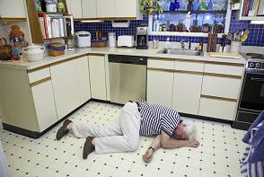
Cardiac Arrest Signs
Sudden, unexpected collapse
Unconsciousness, no sign of life
Abnormal breathing (gasping) common
Brief seizure – lack of oxygen to brain

Slide 21

Identifying Cardiac Arrest
Is the patient conscious?
Is the patient breathing normally?
“No – No – Go”
Notes:
The purpose of the All Caller Interview is to identify patients in cardiac arrest. We do this through the asking of 2 key questions.
First – Is the patient conscious? If the patient is unconscious the next question we ask is if the patient breathing NORMALLY? While we do train our telecommunicators on agonal respirations and they understand what they are and what they sound like, we do not get into the weeds of breathing diagnostics. Too much time is wasted trying to determine if agonal are present or not. And agonal can sound like any number of things, from snoring to groaning, snorting, gasping and so on. Instead, we focus on is the breathing “normal”.
We have a saying called “NO – NO – GO”. NO conscious, NO breathing normally, GO for CPR! Let’s listen to what that sounds like when done properly (Click on first audio icon).
Audio Call #1 – Example of perfect all caller work flow and rapid identification of cardiac arrest (00:00:20)
It’s important to note that the King County EMD (emergency medical dispatch) program is a GUIDELINE based program, not a PROTOCOL. What this means is that call receiver can deviate from the All Caller workflow as dictated by the situation. As an example, if a caller begins the conversation by saying they can’t wake up their dad, does it make sense to waste time asking if the patient is conscious? No, of course not. The caller has already told us what we need to know. So, in a situation like this, the call receiver must demonstrate flexibility and move directly into identifying the status of breathing for the patient. (Click on second audio icon)
Audio Call #2 – Caller states dad is not breathing. Telecommunicator moves right into CPR instructions (00:0013_

Slide 22
All Caller Interrogation
Is the patient awake?
  Yes: Respond as usual (see appropriate chief complaint)
  No: Go to Step 2
  Unsure: Try to wake them up while I wait on the line
Is the patient breathing normally?
  Yes: Respond as usual (see appropriate chief complaint)
  No: Dispatch ALS/BLS; Transfer to MC EMS Communicator
  Unknown: Go to Step 3

Slide 23
Agonal Breathing
Slow, passive & ineffective breathing.
  Formal: Abnormal pattern of breathing characterized by shallow, slow (3-4 per minute), irregular inspirations followed by irregular pauses.
  Chest does not rise and fall NORMALLY – in a rhythmic pattern
Cause cerebral ischemia, due to extreme hypoxia
Caller often mistakes as breathing

Slide 24
Agonal Respirations
Is the patient breathing NORMALLY?
**Don’t be fooled by Agonal respirations
Variety of words used by callers:
“Gasping” “Snoring” “Snorting” “Sighing” “Gurgling” “Puffing”
“Light” “Labored” “Shallow”
Audio 1

Slide 25
Two No’s and Go
Callers reporting a person unconscious and not breathing normally require ALS response & immediate CPR instructions
  PSAP will transfer call
OK, Sir/Ma’am I am sending an ambulance now. I am also transferring you to my partner who will give you more directions…
Once the MC EMS Communicator answers, PSAP states:
This _______ dispatch center. I have a caller reporting an ____(age if known) PNB (give an pertinent details e.g., post drowning). Unit____ has been dispatched.

Slide 26

Common Delays in Delivering CPR
  Unnecessary questions asked
  Caller not near patient
  Omission of “breathing normally”
  Deviation from protocols
Remember:
Studies have shown giving CPR to a person not in cardiac arrest does minimal harm
Not giving CPR when someone is in arrest significantly decreases survival
Decreasing TIME To CPR is Key!

Slide 27
Process
Identify cardiac arrest
  Two no’s and go
Ensure responding units are being dispatched
Transfer call to EMS Communications
  Stay on the phone until you can tell the communicator where you are calling from
  Then you can hang up
Send an email notifying xxxx (insert name) that you transferred a call

Slide 28
Questions/
Discussion

