Slide 1
Increasing Cardiac Arrest Survival through Dispatcher Assisted Bystander CPR
PSAP Review for identifying patients who are pulseless and not breathing

Slide 2
Training Review
Identifying patients who need dispatcher CPR

Slide 3
Why are we doing this?
Each year 800 people have an out-of-hospital cardiac arrest in Milwaukee County and 90% die
Less than 19% have the benefit of bystander CPR
Bringing dispatcher assisted CPR to your community will CHANGE:
Bystander CPR rates
Cardiac arrest survival rates
Notes:
As you likely know, every citizen in this county, has the power to save a life just by putting one hand on top of the other and pushing hard and fast on a cardiac arrest victim’s chest. Yet when faced with this high stress high emotion situation few choose to act, in Milwaukee County less than 19% of the time bystanders perform CPR. However, other communities have shown that by having 9-1-1 dispatchers prompt people into action this rate can change and more lives can be saved --- every citizen can become a first responder.

Slide 4
What’s happened so far?
CALL TRANSFERS AS OF MARCH 8, 2016
Calls Transferred to Communication Center | 92
Victims Identified as Needing Compressions | 23
Victims Who Received Bystander Compressions | 6 (26%)
Victims Who Survived to the Emergency Department | 3 (data incomplete)
Victims Who Survived to Hospital Discharge | 1 (data incomplete)

Slide 5
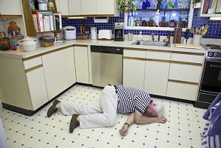
Cardiac Arrest Signs
Sudden, unexpected collapse
Unconsciousness, no sign of life
Abnormal breathing (gasping) common
Brief seizure – lack of oxygen to brain

Slide 6

Identifying Cardiac Arrest
Is the patient awake?
Is the patient breathing normally?
“No – No – Go”
Notes:
The purpose of the All Caller Interview is to identify patients in cardiac arrest. We do this through the asking of 2 key questions.
First – Is the patient conscious? If the patient is unconscious the next question we ask is if the patient breathing NORMALLY? While we do train our telecommunicators on agonal respirations and they understand what they are and what they sound like, we do not get into the weeds of breathing diagnostics. Too much time is wasted trying to determine if agonal are present or not. And agonal can sound like any number of things, from snoring to groaning, snorting, gasping and so on. Instead, we focus on is the breathing “normal”.
We have a saying called “NO – NO – GO”. NO conscious, NO breathing normally, GO for CPR! Let’s listen to what that sounds like when done properly (Click on first audio icon).
Audio Call #1 – Example of perfect all caller work flow and rapid identification of cardiac arrest (00:00:20)
It’s important to note that the King County EMD (emergency medical dispatch) program is a GUIDELINE based program, not a PROTOCOL. What this means is that call receiver can deviate from the All Caller workflow as dictated by the situation. As an example, if a caller begins the conversation by saying they can’t wake up their dad, does it make sense to waste time asking if the patient is conscious? No, of course not. The caller has already told us what we need to know. So, in a situation like this, the call receiver must demonstrate flexibility and move directly into identifying the status of breathing for the patient. (Click on second audio icon)
Audio Call #2 – Caller states dad is not breathing. Telecommunicator moves right into CPR instructions (00:0013_

Slide 7
Why ask Breathing Normally?
Time since Called Dispatcher | Question | Caller Answer
0:11 | What’s happening there? | My daughter […] so now she is absolutely passed out. I can’t get her to sit up or anything.
0:21 | Is she breathing? | Yes, she is breathing, but very slightly. Her neck is very warm.
1:15 | But she’s breathing? | She’s breathing and moaning, yes.
1:35 | Alright. But she is breathing, though? | She’s breathing, but with a heavy breathing.
3:09 | Is she breathing? | Yes, she is, but then she makes this moan and then she closes her eyes again.
4:29 | Make sure she’s still breathing. | She’s still breathing, but she’s not opening her eyes at all.
4:57 | Is her breathing normal? | No.
On EMS arrival patient pulseless with agonal breathing

Slide 8
Agonal Breathing
Slow, passive & ineffective breathing.
Cause cerebral ischemia, due to extreme hypoxia
Caller often mistakes as breathing
Words used by callers when there is agonal breathing:
“Gasping” “Snoring” “Snorting” “Sighing” “Gurgling” “Puffing”
“Light” “Labored” “Shallow”

Slide 9
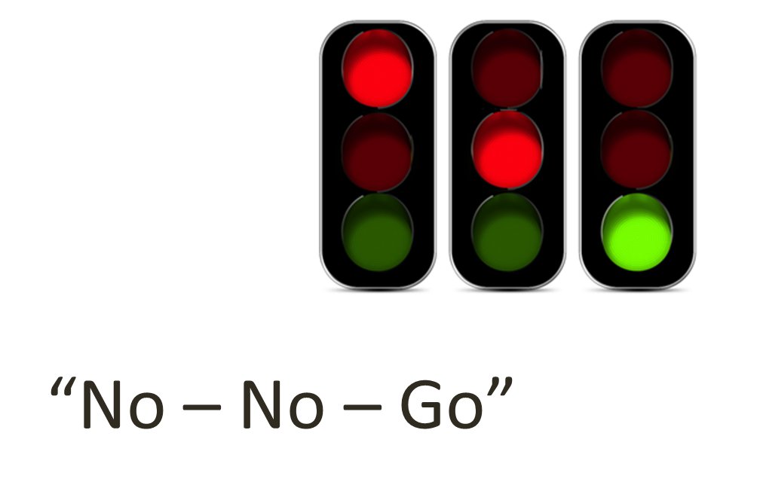
Review of Script
Is the patient awake?
Yes: Respond as usual (see appropriate chief complaint)
No: Go to Step 2
Unsure: Try to wake them up while I wait on the line
Is the patient breathing normally?
Yes: Respond as usual (see appropriate chief complaint)
No: Dispatch ALS/BLS; Transfer to MC EMS Communicator
Unknown: Go to Step 3

Slide 10

Remember
Studies have shown giving CPR to a person not in cardiac arrest does minimal harm
Not giving CPR when someone is in arrest significantly decreases survival
Decreasing TIME To CPR is Key!
Use the script!

