Slide 1
National Institutes of Health (NIH) Training Opportunities to Develop Clinician Scientists
Jane D. Scott, ScD, MSN
Director, Office of Research Training & Career Development
Division of Cardiovascular Sciences
National Heart, Lung, and Blood Institute, NIH
June 14, 2017

Slide 2
Goals for today
Identify NIH research training opportunities for clinicians interested in pursuing a research career
Provide links to NIH resources
Answer questions

Slide 3
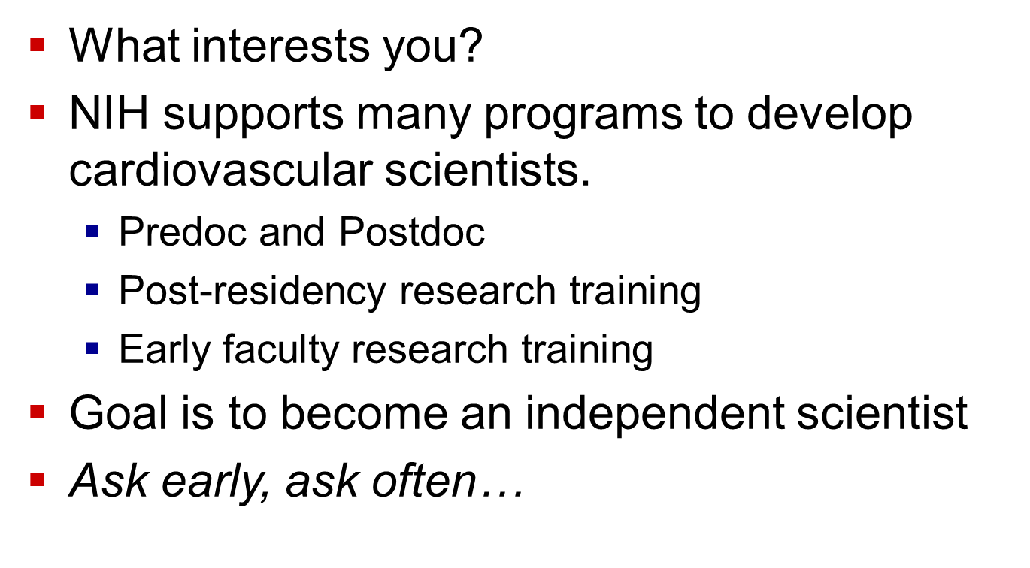
Are you interested in a research career?

Slide 4
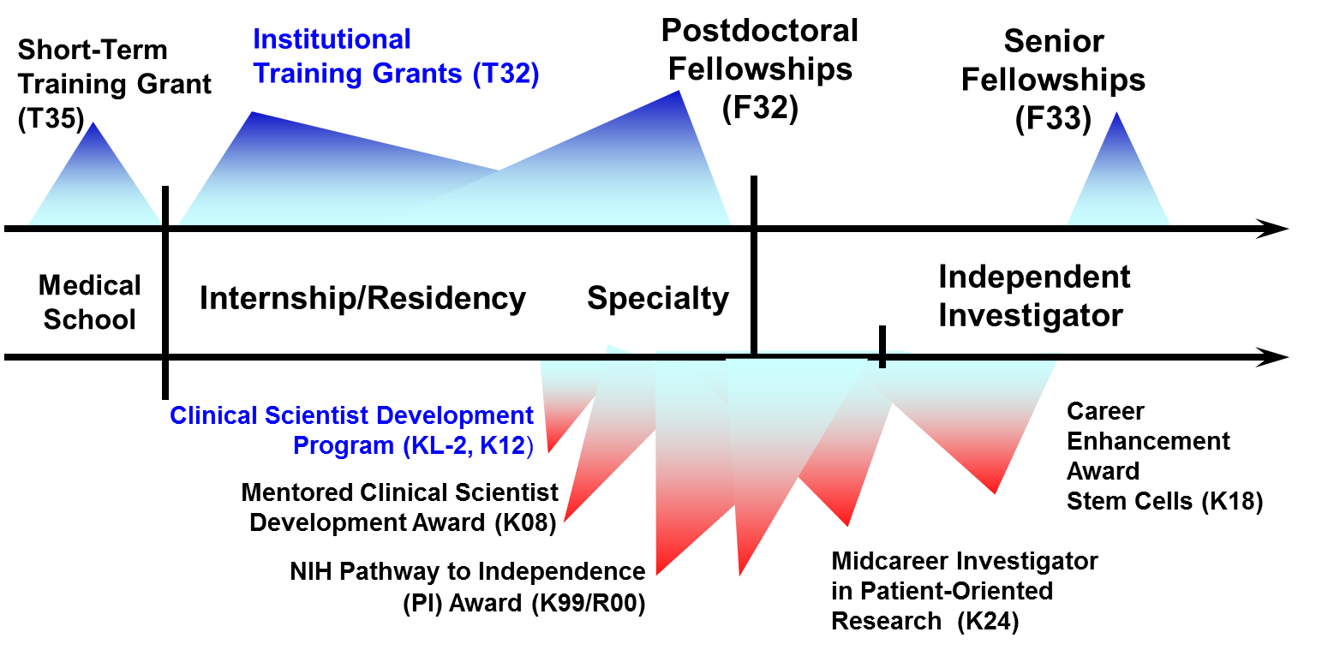
Awards for individuals with a Health-Professional Doctorate
Mentored Patient-Oriented
Research CDA (K23)

Slide 5
NIH Research Training: 4 key programs
Institutional Training Programs for Post-doctoral fellows (T32)
Institutional Career Development Awards early career research training(KL2, K12)
Individual Career Development Awards (K)

Slide 6
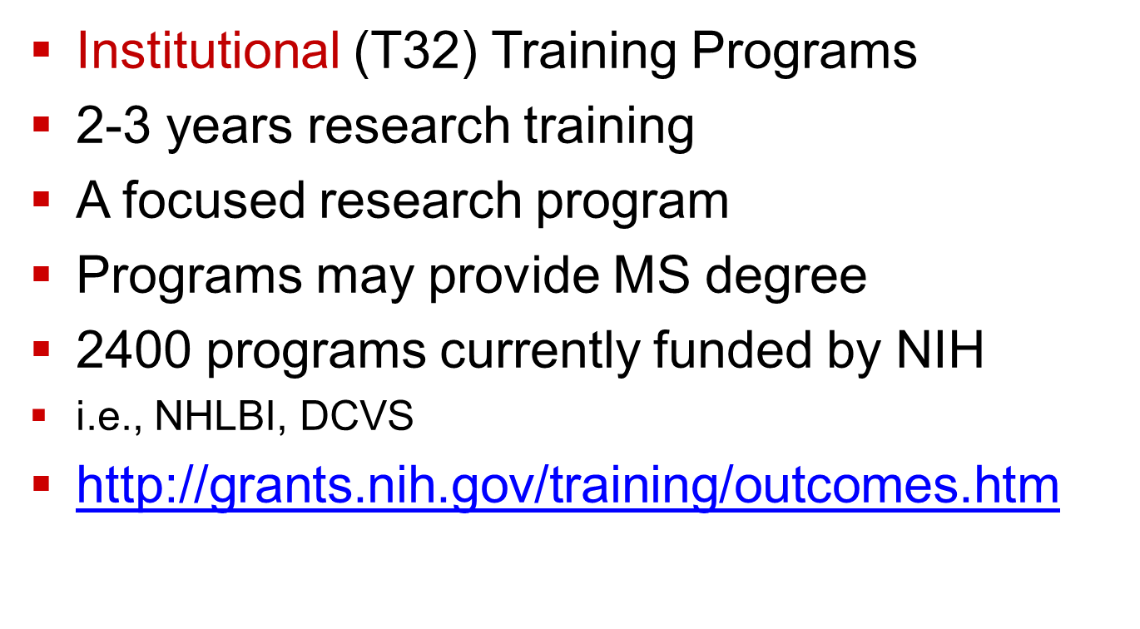
Research Training: T32

Slide 7
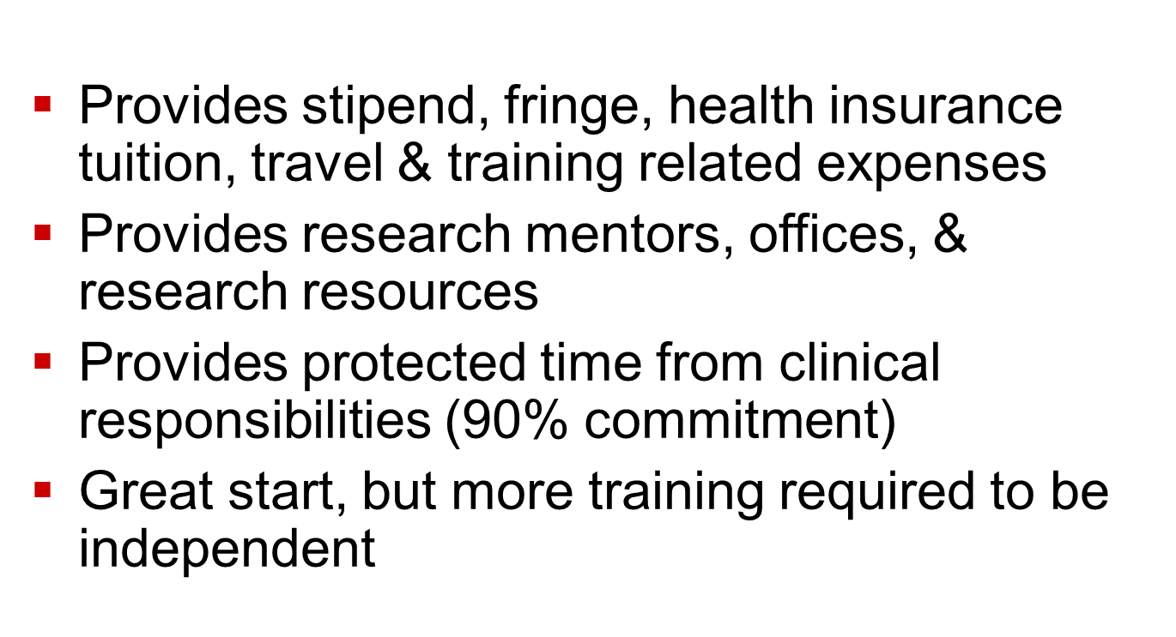
Research Training: T32
Notes:
Up to 5 years pre-doc training and 3 years as a postdoc

Slide 8
For physicians, T32 programs often aligned with subspecialty fellowships
T32 HL007572-31 Research Methods in Pediatric Heart Disease, Jane Newburger, Children’s Hospital Boston
T32HL007915-18 Training in Molecular Therapeutics for Pediatric Cardiology, Robert Levy, CHOP
T32 HL007413-38 Research Training in Pediatric Cardiology, Thomas Scholz, U of Iowa
T32 HL098039-07 Training in Congenital & Acquired Heart Disease, Vidu Garg, Nationwide Children’s Hospital, Columbus, Ohio
T32HL125241-02 Pediatric Cardiovascular & Pulmonary Research Training Program, Washington University, St. Louis

Slide 9
Institutional K Awards (KL2, K12)
“KL2” mentored career development award
Affiliated with CTSA centers nationally
Start late postdoc or early faculty
Apply to a program at an institute
2-3 years of continued training
75% time
Stipends, tuition, travel…..
Some transition to R grants with this training

Slide 10
New Trans NIH K12 Program in ECR
Clinical scholars institutional research training program in emergency care research (multidisciplinary). NIMH and NINR partners.
Stipends, tuition, travel…..
2-3 years of training
4 centers, 8M, 12 scholars, co-PI model
  Vanderbilt University
  Oregon Health & Sciences Center
  University of Indiana
  University of Michigan

Slide 11
New Trans NIH K12 Program in ECR
Start date July 1, 2017, 2018, 2019
https://www.nhlbi.nih.gov/research/training/trans-nih-k12-program-emergency-care-research (includes links to all K12 programs).

Slide 12
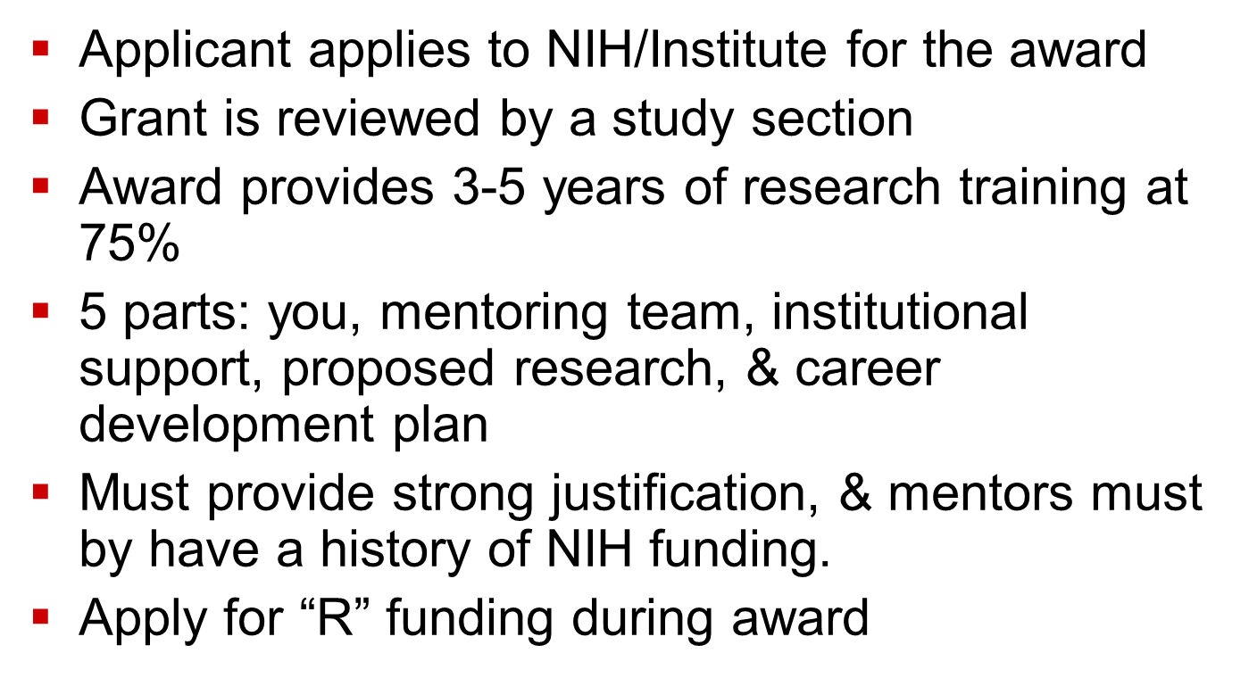
Individual K Awards (early faculty):
Notes:
NHLBI RESTRICTIONS TO CLINICIANS for K08 and K23

Slide 13
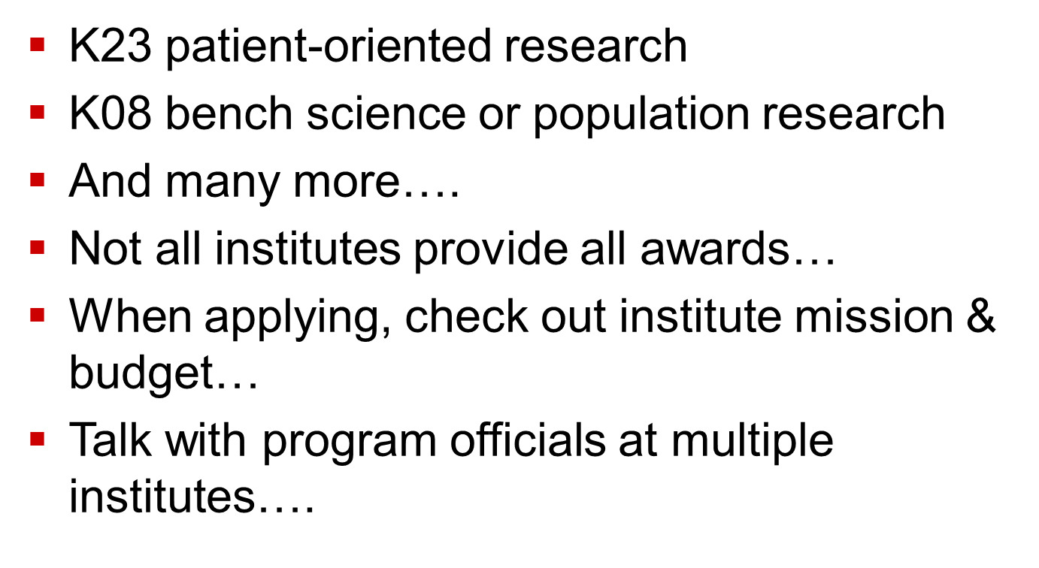
Individual K awards:
Notes:
K01 enhance diversity
K25 early to late career transition from quantative sciences, to bio medicine

Slide 14
K01 Diversity Award
NHLBI K01 Individual Award
  Highly qualified individuals from diverse backgrounds underrepresented in research areas of interest to the NHLBI.
  NHLBI Parent K01 award
    currently the program is restricted in the science supported
    PhDs are eligible to apply for this award

Slide 15
K99/R00 grant
Joint K/R program
Mentored career development (K99) 2 years
Independent research (R00) 3 years
Must be a post-doc
Rules are changing (<5 yrs chg to <4 yrs)
Overwhelmingly utilized by PhDs
No citizenship requirements
Current discussion for broad expansion across NIH

Slide 16
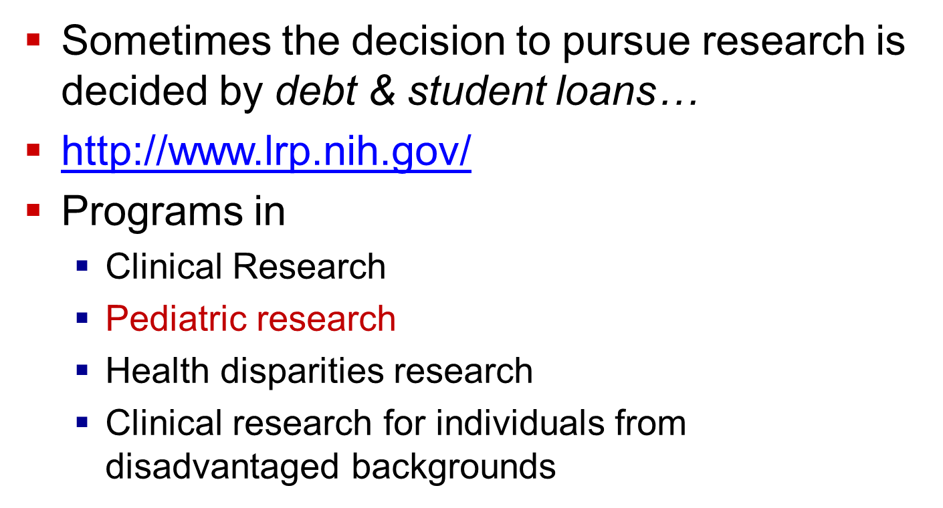
NIH Loan Repayment Programs

Slide 17
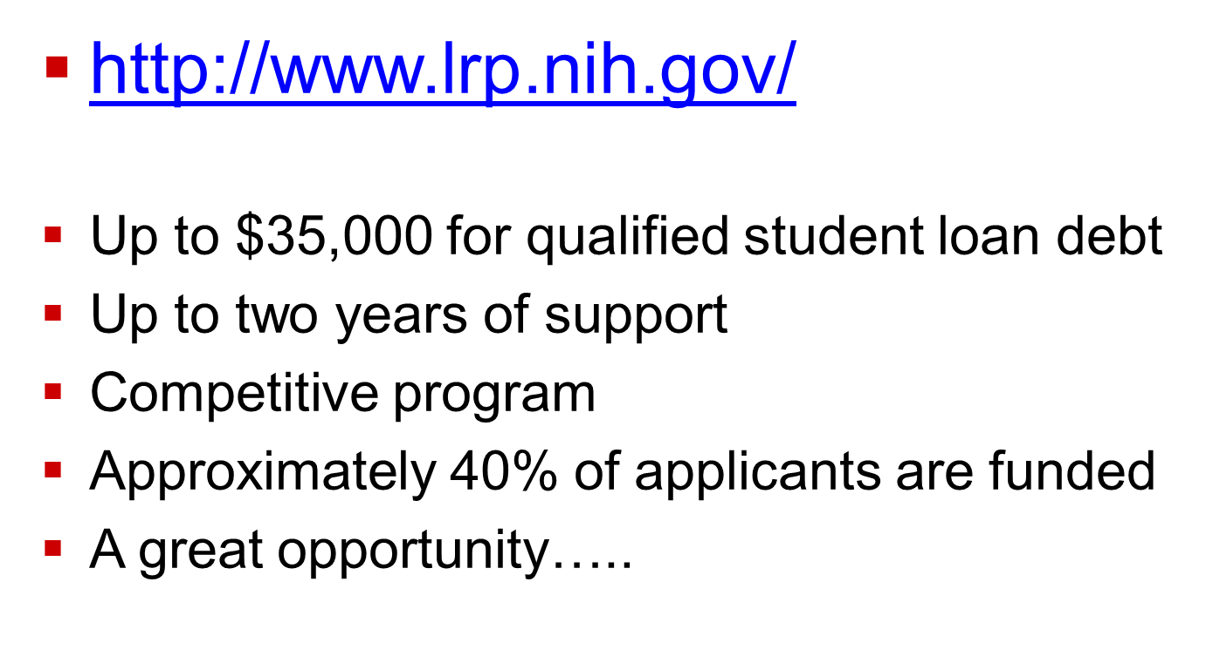
NIH Loan Repayment Programs

Slide 18
NIH Diversity Supplement Awards
Supplements are available for some research awards, & each NIH institute different
Post doctoral research training/early faculty
Requested by the R01 Principal Investigator
Supports the conduct of research by supplement awardees for 2-3 years.
http://www.nhlbi.nih.gov/funding/training/guid-app.htm

Slide 19
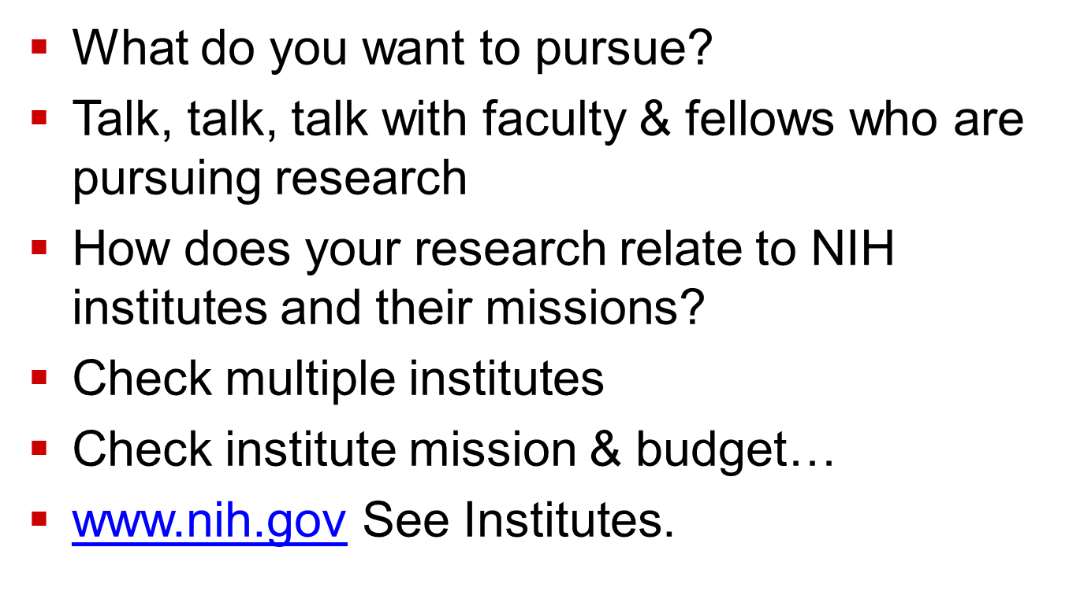
Getting started:

Slide 20
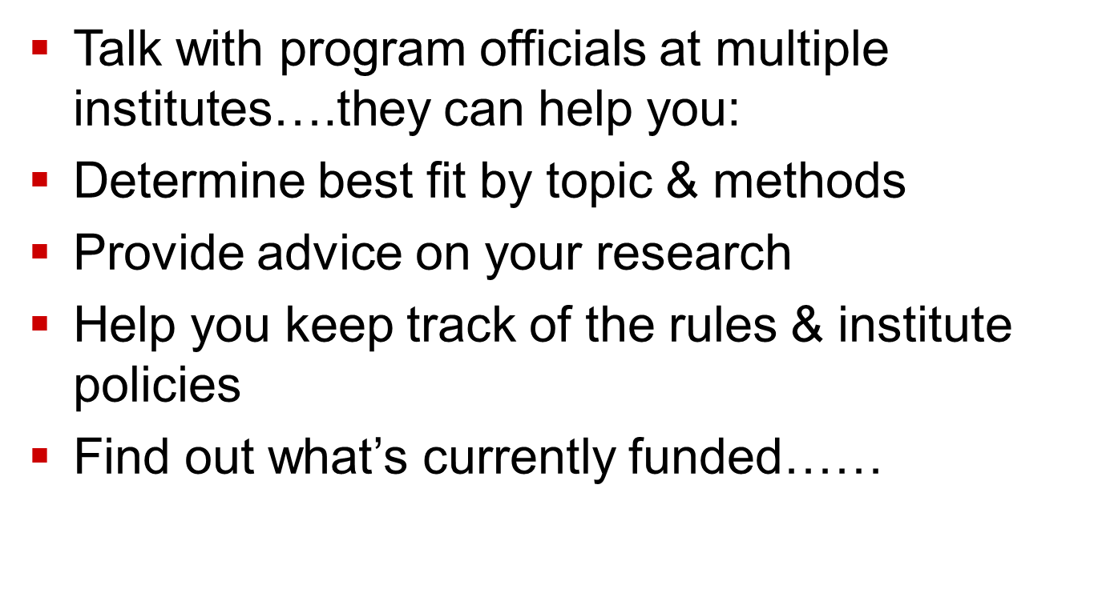
Getting started:

Slide 21
Getting started:
Talk with colleagues and faculty, ask questions
Attend research seminars & meetings
Find local resources
  Who is already funded with a K grant?
  Who is already funded with an R grant?
Develop research mentors for you!
Develop a plan
Identify institutional research support

Slide 22
Check RePorter: Powerful search engine
www.report.nih.gov
http://projectreporter.nih.gov/reporter.cfm
Lists all funded NIH grants & training awards
Call up awards by institute, mechanism, search terms, or geography
If applying to NHLBI for a K award, check abstracts of currently funded Ks.
Make sure your work is innovative & does not duplicate other ongoing funded work

Slide 23
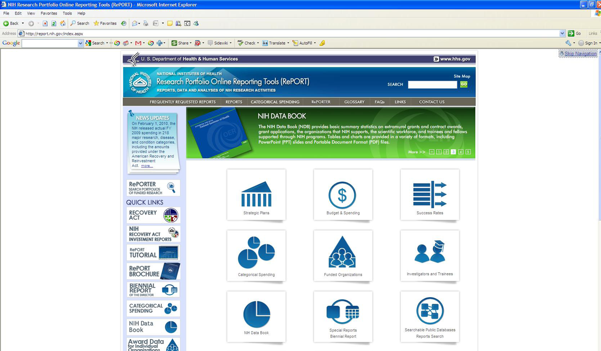
RePORT & RePorter: http://report.nih.gov

Slide 24
Resources: New search function by institution
http://report.nih.gov/award/index.cfm
CHILDREN'S HOSP OF PHILADELPHIA K awards summary for
Fiscal Year 2014
Activity Code | Dollar Amount | Awards
K01 | $128,301 | 1
K08 | $555,734 | 4
K12 | $432,000 | 1
K23 | $428,084 | 4

Slide 25
New search function by institution
http://report.nih.gov/award/index.cfm
Children’s Hospital Corporation, Boston: K awards summary Fiscal Year 2014
Activity Code | Dollar Amount | Awards
K01 | $275,572 | 2
K08 | $640,116 | 4
K12 | $418,651 | 1
K23 | $574,215 | 4
K25 | $173,517 | 1
K99 | $90,000 | 1

Slide 26
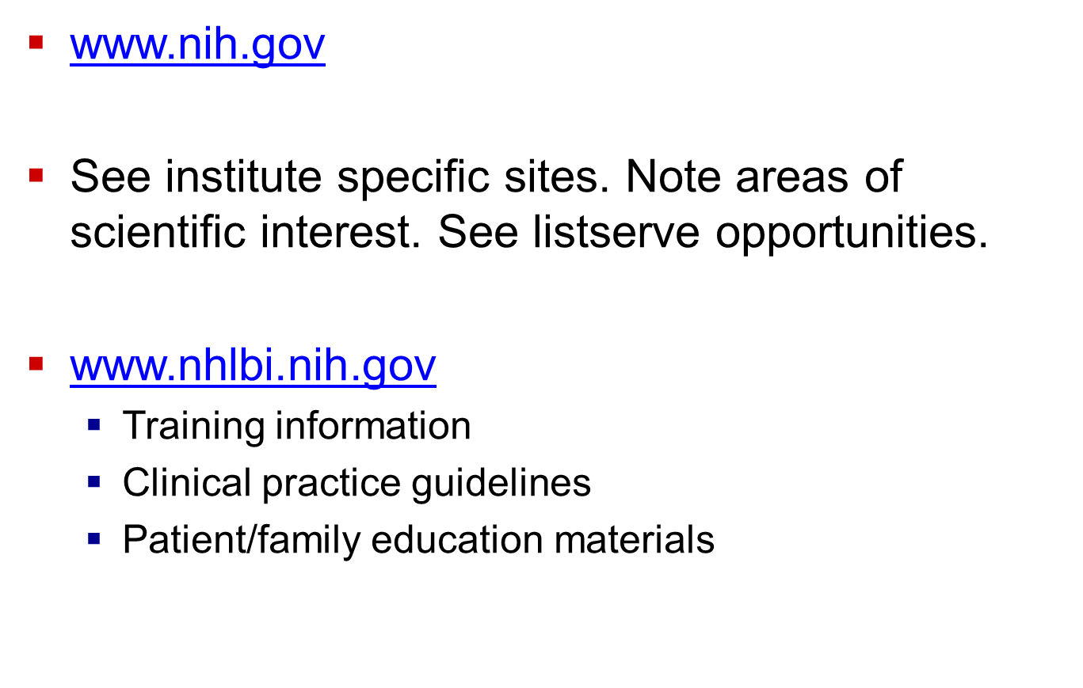
For more information

Slide 27
For more information
http://projectreporter.nih.gov/reporter.cfm
http://grants.nih.gov/grants/oer.hhtm
www.nih.gov
www.nhlbi.nih.gov

Slide 28
Office of Research Training & Career Development, Division of Cardiovascular Sciences, NHLBI, NIH:
301.435.0545
Jane Scott, ScD, MSN
Drew Carlson, PhD
Wayne Wang, PhD
Li-Shin Huang, PhD
Tawanna Meadows, BS

Slide 29
NIH Research Training Opportunities
Questions???

Slide 30

NHLBI: People…Science…Health

