Slide 1
Cardiac Unknown

Slide 2
Case Presentation
68 year male with history of liver transplant 13 years back
Presented with fatigue
Underwent contrast enhanced CT (computed tomography) scan

Slide 3
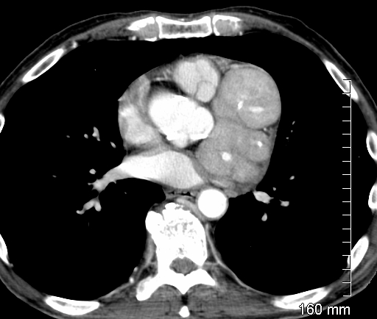
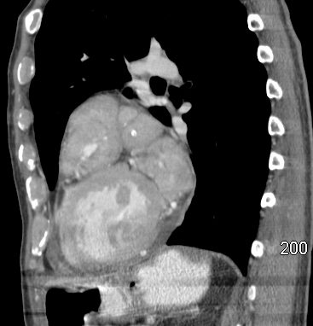
Contrast enhanced axial CT
Sagittal reformatted image
Findings: Extensive enhancing soft tissue masses surrounding the left anterior descending (LAD) (yellow arrow) and circumflex coronary (green arrow) arteries

Slide 4
2 Chamber long axis SSFP (steady state free precision) cine
4 Chamber SSFP cine

Slide 5
2 Chamber long axis SSFP (steady state free precision) cine
4 Chamber SSFP cine
Findings: MRI (magnetic resonance imaging) confirms CT findings and shows underlying aneurysmal dilatation of LAD (yellow arrow)

Slide 6
3 chamber SSFP cine showing incidental significant aortic valve stenosis

Slide 7
Dynamic gradient perfusion images showing relatively increased perfusion as compared to normal myocardium

Slide 8
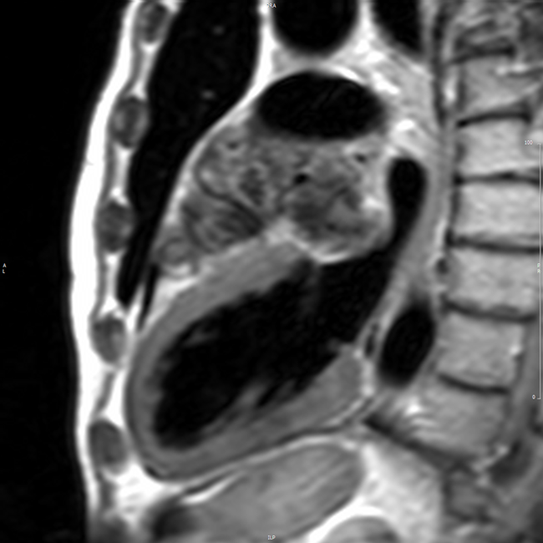
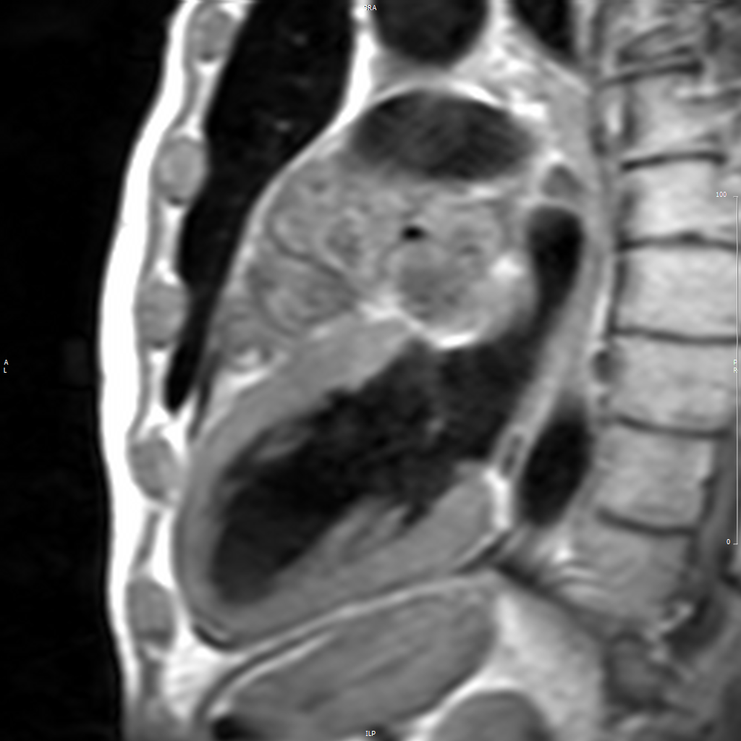
Pre and postcontrast non fat suppressed sagittal T1 weighted turbo spin echo images reveal heterogeneous enhancement of the soft tissue mass lesion

Slide 9
Imaging Findings
Extensive soft tissue surrounding the left anterior descending and circumflex coronary arteries seen on CT and MRI images
This soft tissue is enhancing on post contrast images
Incidental aortic stenosis

Slide 10
Discussion/Teaching Points
Enhancing soft tissue masses around the coronary artery is nonspecific in appearance
Differentials include inflammatory disorder or neoplastic etiology like lymphoma
Open biopsy was performed which revealed IgG4 related disease

Slide 11
Discussion/Teaching Points
IgG4 is a chronic inflammatory disease characterized by IgG4 positive plasma cell infiltrate
This type of inflammatory changes were first described histopathologically in autoimmune pancreatitis in 2001
Though IgG4 related disease occurs commonly in glandular and ductal tissues this entity is also discussed in association with vascular system

Slide 12
Discussion/Teaching Points
IgG4 related inflammatory pseudotumor have been reported involving coronary artery
Coronary artery aneurysm formation is also described with IgG4 related disease
Recent reports suggested that there may be a role of IgG4 related inflammatory reactions in coronary atherosclerosis development leading to coronary stenosis

Slide 13
References
Hamano H, Kawa S, Horiuchi A, et al. High serum IgG4 concentrations in patients with sclerosing pancreatitis. N Engl J Med 2001;344:732-8.
Sugimoto T, Morita Y, Isshiki K et al. Constrictive pericarditis as an emerging manifestation of hyper-IgG4 disease. Int J Cardiol 2008; 130:e100.
Matsumoto Y, Kasashima S, Kawashima A, Sasaki H, Endo M, Kawakami K, Zen Y, Nakanuma Y. A case of multiple immunoglobulin G4-related periarteritis: a tumorous lesion of the coronary artery and abdominal aortic aneurysm. Hum Pathol. 2008 Jun;39(6):975-80.
Nobukazu Ishizaka. IgG4-related disease underlying the pathogenesis of coronary artery disease. 2013, Clinica Chimica Acta 415, 220–225.

Slide 14
Coronary wrap IgG4 disease – inflammatory pseudotumor
Dhiraj Baruah, MD
Jason Rubenstein, MD
Kaushik Shahir, MD
Department of Radiology
Medical College of Wisconsin

