Slide 1
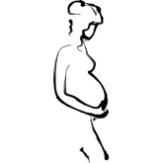
Moms program orientation
Monday aug 28, 2017
Adapted from Bridget Kelly’s original MoMS presentation; contributions from Brittany Duffy and Sivani Aluru

Slide 2
Purpose of the MoMS programs
Offer support to pregnant woman
Be a resource for the woman during her pregnancy
Enhance communication between the woman and her health care provider

Slide 3
For the students
Through participation in the MoMS program, students will learn and develop valued skills:
Patient advocacy
Empathy/support
Communication with a non-standard patient population
Community engagement experience

Slide 4
For the moms…
They will receive support throughout their pregnancy to help them remain comfortable, knowledgeable, and healthy during their pregnancy

Slide 5
How the MoMS programs works
Matched 1-on-1 with a pregnant woman
Interested moms sign up at their prenatal appointment at Froedtert Specialty Clinics
You will be contacted when you are matched with a patient
You will attend the prenatal appointments with your match, and potentially their labor & delivery.
Additional experiences are up to you and your match.
  Prenatal classes
  Psychiatry appointments
  Imaging appointments
  Baby showers

Slide 6
How you can participate
Sign up today on the laptop.
Wait until you are matched with an interested expectant mom (via email).
You must email Sivani back within 24 hours or they will forward the match to another student.
Contact the mom within 3 days of being matched.
Set up a time to meet – either the next appointment or an independent meeting (up to you and her).
Complete and return the paperwork we will send to you.

Slide 7
1st Appointment
3 forms emailed to you once you are matched
    MoMS letter to physician → Give to health care provider at first appointment (hard copy)
    MoMS patient consent → Get the mom’s signature & then give to me (email or hard copy)
    MoMS student consent → you sign & then give to me (email or hard copy)

Slide 8
All Appointments
Call/text/email her to confirm the appointment before (3 days notice).
1
Meet her before the appointment.
Talk to her about what she wants out of the appointment and any questions she has.
2
After the appointment, research any additional things to discuss at the next appointment.
4
During the appointment, listen carefully and ask questions.
Schedule her next appointment.
3

Slide 9
Expectations → Serious commitment
Please don’t quit after you are matched! → These women signed up for the program because they want and need support. Don’t sign up unless you are committed.
Attendance at 60%++ of prenatal appointments is required.
  All appointments are at Froedtert Specialty Clinics.
  Exception: If pregnancy is high risk, she may have more appointments but you’re are not expected to go to more than 1 per week.
Each appt lasts about 15 mins, plus waiting time
  Expect to schedule 1.5 hours out of your day for the visit
Roughly 12 visits over 9 months, plus 2 ultrasounds, and delivery.
  Will vary depending on how far along the woman is when you are matched.

Slide 10
Conflicting Schedules
APPOINTMENTS
Talk to your match about your availability
  1st appointment may be scheduled at a time that you can’t make.
  If your match can’t reschedule, just plan to meet her at the next appointment or meet for lunch/coffee.
DO NOT expect miss class for appointments!
  M1s – most classes on not required, so it is entirely up to you if you want to go during class time
  M2s – most classes are not required now either
If we can’t reach a compromise on the scheduling, we can re-match your mother.

Slide 11
Labor and Delivery
Usually not planned at a convenient time! Even if induced, you will likely be there for many hours.
Please note the due date in the first email and take that into consideration with your vacation and exam schedule.
  Try not to take a match if you will be out of town within 3 weeks prior to due date.
  If exams are near due date and you still feel comfortable accepting the match, make sure you are prepared for your exam in the event that she goes into labor during your study time.
  DO NOT miss an exam under ANY circumstance. We are not an approved absence excuse!

Slide 12
Who? What? Where? WHEN?
M2s:
  Matched with due date before April 1st, 2018.
M1s:
  Indicate summer availability when you sign up!
  If not available in the summer, we will try to match with a mom with a due date before Spring 2018 finals week.
OGIG members will have first priority when it comes to matching!

Slide 13
Supply & Demand - Tricky
Usually we have more students than patients who participate.
Not everyone will be matched immediately.
Some may have to wait until M2 year
If you are unsure about commitment or would like to wait until you get settled in to med school, please indicate that on the sign up sheet so that I can match you towards the end of the year/summer/next year
I want everybody to have a chance to be matched! Please be patient, we are doing our best!!

Slide 14
Columbia St. Mary’s FHC Resources
MCH (Maternal-Child Health) Clinic on Thursdays
  Dr. Garrison is in the morning
  Dr. Koch is in the evening
OB chart review once a month
  Wed. 1:30-3:30 pm
  Great opportunity to learn about Obstetrical care as a whole! Highly encouraged to attend one.
  *If interested in attending, email me at saluru@mcw.edu and I will put you in touch with these physicians*

Slide 15
M1 Liaison
If you are interested in becoming one of the MoMS Program M1 Liaison (part of OGIG Exec), please see Sivani after the orientation is over.
Must be a member of OGIG to apply and be considered for the position.
Applications due Friday, 9/8 at 5 pm.

Slide 16
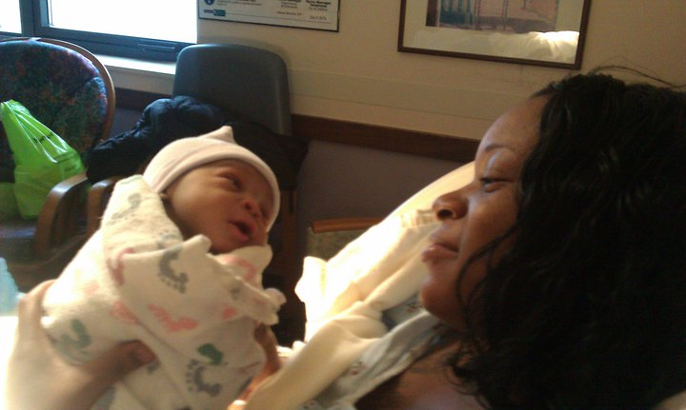
Have fun!
Contact us with ANY questions, comments or concerns. We LOVE hearing about how your match is going!
2017-2018 Program Coordinator: saluru@mcw.edu

