Slide 1
How to Talk Science and Influence the World
Peggy Vorwald, Ph.D.
Associate Account Director, W2O Group

Slide 2
From there to here
INC Research
Little Dog Communications
CG Life
W2O Group

Slide 3
Medical writing
Powerpoints
Manuscripts
Medical Conferences: Abstracts and posters
Regulatory documents

Slide 4
From there to here
INC Research
Little Dog Communications
CG Life
W2O Group

Slide 5
Public relations
Telling the company’s story to a a wide range of audiences
Press releases/news coverage
Speaking opportunities
Awards
Digital storytelling
Website, social media, blogs

Slide 6
From there to here
INC Research
Little Dog Communications
CG Life
W2O Group

Slide 7
Content
Fact sheets
White papers
Contributed articles
Sponsored articles
Advertising
Search engine optimization
Graphics

Slide 8
From there to here
INC Research
Little Dog Communications
CG Life
W2O Group

Slide 9
Endless opportunity
Partnerships with influencers or brands and share your same values and goals
Host or sponsor conferences
Speak on the worlds stage
Build the voice people listen to

Slide 10
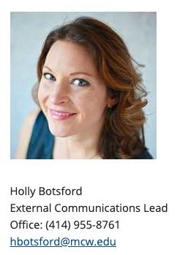
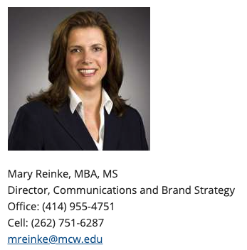
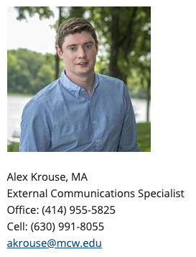
How do you prepare?
Read
STAT News
Endpoints
GenomeWeb
Big4Bio
Learn
UCSD Science Writing Course: https://extension.ucsd.edu/courses-and-programs/science-writing-i
Network
Volunteer
MCW has communications team

