Slide 1

Crime Lab Tests

Slide 2

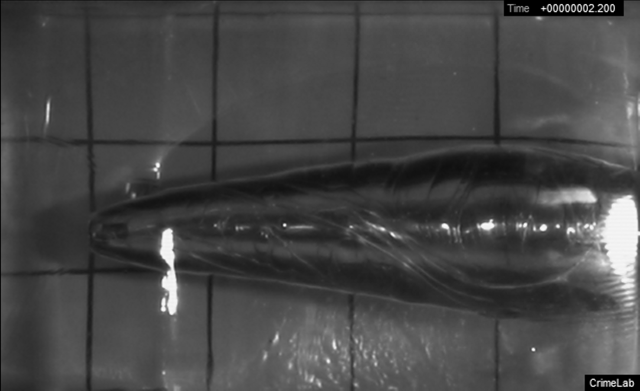
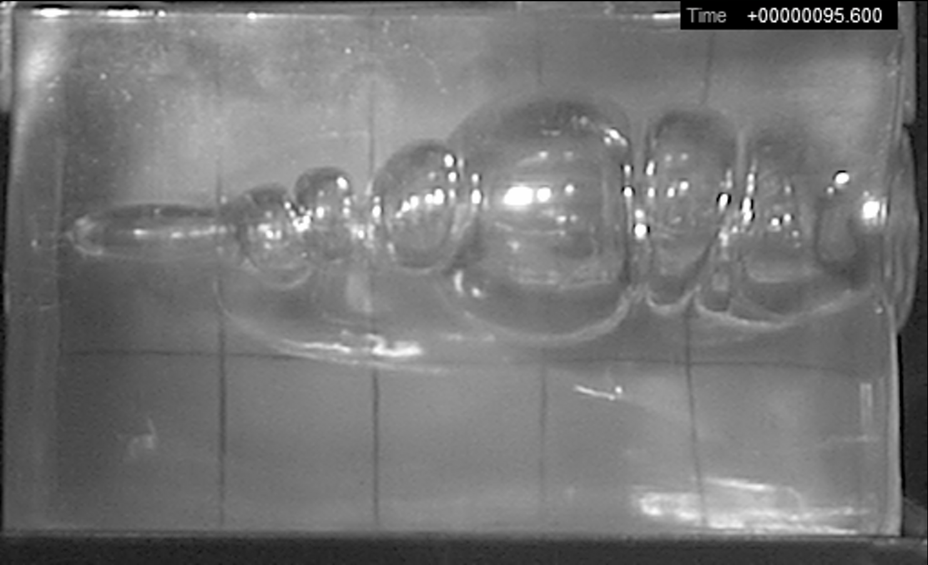
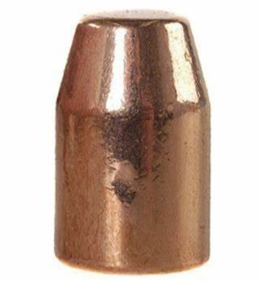
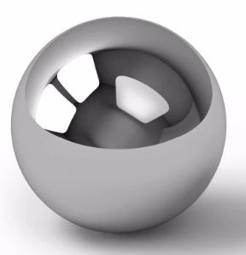
Same Cavity at Different Pressures?
.40 Cal (~1ms after bullet entered gel)
Musket Ball (~9ms after bullet entered gel)
May be related to the rifling of the barrel and the shape of the projectile.
The rifled barrel of the .40 cal handgun causes the bullet to spin. The resulting temporary cavity also appears to spin as it expands behind the bullet. The largest temporary cavity follows shortly behind the bullet.
The ball’s rotation is not controlled and will depend on frictional imbalances as it passes through the barrel. The temporary cavity behind the ball is initially smooth, but bubbles over time as expanding pressures act on one another. The largest cavity comes much later than what is seen with the bullet.

Slide 3

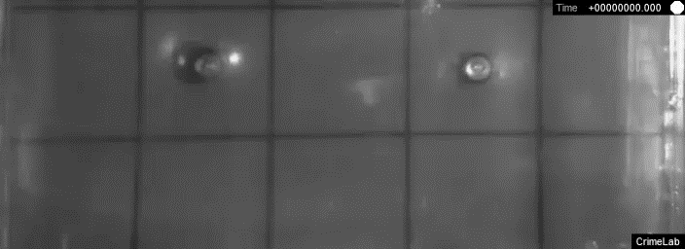
.25 Caliber

Slide 4
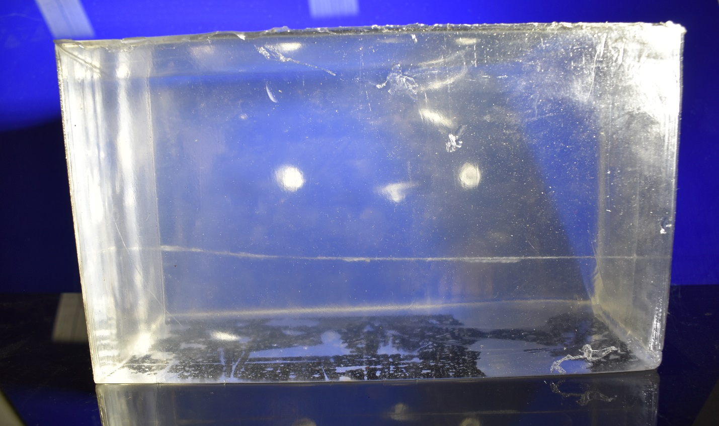
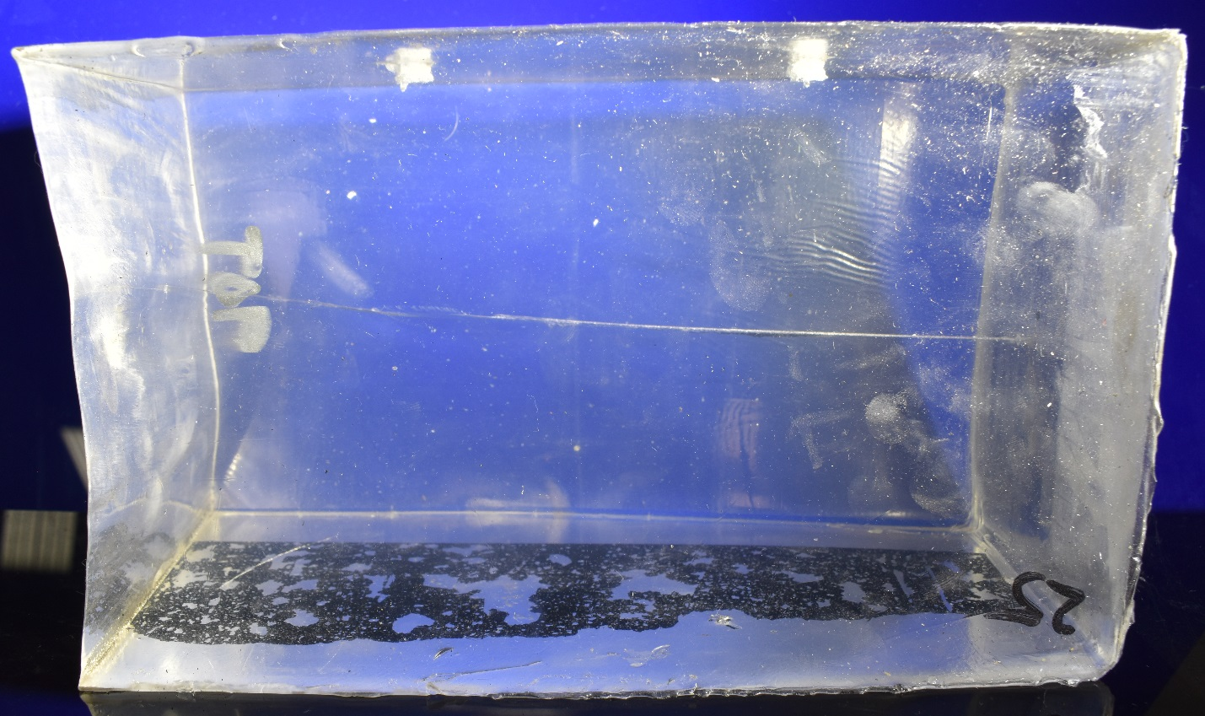
.25 Caliber
Lateral view. Bullet travelled right to left.
Top view. Bullet travelled right to left.

Slide 5
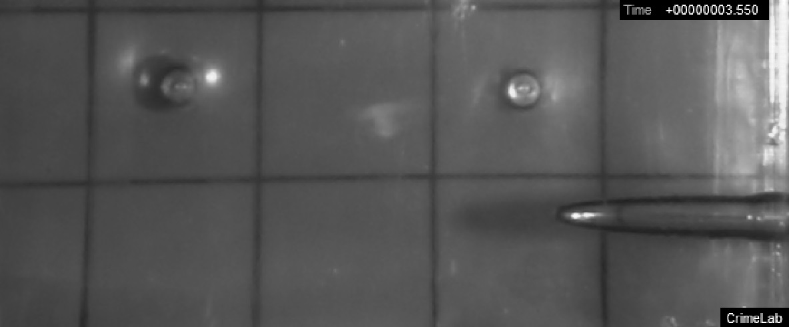
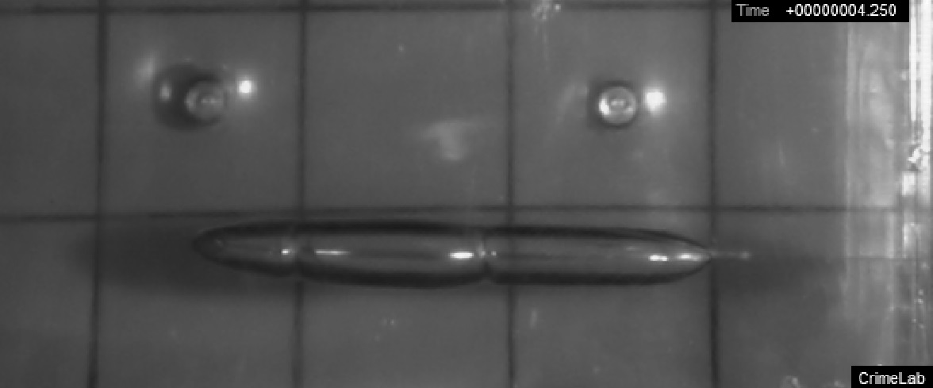
.25 Caliber
Filtered at 2500Hz
Bullet enters gel

Slide 6
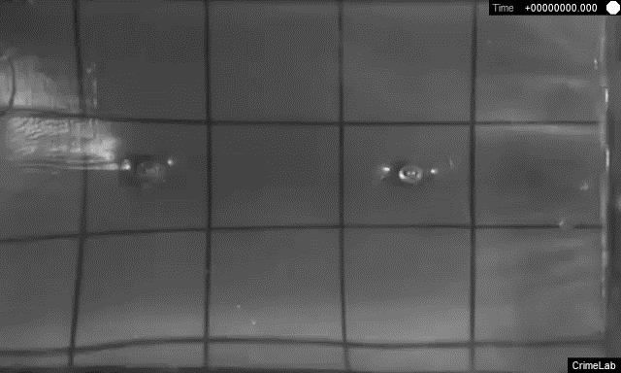
.32 Caliber

Slide 7
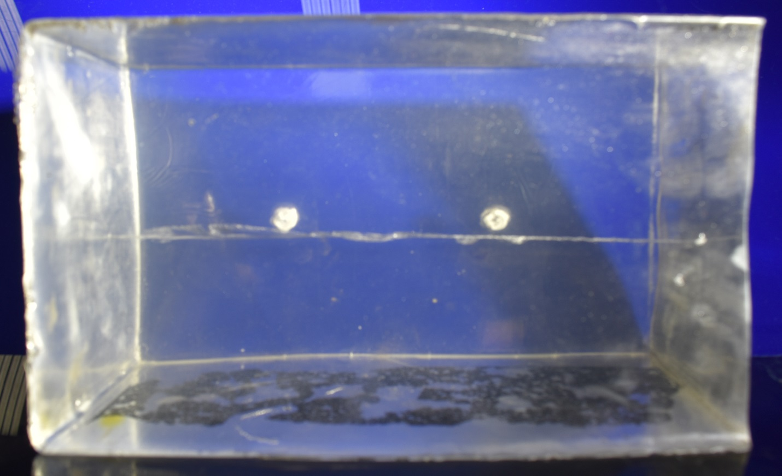
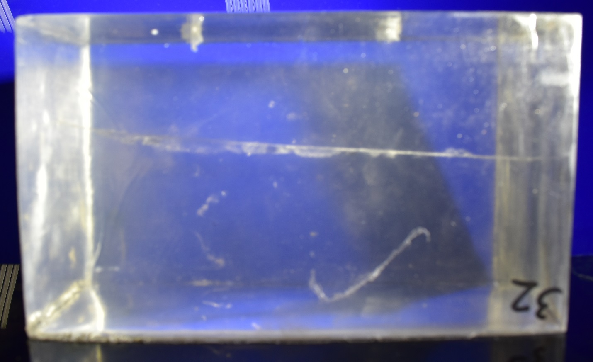
.32 Caliber
Lateral view. Bullet travelled right to left.
Top view. Bullet travelled right to left.

Slide 8
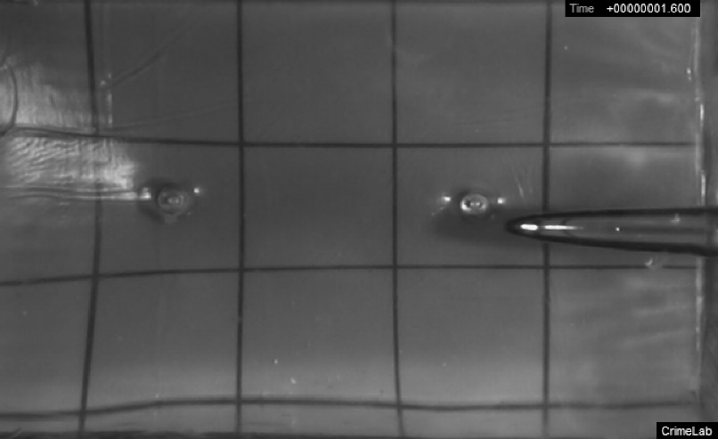
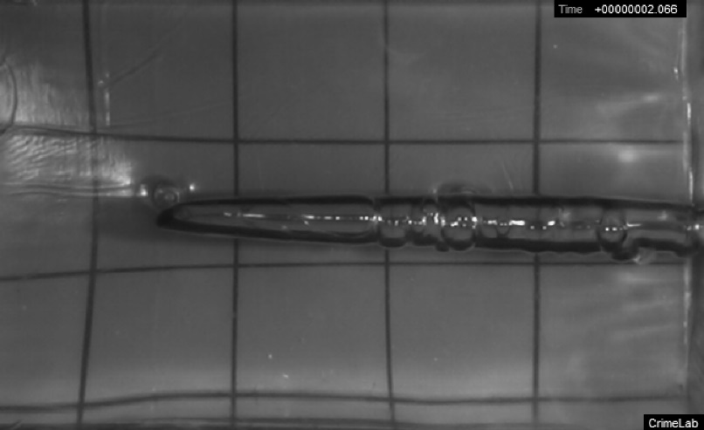
.32 Caliber
Filtered at 2500Hz
Bullet enters gel

Slide 9
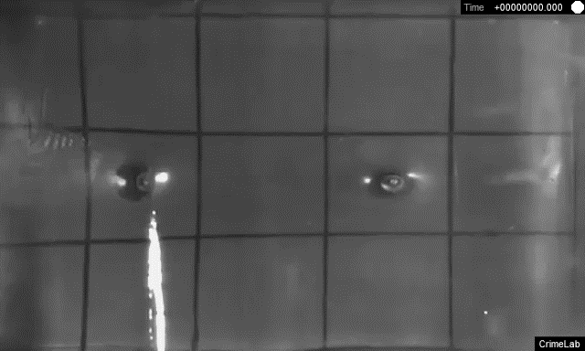
.40 Caliber

Slide 10
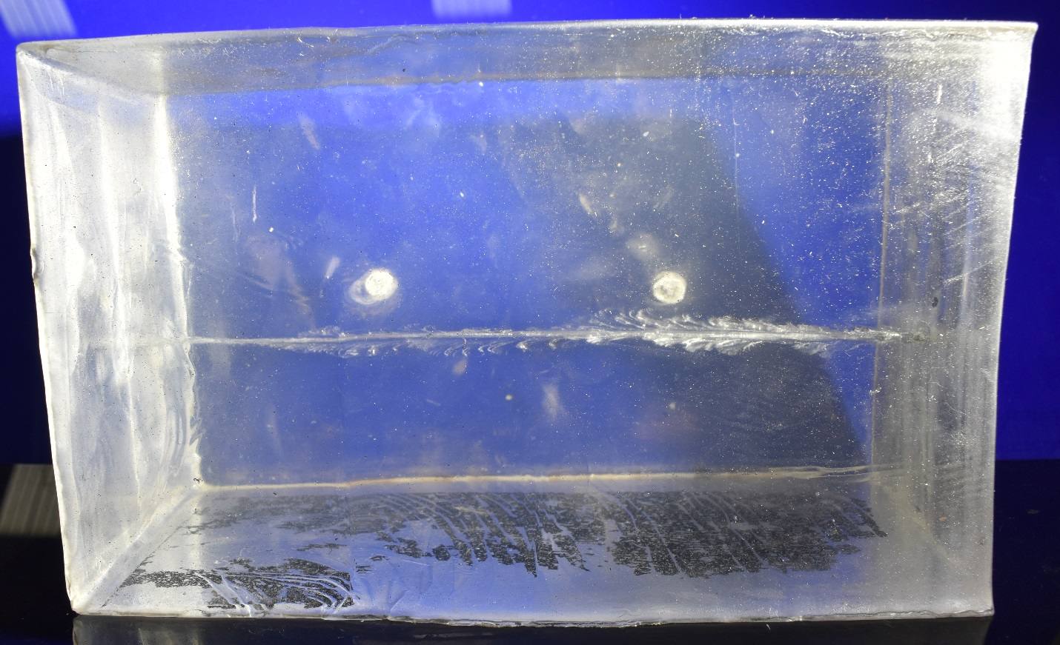
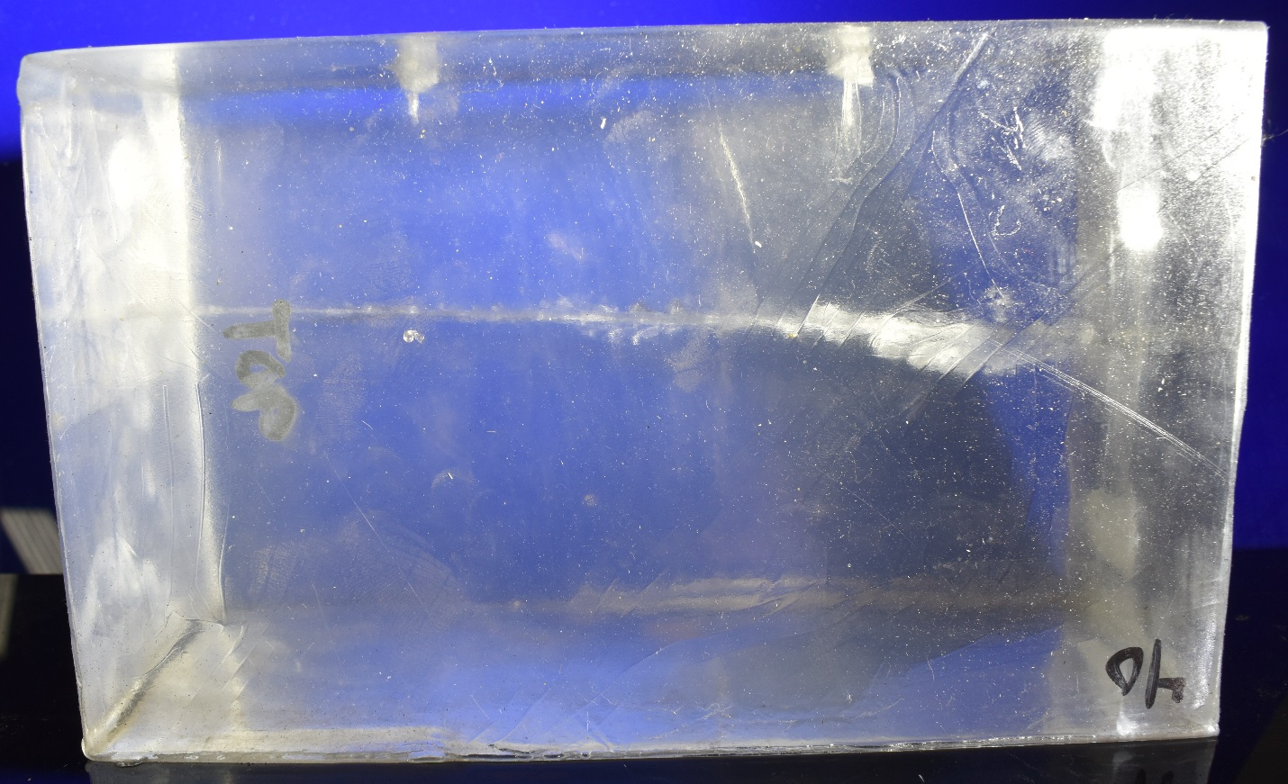
.40 Caliber
Lateral view. Bullet travelled right to left.
Top view. Bullet travelled right to left.

Slide 11
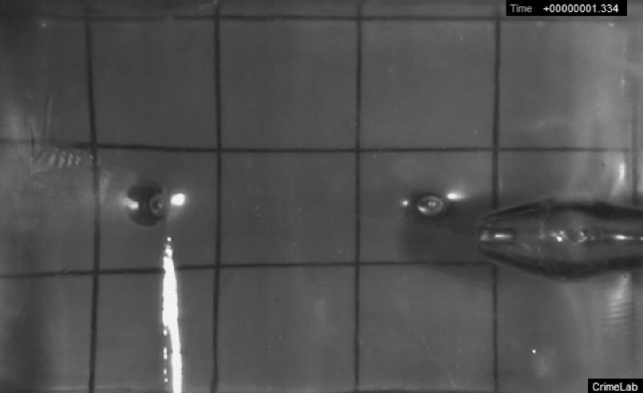
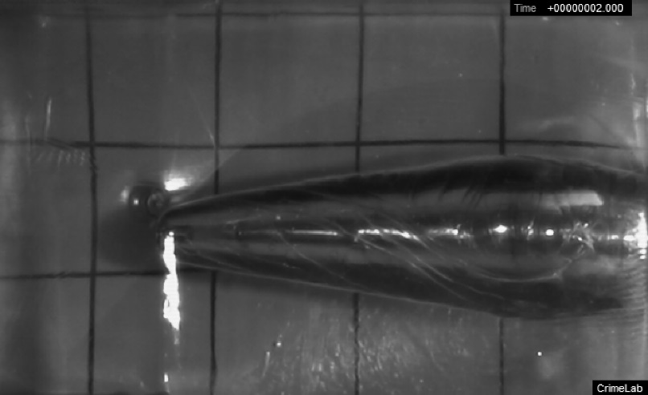
.40 Caliber
Filtered at 2500Hz
Bullet enters gel

Slide 12
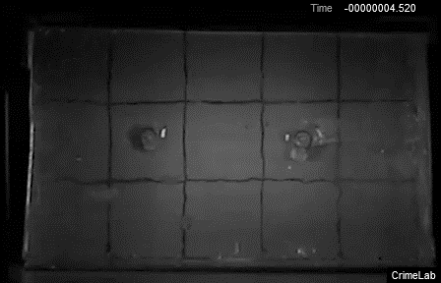
5.56 NATO

Slide 13
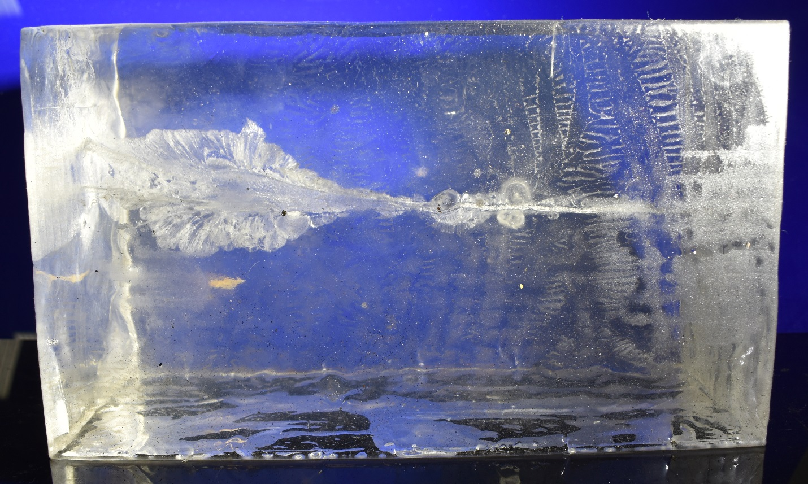
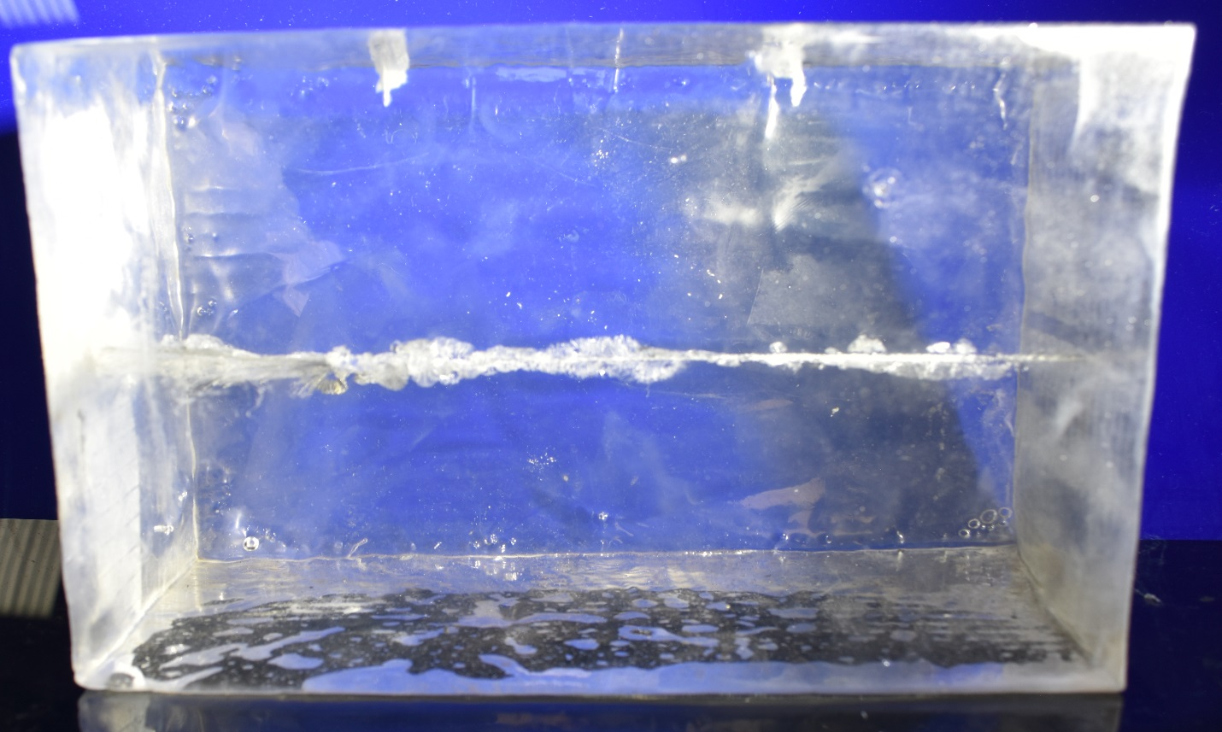
5.56 NATO
Lateral view. Bullet travelled right to left.
Top view. Bullet travelled right to left.

Slide 14
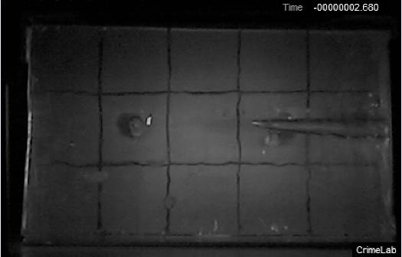
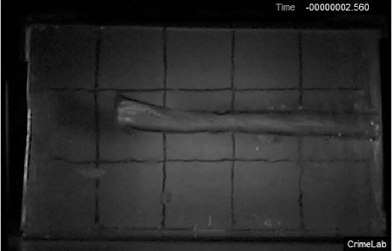
5.56 NATO
Filtered at 2500Hz
Bullet enters gel
Sensor breaks at -2.427ms

Slide 15
Summary
Round Type | Pressure [kPa], Initial Peak, Near Sensor (2500Hz Filter) | Pressure [kPa], Initial Peak, Far Sensor (2500Hz Filter) | Pressure [kPa], Initial Peak, Near Sensor (Unfiltered) | Pressure [kPa], Initial Peak, Far Sensor (Unfiltered) | Peak Diameter of Temporary Cavity [inches]
.25 Caliber | 18.2 | 32.8 | 58.0 | 63.0 | 1.0
.32 Caliber | 138.3 | 251.7 | 199.2 | 323.0 | 1.5
.40 Caliber | 756.9* | 361.2 | 1221* | 553.8 | 3.3*
5.56 NATO | 712.7 | 774.4 | 2629 | 3956 | 5.4
*The .40 caliber bullet was the only one that created a peak temporary cavity and pressures in the vicinity of the near sensor.

Slide 16
Calculations Summary
Round Type | Pressure [kPa], Initial Peak, Near Sensor (2500Hz Filter) | Pressure [kPa], Initial Peak, Far Sensor (2500Hz Filter) | Peak Diameter of Temporary Cavity [inches] | Bullet Mass [g] | Energy Lost by Bullet while Passing thru Gel [J] | % Transferred
.25 Caliber | 18.2 | 32.8 | 1.0 | 3.240 | 54.13 | 83.2
.32 Caliber | 138.3 | 251.7 | 1.5 | 4.601 | 108.73 | 58.8
.40 Caliber | 756.9* | 361.2 | 3.3* | 11.664 | 265.99 | 75.3
5.56 NATO | 712.7 | 774.4 | 5.4 | 3.564 | 1,055.05 | 67.6
Musket Ball | 267.6* | 107.7 | 3.1* | 3.531 | 111.27 | 77.1
*Denotes peak pressures and temporary cavities that were located closer to the near sensor.

