Slide 1
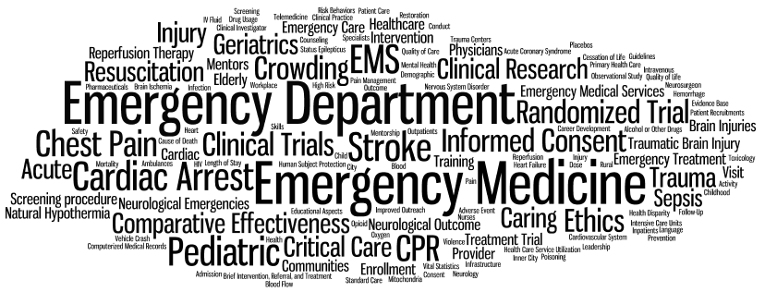

Slide 2
The missions of the
Office of Emergency Care Research
Catalyze
  OECR catalyzes the development and refinement of existing research portfolios within NIH Institutes that impact patients with time sensitive medical conditions
Coordinate
  OECR will coordinate research that involves multiple NIH institutes and centers
Create
  OECR will work across NIH to create ways to fund new research that impacts patients with time sensitive medical conditions
Career development
  OECR will work to train the next generation of clinicians researching emergency care

Slide 3
NIH Funding to Departments 2015
Notes:
This does not include departments of Internal Medicine whose 2014 funding levels were $3.2 billion

Slide 4

2017 – Emergency Care joins the ranks of the RCDC list
Notes:
Note the difference between the Blue Ridge estimation and the RCDC estimation for 2015- $36m vs $128m.

Slide 5
RPG awards 2011-2015 by clinical specialty

Slide 6
RPG awards per 100 practicing physicians 2011-2015

Slide 10
R01 applications by EM and other specialties by comparative size 2011-2015

Slide 11
To which institutes do emergency physicians submit R01s? (2011-2015)

Slide 12
Overall Funding to Emergency Care
(new and ongoing projects)
Institute | Number of Projects | Support
LM | 2 | 558,638
AR | 4 | 708,582
CA | 3 | 977,446
TW | 6 | 1,132,689
NR | 2 | 1,175,101
AI | 7 | 1,241,604
MD | 5 | 1,445,602
GM | 8 | 1,666,859
DC | 3 | 1,778,501
EB | 4 | 2,225,910
DK | 9 | 3,218,155
AG | 14 | 4,036,622
OD | 2 | 4,513,225
AA | 14 | 5,279,844
ES | 33 | 5,467,267
DA | 20 | 7,738,800
HD | 24 | 10,845,730
MH | 17 | 14,697,741
NS | 49 | 22,463,136
HL | 54 | 27,598,321
Total | 280 | $118,769,773

Slide 13
New Funding to Emergency Care 2016
Institute | Number of Projects | Support
LM | 1 | -
GM | 1 | -
DC | 1 | 38,507
AR | 1 | 59,903
AI | 3 | 434,433
CA | 2 | 779,022
TW | 4 | 893,398
AA | 2 | 942,921
MD | 2 | 1,068,958
DK | 5 | 1,496,364
ES | 14 | 1,692,803
HD | 5 | 1,744,047
AG | 8 | 2,681,299
DA | 10 | 3,150,358
OD | 1 | 4,195,725
NS | 8 | 4,854,797
MH | 7 | 8,250,958
HL | 27 | 9,828,742
Total | 102 | $42,112,235

Slide 14
New Emergency Care Research Funded by NICHD in 2016
UNIVERSITY OF CALIFORNIA LOS ANGELES | PEDIATRICS | Well-Child Care Clinical Practice Redesign: A Parent Coach-Led Model of Care for Young Children | R01
DIGITAL HEALTH EMPOWERMENT, INC. | INDUSTRY | Mobile Augmented Screening Tool to Increase Adolescent HIV Testing and Linkage to Care | R41
UNIVERSITY OF COLORADO DENVER | EMERGENCY MEDICINE | Using Clinical Design Support to Improve Child Physical Abuse Testing | K23
UNIVERSITY OF CALIFORNIA AT DAVIS | EMERGENCY MEDICINE | Validation of Decision Rules for CT Use in Children with Abdominal or Head Trauma | R01
CHILDREN'S MERCY HOSP (KANSAS CITY, MO) | EMERGENCY MEDICINE | Enhanced Intervention to Improve Adolescent Outcomes: A Clinical Trial | K23

Slide 15
New R01 awards in 2016 to EM
22 applications, 3 awards:
NCI
  Optimizing Tobacco Dependence Treatment in the Emergency Department (Bernstein, Yale)
NIA
  Urine antimicrobial proteins in older adults: aging, infection, & innate immunity (Caterino, Ohio State)
NICHD
  Validation of Decision Rules for CT Use in Children with Abdominal or Head Trauma (Holmes, UC Davis)

Slide 16
Mentored Individual K applications by EM and other specialties by comparative size 2011-2015

Slide 17
New K23 awards in 2016 to EM
17 submissions: 8 awards
  NIAID (1)
    Biomarkers and Risk Stratification in Pediatric Community-Acquired Pneumonia (Florin, Cincinatti)
  NIDA (2)
    M-Health to Decrease Youth Substance Misuse & High Risk Illegal Firearm Behaviors (Carter, Michigan)
    Addressing Homelessness and Substance Use in Emergency Department Patients (Doran, NYU)
  NIDDK (1)
    Trial to Examine Text Message-based mHealth in Emergency department patients with Diabetes with Family And friends Network Supporters (Burner, USC)
  NICHD (2)
    Enhanced Intervention to Improve Adolescent Outcomes: A Clinical Trial (Miller, Kansas)
    Using Clinical Design Support to Improve Child Physical Abuse Testing (Lindberg, Colorado)
  NHLBI (2)
    Improving the Safety and Efficacy of Out-of-Hospital Pediatric Airway Management (Hansen, Oregon)
    SYNDICARE: Syncope Decision Aid for Emergency Care (Probst, Mt Sinai NY)

Slide 18
The SIREN Network
10 Hubs
With scalable spokes
PARTNERS
NINDS
CCC
DCC
NHLBI
DoD
NCATS
OECR
NCATS
CTSA
Central IRB, Central contracting,
Monitoring

Slide 20
What next?
The NIH funds a wide range of research relevant to Emergency Medicine
There are opportunities for both training and independent research
NIH supports research infrastructure for emergency care
…so how will you take advantage of all this?

Slide 21
Jeremy.brown@nih.gov
301-594-4481

