Slide 1
Increasing Cardiac Arrest Survival through Dispatcher Assisted Bystander CPR
Milwaukee County EMS Communicator Training for giving Prearrival CPR Instructions

Slide 2
Disclosure
This work is supported by funds from Advancing a Healthier Wisconsin’s Change Maker Program

Slide 3
Training Overview
Project Vision: where we are and where we want to be
Identifying patients who need dispatcher CPR
Moving callers from reporters to actors
The Instructions
Quality Improvement
Practice! Practice! Practice!

Slide 4
Project Vision
“I'm sorry no one saved you.”
― Maggie Stiefvater, The Dream Thieves

Slide 5
To Give Every 9-1-1 Caller the Opportunity to be a First Responder
Each year 800 people have an out-of-hospital cardiac arrest in Milwaukee County and 90% die
Less than 19% have the benefit of bystander CPR
Bringing dispatcher assisted CPR to Milwaukee County will CHANGE:
      Bystander CPR rates
      Cardiac arrest survival rates
Notes:
As you likely know, every citizen in this county, has the power to save a life just by putting one hand on top of the other and pushing hard and fast on a cardiac arrest victim’s chest. Yet when faced with this high stress high emotion situation few choose to act, in Milwaukee County less than 19% of the time bystanders perform CPR. However, other communities have shown that by having 9-1-1 dispatchers prompt people into action this rate can change and more lives can be saved --- every citizen can become a first responder.
<<play recording>>
As you may have identified, this couple knew CPR, but while they had initiated the 9-1-1 call, they had not used that knowledge until prompted by the dispatcher. We want to bring these prompts to the citizens of Milwaukee and create a measurable CHANGE in our rates of bystander CPR and cardiac arrest survival. Listening to this recording it may sound simple, but make no mistake, what you heard was a complex process. The dispatchers words were carefully chosen and the result of intensive training and a quality improvement program that coached her to maintain her skills. Also, the citizens who called were caring for a stranger and the dispatcher did not have to deal with the more typical caller unable to get through their emotions to reach a state of action. What we are proposing is to train dispatchers to use the power of their voice to take charge of a total stranger’s actions and guide them to act in a time of high stress and emotion. This can not be done without significant initial and continued training as well as some change to the 9-1-1 infrastructure, and a grass routes campaign to show administrators that this service is expected by the citizens and the most cost effective way to improve our dismal 10% survival rate.

Slide 6

The Goal
Thoughts?
What did you notice about these callers?
Without the dispatcher what would have happened?
How did the dispatcher sound?
Did it work?
Notes:
The callers know CPR but they were not doing it, they needed the dispatcher
Was she asking or telling

Slide 7
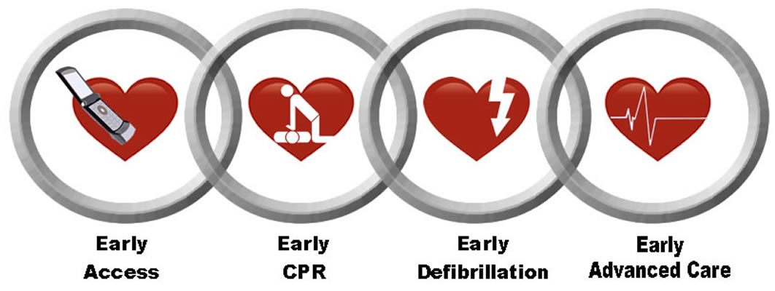
Links in the Chain of Survival
The Metaphor

Slide 8
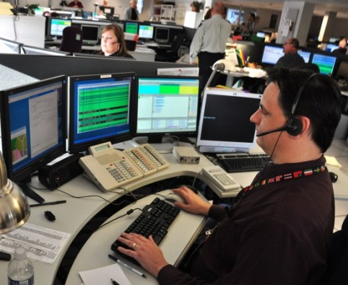
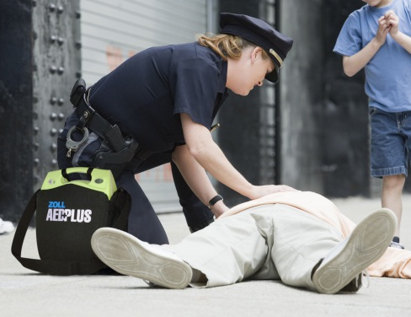
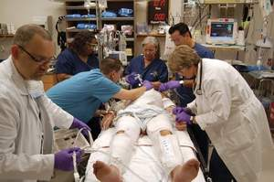


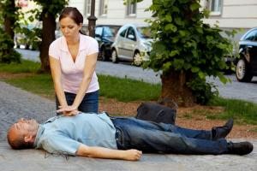
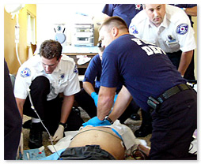
The Links => Ideal Response

Slide 9
Milwaukee County When We Started
Directions only
in City, W. Allis, Oak Creek
Only 19% of the time

Slide 10
Moving Our Focus to the First Two Links
Time to first shock
Time to CPR | 0-8 min | 9-12 min | 13+ min
0-4 min | 64% | 41% | 30%
5-8 min | 49% | 27% | 12%
9+min | N/A | 10% | 0%
Data on Survival from Witnessed VF Rhythm
In King County 2005-2012

Slide 11
Slope of Death
100%
90%
80%
70%
Survival
60%
50%
40%
30%
20%
10%
1
2
3
4
5
6
7
8
9
10
Minutes

Slide 12
Where we are without Dispatcher CPR
100%
Turn out
90%
80%
70%
Defib
60%
Dispatch
50%
HP-CPR
40%
At scene
30%
20%
At pt. side
10%
1
2
3
4
5
6
7
8
9
10
Minutes

Slide 13
Where we are going
100%
Turn out
90%
B-CPR
80%
70%
HP-CPR
Defib
60%
Dispatch
50%
At scene
40%
35%
At pt. side
30%
20%
10%
1
2
3
4
5
6
7
8
9
10
Minutes

Slide 14
The Plan for Change
First 6 months – Jan –June 2015
  Infrastructure changes
    EMScom call taking equipment: headphone, pedal, expanded recording capabilities
    QI development: database and process
    Dispatcher protocol/training: Develop dispatcher assisted CPR protocol/training
  Dispatcher training
    EMScom dispatchers
  Municipal PSAPs
    Implementation planning
Notes:
We are proposing a two year project. During the first six months we will initiate infrastructure changes, the EMS communication center or EMScom will need a minimal amount of additional equipment. We will also need to develop a database to record caller/call taker interactions. Training will be developed and provided to the EMScom dispatchers. Finally, our team will initiate implementation planning with each municipality.

Slide 15
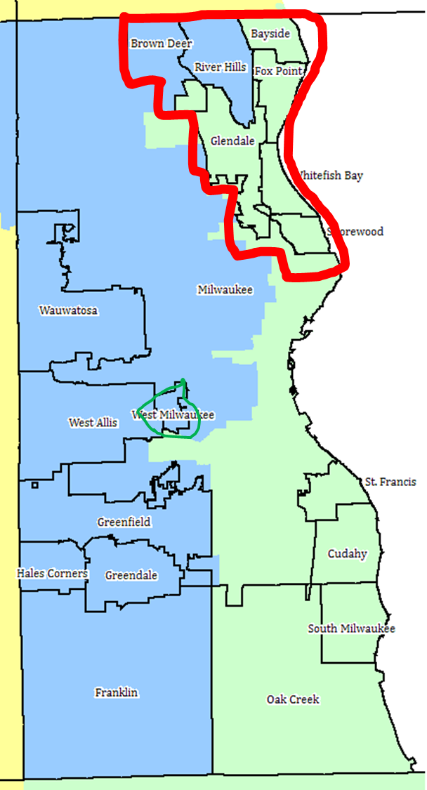
The Plan for Change
Second 6 months (June – December 2015)
  Staged roll out
    Municipality dispatcher training to transfer calls
    Initiation of process
      ~2 centers per month
  100% QI
Notes:
During the second six months we will begin a staged roll out. This will include working with municipal PSAPs, or 9-1-1 centers, to train their call takers to transfer potential cardiac arrests to EMScom. There are 13 PSAP’s in the county, 10 do not provide CPR instructions. We will initiate the call transfers at two of these 10 PSAPs per month. We will review every call and adjust the training and process as needed.

Slide 16
The Plan for Change
Year 2 – Jan – Dec 2016
  100% QI
  Evaluation of missed transfers
  Evaluation of outcomes
Beyond year 2 program sustained by Milwaukee County
  QI maintained but at a lower %
  EMSCom new hires trained during orientation
Notes:
At the start of year 2 the program will be fully implemented. We will review 100% of the calls, including listening to recordings of each interaction. We will also review all cardiac arrests treated by EMS in the county and determine if those calls were transferred to EMScom. If they were not we will investigate to see if the transfer process can be improved. Finally we will evaluate patient outcomes and measure change.

Slide 17
Measures of Success
Outcome Measures: Rate of Bystander CPR in Milwaukee
  Rate of cardiac arrest survival to hospital discharge
Process Measures: Number of callers for cardiac arrest patients that receive pre-arrival instructions
  Number of callers that give compressions
Notes:
This project will be considered successful if we have increased bystander CPR rates– prior studies and our pilot work have shown this will occur. We will also determine if this equates to improved survival which has also been shown in other communities.
Finally, We will look at process measures including the number of callers for cardiac arrest patients that receive instructions and of those the number that actually give a chest compression.

Slide 18
Questions/
Discussion

