Slide 1
Identifying Patients Who Need CPR: Over the Phone
“Courage is not the absence of fear, but rather the judgment that something else is more important than fear.”
― Ambrose Redmoon

Slide 2
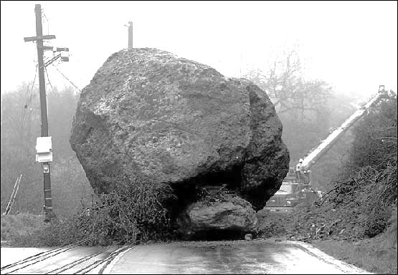
What are the roadblocks to bystander CPR?
Cardiac arrest is hard to recognize.
Rescuers do not have confidence to act.
Traditional CPR is technically too difficult.

Slide 3
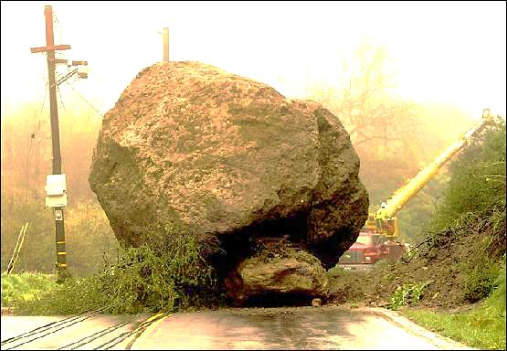
What are the roadblocks to bystander CPR?
Cardiac arrest is hard to recognize.
Rescuers do not have confidence to act.
CPR is technically too difficult.
YES YES YES
………….What to do?

Slide 4


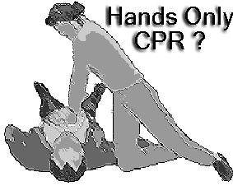
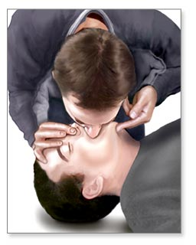
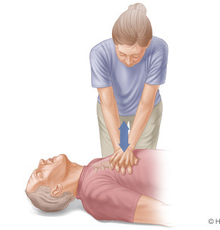
Dispatchers can:
1. Facilitate rapid identification
2. Instill bystander confidence
3. Coach competent CPR
Keep It Simple
An approach validated by randomized trials
Survivall
15% 10%
Hands Only Rescue Breathing
+ Chest Compressions

Slide 5
How Do We Know
Seattle - King County experience (1985 - 2012)
50%
T-CPR has potential to double proportion who receive CPR
25%
Bystander-initiated
(No T-CPR)
Notes:
Telecommunicator CPR program doubled the rate of bystander CPR.

Slide 6
How Do We Know
Seattle - King County experience (1985 - 2012)
50%
T-CPR has potential to double proportion who receive CPR
Dispatcher Instruction doubles the rate of bystander CPR!!
25%
Bystander-initiated
(No T-CPR)
Notes:
Telecommunicator CPR program doubled the rate of bystander CPR.

Slide 7
Cardiac Arrest Signs
Sudden, unexpected collapse
Unconsciousness, no sign of life
Abnormal breathing (gasping) common
Brief seizure – lack of oxygen to brain

Slide 8

Identifying Cardiac Arrest
Is the patient conscious?
Is the patient breathing normally?
“No – No – Go”
Notes:
The purpose of the All Caller Interview is to identify patients in cardiac arrest. We do this through the asking of 2 key questions.
First – Is the patient conscious? If the patient is unconscious the next question we ask is if the patient breathing NORMALLY? While we do train our telecommunicators on agonal respirations and they understand what they are and what they sound like, we do not get into the weeds of breathing diagnostics. Too much time is wasted trying to determine if agonal are present or not. And agonal can sound like any number of things, from snoring to groaning, snorting, gasping and so on. Instead, we focus on is the breathing “normal”.
We have a saying called “NO – NO – GO”. NO conscious, NO breathing normally, GO for CPR! Let’s listen to what that sounds like when done properly (Click on first audio icon).
Audio Call #1 – Example of perfect all caller work flow and rapid identification of cardiac arrest (00:00:20)
It’s important to note that the King County EMD (emergency medical dispatch) program is a GUIDELINE based program, not a PROTOCOL. What this means is that call receiver can deviate from the All Caller workflow as dictated by the situation. As an example, if a caller begins the conversation by saying they can’t wake up their dad, does it make sense to waste time asking if the patient is conscious? No, of course not. The caller has already told us what we need to know. So, in a situation like this, the call receiver must demonstrate flexibility and move directly into identifying the status of breathing for the patient. (Click on second audio icon)
Audio Call #2 – Caller states dad is not breathing. Telecommunicator moves right into CPR instructions (00:0013_

Slide 9
All Callers Interrogation
Is the patient awake?
  Yes: Respond as usual (see appropriate chief complaint)
  No: Go to Step 2
  Unsure: Try to wake them up while I wait on the line
Is the patient breathing normally?
  Yes: Respond as usual (see appropriate chief complaint)
  No: Dispatch ALS/BLS; Transfer to MC EMS Communicator
  Unknown: Go to Step 3

Slide 10
Agonal Breathing
Slow, passive & ineffective breathing.
  Formal: Abnormal pattern of breathing characterized by shallow, slow (3-4 per minute), irregular inspirations followed by irregular pauses.
  Chest does not rise and fall NORMALLY – in a rhythmic pattern
Cause cerebral ischemia, due to extreme hypoxia
Caller often mistakes as breathing

Slide 11
Agonal Respirations
Is the patient breathing NORMALLY?
**Don’t be fooled by Agonal respirations
Variety of words used by callers:
“Gasping” “Snoring” “Snorting” “Sighing” “Gurgling” “Puffing”
“Light” “Labored” “Shallow”
Audio 1

Slide 12
Two No’s and Go
Callers reporting a person unconscious and not breathing normally require ALS response & immediate CPR instructions
  PSAP will transfer call or initiate instructions
OK, Sir/Ma’am I am sending an ambulance now. I am also transferring you to my partner who will give you more directions…
Once the MC EMS Communicator answers, PSAP states:
This _______ dispatch center. I have a caller reporting an ____(age if known) PNB (give an pertinent details e.g., post drowning). Unit____ has been dispatched.

Slide 13

Common Delays in Delivering CPR
  Unnecessary questions asked
  Caller not near patient
  Omission of “breathing normally”
  Deviation from protocols
Remember:
Studies have shown giving CPR to a person not in cardiac arrest does minimal harm
Not giving CPR when someone is in arrest significantly decreases survival
Decreasing TIME To CPR is Key!
Our script does not require EMSCom communicators to verify cardiac arrest

Slide 14
Situations in which CPR would not be offered
Obvious DOA – cold, stiff, decapitated etc.
DANGER TO THE RESCUER
Don’t ask! Listen to what they say – better to start than waste TIME

Slide 15
Questions/
Discussion

