Slide 1
Moving callers from Reporters to Actors
“It is a dangerous position to be in when you can't see, can't hear and won't listen...”
― Stella Payton

Slide 2
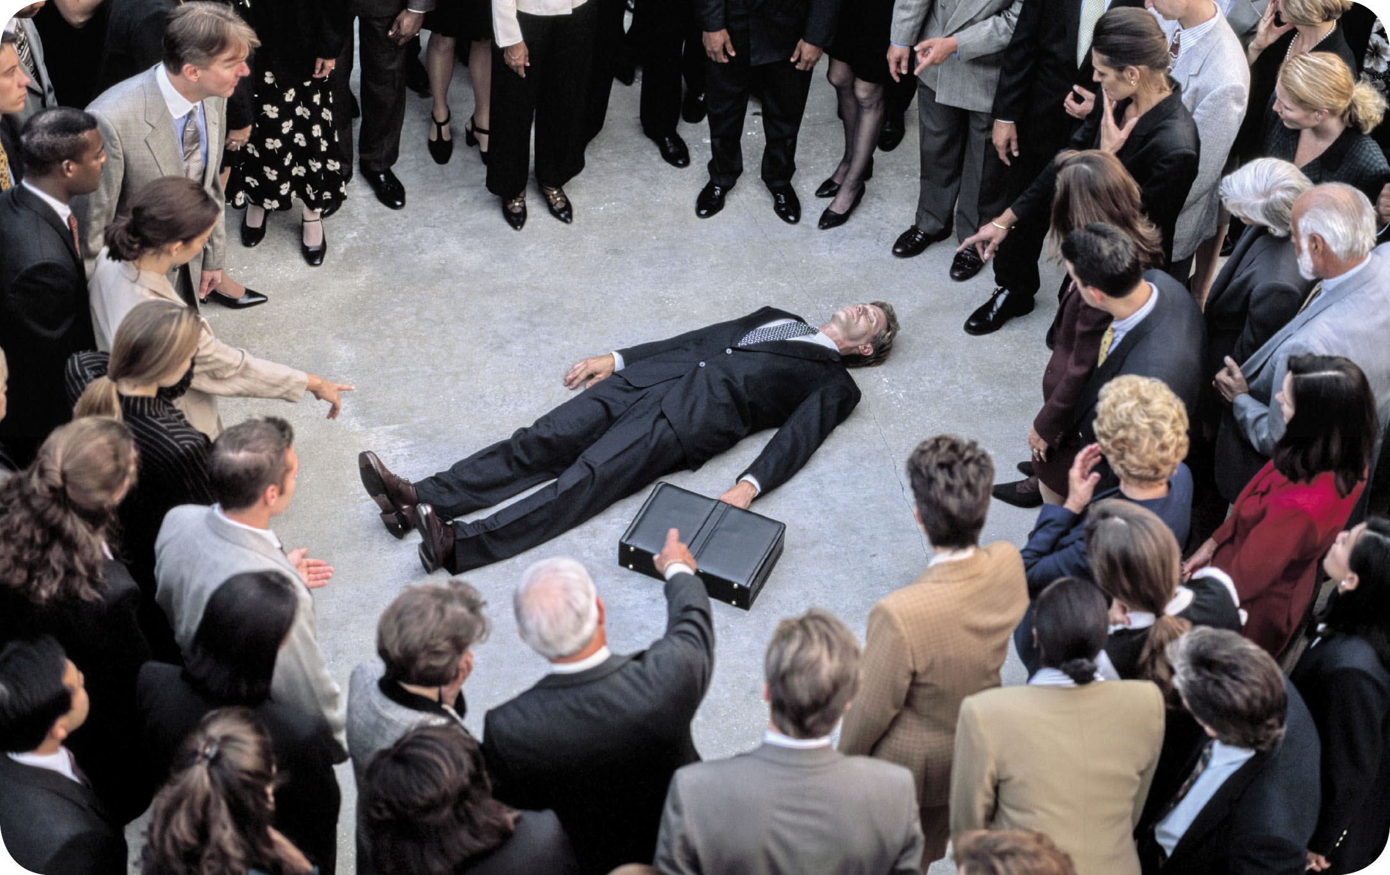
Laypersons may not have confidence

Slide 3
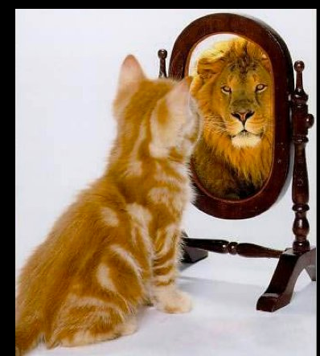
Confidence Predicts Action

Slide 4
How do we gain confidence?
Education
Practice
Experience
Encouragement

Slide 5
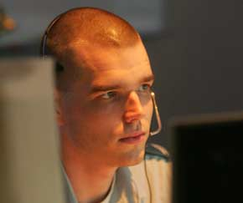
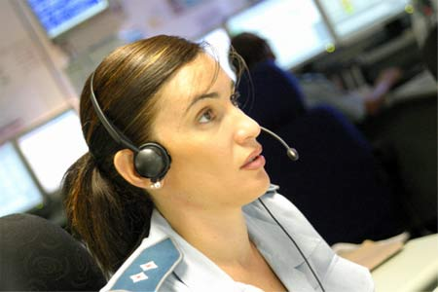

How do we gain confidence?
Education
Practice
Experience
Encouragement
Dispatchers engage and direct……they do not ask?

Slide 6
Challenges of Early CPR
Cardiac arrest is hard to recognize
Laypersons may not have confidence
CPR can be technically difficult

Slide 7
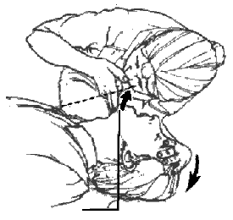
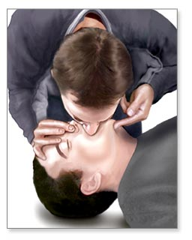
The average time required to open the airway and provide 2 breaths for bystanders during the first cycle is…..?
10 seconds
20 seconds
30 seconds
60 seconds
Initial airway management

Slide 8
The average time required to open the airway and provide 2 breaths for bystanders during the first cycle is…..?
10 seconds
20 seconds
30 seconds
60 seconds
Initial airway management

Slide 9
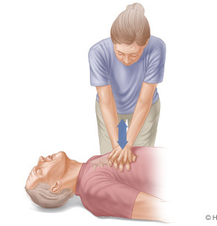
During subsequent cycles of CPR by the bystander, ventilations interrupt chest compressions …..?
5 seconds
10 seconds
15 seconds
20 seconds
Subsequent CPR cycles

Slide 10
During subsequent cycles of CPR by the bystander, ventilations interrupt chest compressions …..?
5 seconds
10 seconds
15 seconds
20 seconds
Subsequent CPR cycles

Slide 11
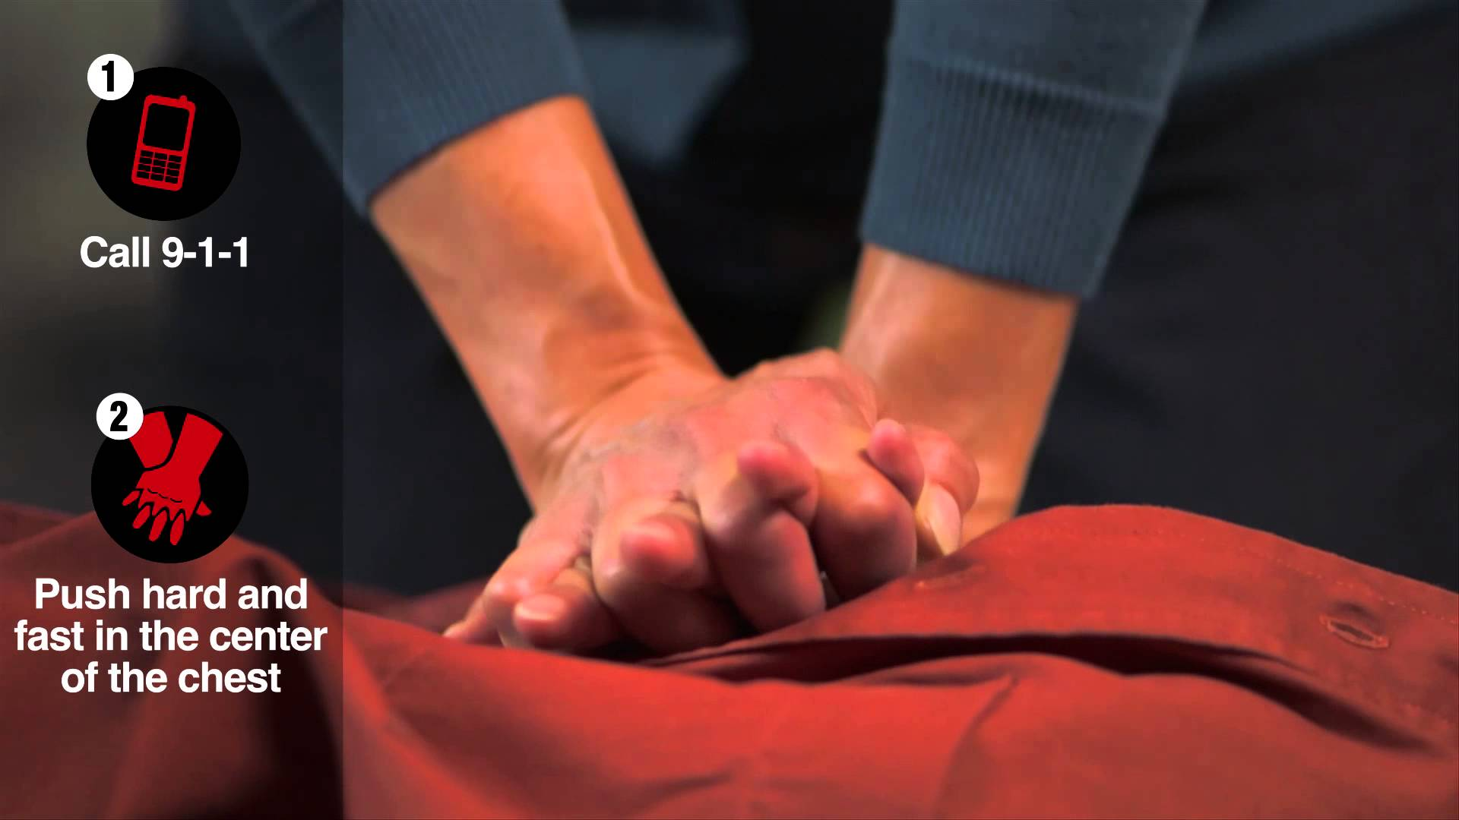
Keep It Simple
Hands Only CPR
Eliminate ventilations
Focus on chest compressions

Slide 12
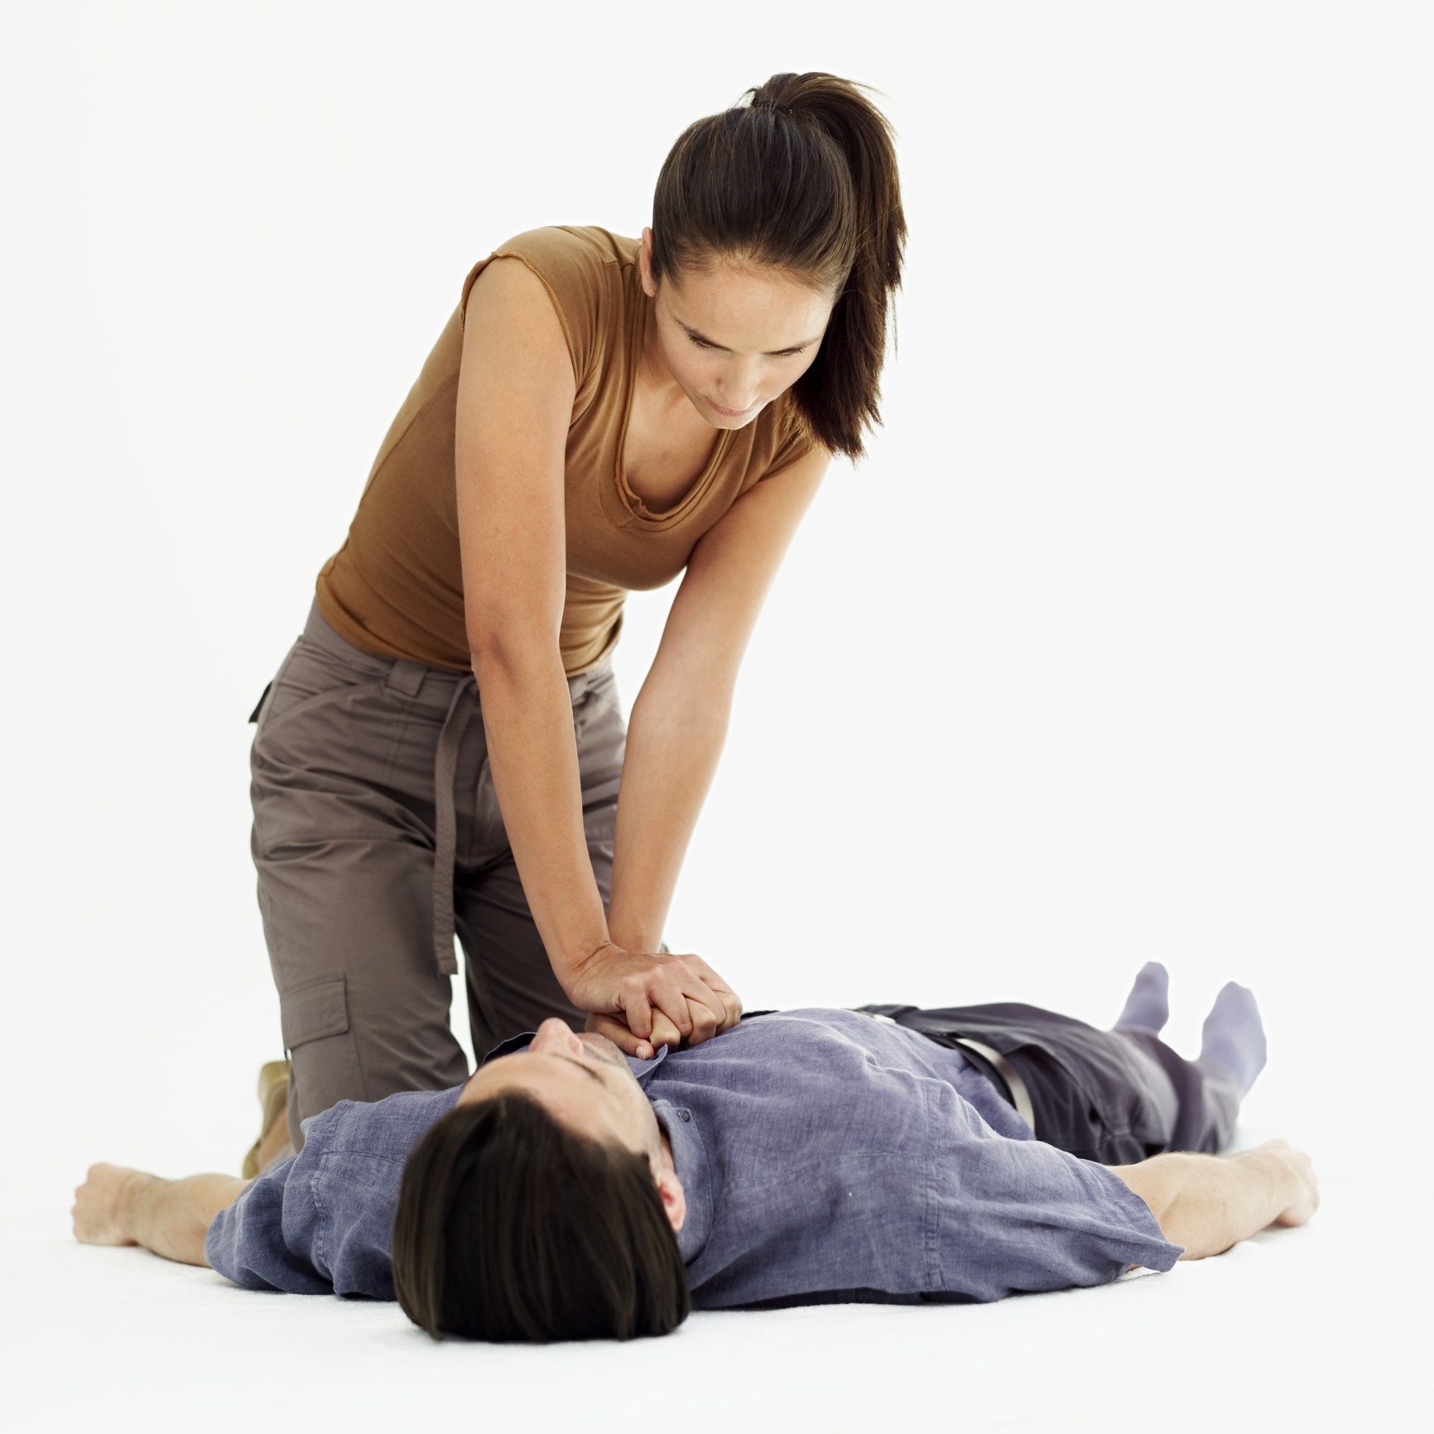
Keep It Simple
Survival
15% 10%
Hands Only Rescue Breathing
+ Chest Compressions

Slide 13
Don’t Ask Tell
Active listening: the first few seconds
  Callers often volunteer critical information
Be calm; be assertive
Goal: start CPR as early as possible

Slide 14
Barriers to Bystander CPR
Panic
Squeamish about mouth-to-mouth CPR
Fear of legal ramifications
Can’t get person to the floor
Fear of causing harm

Slide 15
Panic
Most frequent reason for CPR non-provision
High stress and panicked situations can lead to breakdown in communication between dispatcher and bystander

Slide 16
Tactic: Confident Assertiveness
Assertiveness is key
  Dispatcher’s confidence becomes the bystander’s confidence when coached assertively
75% of recently-trained bystanders stated that instructions from a dispatcher make it easier to perform CPR

Slide 17
Squeamish about Mouth-to-Mouth CPR
Without clear verbal specification of chest-only compression CPR, bystanders may assume they must perform mouth-to-mouth when a dispatcher says “CPR”

Slide 18
Tactic: Compression-Only CPR
Utilize key phrases:
  “No Mouth-to-Mouth”
  “No Breaths”
  “Only chest compressions”
Tell the bystander that the patient needs chest compressions

Slide 19
Tactic: Skip it!
We have some protocols with breaths
  Children
  Pregnant women
  Trach/Stoma
  Obvious respirator cause (drowning)
If the patient needs breaths and the caller does NOT want to
  SKIP IT

Slide 20
Fear of Causing Harm
“Why should I get involved? I don’t know how to do CPR and if I hurt the patient, I could be sued.”
  Must suppress this bystander thought to avoid delays and impeding CPR

Slide 21
Tactic: Good Samaritan Laws
Inform bystander of their protections from legal ramifications when administering CPR
  “You will not hurt them and you will not be sued.”
  Frequency of serious injury related to dispatcher-assisted bystander CPR is low and does not outweigh benefits of bystander CPR

Slide 22
Barrier: Getting Patient on Floor
When there is a barrier to starting CPR, it is frequently due to the caller’s inability to get patient to the floor
  Most often: patient needs to be moved from bed to the floor

Slide 23
Tactic: Emphasize Emergency Situation
Reiterate that no injury to patient is comparable or relevant when facing cardiac arrest
Instruct help of other bystanders
Tell bystander to push, pull, tug, or roll patient onto hard, flat surface
  From bed
    Bring patient’s legs to floor
    Bring patient’s head down

Slide 24
Barrier: Fear of Causing Harm
Fear of broken ribs, crushing patient, or causing visceral organ damage
Cracking sounds of breaking ribs and tearing cartilage reinforce fear once compressions begin

Slide 25
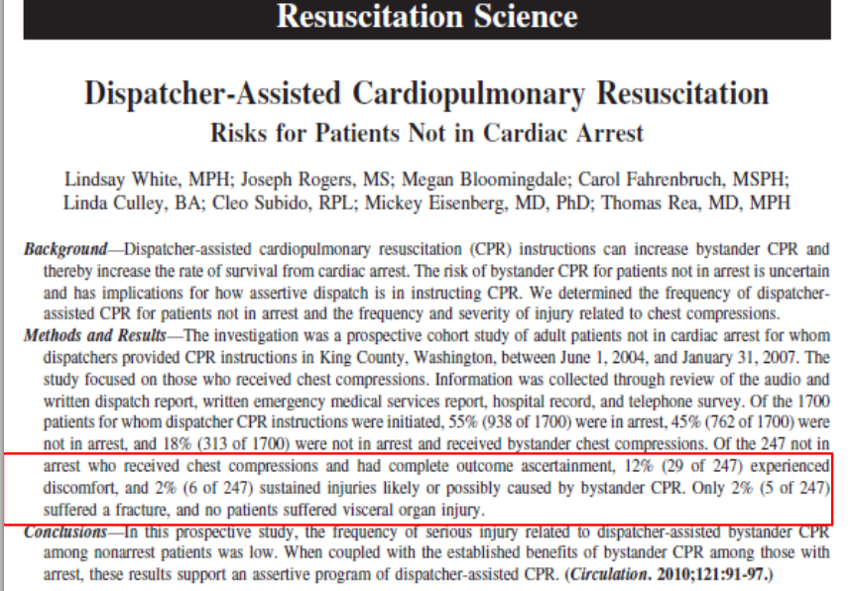
Tactic: Justification
Minimal risk of major injury
1 : 1000
Vs
9 : 10 Dead

Slide 26
Questions/
Discussion

