Slide 1
When and How to Talk to Project Officers
Part II
Li-Shin Huang, Ph.D.
Program Officer
National Heart, Lung, and Blood Institute
EMS Grant Workshop
Health Resources and Service Administration
Wednesday, June 14, 2017

Slide 2
Know the NIH
Center for Scientific Review (CSR) versus other Institutes & Centers (ICs)
Review versus Program
Source for Specific Review: PA, PAR, RFA.
Learn to Navigate the NIH Web Site
Talk with NIH Staff
Scientific Review Officer (SRO)
Program Officer (PO)

Slide 3
What Grant Mechanism to Apply ?
Know your career stage

Slide 4
Career Path for a Ph.D or M.D (or Equivalent)
F31
or
T32
F32
or
T32
K99/
R00
K01 or K25
R01
Ph.D. Faculty Position
Graduate Student
Independent PI
M.D. Clinical Training Faculty Position
Medical Student
K08 or K23
T35

Slide 5
What Grant Mechanism to Apply ?
Know your career stage
Fs, Ks and Rs.
Identify appropriate funding opportunity announcements (FOAs)
Parent announcement (PA)
PA with special receipt, referral and/or review considerations (PAR)
Request for Application (RFA)
https://grants.nih.gov/grants/how-to-apply-application-guide/prepare-to-apply-and-register/understand-funding-opportunities.htm

Slide 6
Know the Program Announcement
Participating Institute/Centers (ICs)
IC-specific missions
NIH RePORTER
Contact NIH Staff
IC-specific programs
e.g., NHLBI-specific diversity K01 (RFA-HL-006)
IC-specific requirements
e.g., parent K01 (PA-16-190)

Slide 7
Use NIH Reporter (Example MATCHMAKER Tab)-1
Ahn JH, Jeon J, Toh HC, Noble VE, Kim JS, Kim YS, Do HH, Ha YR. SEARCH 8Es: A novel point of care ultrasound protocol for patients with chest pain, dyspnea or symptomatic hypotension in the emergency department. PLoS One. 2017 Mar 29;12(3):e0174581. doi: 10.1371/journal.pone.0174581. eCollection 2017 Mar 29. PubMed PMID: 28355246

Slide 8
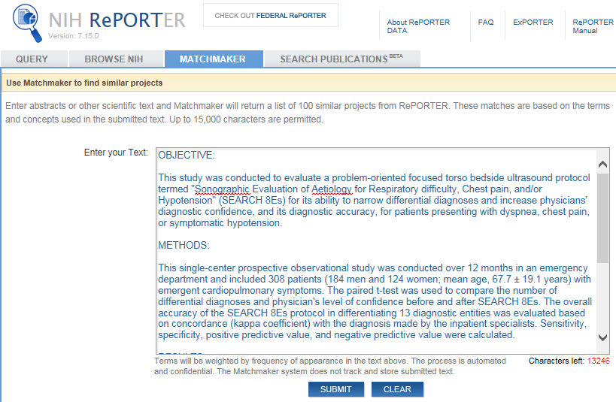
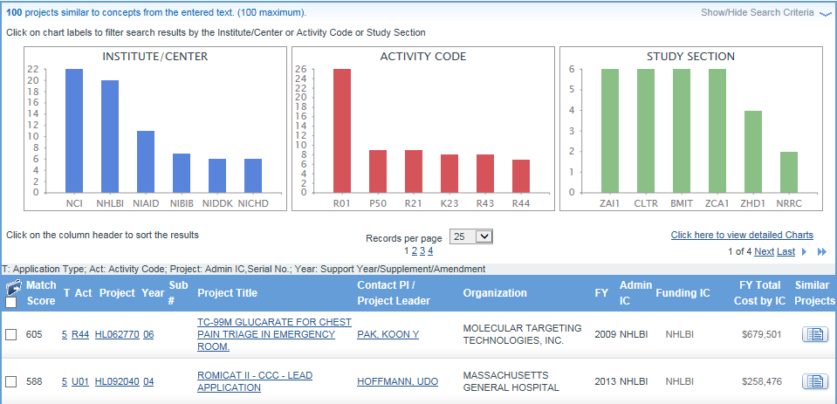
Use NIH Reporter (Example MATCHMAKER Tab)-2
Ahn JH, Jeon J, Toh HC, Noble VE, Kim JS, Kim YS, Do HH, Ha YR. SEARCH 8Es: A novel point of care ultrasound protocol for patients with chest pain, dyspnea or symptomatic hypotension in the emergency department. PLoS One. 2017 Mar 29;12(3):e0174581. doi: 10.1371/journal.pone.0174581. eCollection 2017 Mar 29. PubMed PMID: 28355246

Slide 9
Use NIH Reporter (Example MATCHMAKER Tab)-3
Ahn JH, Jeon J, Toh HC, Noble VE, Kim JS, Kim YS, Do HH, Ha YR. SEARCH 8Es: A novel point of care ultrasound protocol for patients with chest pain, dyspnea or symptomatic hypotension in the emergency department. PLoS One. 2017 Mar 29;12(3):e0174581. doi: 10.1371/journal.pone.0174581. eCollection 2017 Mar 29. PubMed PMID: 28355246

Slide 10
Know the Program Announcement
Participating Institute/Centers (ICs)
IC-specific missions
IC-specific programs
e.g., NHLBI-specific diversity K01 (RFA-HL-006)
IC-specific requirements
e.g., parent K01 (PA-16-190)

Slide 11
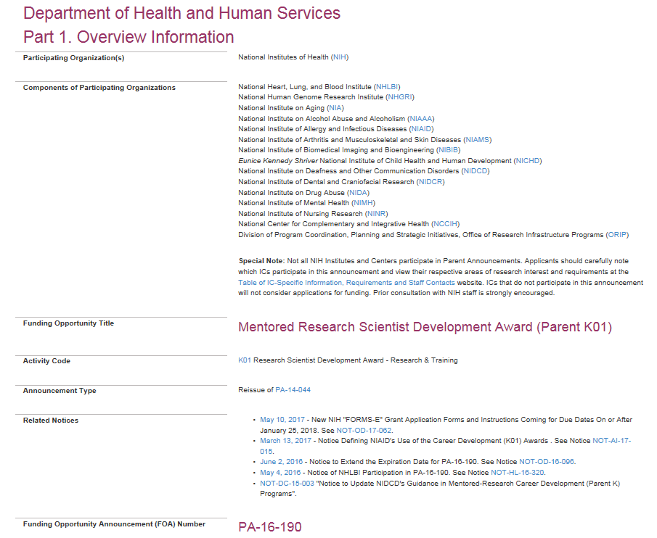
Example: Parent K01 (Basic Research)
Participating Organization(s)
Special Note:

Slide 12
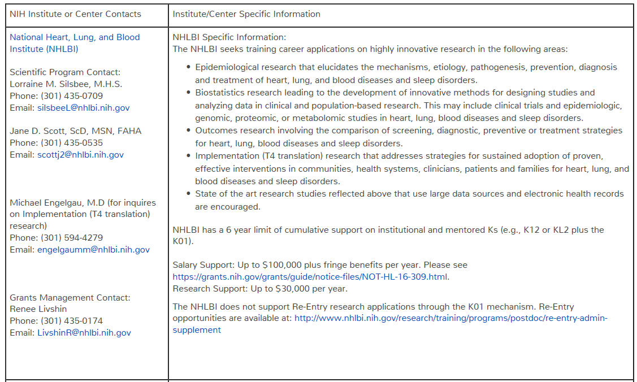
Parent K01 (PA-16-190) Table of IC-Specific Informatin, Requirements and Staff Contacts

Slide 13
Preparing an Application
Use appropriate application form
SF424 Form D (as of today)
New Form for Clinical Trials (2018)
Read Instructions
Requirements are indicated in FOAs
Guidelines for format, page limits and others are in application form
Keep alert for new requirements:

Slide 14
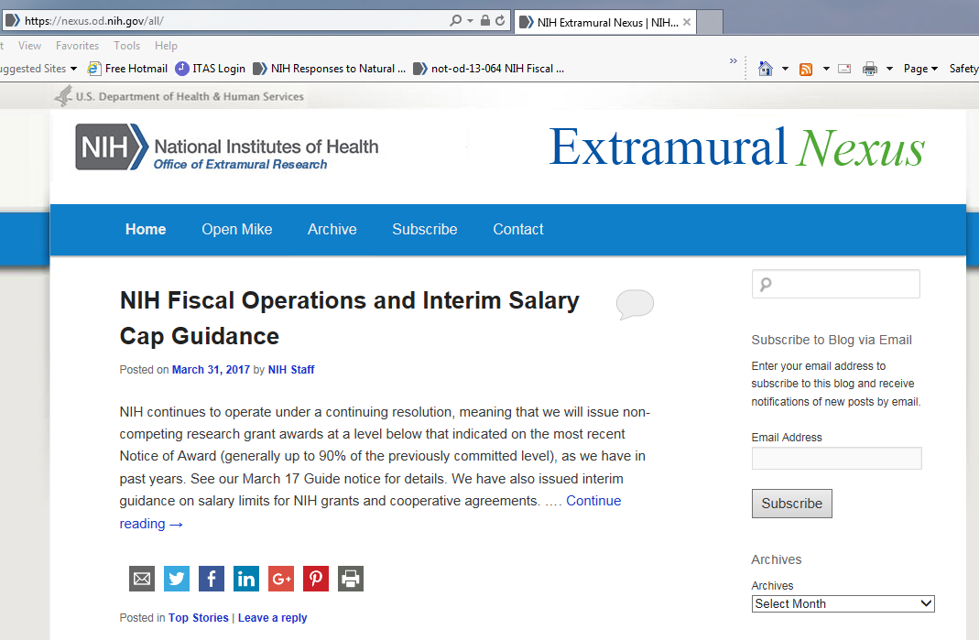
Keep Alert for New Requirements-1

Slide 15
Keep Alert for New Requirements-2

Slide 16
Review Criteria
Fellowships (Fs) | Career Development Awards (Ks) | Research Project Grants (Rs)
Applicant | Candidate | Significance
Sponsors, Collaborators, and Consultants | Career Development/Career Goals & Objectives | Investigator(s)
Research Training Plan | Research Plan | Innovation
Training Potential | Mentor(s), Co-Mentor(s), Consultant(s), Collaborator(s) | Approach
Institutional Environment & Commitment to Training | Environment & Institutional Commitment to the Candidate | Environment

Slide 17
Additional Criteria for Review
Scoring criteria
Protection of Human Subjects
Inclusion of Women, Minorities and Children
Vertebrate Animals
Scientific Premises, Scientific Rigor
Sex and Other Biological Variables
Biohazard
Vertebrate Animals
Non-scoring criteria
Training in the Responsible Conduct of Research
Select Agent Research
Resource Sharing Plan
Authentication of Key Biological and/or Chemical Resources
Budget and Period of Support

Slide 18
Tips for Getting a Career Development Awards
Start early
Read announcements thoroughly
Follow instructions carefully
Understand review criteria and work with your mentor(s)
Don’t overlook other criteria
Get critiques from your mentor(s) and colleagues
Be responsive to reviewers’ critiques for resubmissions
http://www.asbmb.org/asbmbtoday/201612/ProfessionalDevelopment/

Slide 19
Summary of the Process
Stage | Primary Resources
Preparing an Application | NIH and IC Web Sites NIH Program and Review Staff
Electronic Submission | Grants.Gov and eRA Commons Web Sites Your Institutional Grants Office
After Submission until the Peer Review Date | Scientific Review Officer
After Peer Review | Assigned Program Officer
Approval by Council and Inclusion in the Pay Plan | Assigned Program Officer Assigned Grants Management Specialist Your Institutional Grants Office

Slide 20
Additional References for Career-Development Awards
NIH K-Kiosk, https://researchtraining.nih.gov/programs/career-development
Houser, S. R., Circ. Res. 110, 907–909 (2012).
Scott, J. D., & D. E. Carlson, Circ. Res. 110, 910–914 (2012)
Lindman, B. R. et al., J. Am. Coll. Cardiol. 66, 1816–1827 (2015)
Carlson, D. E. et al., Circ. Res. 119, 904–908 (2016)

Slide 21
Office of Research Training and Career Development Division of Cardiovascular Sciences (DCVS), NHLBI
Jane D. Scott, ScD, MSN – scottj2@nhlbi.nih.gov
Wayne Wang, PhD – wangwc@nhlbi.nih.gov
Drew Carlson, PhD – carlsonde@nhlbi.nih.gov
Li-Shin Huang, PhD - li-shin.huang@nih.gov
Tawanna Meadows, BS – meadowst@nhlbi.nih.gov
NIH, NHLBI, DCVS Training 301-435-0535
For Population-based work, Lorraine Silsbee - silsbeel@nhlbi.nih.gov

