Slide 1
An Investigator’s Guide to the Clinical and Translational Science Awards and the Trial Innovation Network (TIN) What can we do for you?
May 2017

Slide 2
Clinical and Translational Science Award Program
Examples of CTSA Resources at Each Institution
Informatics
Funding Awards
Research Education
Clinical Research Space
Biostatistics
Regulatory Knowledge
Funded by NCATS
Approximately 60 Academic Medical Institutions
Created to accelerate discoveries and improve clinical and translational research

Slide 3
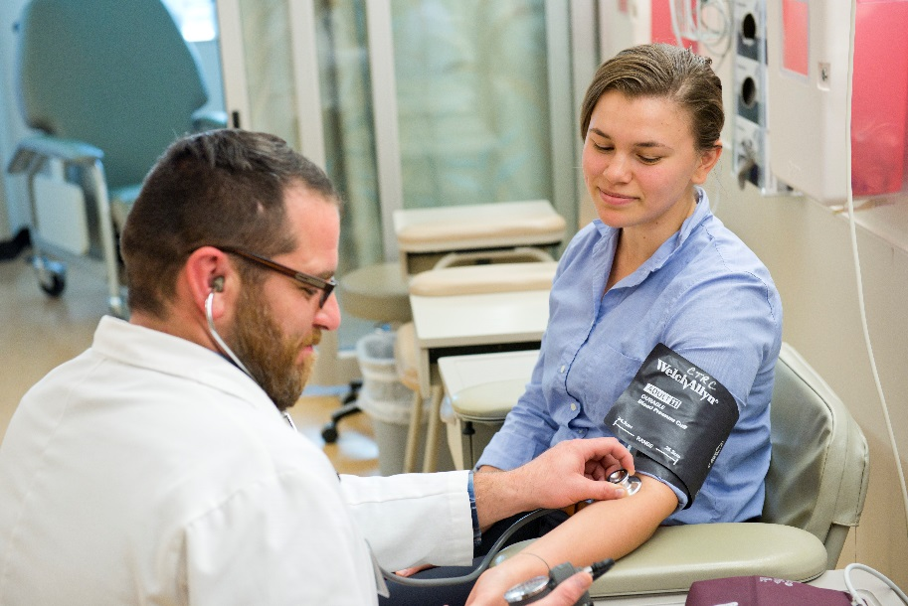
What does this mean to you?
Cohort Discovery
Electronic Medical Record
We are here to support the research community!
Clinic Space
Researcher Query
Number of Possible Participants
Limited dataset
Research Navigator
(Concierge or Front Door)
Funding
Notes:
OHSU’s Clinical and Translational Science Institute
Recipient of a Clinical and Translational Science Award (CTSA)
Mission to enhance and support clinical and translational research
Some examples of support and services provided by CTSAs include – Research Navigator, sometimes called Concierge or Front Door, a dedicated office to help guide researchers to resources and answer questions about conducting research.
Cohort Discovery or i2B2 – a web based tool set up for investigators to query the electronic health record and return a number of people within the HER that meet their criteria. This is very useful for feasibility assessment and can be used for recruitment as well.
CTSAs administer a web based data management software called REDCap. This is a user friendly platform that researchers can use to build flexible data collection forms and organize their study data.
Most CTSIs also have a clinical unit dedicated to research. This may include nursing staff, lab facilities in addition to the exam rooms and inpatient unit.
Additionally, most CTSA sites administer an award program that releases targeted RFAs aimed at boosting research innovation.

Slide 4
Case Study: Part 1 CTSA assistance
Dr. Smith – Junior Investigator; unfunded; needs pilot data in preparation for grant proposal.
The pilot data will be single site and involve stress relief intervention in patients with high blood pressure who are not on a medication.
Local CTSA Help:
1) Navigator helps determine applicable resources & costs for Pilot Study
2) Use of COHORT DISCOVERY to identify subjects for recruitment
3) Use of REDCap for data management
4) Researcher enrolls and completes data collection.
5) Consults with CTSA experts: review pilot data, study design.
NEXT STEPS:
Pilot data show that this study will need to be a Multi-site Clinical Trial
Possible Barriers to Overcome

Slide 5
Clinical Trial Key Roadblocks
What Barriers? Clinical Trials Advance Healthcare
But are Slow
Entry criteria and study budgets not vetted with sites before funding
Fragmented operating models
Complex protocols
Recruitment
challenges
Fewer trials completed on time and within budget
Decreased public health impact
Decreased return on research investments
High costs

Slide 6
Trial Innovation Network
CTSA Trial Innovation Network
A possible solution
A Clinical Trials Highway
Notes:
Created to leverage partnerships between NIH Institutions and Centers and to bring together CTSA sites around the nation.
Intended for Multi-site, NIH funded, Clinical Trials

Slide 7
Idea
Early hypothesis test, explanatory study
Pilot or feasibility, planning grant
Pragmatic or definitive clinical trial
Institutional
CTSA
National CTSA Consortium - TIN

Slide 8
The Trial Innovation Network Each CTSA site is a Hub
Duke/
Vanderbilt
University of Utah
Johns Hopkins/
Tufts
Trial Innovation Network
CTSA Site
CTSA Site
CTSA Site
OCTRI
CTSA Site
CTSA Site
Reciprocal Relationship
TIN
Other CTSA sites
Investigator
TIN asks CTSA sites to participate in a study
Investigators may seek TIN Services and Consults

Slide 9
How can TIN help? Operational Excellence
Trial Planning
Protocol Design
Study and Budget Feasibility
Statistical Analysis Plan
Risk Assessment
Engagement and Recruitment Plans
Patient Engagement Studio (focus groups)
Find Sites! Cohort Discovery Leveraging EHR
Recruitment Training
Access to unique populations & rare diseases
Clinical Expertise
At this time services and consults are at no cost to the investigator

Slide 10
How can TIN help? Operational Excellence
Trial Execution (Funded or Submitted)
3 Academic Central IRBs
Standard Agreements Used Across Network:
Federal Demonstration Partnership – Clinical Trials Subaward Agreement (FDP-CTSA)
CTSA Program Recruitment Sites with local TIN teams
Streamlined Case Report Forms
Site Selection, Initiation, Training
Enrollment Metrics & Performance Accountability
Recruitment Plans and Tools
Data Management
DSMB

Slide 11
What is the Local Hub role? OCTRI as an Example
OCTRI’s Clinical Research Development Team: Goal is to help investigators at all stages of developing and troubleshooting ongoing clinical research.
These can be single or multi-site research projects.
Includes expertise in informatics, recruitment, study design, regulatory knowledge & clinical study implementation.
Help investigators identify what aspects of the TIN may be useful to them and assist in the application process.
Help identify potential investigators at OHSU for multi-site research originating at other CTSA sites.
Can help identifying local tools, methods and services available at OHSU.
Ex: Cohort Discovery; Research Data Warehouse; Epic Workbench, MyChart, Data Coordination Center
OCTRI’s Research Team

Slide 12
National Assistance
Develop study with OCTRI Clinical Research Development Team
OCTRI CRDT helps identify national & local services & support
Investigator and OCTRI submit proposal to the Trial Innovation Network
Local Assistance
Investigator Ideas
TIN Request Review
Investigator and
OCTRI CRDT
determine next steps
Declined
Accepted
Successful Clinical Trial!
OHSU Investigator Project
OCTRI Research Team
Trial Innovation Network (TIN) Service(s) & Support
Example OHSU Investigator Project
Notes:
Types of requests include - Level 1 or ala carte requests:
Operationalize Master Agreements
Operationalize Single IRB
Study Design Consultation
Study Budget Consultation
Site Identification Consultation
Recruitment Consultation
Recruitment Materials
Patient Engagement Studio
Level 2 or Comprehensive Requests:
Comprehensive Protocol Development
Project planning
Development of study and site budgets
Site selection/assessment
Data Safety and Monitoring Plan
Statistical Analysis
Risk Based Monitoring Plan
Regulatory Support for FDA Submission
Development of Recruitment Plan/Feasibility
Assessment of Informatics Tool Consultation/Recruitment Training
Implementation of clinical trial/act as coordinating center

Slide 13
Case Study: Part 2 - Proposal
FUNDED!
Dr. Smith – Junior Investigator; has pilot data and is applying for an NIH grant.
The proposal will need multiple sites and a single IRB of record (per policy)
CTSA Help:
1) Local CTSA Clinical Research Design Team meets to review the study and identify resources available.
2) Together with the PI submits a request to the TIN for Central IRB, Master Contracts, Site Identification and Feasibility Assessment.
3) TIN Accepts the proposal and provides Assessment and Connects PI to sites.
4) Researcher includes the Trial Innovation Network provided information and resources in the proposal to NIH.

Slide 14
Case Study: Part 3 - Implementation
Dr. Smith – Junior Investigator; is NIH funded and ready to begin the trial.
The proposal has been accepted by the Trial Innovation Network.
CTSA Help:
1) TIN assigns a Central IRB. The Central IRB initiates contact with the Investigator to begin the IRB review process.
2) All participating sites IRB’s sign on to agree to waive IRB review to the TIN central IRB
3) Local site Contracting group initiates sub contracts with sites per the
Federal Demonstration Partnership Clinical Trial Standard Agreement (FDP-CTSA)
4) TIN provided recruitment plan is implemented at each site
Successful Clinical Trial!

Slide 15
How does TIN provide Single IRB review?
TIN uses the SMART IRB system – including the “Exchange” platform
Provides a method that can be used to facilitate single IRB review agreements
TIN approved requests can use SMART IRB to rely on one of the TIN designated central IRBs
Johns Hopkins,
University of Utah
Vanderbilt
All participating sites must “join” SMART IRB
Not all participating sites need to be at CTSA sites

Slide 16
How does TIN interact with other Networks?
Which pieces fit?
Where do the needs of the project match up with TIN resources?
Feasibility Assessment
Trial Network
Recruitment Consultation
Single IRB
Master Contracting

Slide 17
Trial Innovation Network
Questions?
https://trialinnovationnetwork.org/

Slide 19
Trial Innovation Network (TIN) Workflow for SMART IRB EXCHANGE
Reviewing IRB creates study in IRB Exchange
Exchange sends confirmation of reliance to Reviewing IRB
Reviewing IRB uploads approval documents for Relying Site’s
Exchange notifies sites’ IRB POCs of study via email
Site IRB POC
logs in to access study info + documents
Site IRB POC indicates cede review decision
Exchange sends confirmation of reliance to
Site IRB POC
Exchange notifies Site IRB POC + study team with approval documents

Slide 20
New NIH Policy on Clinical Trials
Final rules go into effect Sept, 2017
RCTs must go through an FOA specifically designed for clinical trials
Focus on the rationale, design, and operational and analysis plans
Must submit summary results to ClinicalTrials.gov no more than 12 months after the trial ends
Must submit protocol and final statistical analysis plan
Single IRB required
Many institutes use the R34 or U34 mechanism for RCT planning
Many institutes require paired applications: UG3/UH3 for a clinical coordinating center, and a U24 for a data coordinating center
Request approval for any trials with >$500K direct costs in any one year; special procedure if >$1.5M

Slide 21
Who is the Trial Innovation Network for?
Planning a multi-site clinical research proposal
Have an already funded multi-site clinical research project
At OCTRI –
Planning or implementing a single site study that may lead to a larger multi-site study in the future.

