Slide 1
Wearables and Sleep/Wellness
Axel Shum
July 30, 2024
Best Evidence ENT

Slide 2
Overview: Motivation
Increasing acceptance/usage of consumer wearable technology
Patient questions and potential clinical utility of consumer wearables
Lack of training on the clinical strengths/weaknesses of wearables

Slide 3
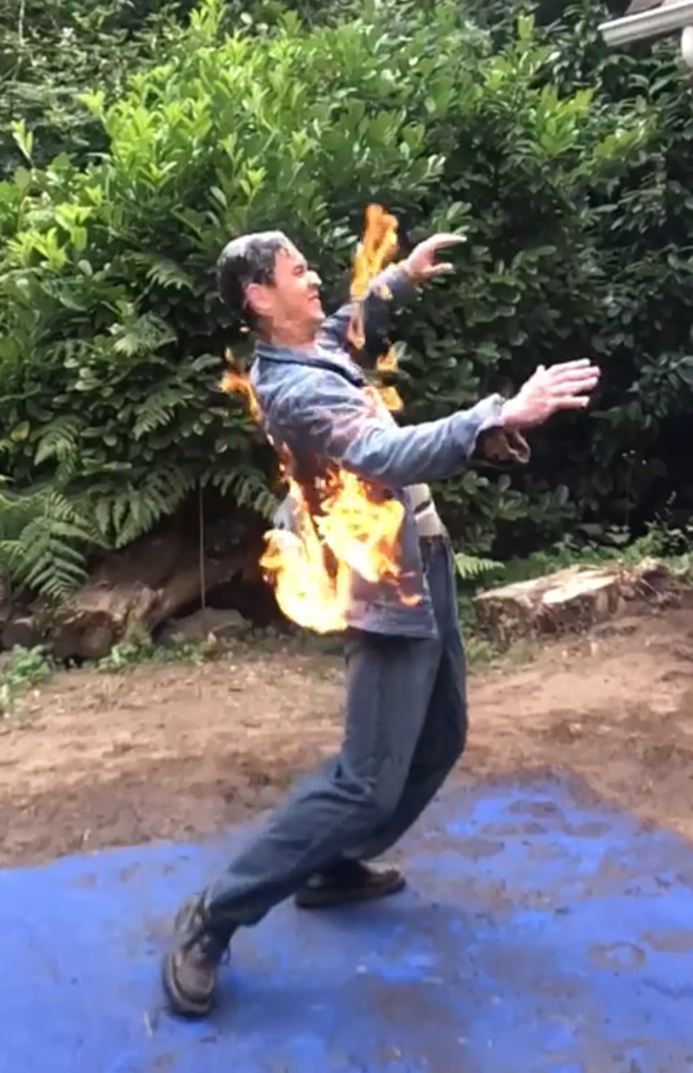

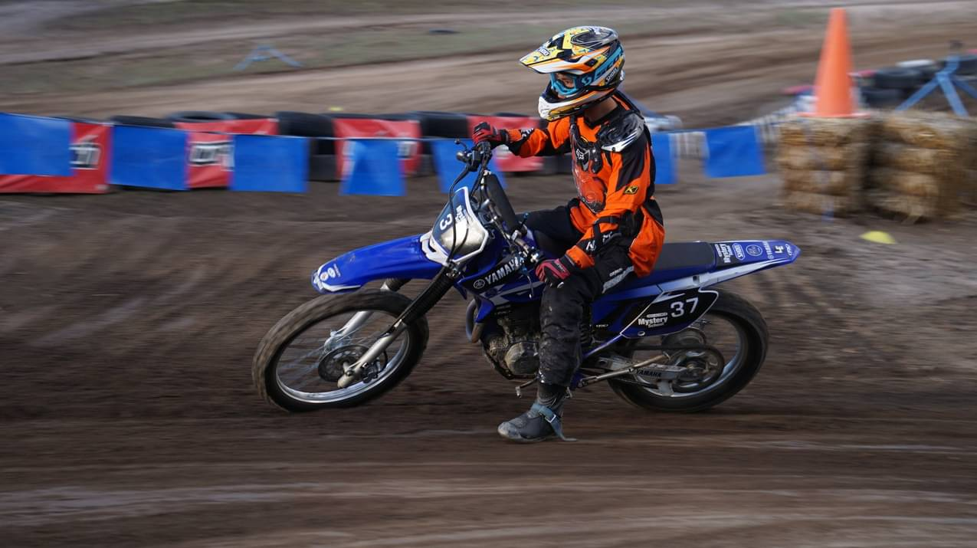
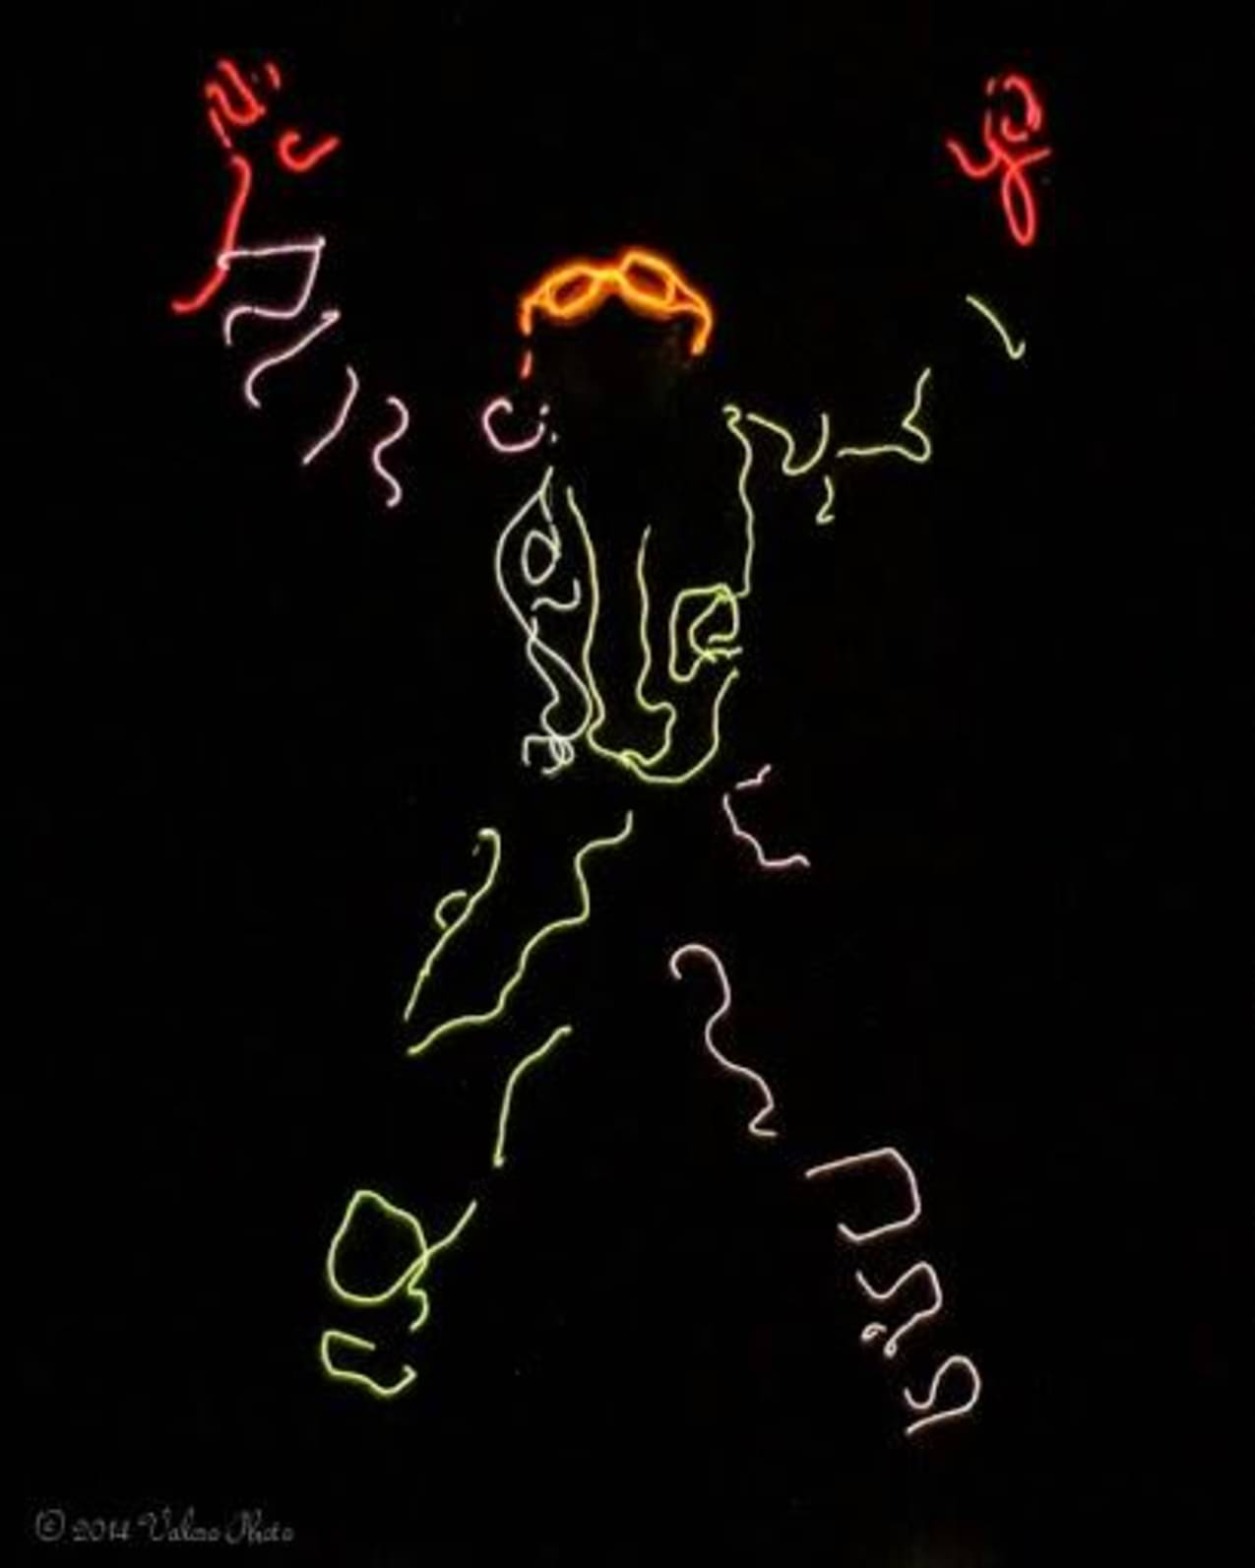
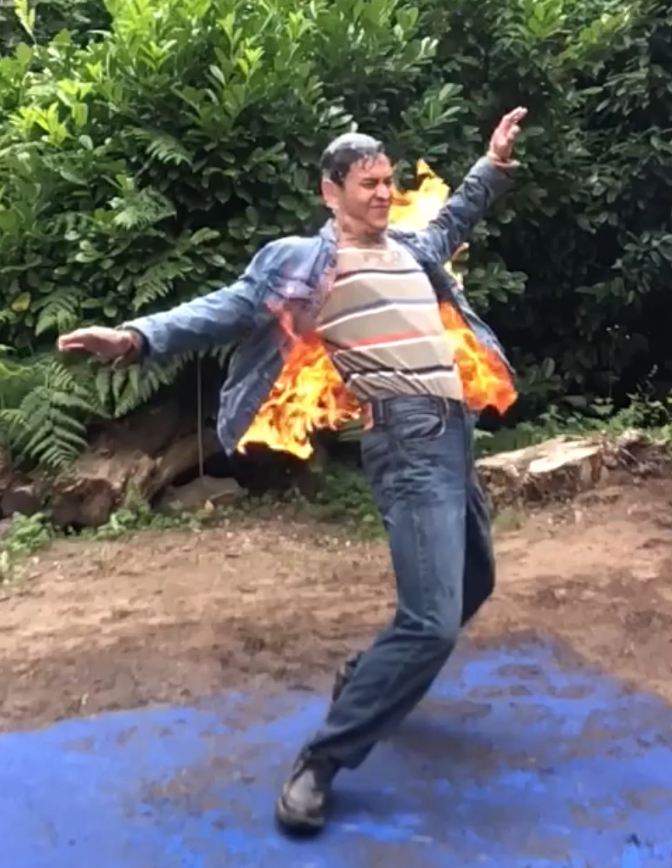

Slide 4
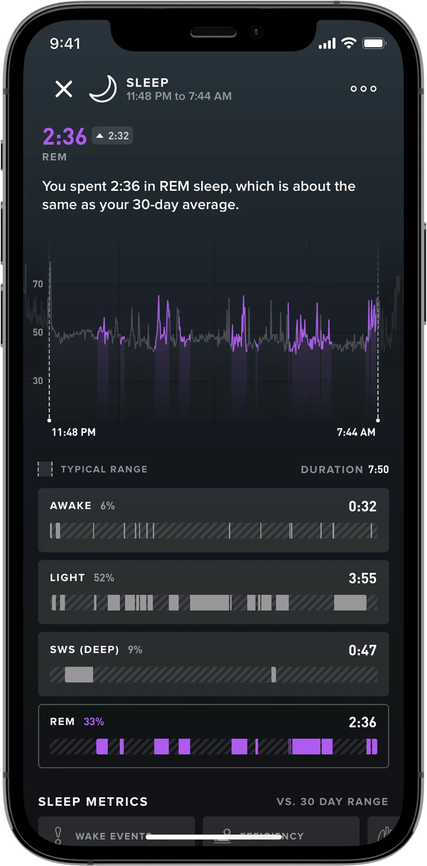
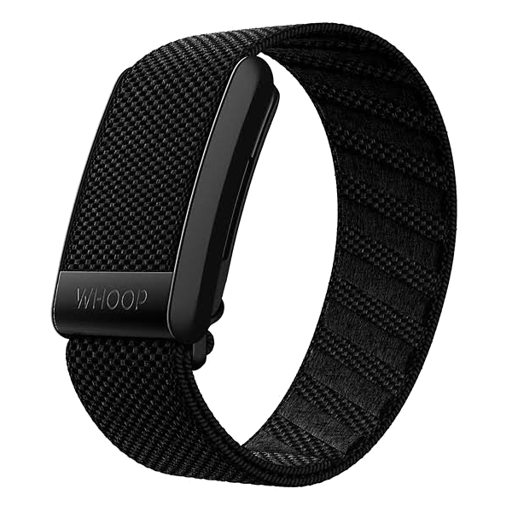

Slide 5
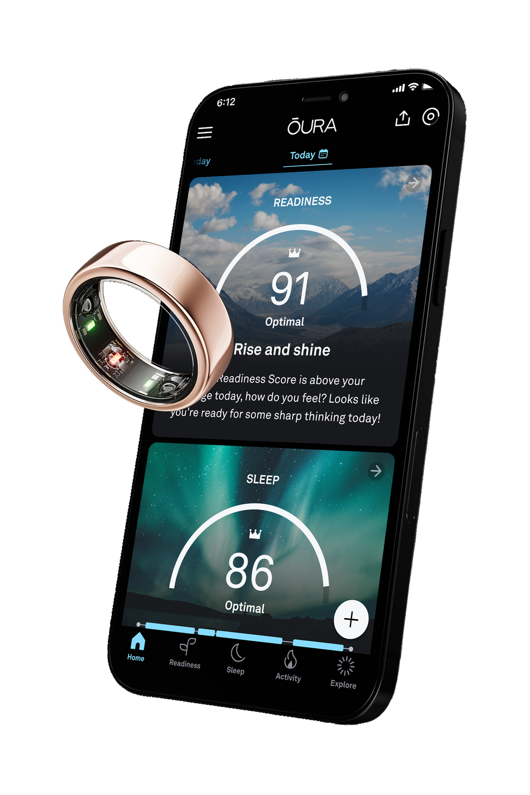

Slide 6
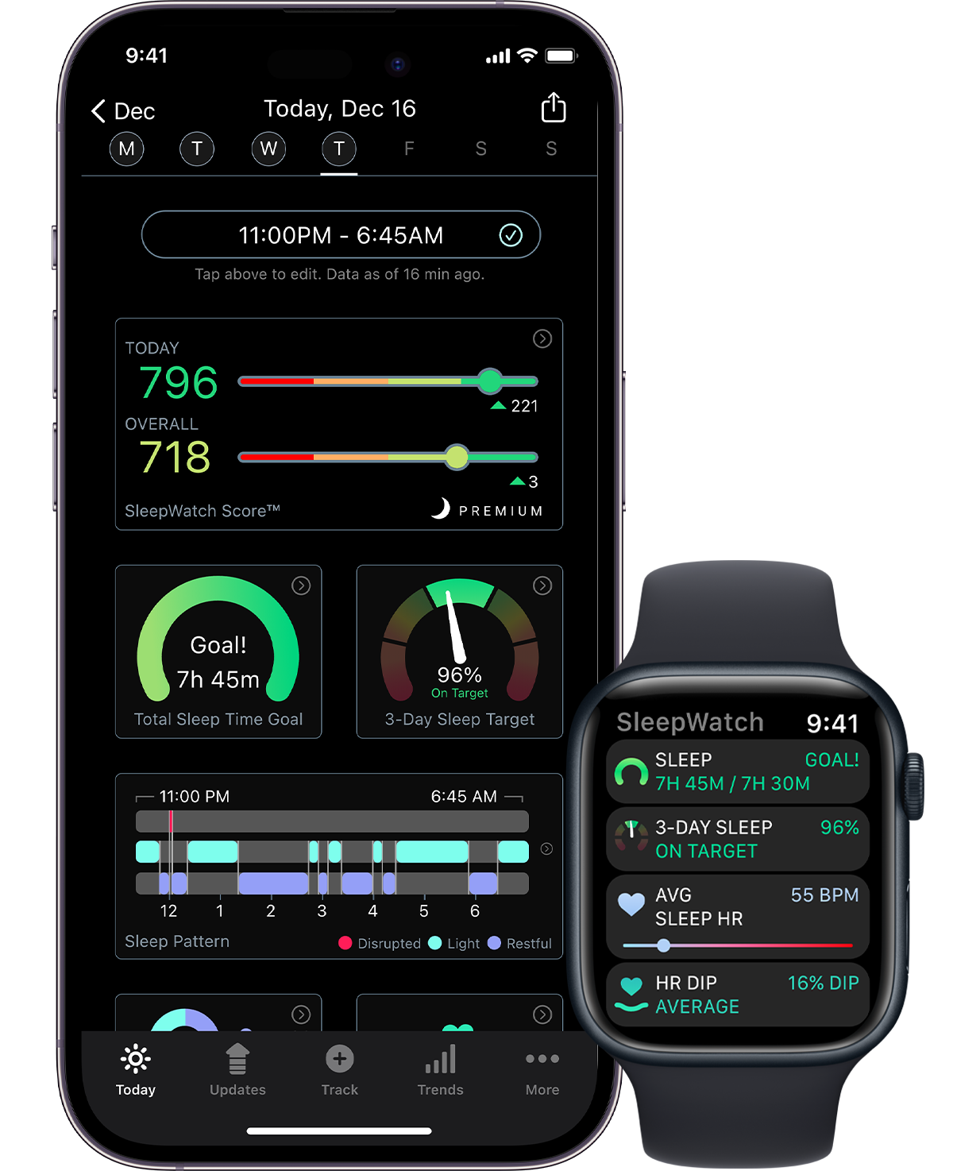

Slide 7
Overview: Motivation
What measurements do these devices actually collect?
What is the relationship between CWST data and PSG data?
How can we put CWST data in context without stifling patient engagement in their sleep/health?
Is there a role for CWST in patient care? What is it?

Slide 8
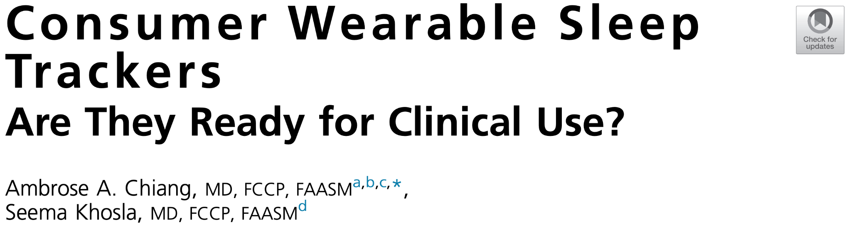
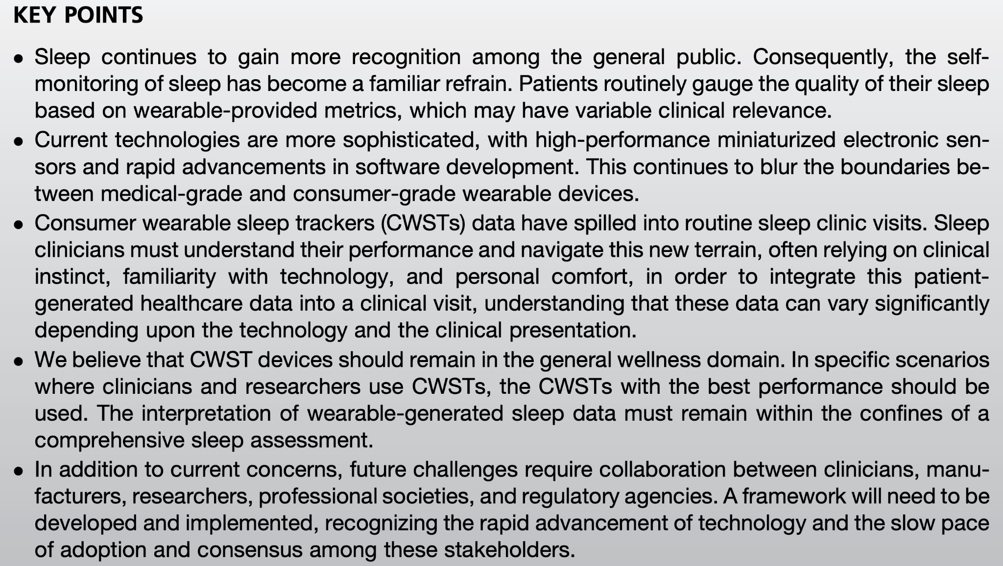

Slide 9
Introduction: Wearable Technology
Photoplethysmography
Accelerometry
Pulse oximetry
Heart rate variability data
Computational advances
  Artificial intelligence
  Machine learning
  “Deep Learning”
Chiang, A. A., & Khosla, S. (2023). Consumer Wearable Sleep Trackers: Are They Ready for Clinical Use?. Sleep medicine clinics, 18(3), 311–330. https://doi.org/10.1016/j.jsmc.2023.05.005

Slide 10
Introduction: Wearable Technology
Lack of regulatory oversight
Lack of third-party performance assessments
Opaque consumer wearable algorithms/terminology
(e.g., “sleep score”, etc.)
Photoplethysmography
Accelerometry
Pulse oximetry
Heart rate variability data
Computational advances
  Artificial intelligence
  Machine learning
  “Deep Learning”
Chiang, A. A., & Khosla, S. (2023). Consumer Wearable Sleep Trackers: Are They Ready for Clinical Use?. Sleep medicine clinics, 18(3), 311–330. https://doi.org/10.1016/j.jsmc.2023.05.005

Slide 11
Medical-grade vs. Consumer-grade
Medical-grade:
  Cleared by the U.S. Food & Drug Administration (FDA)
    Paper specifies “class II device” – more on this later
    Cost of 510(k) clearance for class II device in 2022: $30,000-44,000
More difficult lately to distinguish due to increasing acceptance of overwhelming barrage of (often high-quality) consumer devices
Chiang, A. A., & Khosla, S. (2023). Consumer Wearable Sleep Trackers: Are They Ready for Clinical Use?. Sleep medicine clinics, 18(3), 311–330. https://doi.org/10.1016/j.jsmc.2023.05.005
Notes:
I - compression stockings, tongue depressor
II - blood pressure cuff, syringe
III - Inspire, artificial heart valve

Slide 12
FDA Classifications (for Devices)
Class 1 - low risk
  Tongue depressor
  Compression stockings
Class 2 - medium risk
  Blood pressure cuff
  Syringe
Class 3 - high risk
  Inspire II nerve stimulator
  Artificial heart valve
General wellness or sports use
FDA-listed or registered
FDA-cleared
FDA-approved
Rigorous diagnostics or treatment
Notes:
I - compression stockings, tongue depressor
II - blood pressure cuff, syringe
III - Inspire, artificial heart valve

Slide 13
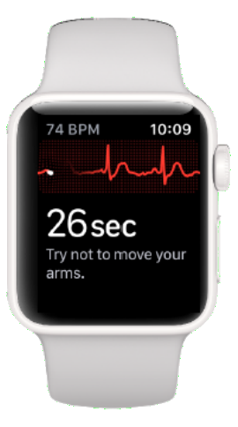
Medical-grade vs. Consumer-grade
Mixed medical/consumer-grade within a single device
  FDA clearance for arrhythmia detection is becoming more common
  FDA clearance for (non-fingertip) pulse ox is less common
For example, Apple Watch comes with 8 health-related apps pre-installed, but only the ECG app is FDA-cleared (and two 3rd party apps are FDA-cleared: StrivePD and NaturalCycles)
Chiang, A. A., & Khosla, S. (2023). Consumer Wearable Sleep Trackers: Are They Ready for Clinical Use?. Sleep medicine clinics, 18(3), 311–330. https://doi.org/10.1016/j.jsmc.2023.05.005
Notes:
ECG app on apple is FDA approved for afib detection and logging afib history for people age 22 years or older
I - compression stockings, tongue depressor
II - blood pressure cuff, syringe
III - Inspire, artificial heart valve

Slide 14
Medical-grade vs. Consumer-grade
FDA registration vs. FDA clearance
  FDA-registered class I devices
    General wellness
    Sports use
  FDA-cleared class II devices
    Diagnostics
    Treatment of disease
Relatively easy to achieve
Requires rigorous testing against “gold standard”
Chiang, A. A., & Khosla, S. (2023). Consumer Wearable Sleep Trackers: Are They Ready for Clinical Use?. Sleep medicine clinics, 18(3), 311–330. https://doi.org/10.1016/j.jsmc.2023.05.005
Notes:
ECG app on apple is FDA approved for afib detection and logging afib history for people age 22 years or older
I - compression stockings, tongue depressor
II - blood pressure cuff, syringe
III - Inspire, artificial heart valve

Slide 15
Medical-grade vs. Consumer-grade
FDA registration vs. FDA clearance
  FDA-registered class I devices
    General wellness
    Sports use
  FDA-cleared class II devices
    Diagnostics
    Treatment of disease
“...it is appropriate for an FDA-registered CWST to explore, track, and record sleep as part of a healthy lifestyle, but unfitting for the device to diagnose or treat a disease/condition.”
Chiang, A. A., & Khosla, S. (2023). Consumer Wearable Sleep Trackers: Are They Ready for Clinical Use?. Sleep medicine clinics, 18(3), 311–330. https://doi.org/10.1016/j.jsmc.2023.05.005
Notes:
ECG app on apple is FDA approved for afib detection and logging afib history for people age 22 years or older
I - compression stockings, tongue depressor
II - blood pressure cuff, syringe
III - Inspire, artificial heart valve

Slide 16
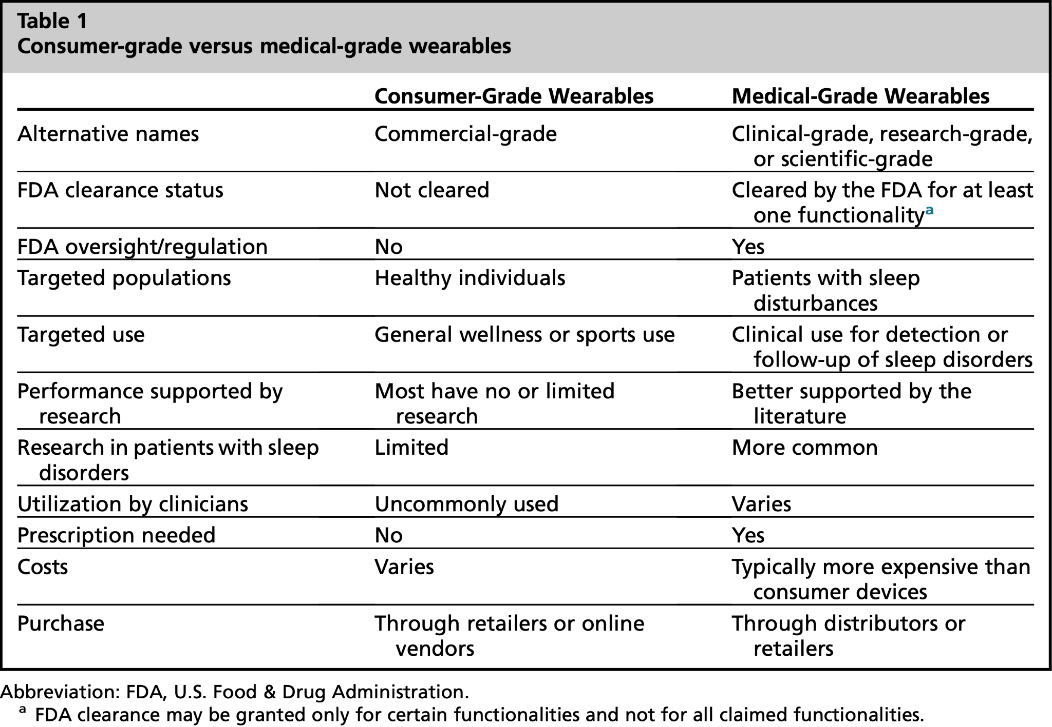
Medical-grade vs. Consumer-grade
Chiang, A. A., & Khosla, S. (2023). Consumer Wearable Sleep Trackers: Are They Ready for Clinical Use?. Sleep medicine clinics, 18(3), 311–330. https://doi.org/10.1016/j.jsmc.2023.05.005
Notes:
ECG app on apple is FDA approved for afib detection and logging afib history for people age 22 years or older
I - compression stockings, tongue depressor
II - blood pressure cuff, syringe
III - Inspire, artificial heart valve

Slide 17
Hardware Advances: Sensor Miniaturization
Multi-sensor CWSTs usually rely primarily on:
  Photoplethysmography (PPG) - IR light absorption
  3-axis accelerometer - physical acceleration/gravity
They may also contain
  Gyroscope(s) - rotation/orientation
  Temperature sensor
Chiang, A. A., & Khosla, S. (2023). Consumer Wearable Sleep Trackers: Are They Ready for Clinical Use?. Sleep medicine clinics, 18(3), 311–330. https://doi.org/10.1016/j.jsmc.2023.05.005

Slide 18
Software Advances: Beyond “If-Then”
Artificial intelligence (AI)
Machine learning (ML)
Deep learning (DL) neural networks
Smaller/cheaper CWST sensors → large datasets → ability to extrapolate findings from more subtle and complex input signals using AI/ML/DL retraining
“AI/ML/DL algorithms using PPG signals can enable sleep stage classification, OSA detection, and apnea severity categorization.”
Chiang, A. A., & Khosla, S. (2023). Consumer Wearable Sleep Trackers: Are They Ready for Clinical Use?. Sleep medicine clinics, 18(3), 311–330. https://doi.org/10.1016/j.jsmc.2023.05.005

Slide 19
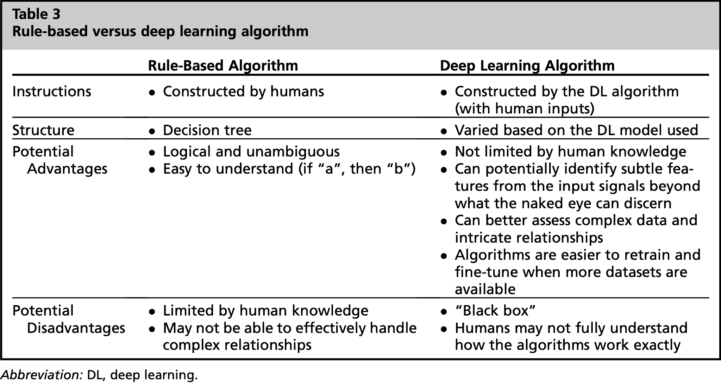
Software Advances: Beyond “If-Then”
Chiang, A. A., & Khosla, S. (2023). Consumer Wearable Sleep Trackers: Are They Ready for Clinical Use?. Sleep medicine clinics, 18(3), 311–330. https://doi.org/10.1016/j.jsmc.2023.05.005

Slide 20
CWSTs and Sleep
“...medical-grade actigraphy devices tend to:...”
  Overestimate sleep
    Sensitivity 0.91-0.96
  Underestimate wakefulness
    Specificity for sleep 0.34-0.63
Chiang, A. A., & Khosla, S. (2023). Consumer Wearable Sleep Trackers: Are They Ready for Clinical Use?. Sleep medicine clinics, 18(3), 311–330. https://doi.org/10.1016/j.jsmc.2023.05.005

Slide 21
CWSTs and Sleep
CWSTs that rely on accelerometer (Fitbit, Jawbone) function similarly
  SN 0.97-0.98
  SP 0.20-0.42
Wrist/hand-worn accelerometers perform closer to clinical actigraphy
  Wrist (Apple Watch, Fitbit Charge, Alta HR)
    SN 0.93-0.98
    SP 0.51-0.69
  Ring (Oura)
    SN 0.96
    SP 0.41-0.48
Chiang, A. A., & Khosla, S. (2023). Consumer Wearable Sleep Trackers: Are They Ready for Clinical Use?. Sleep medicine clinics, 18(3), 311–330. https://doi.org/10.1016/j.jsmc.2023.05.005

Slide 22
CWSTs and Sleep
Combining actigraphy with PPG (Apple Watch 6+, Garmin Forerunner, Polar Vantage V, Oura ring 2+, Whoop 3+, Somfit) - study of n=53
  SN 0.90-0.97
  SP 0.26-0.51
  Variability between devices
    κ = 0.30-0.51
    Wide variability in total sleep time accuracy
Chiang, A. A., & Khosla, S. (2023). Consumer Wearable Sleep Trackers: Are They Ready for Clinical Use?. Sleep medicine clinics, 18(3), 311–330. https://doi.org/10.1016/j.jsmc.2023.05.005

Slide 23
Analyses of CWSTs Worn during PSG
Chinoy et al., 2022
  4 CWSTs: Fatigue Science Readiband, Fitbit Alta HR, Garmin Fenix 5S, Garmin Vivosmart 3
    High sensitivity in detecting sleep
    Low specificity (poor wake detection), SP 0.18-0.54
Chiang, A. A., & Khosla, S. (2023). Consumer Wearable Sleep Trackers: Are They Ready for Clinical Use?. Sleep medicine clinics, 18(3), 311–330. https://doi.org/10.1016/j.jsmc.2023.05.005

Slide 24
Analyses of CWSTs Worn during PSG
Chinoy et al., 2022
  4 CWSTs: Fatigue Science Readiband, Fitbit Alta HR, Garmin Fenix 5S, Garmin Vivosmart 3
    High sensitivity in detecting sleep
    Low specificity (poor wake detection), SP 0.18-0.54
Fitbit Alta HR, SP = 0.54
ActiWatch, SP = 0.35-0.39
Chiang, A. A., & Khosla, S. (2023). Consumer Wearable Sleep Trackers: Are They Ready for Clinical Use?. Sleep medicine clinics, 18(3), 311–330. https://doi.org/10.1016/j.jsmc.2023.05.005

Slide 25
Analyses of CWSTs Worn during PSG
Chinoy et al., 2022
  4 CWSTs: Fatigue Science Readiband, Fitbit Alta HR, Garmin Fenix 5S, Garmin Vivosmart 3
    High sensitivity in detecting sleep
    Low specificity (poor wake detection), SP 0.18-0.54
Epoch by epoch (EBE) detection/agreement N1+N2 vs. N3 vs. REM ~ 50s-60s% accurate, with some reports from newer devices in the 70s% to low 80s%
Chiang, A. A., & Khosla, S. (2023). Consumer Wearable Sleep Trackers: Are They Ready for Clinical Use?. Sleep medicine clinics, 18(3), 311–330. https://doi.org/10.1016/j.jsmc.2023.05.005

Slide 26
Performance in Assessing Sleep Disorders
Sleep vs. wake CWST performance is at best 50s-60s% accurate in healthy young adults, and they tend to miss fragmentation
We therefore expect poorer performance in fragmented/disturbed sleep
Adults with insomnia - poorer performance than healthy subjects
Children with OSA - “comparable to Actiwatch 2” referring to sleep/wake detection, overall poor performance
Hypersomnia - AASM actigraphy CPG indicates that even medical actigraphy cannot even be used to replace PSG prior to MSLT
Chiang, A. A., & Khosla, S. (2023). Consumer Wearable Sleep Trackers: Are They Ready for Clinical Use?. Sleep medicine clinics, 18(3), 311–330. https://doi.org/10.1016/j.jsmc.2023.05.005

Slide 27
Pulse Oximetry
Fingertip has more vascular distribution–better for SPO2
Back of wrist – worse for accuracy, better for convenience
  More variability in vasculature, less in general
  Poorer contact
    More sweat
    More hair
    Thicker skin
    Possible tattoos
Technology for pulse ox improved during COVID-19 due to demand
Chiang, A. A., & Khosla, S. (2023). Consumer Wearable Sleep Trackers: Are They Ready for Clinical Use?. Sleep medicine clinics, 18(3), 311–330. https://doi.org/10.1016/j.jsmc.2023.05.005

Slide 28
Pulse Oximetry: Skin Pigmentation
Pulse ox is less accurate on darker skin pigmentation
2013 FDA guidance: >15% darkly pigmented premarket participants
CWSTs (usually) use green light, PPG-based devices use IR or red light
Sjoding et al. retrospectively found in 2 large cohorts that “black patients had nearly three times the frequency of occult hypoxemia” (defined as SaO2 of <88% despite SpO2 of 92%-96% on finger pulse oximetry)
2021 FDA guidance to emphasize the limitations of FDA-cleared pulse oximeters (best at 90%, worst <80%, affected by skin pigmentation)
Chiang, A. A., & Khosla, S. (2023). Consumer Wearable Sleep Trackers: Are They Ready for Clinical Use?. Sleep medicine clinics, 18(3), 311–330. https://doi.org/10.1016/j.jsmc.2023.05.005

Slide 29
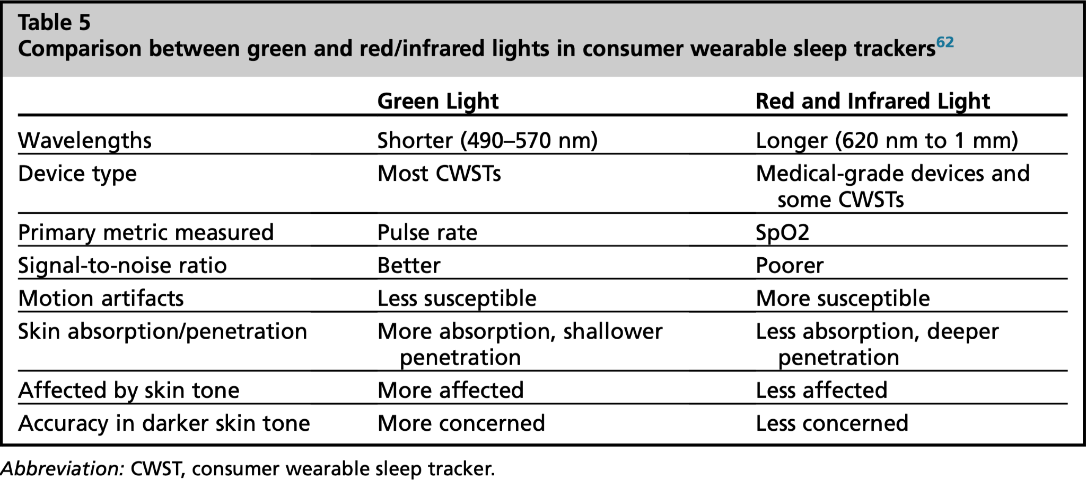
Chiang, A. A., & Khosla, S. (2023). Consumer Wearable Sleep Trackers: Are They Ready for Clinical Use?. Sleep medicine clinics, 18(3), 311–330. https://doi.org/10.1016/j.jsmc.2023.05.005

Slide 30
Pulse Oximetry: Skin Pigmentation
Only 1 device (Withings ScanWatch) has FDA-clearance for pulse ox
  ODIs should be interpreted with this in mind
SLEEPON Go2sleep is a fingertip device
  No part of the device is FDA-cleared
  Smartphone app reports an “AHI”
  No guidance from manufacturer about how this is calculated or how to use it.
Chiang, A. A., & Khosla, S. (2023). Consumer Wearable Sleep Trackers: Are They Ready for Clinical Use?. Sleep medicine clinics, 18(3), 311–330. https://doi.org/10.1016/j.jsmc.2023.05.005

Slide 31
Heart Rate Variability
R-R interval on ECG, can be estimated by the peak-peak interval on PPG
  Indirect measurement of autonomic nervous system
  Depends on:
    Age
    Gender
    Physical fitness
    “Overall health” - low HRV associated with all-cause death and cardiovascular events
Chiang, A. A., & Khosla, S. (2023). Consumer Wearable Sleep Trackers: Are They Ready for Clinical Use?. Sleep medicine clinics, 18(3), 311–330. https://doi.org/10.1016/j.jsmc.2023.05.005

Slide 32
Heart Rate Variability
HRV and pulse rate variability (PRV) are not the same
  Clinical studies specifically use HRV, which is affected by QRS complex morphology
  “Few studies have examined the correlation between CWST PRV and ECG HRV metrics, and even fewer have investigated PRV during sleep.”
Clinical research on HRV has identified a number of associations to small changes, unclear utility as a clinical target
HRV is affected by many variables
Chiang, A. A., & Khosla, S. (2023). Consumer Wearable Sleep Trackers: Are They Ready for Clinical Use?. Sleep medicine clinics, 18(3), 311–330. https://doi.org/10.1016/j.jsmc.2023.05.005

Slide 33
Heart Rate Variability
HRV and pulse rate variability (PRV) are not the same
  Clinical studies specifically use HRV, which is affected by QRS complex morphology
  “Few studies have examined the correlation between CWST PRV and ECG HRV metrics, and even fewer have investigated PRV during sleep.”
  “PRV was a poor surrogate for HRV under free-living conditions”
  “HRV-PRV difference may increase with OSA and vascular aging.”
Clinical research on HRV has identified a number of associations to small changes, unclear utility as a clinical target
Chiang, A. A., & Khosla, S. (2023). Consumer Wearable Sleep Trackers: Are They Ready for Clinical Use?. Sleep medicine clinics, 18(3), 311–330. https://doi.org/10.1016/j.jsmc.2023.05.005

Slide 34
Heart Rate Variability
PRV however is acceptably accurate, even with noise in PPG signal
More CWST data: many hours every day, compared to 5-minute average (or overnight average)
Chiang, A. A., & Khosla, S. (2023). Consumer Wearable Sleep Trackers: Are They Ready for Clinical Use?. Sleep medicine clinics, 18(3), 311–330. https://doi.org/10.1016/j.jsmc.2023.05.005

Slide 35
Heart Rate Variability
Growing body of research on associations to sub-components of HRV:
  Standard deviation of beat-to-beat intervals over 24 hrs (SDNN) is associated with lower all-cause morbidity and mortality
  Multiple measures associated with parasympathetic activity:
    Root mean square of successive differences (RMSDD)
    Fraction of beat-to-beat intervals that differ by >50 ms (PNN50)
    Spectral density of “high frequency” beats (0.15 to 0.4 Hz)
  Others seem related to sympathetic activity
    Spectral density of “low frequency” beats (0.04 to 0.15 Hz)
  Still others have been associated with baroreflex activity and the function of the renin-angiotensin system, but mostly they are associated with the autonomic nervous system
Chiang, A. A., & Khosla, S. (2023). Consumer Wearable Sleep Trackers: Are They Ready for Clinical Use?. Sleep medicine clinics, 18(3), 311–330. https://doi.org/10.1016/j.jsmc.2023.05.005

Slide 36
Use Cases: Healthy Patient Sleep Tracking/Log
Consumer-initiated (more accessible or obtained for non-sleep reason)
This indication would be consistent with FDA classification
Small but significant improvement in PROMIS score w/ use of Whoop 2
Chiang, A. A., & Khosla, S. (2023). Consumer Wearable Sleep Trackers: Are They Ready for Clinical Use?. Sleep medicine clinics, 18(3), 311–330. https://doi.org/10.1016/j.jsmc.2023.05.005

Slide 37
Use Cases: Sleep Disorder Tracking - Independent
Consumer-initiated, with implication that adjustments would be made based on findings from CWST
This would be inconsistent with FDA recommendation for consumer devices (not restricted to general wellness)
Prevalence of this scenario has not been investigated
Chiang, A. A., & Khosla, S. (2023). Consumer Wearable Sleep Trackers: Are They Ready for Clinical Use?. Sleep medicine clinics, 18(3), 311–330. https://doi.org/10.1016/j.jsmc.2023.05.005

Slide 38
Use Cases: Sleep Disorder Tracking - Guided
Consumer-initiated, with data shared with clinician who can contextualize findings with patient’s medical assessment
Orthosomnia:
  excessive preoccupation with improving/perfecting CWST data
  Can be a barrier to effective CBT-I (negative perception of sleep)
Chiang, A. A., & Khosla, S. (2023). Consumer Wearable Sleep Trackers: Are They Ready for Clinical Use?. Sleep medicine clinics, 18(3), 311–330. https://doi.org/10.1016/j.jsmc.2023.05.005

Slide 39
Use Cases: Sleep Disorder Tracking - Directed
Clinician-initiated or researcher-initiated, with patient collaboration
E.g., Philips Actiwatch series discontinuation after December 29, 2022
Chiang, A. A., & Khosla, S. (2023). Consumer Wearable Sleep Trackers: Are They Ready for Clinical Use?. Sleep medicine clinics, 18(3), 311–330. https://doi.org/10.1016/j.jsmc.2023.05.005

Slide 40
Use Cases: Medical-Grade Wearable Use
Usually clinician-initiated or researcher-initiated
Approval of commercial devices with FDA:
  Software as medical devices (SaMDs) for OSA detection
  Updates to software for devices with appropriate sensor technology
Chiang, A. A., & Khosla, S. (2023). Consumer Wearable Sleep Trackers: Are They Ready for Clinical Use?. Sleep medicine clinics, 18(3), 311–330. https://doi.org/10.1016/j.jsmc.2023.05.005

Slide 41
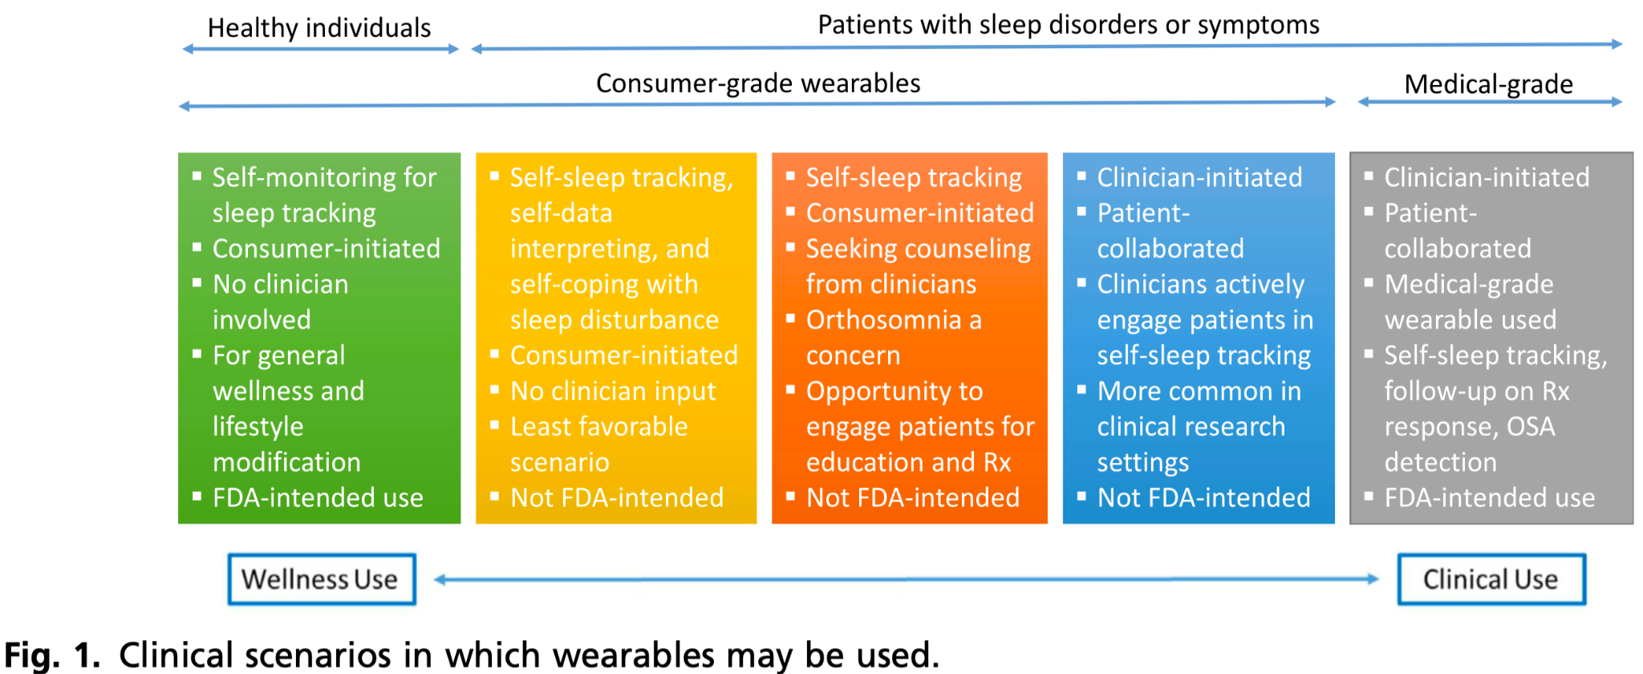
Chiang, A. A., & Khosla, S. (2023). Consumer Wearable Sleep Trackers: Are They Ready for Clinical Use?. Sleep medicine clinics, 18(3), 311–330. https://doi.org/10.1016/j.jsmc.2023.05.005

Slide 42
Recommendations: Areas of Concern
“...line between consumer-grade and medical-grade devices is blurry at best” as technology becomes more “sophisticated”
“Performance analysis for individual devices is time-consuming”
Device validation testing/research continues to lag
2018 SLEEP meeting included a workshop recommending guidelines for performing/interpreting results from wearable device research
Unintended consequences for health disparity (e.g., access to medical care vs. CWST, access to quality CWST, target audiences/consumers)
Chiang, A. A., & Khosla, S. (2023). Consumer Wearable Sleep Trackers: Are They Ready for Clinical Use?. Sleep medicine clinics, 18(3), 311–330. https://doi.org/10.1016/j.jsmc.2023.05.005

Slide 43
Recommendations: Clinician Use of CWSTs
Barriers
  CWST data interpretation training/accuracy
  Malpractice liability related to use of nonmedical devices
  Lack of reimbursement for interpretation of CWST data
  Cybersecurity, privacy, and incorporation of CWST data into EMR
Benefits (not listed in paper)
  Patient engagement
  Data from more natural environment
  Often more aggregate data
Chiang, A. A., & Khosla, S. (2023). Consumer Wearable Sleep Trackers: Are They Ready for Clinical Use?. Sleep medicine clinics, 18(3), 311–330. https://doi.org/10.1016/j.jsmc.2023.05.005

Slide 44
Recommendations: Future Trends
Happy Ring
  Electrodermal activity
  PPG
  Accelerometry
  Temperature data
  Wakefulness SP 0.70 (general) and 0.83 (personalized)
Evie ring - seeking FDA clearance for pulse ox
Earables - sensor advantage using external auditory canal (over wrist)
Chiang, A. A., & Khosla, S. (2023). Consumer Wearable Sleep Trackers: Are They Ready for Clinical Use?. Sleep medicine clinics, 18(3), 311–330. https://doi.org/10.1016/j.jsmc.2023.05.005

Slide 45
Recommendations: Summary
CWST use in healthy individuals may be an adjunct for general wellness
They cannot diagnose or treat disease
Be alert for “orthosomnia”
Their accuracy is low in patients with sleep disorders
Chiang, A. A., & Khosla, S. (2023). Consumer Wearable Sleep Trackers: Are They Ready for Clinical Use?. Sleep medicine clinics, 18(3), 311–330. https://doi.org/10.1016/j.jsmc.2023.05.005

Slide 46
Discussion
Post-market data collection
  We have the potential to review PSG/HST data and CWST data
What data from CWSTs is high quality?
  Short sleep time (high sensitivity for detecting sleep w/ actigraphy)
  Inconsistent sleep schedule (same way we tend to use actigraphy)
What data from CWSTs is likely to be misleading?
  Oxygen desaturations
  ODI
  AHI

Slide 47
Discussion
Additional Items:
  SnoreLab and similar apps (simple microphone, aggregate data can be easily applied to assessing different interventions)
  Simple finger pulse ox monitoring (Lookee devices)
  Consumer EEG devices
  Consumer-modified devices
  When CWSTs “outperform” medical-grade devices

Slide 48
References
Chiang, A. A., & Khosla, S. (2023). Consumer Wearable Sleep Trackers: Are They Ready for Clinical Use?. Sleep medicine clinics, 18(3), 311–330. https://doi.org/10.1016/j.jsmc.2023.05.005

Slide 49
Questions & Discussion

Slide 50
Thank you

Slide 51
Extra Slides

Slide 52
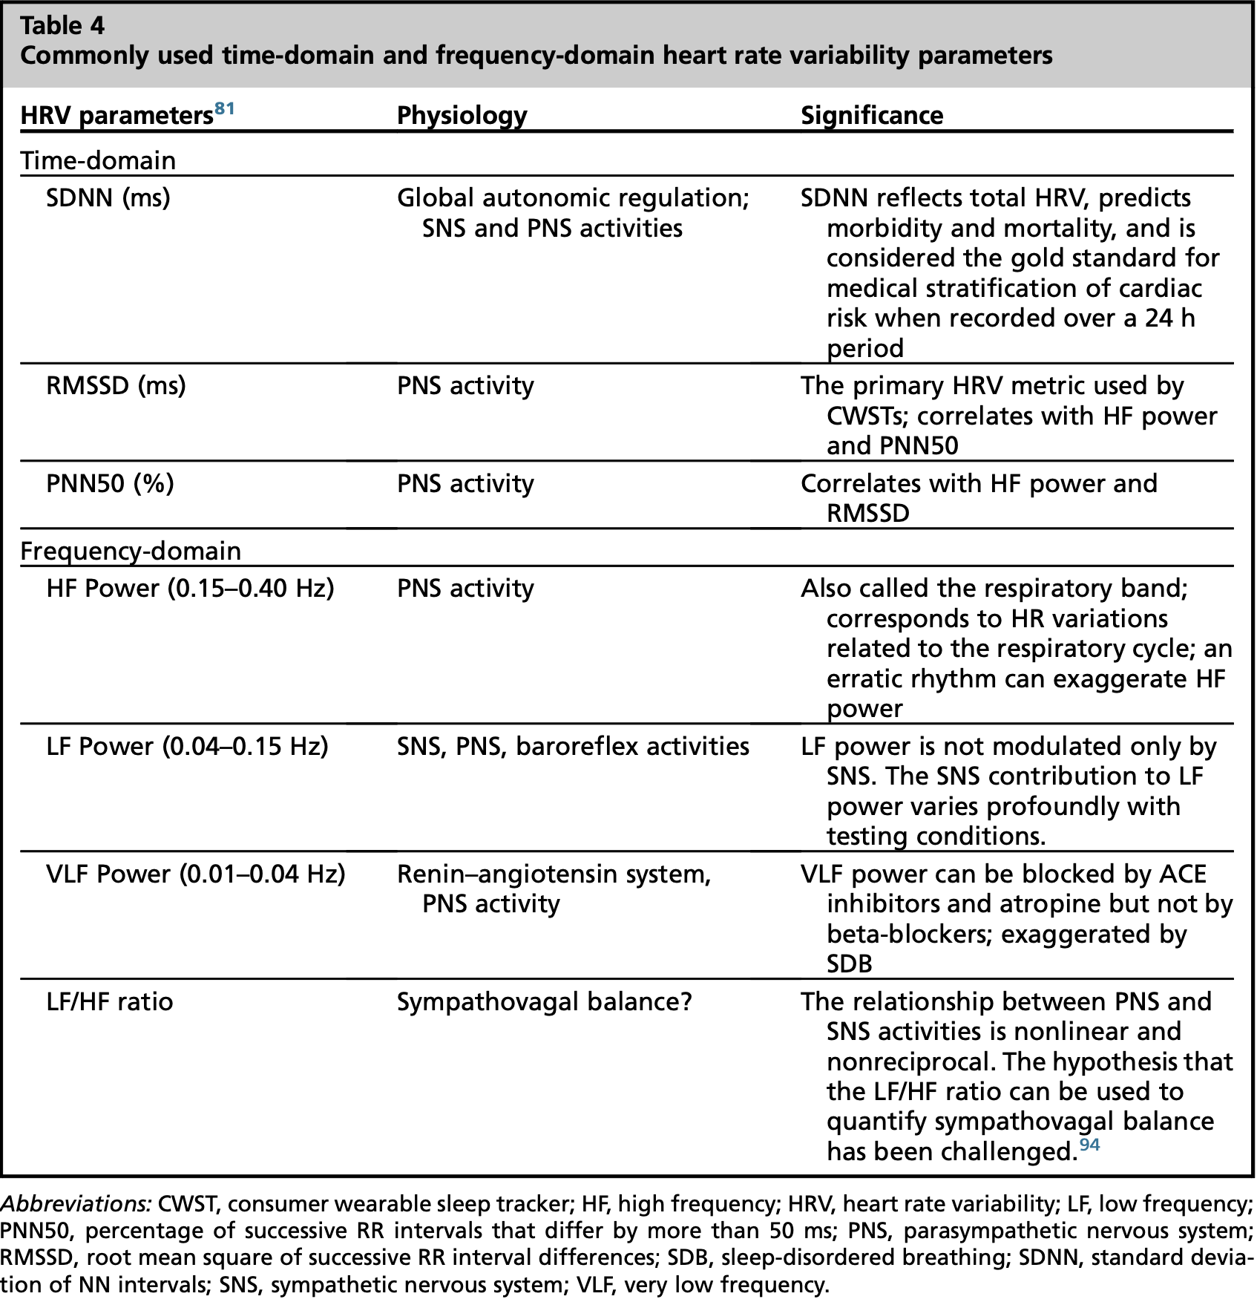
Chiang, A. A., & Khosla, S. (2023). Consumer Wearable Sleep Trackers: Are They Ready for Clinical Use?. Sleep medicine clinics, 18(3), 311–330. https://doi.org/10.1016/j.jsmc.2023.05.005

