Slide 1
What’s My Gargle? Complementary medicine for vocalists
Joel H. Blumin, MD, FACS
Professor
Division of Laryngology & Professional Voice

Slide 2
Learner Objectives
After this presentation you should:
1) Have an understanding about nutrition and supplements thought useful for vocalists

Slide 3
Actual conversation between JHB and choral vocalist
Patient: Do you think I should gargle with ‘x’?
(’x’ was custom mix of raw organic honey and lemon juice)
JHB: If you think that works for you, I have no issue with it. I’ve heard about all the gargles and most are OK. The only ones I would object to are ones that are alcohol based.
Patient: I like to gargle with just a tablespoon of brandy before shows
JHB: <<sigh>>

Slide 4
Best Evidence
Almost everything available on nutrition and supplements specific for singing or voice comes with level V evidence, occasional level IV, or underpowered level III evidence
A lot of what vocalists ingest, or gargle is based on lore, ‘expert’ advice, and personal experience with a high tendency for bias and placebo effect

Slide 5
Nutrition
Meals and performance
Avoid carbonated beverages
Avoid large meals
Don’t want to be bloated or uncomfortable
May trigger reflux, belching
Also, shouldn’t be hungry
Smaller, more frequent meals
Dairy
Presumption that dairy product increase amount or tenacity of laryngopharyngeal mucus
No evidence to this, but many avoid dairy around performances

Slide 6
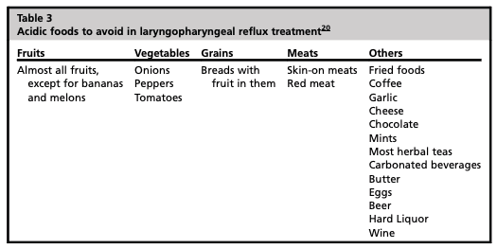
Nutritional
Low-acid diet
>pH5 food to consider
Alkaline water
<pH5 food to avoid
Otherwise, balanced nutritious diets would be recommended

Slide 7
Supplements
Gargles
Sprays
Swallowed (beverage/pill/lozenge)
Intravenous infusions
Almost anything listed can be delivered by any means above

Slide 8
Presumed goals of supplements
Improve performing voice
Reduce vocal effort
Protect performing voice
Increased longevity, reduce fatigue
Protect from injury
Improve performance
Improve overall health, endurance, ability
Anxiolytic/disinhibition
Reduce discomfort or pain
Is this to replace a vocalist’s ability or capability?
Or to augment and supplement?
Most evidence of successful voice is based on training, talent, and behavioral, medical, or surgical management of specific problems

Slide 9
Hydration
Hydrated mucosa functions better than dehydrated mucosa
Best hydration is from…water
‘Pee pale and sing clear’
Very easy, cheap, and safe intervention
Temperature does not matter
Some think ice cold drinks are bad for vocalists

Slide 10
Hydration
Basic science studies show improved rheology or viscoelastic properties of vocal folds that are hydrated
Patient studies with hydration or dehydration (eg: atropine, antihistamines) show inconsistent evidence that this matters with measurements of phonatory threshold pressures (vocal effort)
Large variability, low subject numbers

Slide 11
Desiccation challenge
10 singers/10 non-singers, male, mean age 22 (BYU students)
30-minute oral breathing dry air (<1% humidity), then nebulized saline (3ml or 9ml), crossover
Double blinded but investigators note that all could tell when the air was dry; also, no placebo group
Speaking and singing voice tested
Self perceived effort and dryness worsened and then improved post humidification
However, no changes in physiologic measures of voice (cepstral spectral index of dysphonia or phonation threshold pressure) except with CSID with connected speech
Non-singers had more effort than singers

Slide 12
Gargles
Presumed goals of a gargle
Hydration
Mucolytic
Anesthesia ☹️
Protective coating of larynx/vocal folds
Incorrect assumptions by gargler
The gargle does something to the larynx by direct contact with washing or coating of the vocal folds
The gargler would have to readily penetrate or aspirate to have this happen
Most gargling is an oropharyngeal maneuver

Slide 13
List collected by 8 phoniatricians from Belgium, Canada, Italy, Poland, Portugal, Russia, Turkey, and USA
Western world oriented, did not include traditional Chinese medicine
44 plants, 1 fungus, 1 lichen identified
Some common – eg: tea, ginger, peppermint
Some rare – eg: bitter kola
Singers’ plant (hedge mustard) specific for voice
Aqueous extract, EtOH extract, decoction, tincture, infusion, oil of plant, flower, seeds, bulbs

Slide 14
Abridged list of herbs/flowers
Aconite/monkshood
Agrimony
Bitter kola
Butterbur
Cardamom
Chamomile
Cinnamon
Eucalyptus
Ginger
Globe amaranth
Goldenseal
Green tea
Gum myrrh
Hedge mustard
Hollyhock
Iceland moss
Lemon
Licorice root
Lime flower
Marigold
Mint
Okra
Onion
Oregano
Other citrus
Pasque flower
Pelargonium root
Purple coneflower
Safflower
Sage
Sea buckthorn
Sundew
Thyme
Willow bark

Slide 15
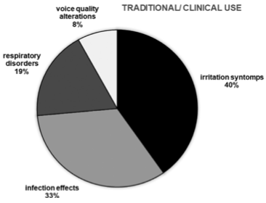

Slide 16
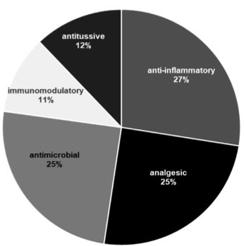
Biological Themes

Slide 17
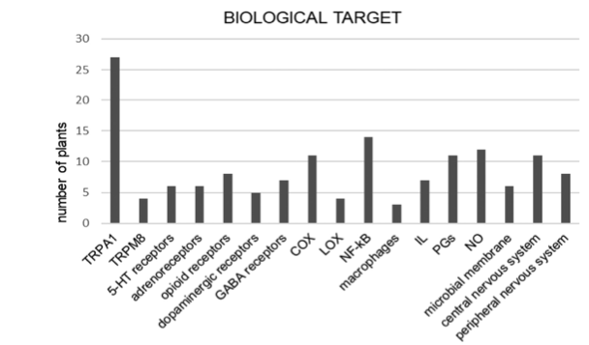
Biological Themes
TRPA1 – nocioceptor and inflammatory pain
TRPM8 – thermosensor, sensation of coolness

Slide 18
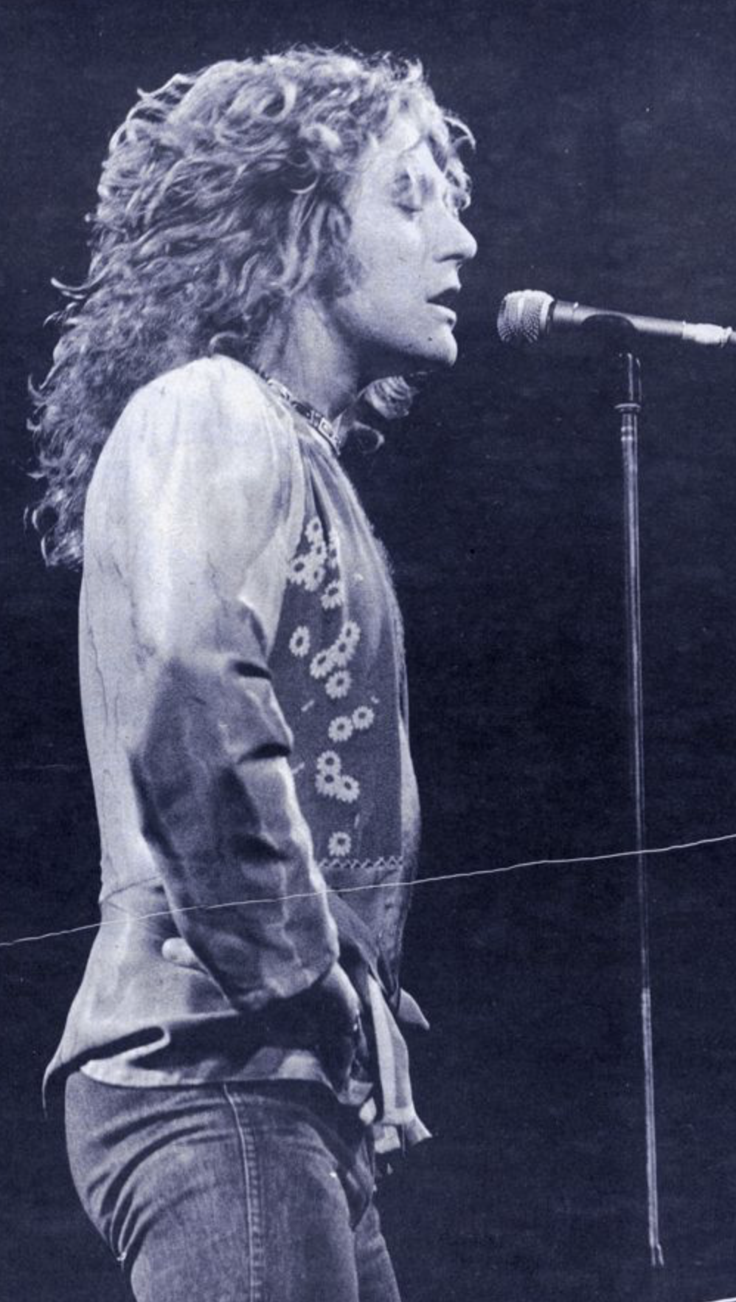
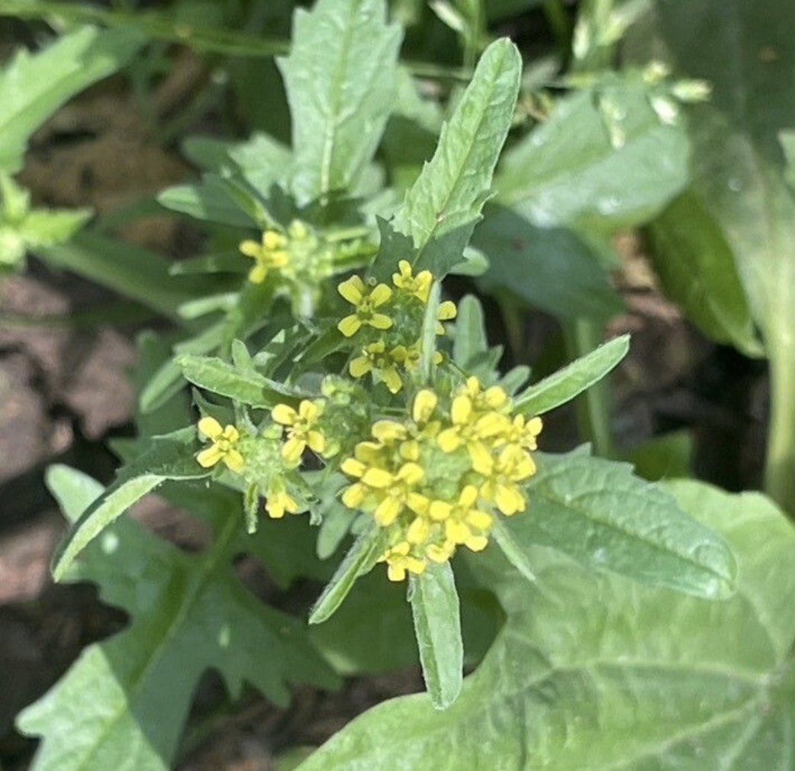
Supplements
Sisymbrium officinale
‘The Singers’ Plant’
Hedge mustard –wild plant common across Europe
First mentioned in 1784 for use in hoarse voice
Common use by opera singers in 19th century
Glucosinolates and isothiocyanate
Stimulate secretion and expectoration
Pungent flavor
TRP1A (nocioception, inflammatory pain) agonist
Plant singing
Singers’ plant

Slide 19
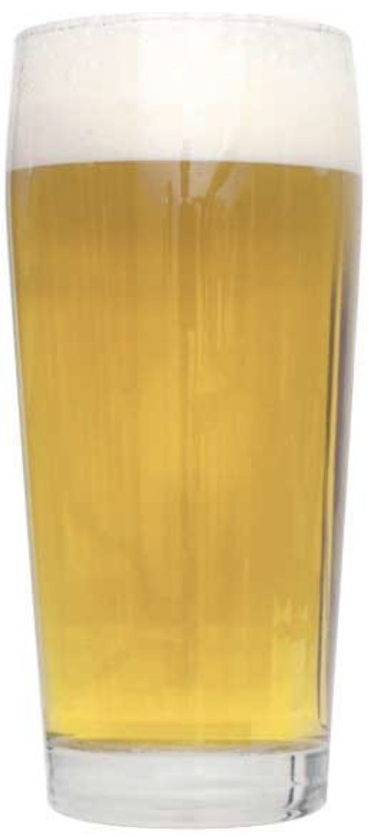
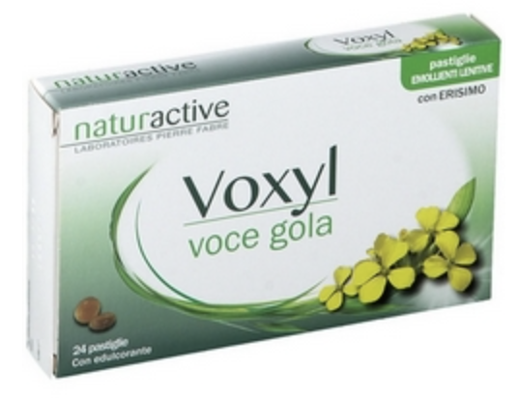
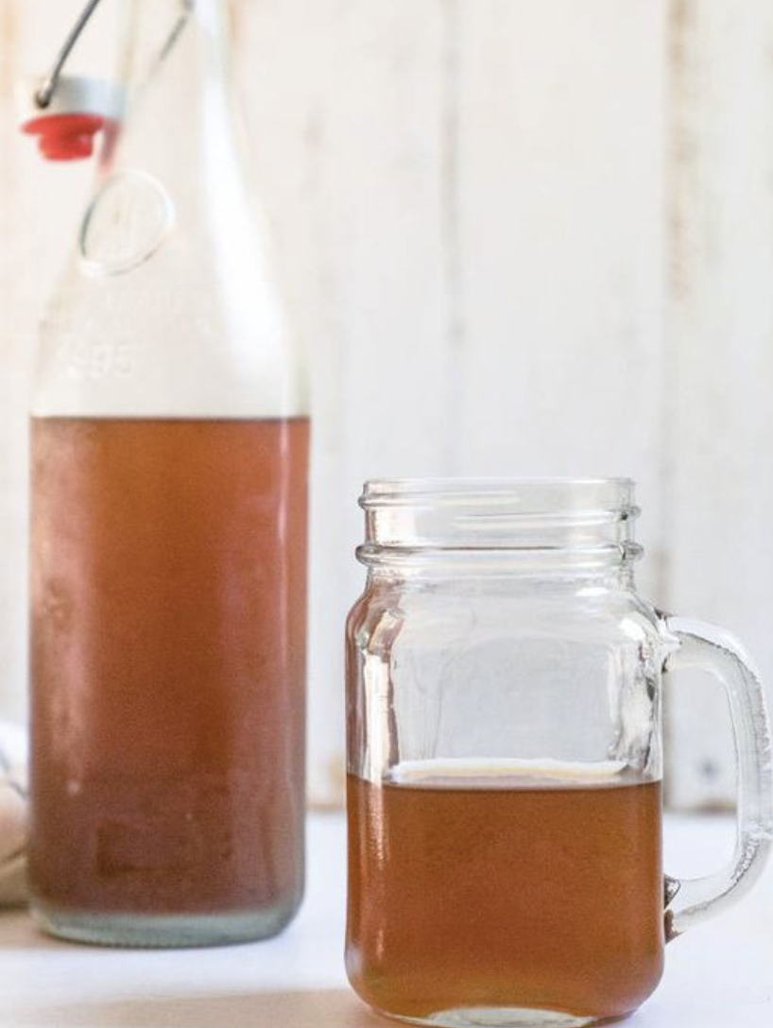
Preparations
Seeds or flowers or both
Dry and seep like tea
Add to water and drink
Add to honey
Kombucha
Add to water and sugar and ferment
Beer – ‘The Singer’s Beer’
Lozenge
Google images

Slide 20
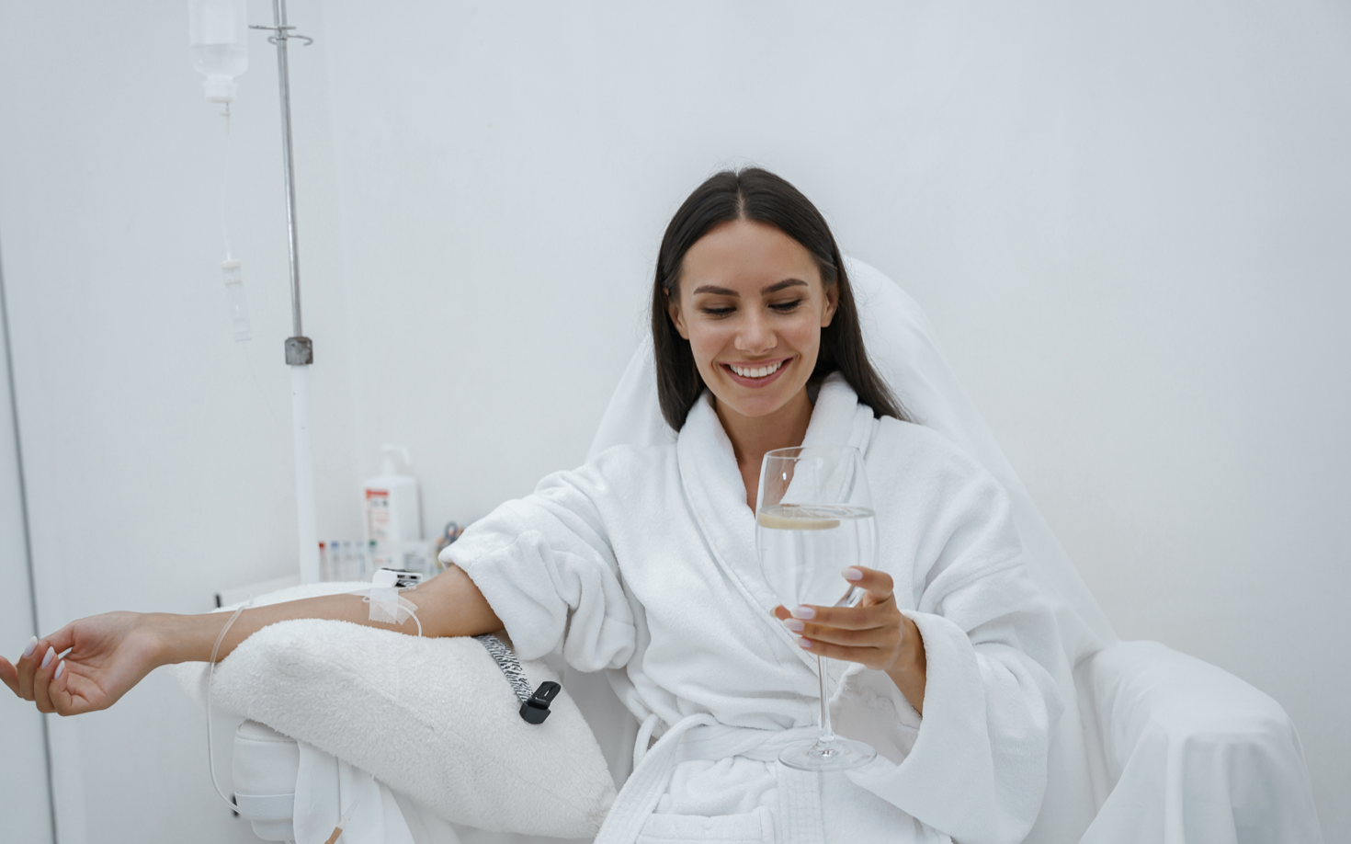
Intravenous medicines
Glutathione
Antioxidant/decreases free radicals
Case report of treatment of polyp
Myer’s cocktail
Magnesium, calcium, selenium, zinc
Vitamins B6, B5, B12, C
Glutathione
Saline
Treats all sort of problems
Asthma, migraine, fatigue, fibromyalgia, muscle spasm, respiratory infections, sinusitis, rhinitis, cardiovascular diseases
Randomized trials show no benefit over placebo
istockphoto/Voronchuk Daria

Slide 21
Summary
There are a lot of herbal or plant products that vocalists use
Most with level of evidence V
Hydration most useful
Recommending water is generally safe, cheap, and easily available
Vocalists feel better, questionable improvement of physiologic function of voice
Avoid drying agents
Anticholinergics, antihistamines, caffeine, smoking, EtOH

