Slide 1
Preventing Burnout in Head and Neck Cancer Physicians and APPs
Michael E. Stadler, MD
Best Evidence ENT
July 29th, 2024
Notes:
Twenty years ago, in its two landmark reports, To Err Is Human:
Building a Safer Health System and Crossing the Quality Chasm: A New
Health System for the 21st Century, the Institute of Medicine (IOM) called
for dramatic attention to the issue of patient safety and more broadly quality
of care. The reports led to major changes in the design of health care
work systems and processes to improve quality of care, and reduce preventable
patient harm. This report, Taking Action Against Clinician Burnout:
A Systems Approach to Professional Well-Being, is a critical follow-up to
these major reports and other reports in the IOM’s Quality Chasm Series,
as it calls attention to the safety, health, and well-being of health care
clinicians.
Quick Answer:
1. You can’t (not now at least…too many barriers and competing forces)
2. Become the CMO of a large hospital 4 months before the pandemic (with limited experience) so that you don’t have to face the reality and root causes of your ongoing clinical burnout
Or, better yet, hire a young budding superstar in the field, promise to mentor him, instead burnout and need to focus on yourself, then stress him and your other two colleagues so that they burnout instead of you?
To prevent it means to first define, understand, recognize, and measure it.

Slide 2
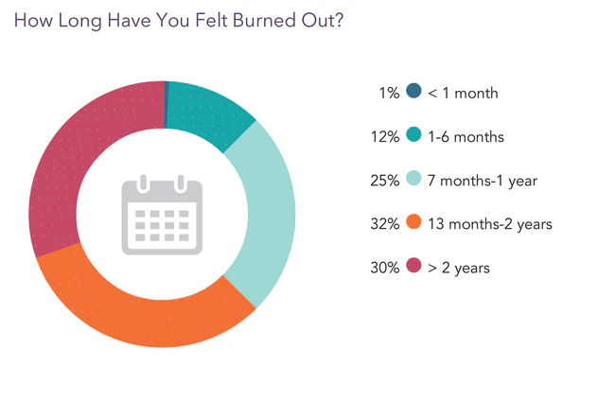
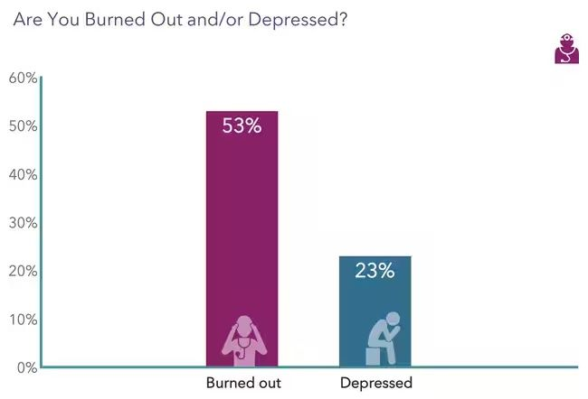
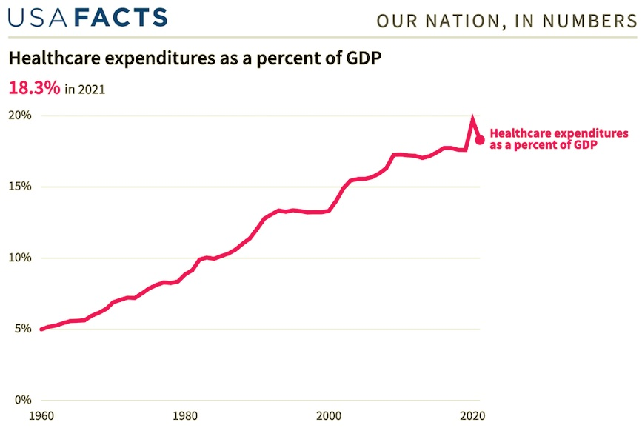
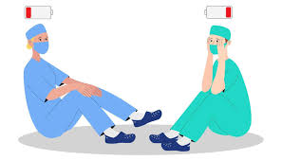
US Healthcare is…
Artist: Maria Kololeeva
Notes:
Tremendously rewarding, a true honor and privilege, “lucky” to have the opportunity, bucket-filling at times, a calling, prestigious, etc.
Yet also…(show of hands or audience response?) Challenging, unsustainable, impossible, BROKEN, poor and/or tremendously variable and unequal outcomes, malaligned incentive structures, Industrial complex, spending is out of control,
Add on the moral distress and ethical dilemas we face – we as clinicians are seeing it all culminate at the bedside and in family consult rooms, and in committee meetings and in boardrooms.
Working in healthcare: biggest privilege and honor of our lives…yet most challenging as well
USA FACTS: Steve Balmer, US administrative data
Sources: Centers for Medicare & Medicaid Services, National Health Expenditures Accounts
Medscape: “I Cry but no one cares” 2023 burnout report
9100 physicians, 29 specialties
Only 42% reported burned out in 2018, just 5yrs prior

Slide 3
Defining burnout: An evolution
Term coined in 1975 by a group of child psychologists
Described by Dr. H.J. Freudenberger, “The staff burn-out syndrome in alternative institutions”
A state of emotional, physical and mental exhaustion caused by excessive and prolonged stress at work
An occupational syndrome characterized by a high degree of emotional exhaustion and depersonalization (i.e., cynicism), and a low sense of personal accomplishment at work
Notes:
Included in the 11th edition of the International Classification of Diseases (ICD-11)
As an occupational phenomenon and not a medical condition

Slide 4
What is burnout?
Characterized by 3 main dimensions:
Emotional Exhaustion:
Feelings of energy depletion, overextension
Depersonalization:
Increased mental distance, feelings of cynicism
Low Personal Accomplishment:
Reduced professional efficacy, moral distress
Notes:
Remember: as it relates to your occupation/job
All physicians encounter adversity in their career and per- sonal life, whether it is divorce, death, litigation, or a pan- demic; and they will need strategies to overcome these adversities.

Slide 5
How is it identified/measured?
Maslach Burnout Inventory (MBI)
Gold-standard tool for measuring in HCWs
10 min validated questionnaire
Measures 3 domains across 22 symptoms
Notes:
Developed by Dr. Christina Maslach and Susan Jackson in late 1970s
- Has become the “MBI-HSS (Human Services Survey) for Medical Professionals”
EE: emotionally drained and overextended, manifests as physical and/or emotional fatigue, caused by prolonged stress and excessive workload
D/C: negative attitudes/feelings/actions towards others (coworkers/team and patients), manifests in ways that negatively impact patient care and team morale (lack of empathy, patientce)
PA/E: sense of inadequacy or failure, lack of fullfillment with work, ineffectiveness

Slide 6
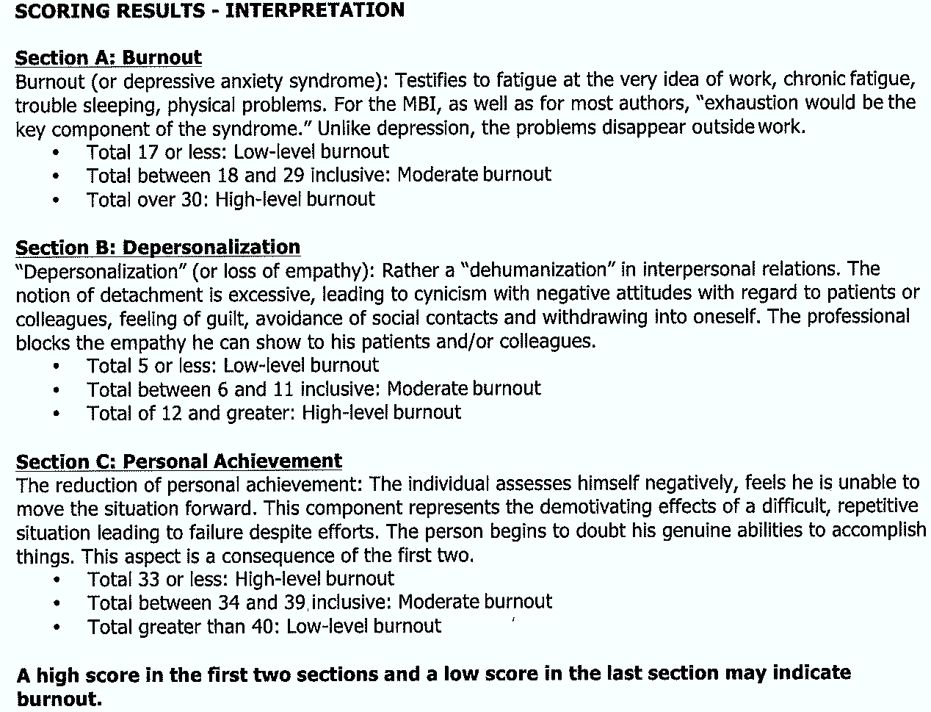
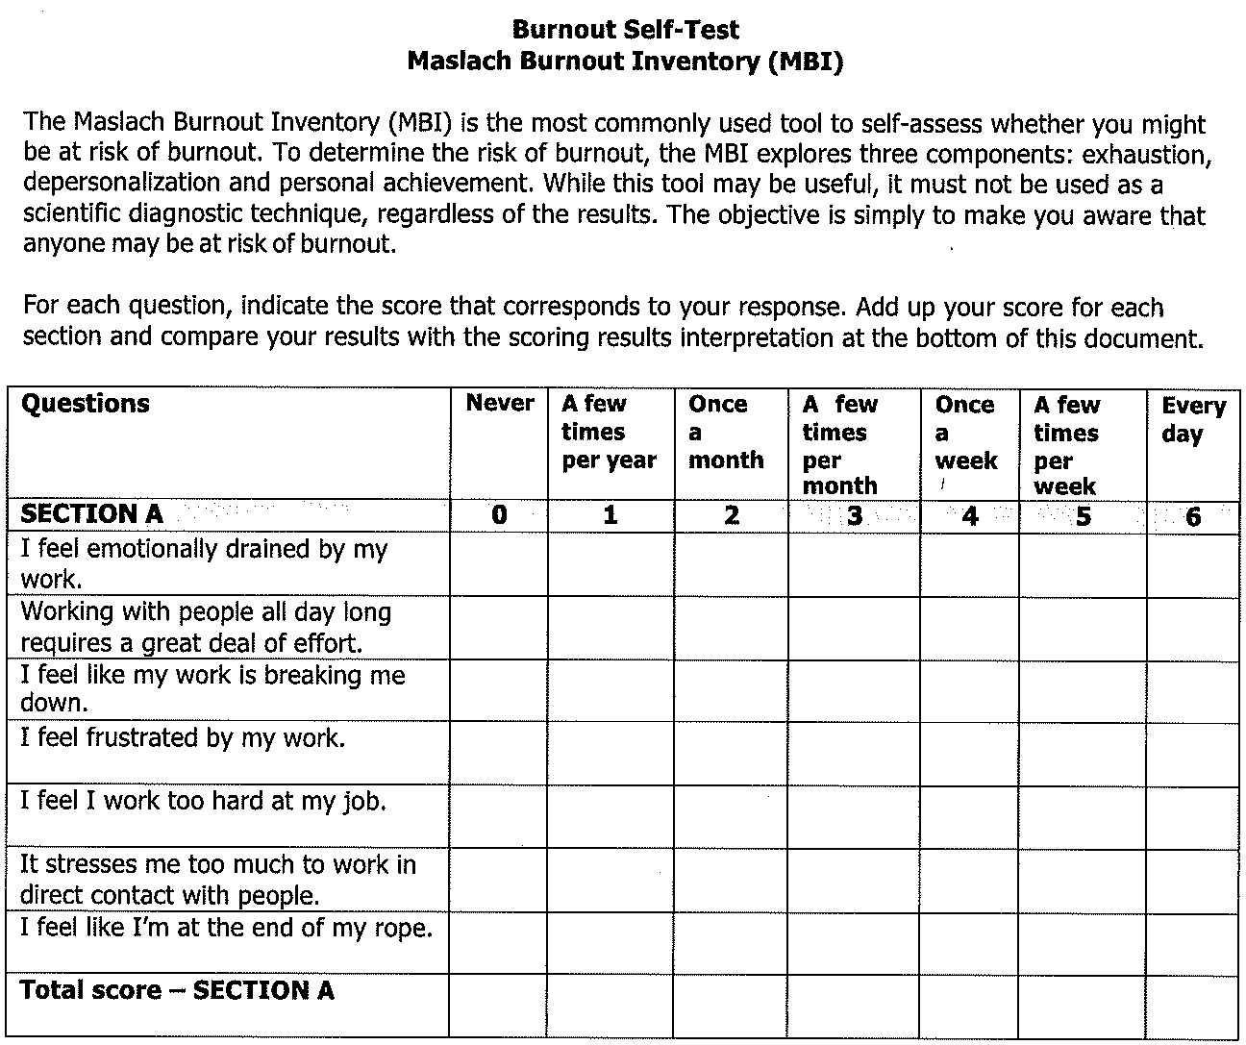
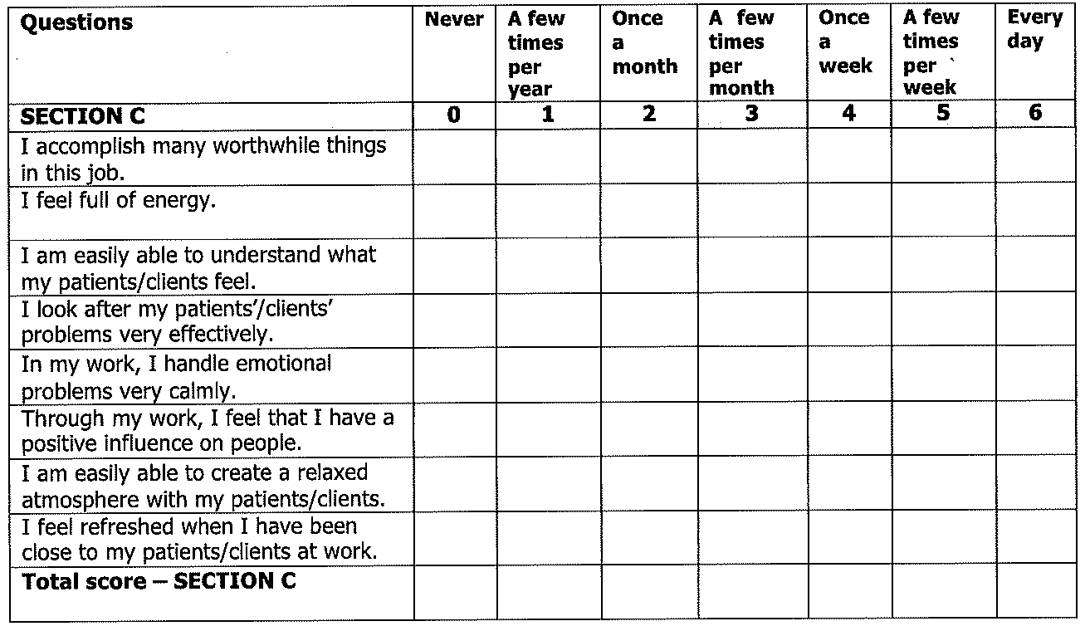
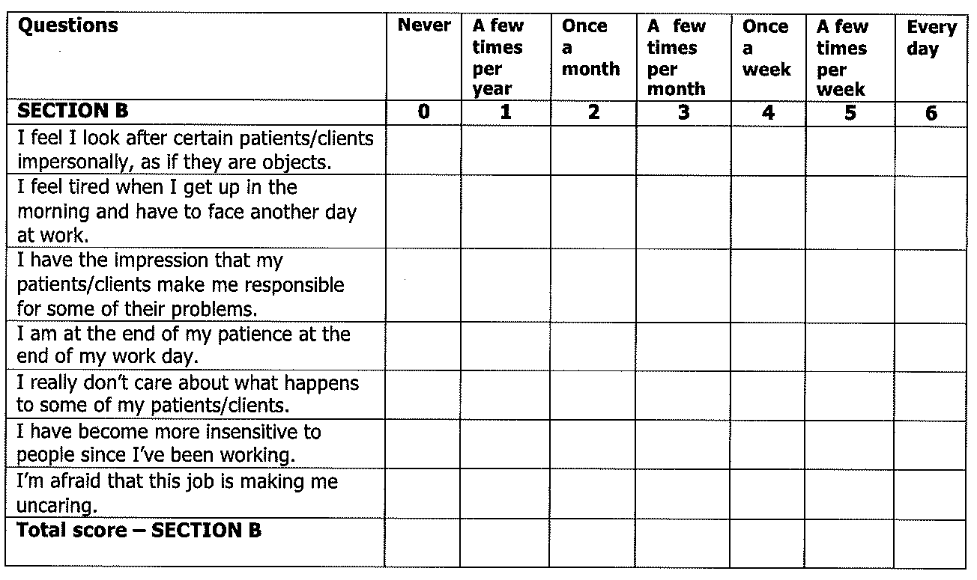

Slide 7
What are the Risk Factors?
Risk Factors:
Younger age (<50yo)
Female
Hours worked/week
Limited control over work/conditions
Exclusion from decisions impacting work
Lack of sense of community
Financial stressors, family obligations/stressors

Slide 8
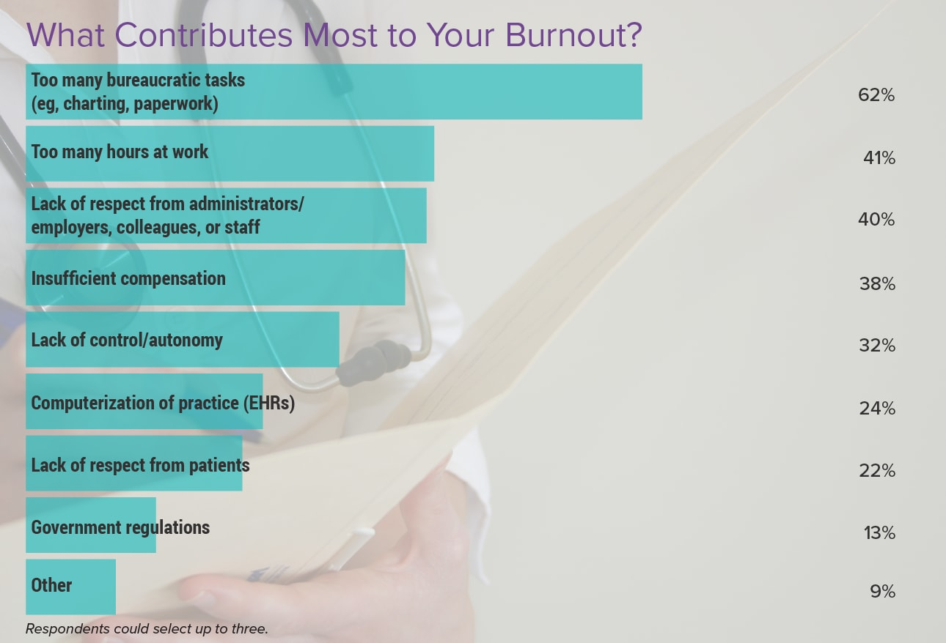
What are the causes?
Jon McKenna | January 26, 2024
Notes:
Medscape Physician Burnout & Depression Report 2024
- Over 9000 respondants, US physicians

Slide 9
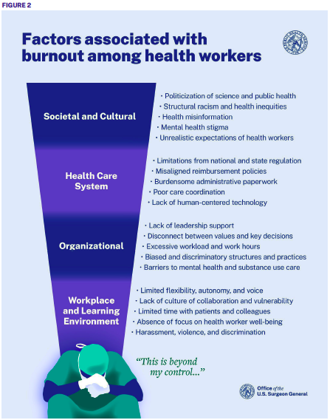

Slide 10
Who is Impacted?
Physicians:
Shanafelt et al (2022):
Physicians experience higher rates of burnout and lower job satisfaction compared to the general population
2024 Medscape survey:
Found burnout in as high as 63% of certain specialties
Golub et al (2008) and Contag et al (2010):
Otolaryngologists: 70%, Microvascular head-neck surgeon: 75%
Advanced Practice Providers (APPs):
Limited data/research
Rates likely similar to those of physicians
Some unique differences in drivers
Notes:
2024 Medscape: 43% ENT burned out
Also seeing increasing percentages of physicians with depression (20% in 2022, up from 15% in 2018)
44% of physicians exhibit at least one symptom of burnout
APPs – Unique differences/drivers:
Emerging models of care that allow all healthcare professionals to work at the full scope and extent of their licensure are recommended as ways to improve efficiency, quality, and to meet healthcare needs; yet considerable challenges to full practice expansion of APRNs persist (Altman, Butler, & Shern, 2015). The expectations for APPs working within these new models suggest a need for consideration of their impact on job stressors.
The job stressors of role ambiguity, work pressures, and lack of autonomy contribute

Slide 11
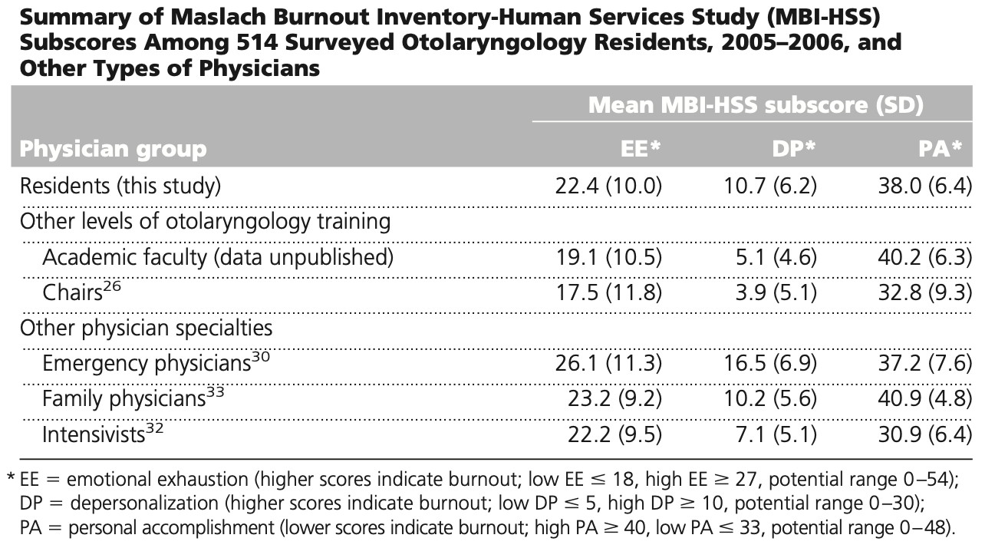
Who is Impacted?
Resident Physicians/Trainees:
Otolaryngology: 50-60%
Nurses (Berlin G et al, 2023):
Recent survey of over 22,000 nurses in the US:
Over 50% experience some level of burnout
Majority citing less compassion for their pts
18-34% considering or planning to leave profession
Other Healthcare Workers are not immune
Notes:
And we know the list goes on and on…data on a many different roles within our healthcare workforce.
Trainees: Similar or slightly elevated rates amongst surgical residents
ENT:
Systematic review and meta-analysis, 25 articles, 2000-2025
In the quantitative analysis, rates of trainee burnout ranged from 29.7% to 86% with an overall trend towards reduced rates of burnout from 2006 to 2021. Utilizing a weighted average, the overall burnout among otolaryngology residents was 58.6%.
Cutouts: Golub JS, 2007
In comparison with other levels of academic rank within otolaryngology, residents were the most burned out, followed by chairs26 and academic faculty. (Data unpublished.) Higher levels of burnout in residents than in trained physicians have also been noted in a smaller study.1 Compared with nonresident physicians of three fields classically considered “high stress,” the burnout levels reported in our study were similar30 –33 (Table 4).
RNs:
50% exhausted and overwhelmed at work
25% sought professional mental health assistance
Other HCWs:
Burnout and workload-related stress are pervasive in healthcare, having been observed among nursing assistants, medical assistants, social workers and other frontline staff working within inpatient clinical care settings during the pandemic (Prasad et al., 2021).

Slide 12
What about Otolaryngologists?
1993, Johnson JT et al:
34% of respondents “burned out”
“Discussion about and confrontation with these issues are appropriate to facilitate and enhance an individual’s ability to continue to function productively in this environment.”
2006, Golub JS et al:
70% of respondents showed moderate or high levels of burnout
Female, Assoc Prof, Microvascular surgeons – higher rates of burnout
2009, Johns MM et al:
84% of Oto Dept Chairs showed moderate or high levels of burnout
Notes:
Johnson et al, 1993:
The membership of the American Society of Head and Neck Surgery and the Society of Head and Neck Surgeons was surveyed by mail relative to burnout
395 respondents
(34%) individuals responded that they felt “burned out.” Only 27%. however, indicated frustration with disease, whereas 67% indicated frustration by government and 58% indi- cated frustration by the economics of medical practice.
Golub JS et al:
Mailed survey, Maslach Burnout Inventory-Human Services Study (MBI-HSS), SUO membership, 351 respondents
High burnout was observed in 4% of faculty, moderate burnout in 66%, and low burnout in 30%. Women experienced a statistically higher level of emotional exhaustion than men. In addition, associate professors were significantly more burned out than full professors and microvascular surgeons were notably more burned out than all other subspecialists. The stron- gest predictors of burnout were dissatisfaction with the balance between personal and professional life, low self- efficacy, inadequate research time, and inadequate ad- ministration time. A significant association was seen be- tween high burnout and likelihood to leave academic medicine within 1-2 yrs.

Slide 13
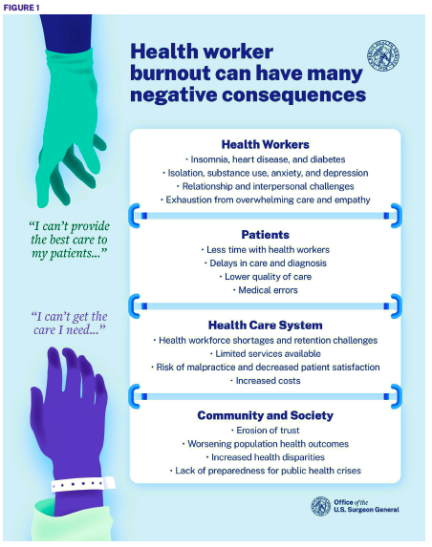
Notes:
IMPACT? Nice summary slide from Surgeon General
Burnout has been shown to impact a healthcare professional’s ability to consistently provide compassionate, safe, high-quality, patient-centered care
Shanafelt et al (Frieshlag is senior author)
Members of the American College of Surgeons were sent an anonymous, cross-sectional survey in June 2008, 7905 respondents, Self-reported
“Major medical errors reported by surgeons are strongly related to a surgeon’s degree of burnout and their mental QOL”
Burnout and depression were among the strongest factors associated with reporting a recent major medical error on multivariate analysis adjusting for other factors.
Since the present study is cross-sectional, we are unable to determine whether distress causes errors or errors cause distress.
References #6 and 7 below show similar findings for IM and Peds resident trainees
West CP, Huschka MM, Novotny PJ, et al. Association of perceived medical errors with resident distress and empathy: a prospective longitudinal study. JAMA. 2006;296:1071–1078.
Fahrenkopf AM, Sectish TC, Barger LK, et al. Rates of medication errors among depressed and burnt out residents: prospective cohort study. BMJ. 2008;336:488 – 491.
Blendon RJ, DesRoches CM, Brodie M, et al. Views of practicing physicians and the public on medical errors. N Engl J Med. 2002;347:1933–1940.

Slide 14
Collaborative for Healing and Renewal in Medicine (CHARM)
Charter on Physician Well-Being (2018)
4 Guiding Principles:
Patient Care
Well-being of all
High-value care
Shared responsibility
3 Key Commitments:
Societal
Organizational
Individual and interpersonal
Thomas LR et al, 2018
Notes:
Formed in 2015: Collaborative for Healing and Renewal in Medicine (CHARM) collaborated to create/support this charter
CHARM is a group of leading medical centers and organizations that includes the AMA
Patient Care: effective care promotes and requires physician well-being
Well-being of all: all members of the team require well-being
High-value care: physician well-being is a quality of care marker
Shared responsibility: requires collaboration between individuals and organizations
Societal: by fostering a supportive work environment and advocating for policies that enhance WB, organization can work to imprve the culture of medicine
Organizational: By building support systems, developing engaged leadership and optiming teams, organizations can develop cultvate a helathier and more productive workforce
Individual: by responding to work challenges, prioritizing mental health care, and promoting self-care, organizations can encourage healthy choices that optimize physician performace.
MCW was an early adopters – listed on AMA’s website

Slide 15
Charter on Physician Well-Being
Invest in Research
AMA’s Practice Transformation Initiative, Joy in Medicine recognition program
Create Positive Work Environments
HCOs need to create/redesign environments that clinicians find to be safe, healthy, and supportive and that foster ethical and meaningful practice
Reduce Administrative Burdens
Barrier to quality care and leading causes of burnout. Need to engage in physicians in processes – can best identify limited to no value and burdens
Create Positive Learning Environments
Incorporate well-being and burnout prevention in professional development
Enable Technology Solutions
Leverage health IT tools for improving clinical care, effective integration into clinical workflows, Artificial Intelligence (AI)
Provide Support to clinicians and learners
Remove the stigma of seeking help, eliminate barriers, address historical culture

Slide 16
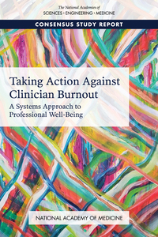
Notes:
PRE-PANDEMIC: Oct 2009: NAM Taking Action Against Clinician Burnout
Studies estimate that between 35 percent and 54 percent of U.S. nurses and physicians have substantial symptoms of burnout, and the range for medical students and residents is between 45 percent and 60 percent.
“There is evidence that interventions focused on work organization can mitigate burnout; thus, health care organizations are a powerful determinant and have a critical role to play in reducing clinician burnout.”
Taking Action Against Clinician Burnout: A Systems Approach to Supporting Professional Well-Being calls upon leaders in health care organizations and health professions educational institutions as well as within the government and industry to prioritize major improvements in clinical work and learning environments in all settings, and for all disciplines to prevent and mitigate clinician burnout and foster professional well-being for the overall health of clinicians, patients, and the nation.
POST-PANDEMIC: Oct 2022: NAM Action Collaborative on Clinician Well-Being and Resilience launched the National Plan for Health Workforce Well-Being, which intends to drive collective action to strengthen health workforce well-being and restore the health of the nation.

Slide 17
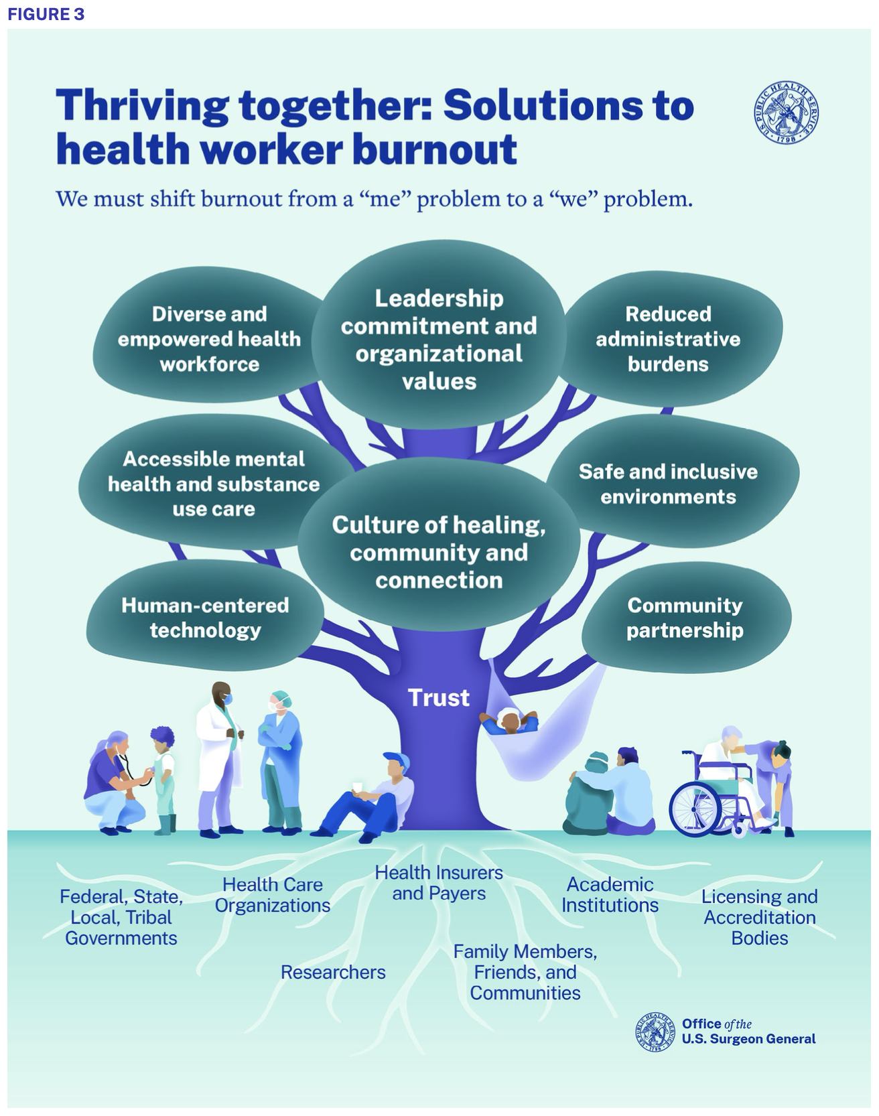

Slide 18
Prevention of Burnout: A multi-pronged approach
Healthcare organizations
Commitment to health and safety, increase access to support, rebuild community/connection, combat bias
Governments
Invest, build partnerships, address punitive policies, reduce administrative burdens, prepare for emergencies
Health insurers
Support both quality and quantity of time spent with patients, reduce administrative burdens (prior auth), invest in preventative care
Healthcare technology companies
Design tools to serve the care team, focus on interoperability

Slide 19
Prevention of Burnout: A multi-pronged approach
Educational Institutions
Prioritize learning well-being, address “hidden curriculum”, strengthen connections, promote mental health resource access
Family/Friends/Community
Learn how to recognize S/Sx, support and be kind to health workers
Researchers
Advance coordinated research to develop validated tool to assess/measure/track/respond, further research on impacts, improve understanding of how to apply health IT
Notes:
Call for further coordinated research to develop a national, validated tool to regularly assess, measure, track, and respond to health worker burnout and well-being across settings.
Improve our understanding of the immediate and long-term impacts of the pandemic on health worker well-being.
Further research on the role of payment models, technology, and private equity in shaping health worker well-being.
Improve our understanding of how to develop and apply health information technology (IT) that more effectively supports health workers in the delivery of care.

Slide 20
Prevention of Burnout: A multi-pronged approach
Healthcare Workers
Awareness and knowledge - recognition
Reframe the dialogue – resilience and flourishing
Set realistic goals
Prioritize self-care
Create and maintain workplace boundaries
Connect with your colleagues and teams
Prioritize and embrace moments of joy and “wins”
Willingness to both advocate and seek assistance
Notes:
Like in health conditions, prevention is the ideal state to achieve
Reframe: all physicians encounter adversity in their career and per- sonal life, whether it is divorce, death, litigation, or a pan- demic; and they will need strategies to overcome these adversities.
Realistic Goals: especially ones that align with values, priorities, and availability
Self-Care: sleep, diet, stress reduction, exercise, social interactions outside of work
Boundaries: socialize with peers and your leaders, be willing to say “no” when appropriate
While these individual strategies are incredibly important, much like our ongoing appreciation and understanding of safety events, and quality outcomes in medicine, it is not the individual but rather the system that drives much of the root cause.
Learn to recognize the signs of distress, mental health challenges, and burnout in yourself and in your colleagues.
Stay connected and reach out for help.
Prioritize moments of joy and connection.
Get back to basics with good health habits.
Use your voice to advocate for positive changes in your workplace, learning environment, or communities.

Slide 21
Thank you
Questions?

