Slide 1
AI: A Cure for Burnout? Exploring the Potential of Artificial Intelligence in Alleviating Clinician Burnout
Sachin Pawar, MD
Associate Professor
Chief, Division of Facial Plastic and Reconstructive Surgery
Surgical Medical Informatics Officer

Slide 2
Disclosures
None

Slide 3
Burnout

Slide 4
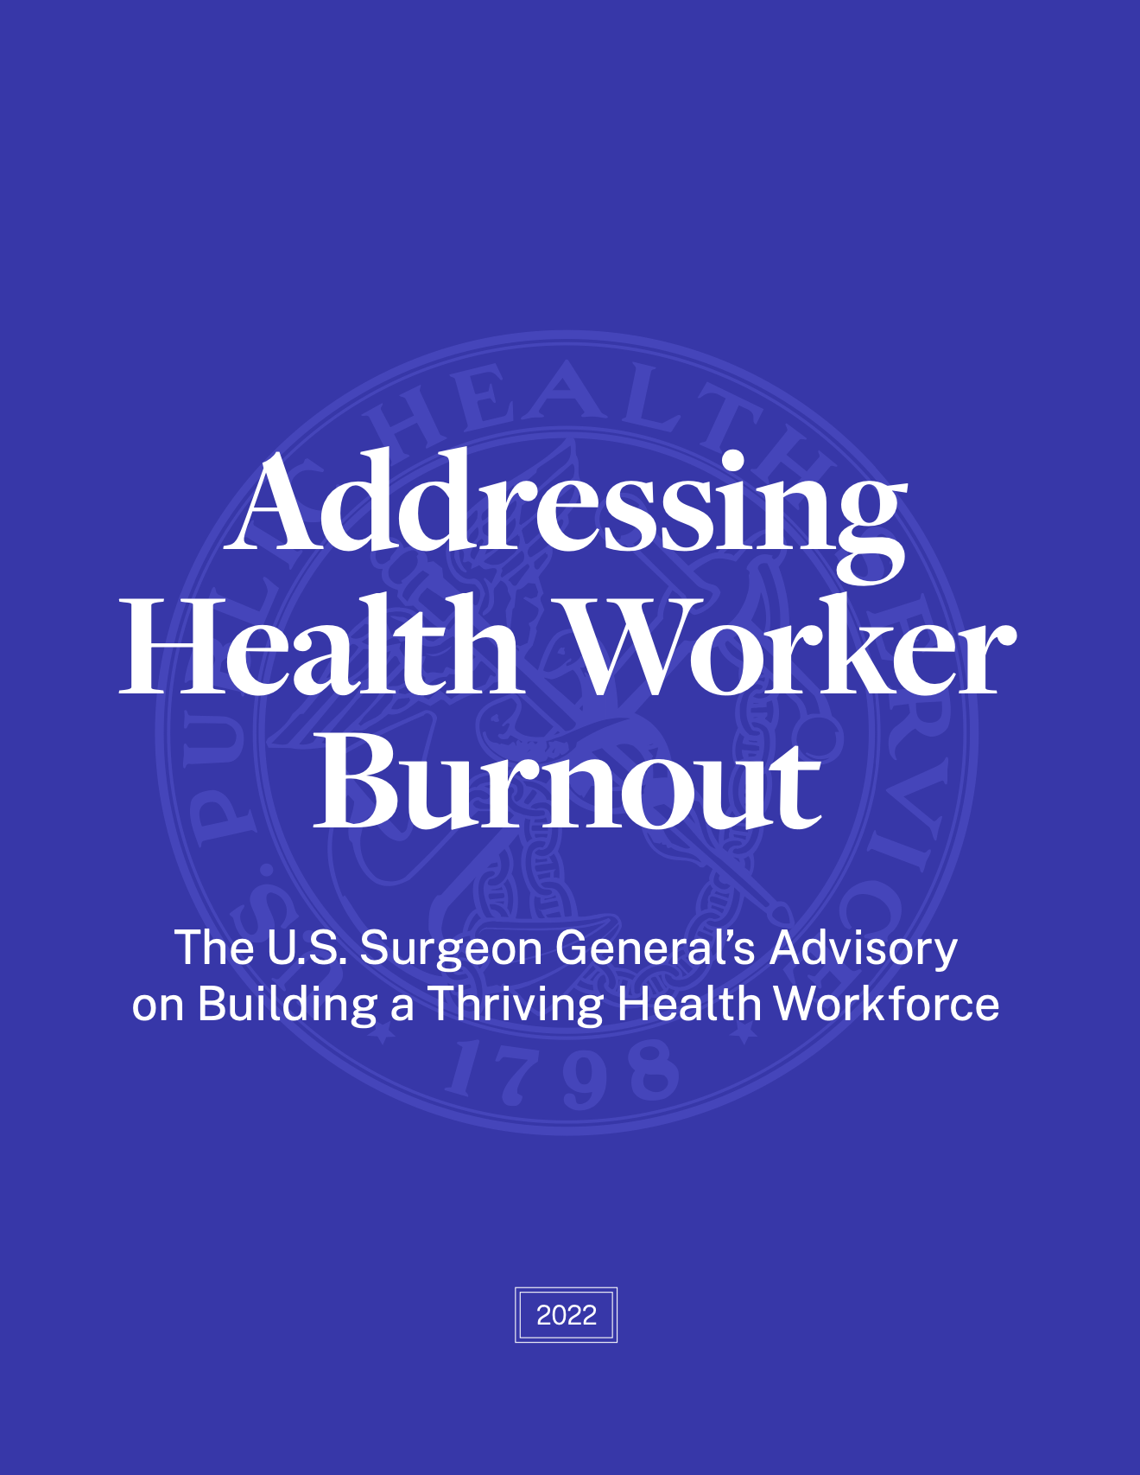
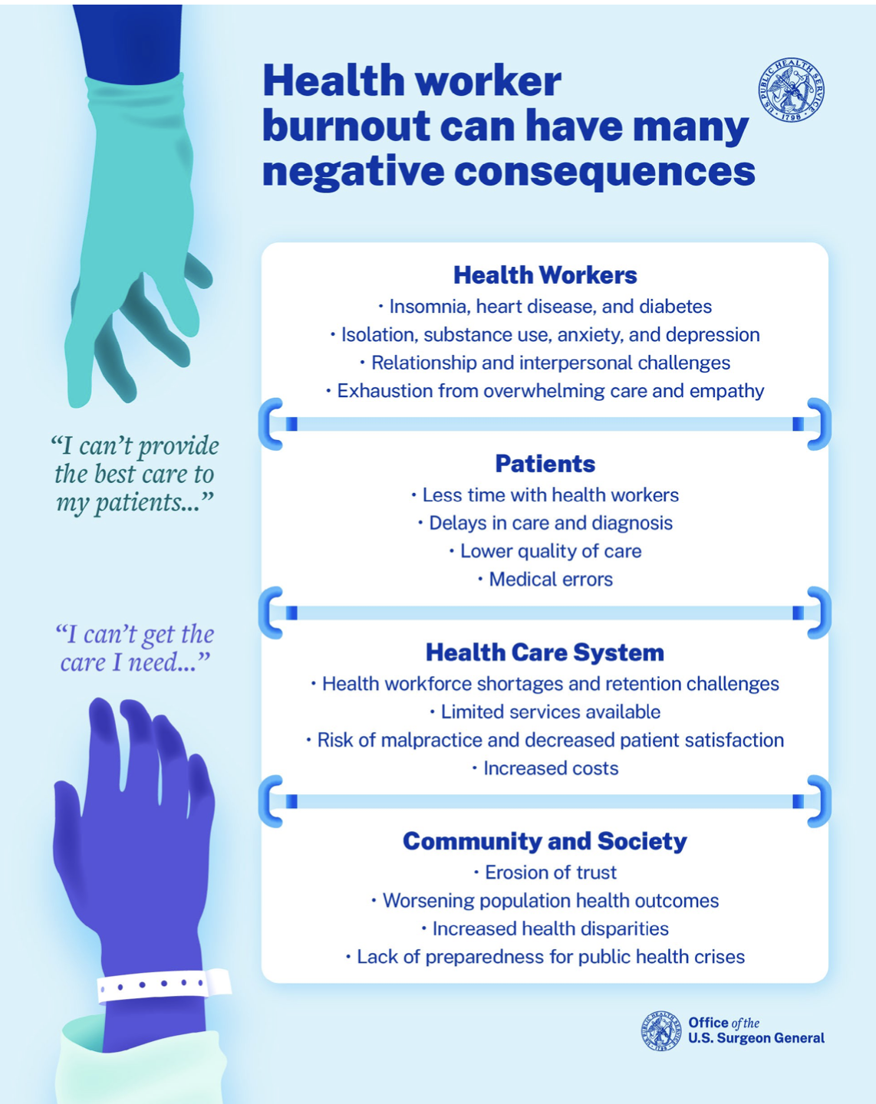
https://www.hhs.gov/surgeongeneral/priorities/health-worker-burnout/index.html

Slide 6
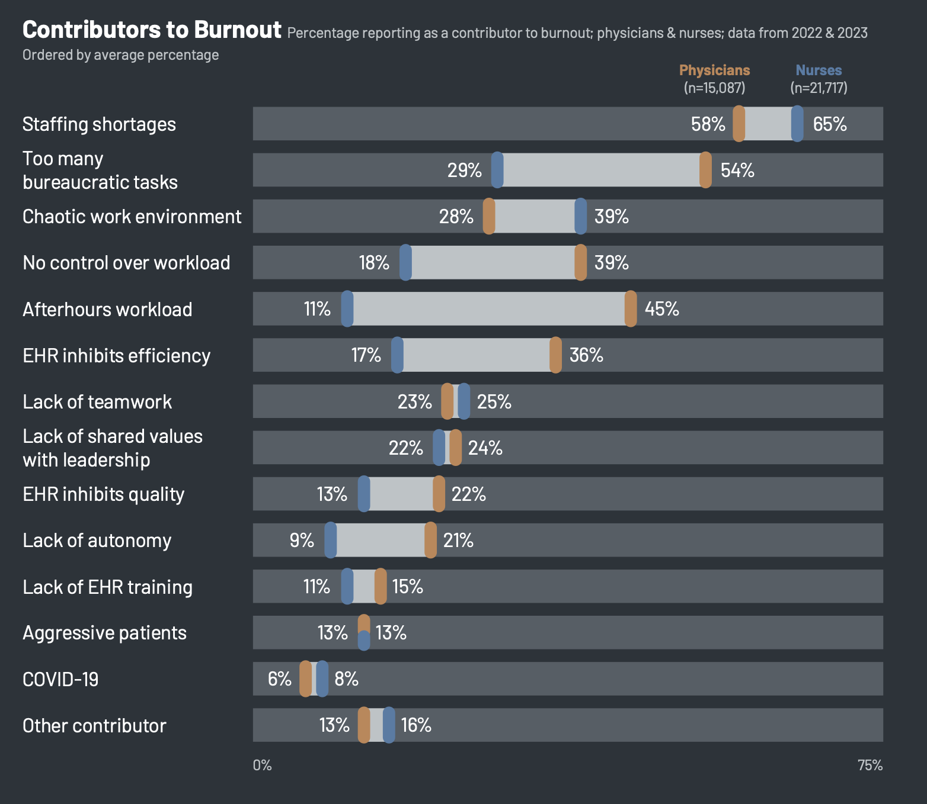

Slide 7
Artificial Intelligence (AI)

Slide 8
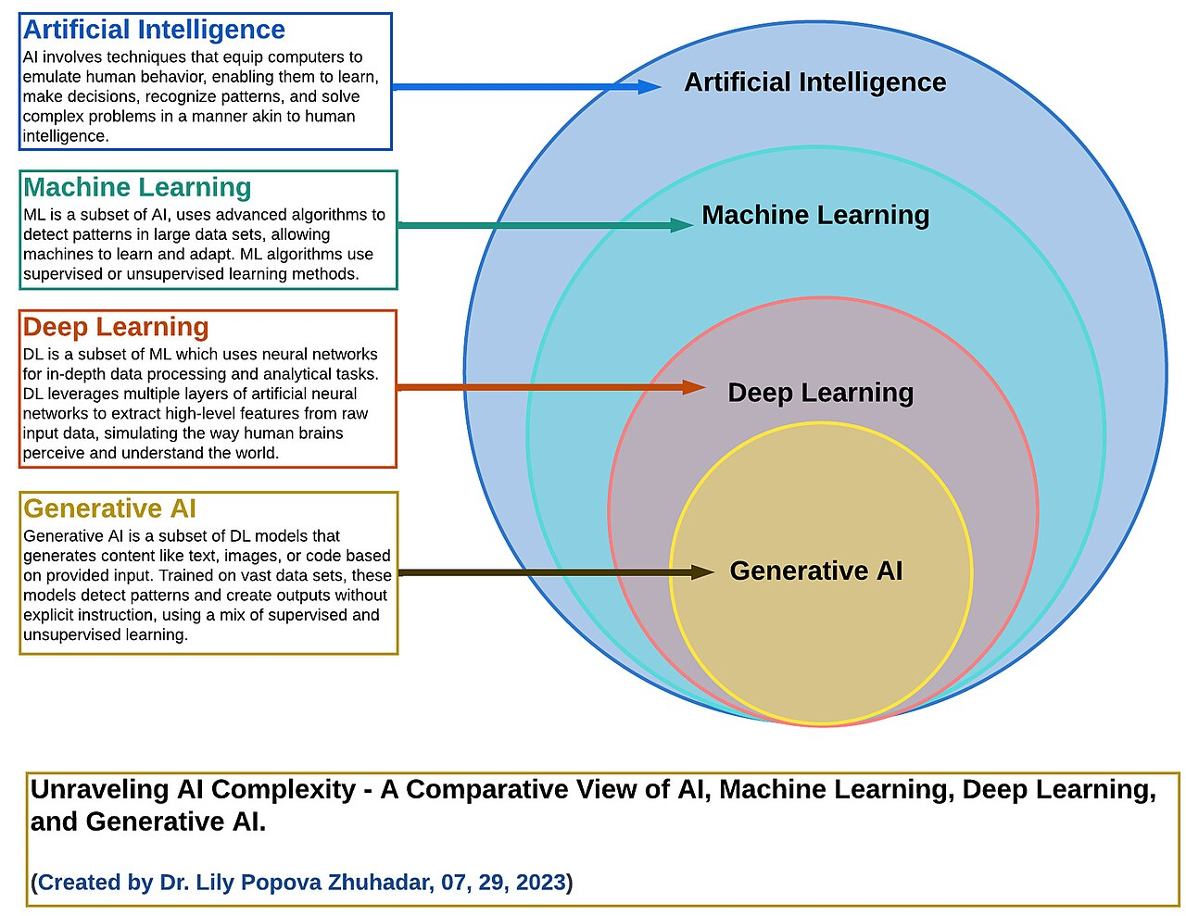

Slide 9
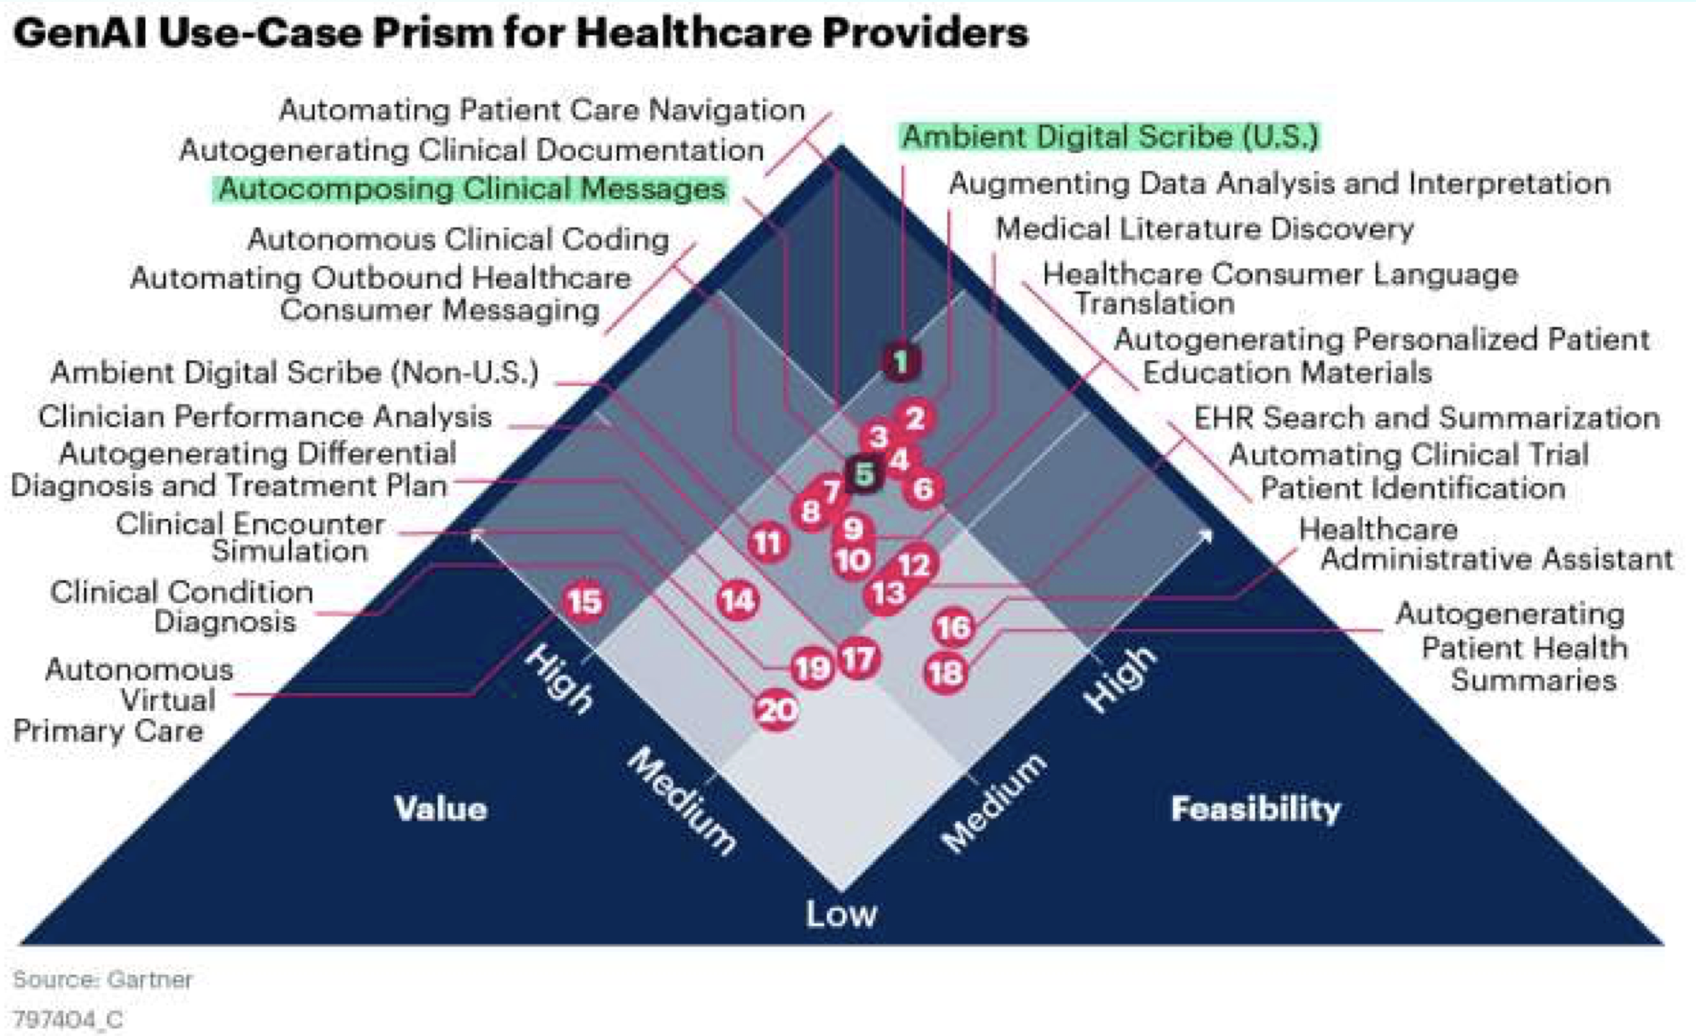
AI in Healthcare

Slide 10
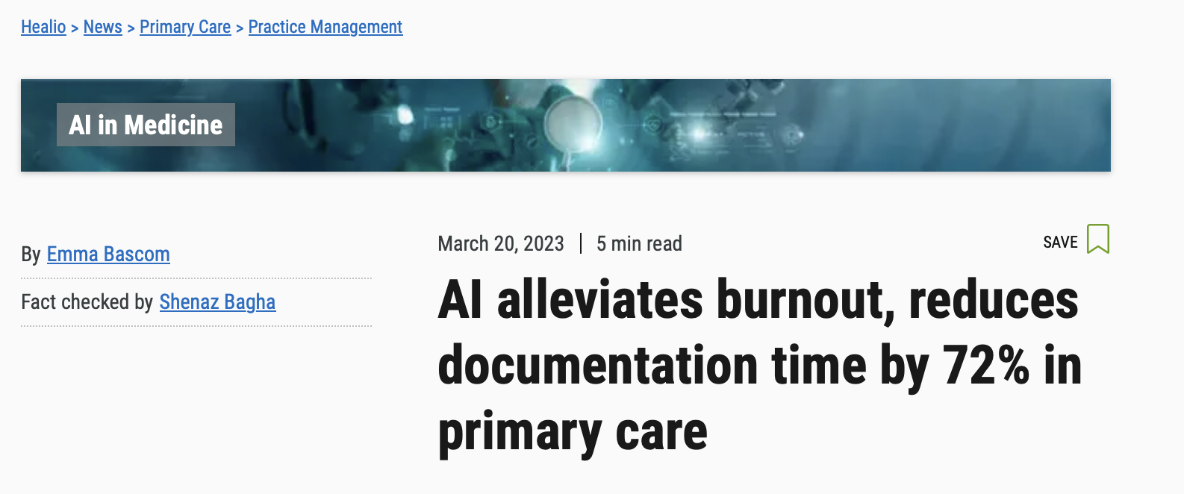
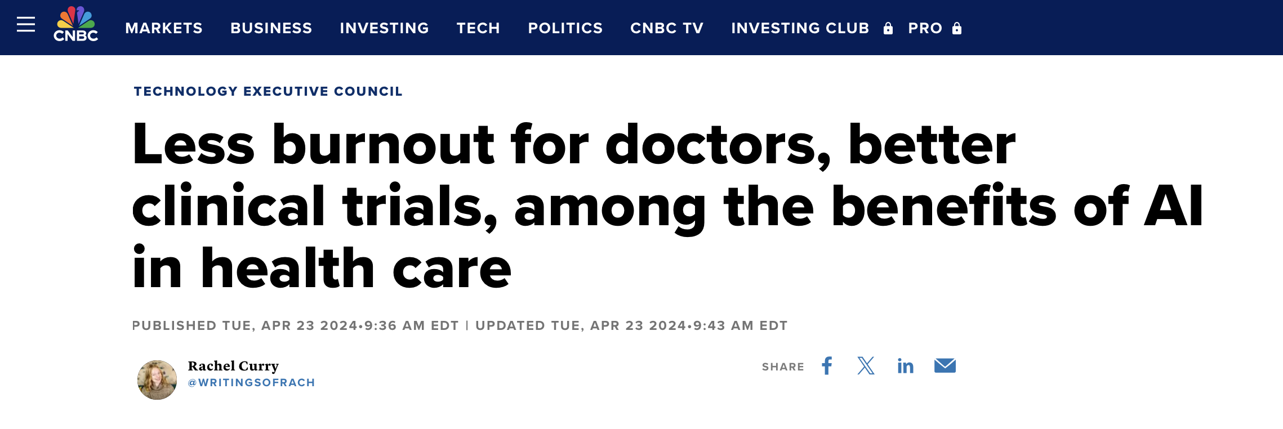

Slide 11
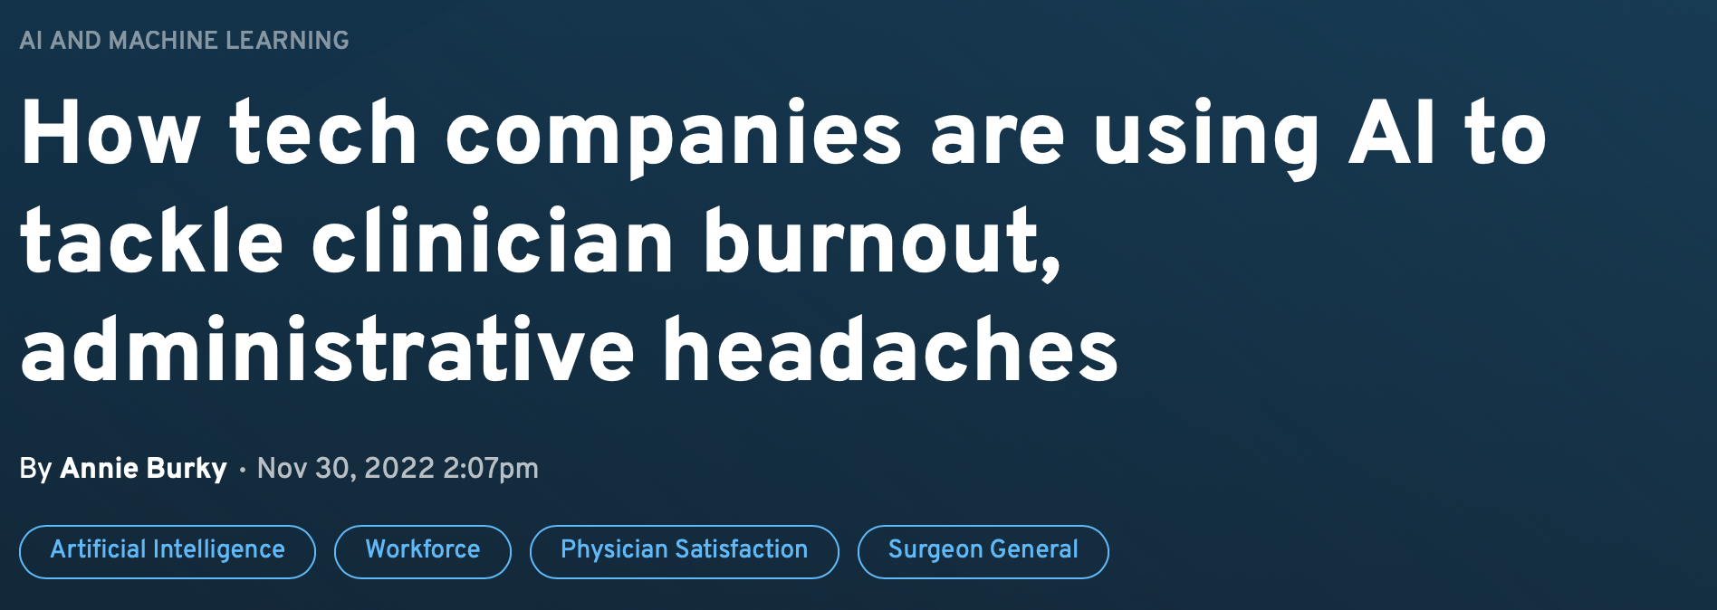
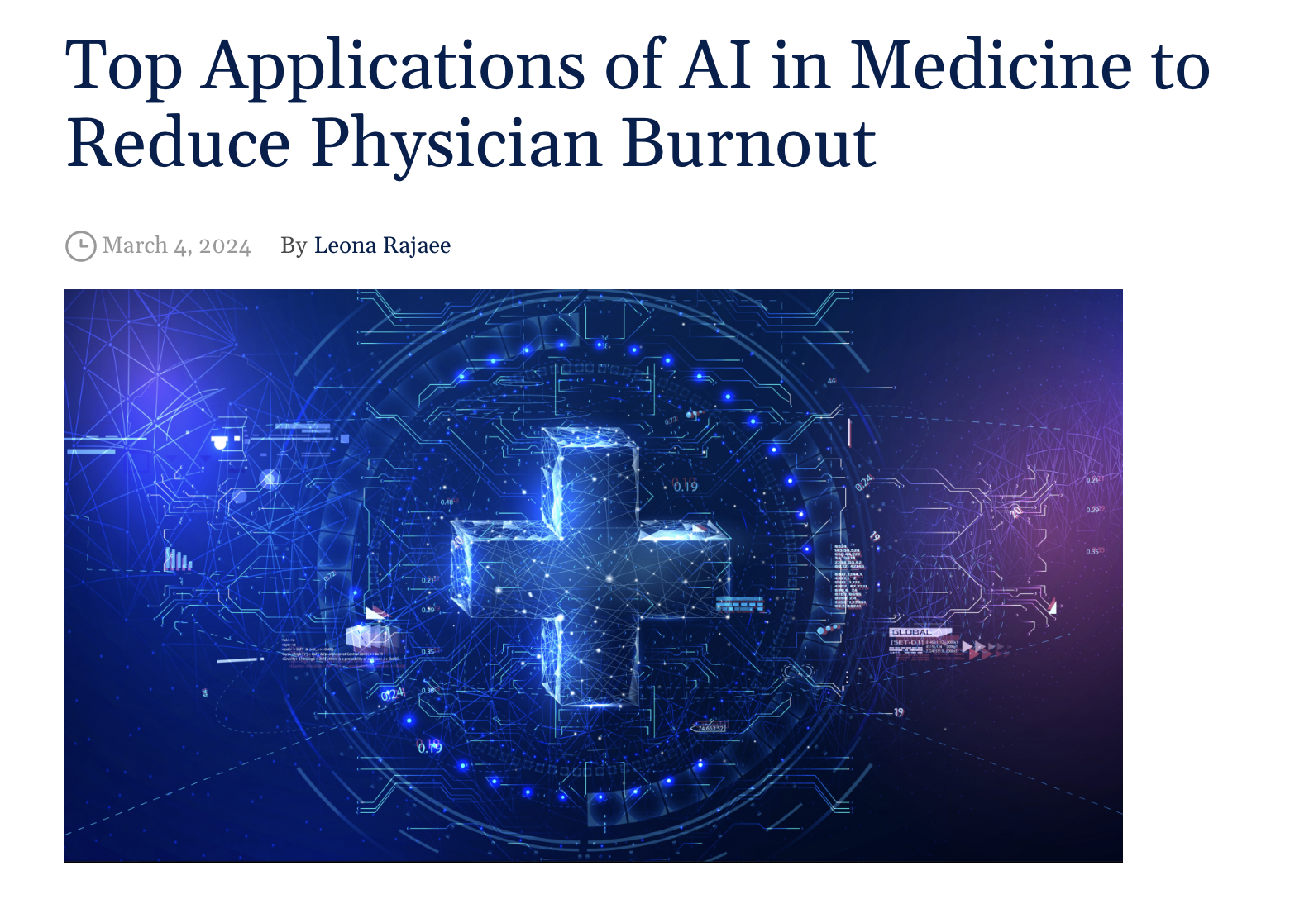

Slide 12
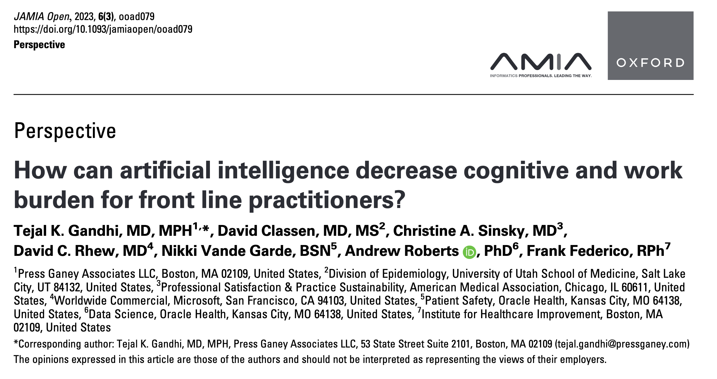
Gandhi, T. K. et al. How can artificial intelligence decrease cognitive and work burden for front line practitioners? JAMIA Open 6, ooad079 (2023).

Slide 13
Clinical and cognitive processes potentially impacted by AI
Function | Description
Data gathering | AI-based tools such as natural language processing (NLP), large language models, and image recognition can help clinicians comb through large volumes of information sources and discrete or unstructured data to help locate, identify, and surface the most relevant pieces of information, as well as missing information, to reduce cognitive and work burden on clinicians.
Data synthesis | AI may be used to help support a new clinical workﬂow (eg, command center; rapid response team) or to improve an existing one (eg, prioritize existing care management outreach based on risk)
Documentation | AI may be used to create or enter a summary of or provide speciﬁc details regarding a patient encounter into an EHR or other system of record using technology. AI can help simplify the billing documentation process, and generative AI can help reduce documentation burden.
Taking appropriate action | AI can provide decision support, prediction tools, targeted outreach, and guidance in response to signals or deploy an “intelligent” command center to help manage populations
Structure asynchronous activities, outcomes and activities. | The care team’s clinical and operational activities, including patient rounds and communication, are unstructured and asynchronous. AI can help manage coordination and synthesis of the information for updates and the next best course of action.
Table adapted from: Gandhi, T. K. et al. How can artificial intelligence decrease cognitive and work burden for front line practitioners? JAMIA Open 6, ooad079 (2023).

Slide 14
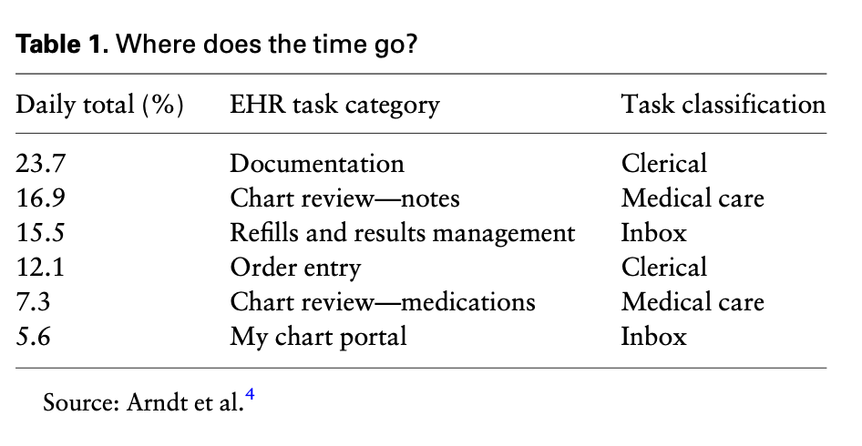
Three Main Areas of Burden
Documentation
Chart Review
Inbox Tasks
Dymek, C. et al. Building the evidence-base to reduce electronic health record–related clinician burden. J. Am. Méd. Inform. Assoc. 28, 1057–1061 (2020).

Slide 16
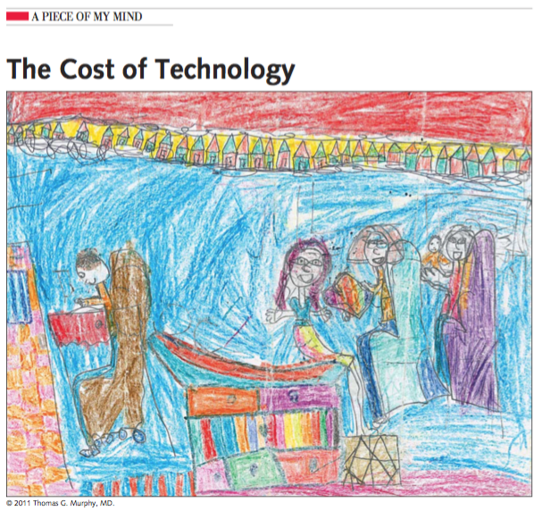
Toll E. A piece of my mind. The cost of technology. JAMA. 2012;307(23):2497-2498. doi:10.1001/jama.2012.4946.

Slide 17
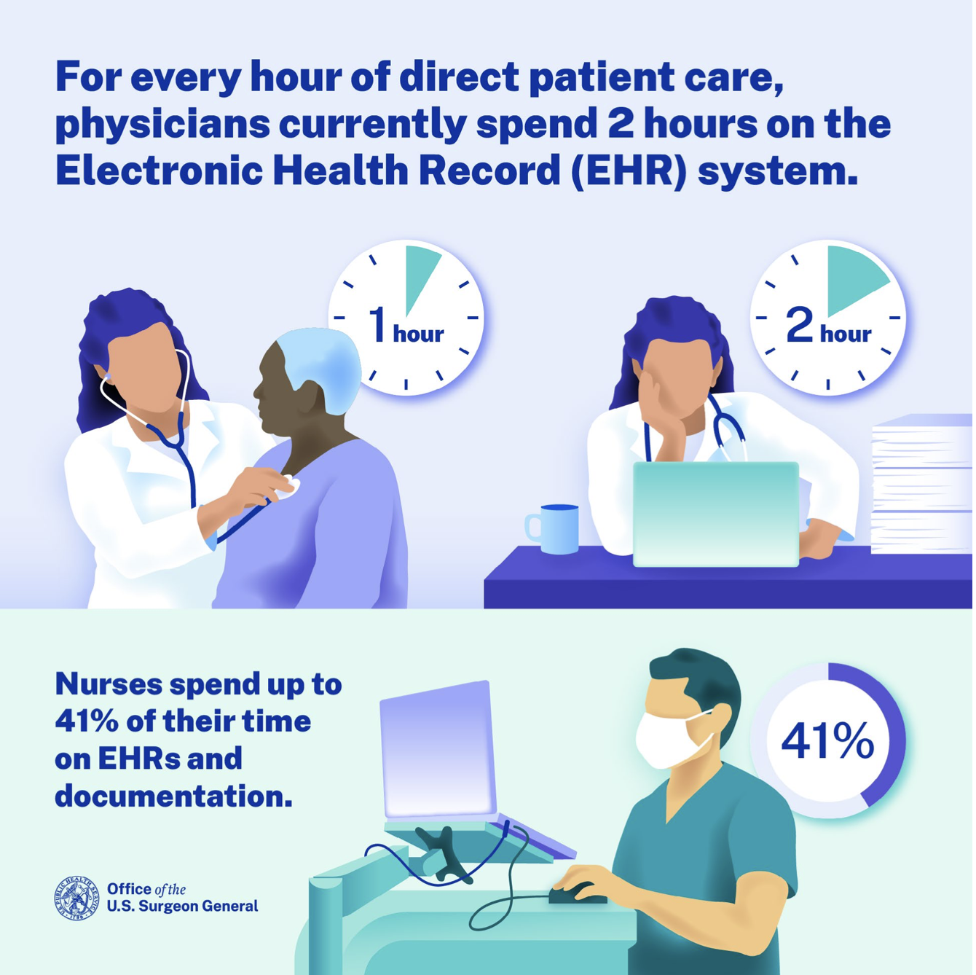
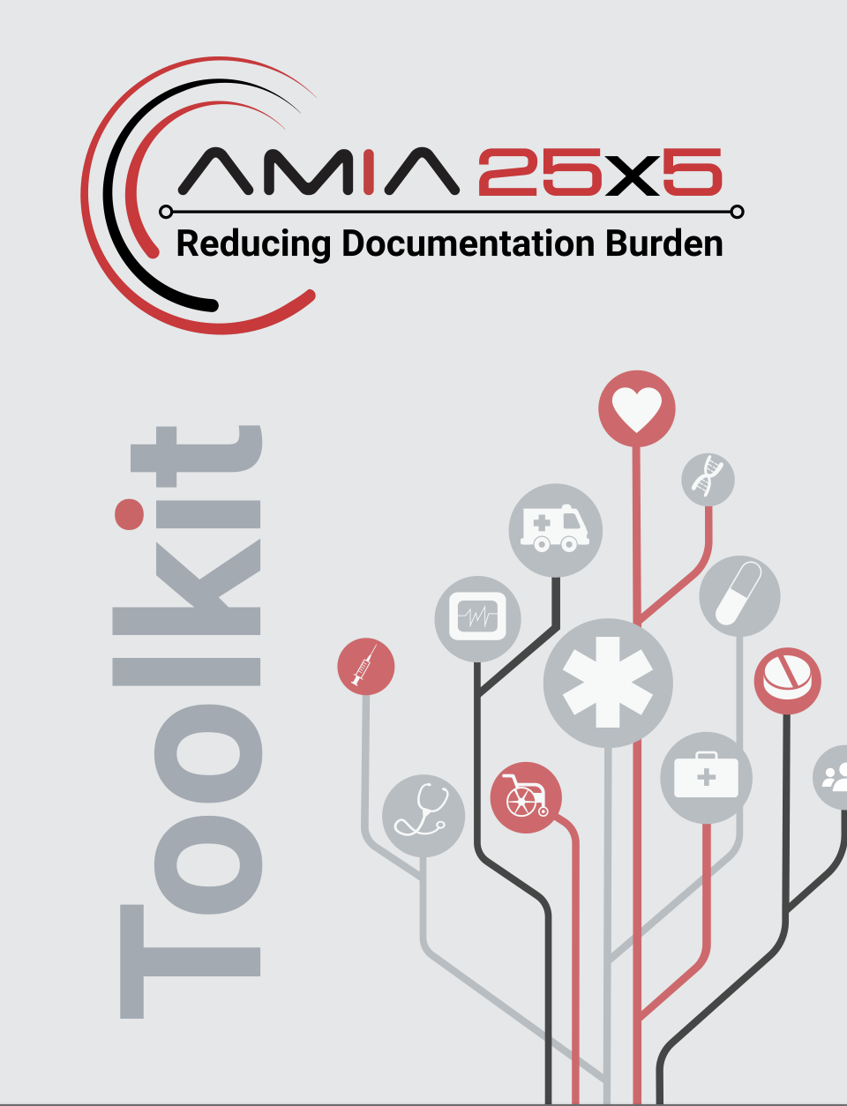
Documentation

Slide 18
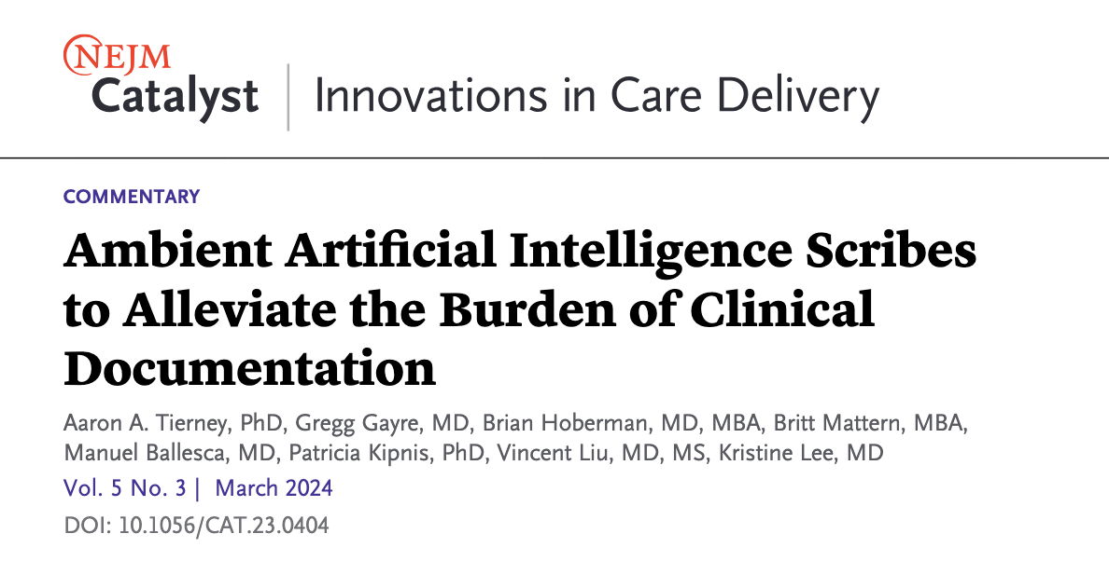
Tierney, A. A. et al. Ambient Artificial Intelligence Scribes to Alleviate the Burden of Clinical Documentation. NEJM Catal. 5, (2024).

Slide 19
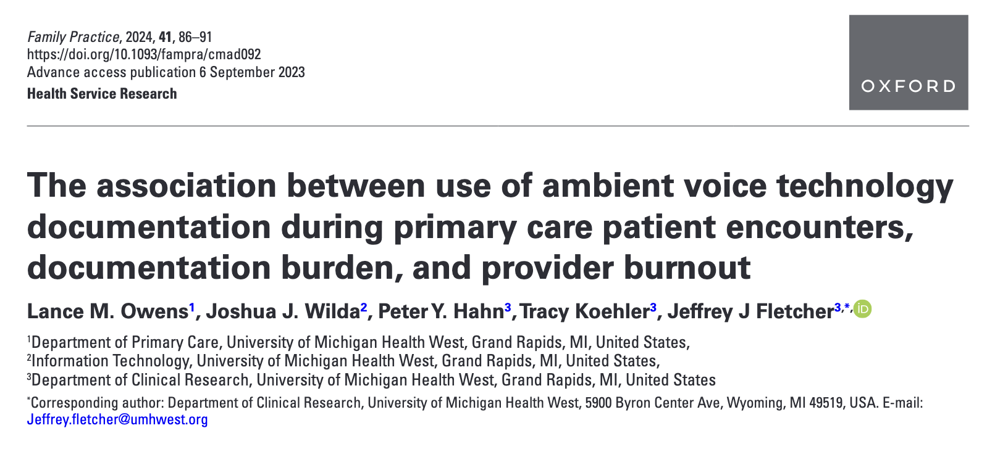
Owens, L. M., Wilda, J. J., Hahn, P. Y., Koehler, T. & Fletcher, J. J. The association between use of ambient voice technology documentation during primary care patient encounters, documentation burden, and provider burnout. Fam. Pr. 41, 86–91 (2023).

Slide 20
Ambient AI “Scribes”

Slide 21
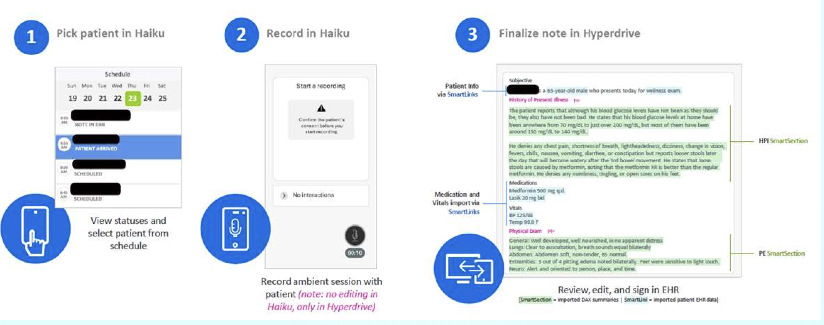
DAX Copilot

Slide 23
Chart Review
AI driven solutions
AI chart summarization and info retrieval
AI tools to quickly identify new or relevant information in chart (contextually relevant info)
Integration of multiple data sources into a holistic view of patient

Slide 24
AI generated chart summarization

Slide 25
Inbox Tasks
Problem
Increasing volume of messages
Notifications
Don’t always employ team based care
Poor EHR inbox design or workflows
Non-compensated time

Slide 27
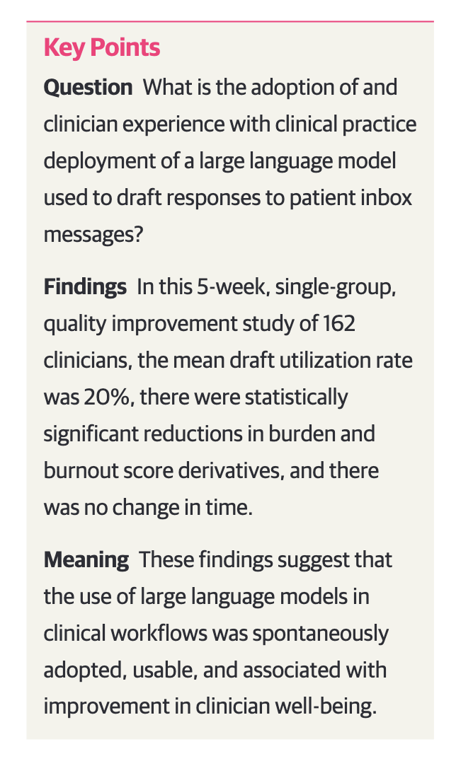
Garcia, P. et al. Artificial Intelligence–Generated Draft Replies to Patient Inbox Messages. JAMA Netw. Open 7, e243201 (2024).

Slide 28
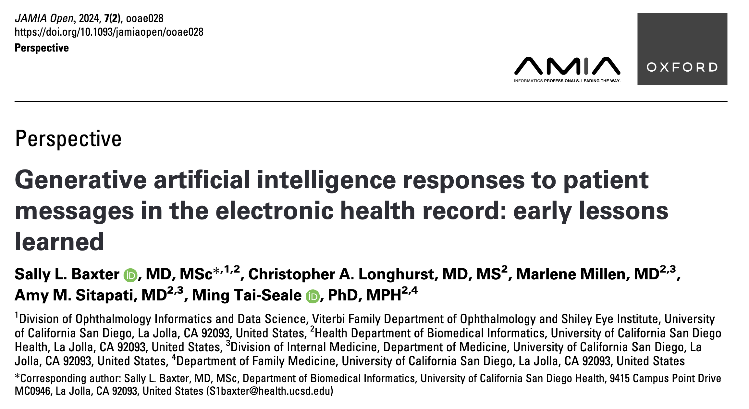
Baxter, S. L., Longhurst, C. A., Millen, M., Sitapati, A. M. & Tai-Seale, M. Generative artificial intelligence responses to patient messages in the electronic health record: early lessons learned. JAMIA Open 7, ooae028 (2024).

Slide 29
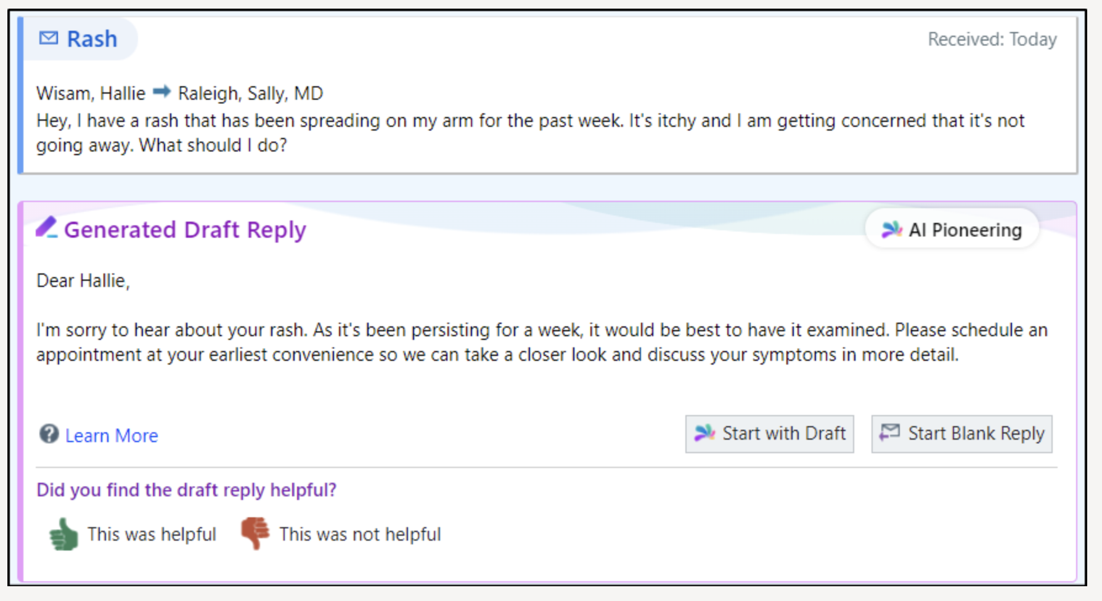
AI Generated Draft Replies to Patient Messages

Slide 30
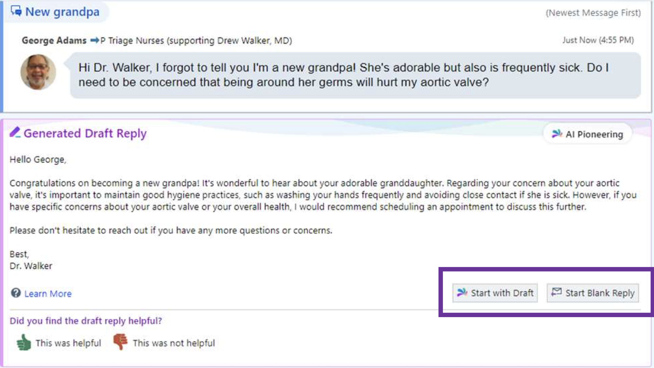
AI Generated Draft Replies to Patient Messages

Slide 32
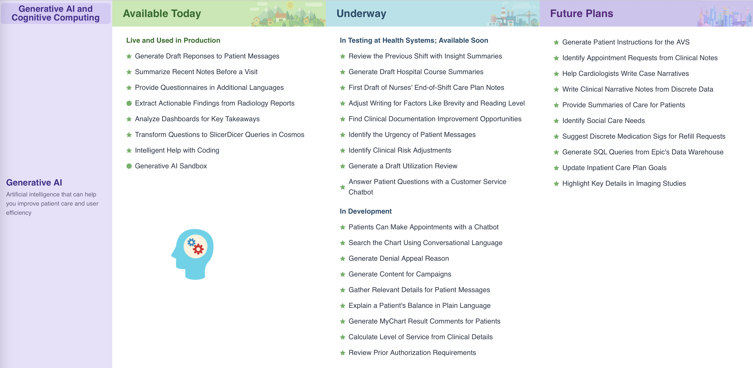

Slide 33
Challenges and Pitfalls
Technical
Issues with data quality, integration, and interoperability
Ethical
Privacy and security concerns, biases in AI algorithms
Adoption Barriers
Resistance to change among clinicians, lack of adequate training

Slide 34
Conclusion
AI has the potential to help alleviate clinician burnout by improving efficiency in clinical documentation, chart review, inbox management, and administrative tasks
Clinicians need to be actively involved in guiding adoption and validating these technologies

Slide 35
