Slide 1
Ergonomics in Otolaryngology
Christopher Long, MD
Associate Professor
chrlong@mcw.edu

Slide 2
Audience Question
Have you ever experienced MSKD related surgical or clinical work?
Have you ever sought care for MSKD related to work?
Have you ever needed to take POT or LOA for a work-related injury?
Have you ever considered retirement related to MSKD?
Have you ever participated in ergonomics training?

Slide 3
Ergonomics
The process of adapting a workplace to fit the physical requirements of a workplace to an individual
  Decrease muscle fatigue
  Increases productivity
  Reduce the incidence and severity of WRMD
Otolaryngologist aware of ergonomic concepts
  62% of ENTs lack knowledge of ergonomic principles
  31% of ENTs have limited knowledge

Slide 4
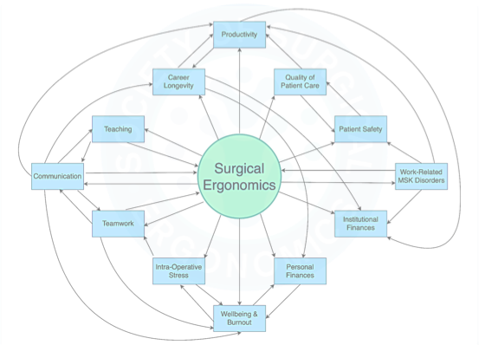
Copyright: Society of Surgical Ergonomics

Slide 5
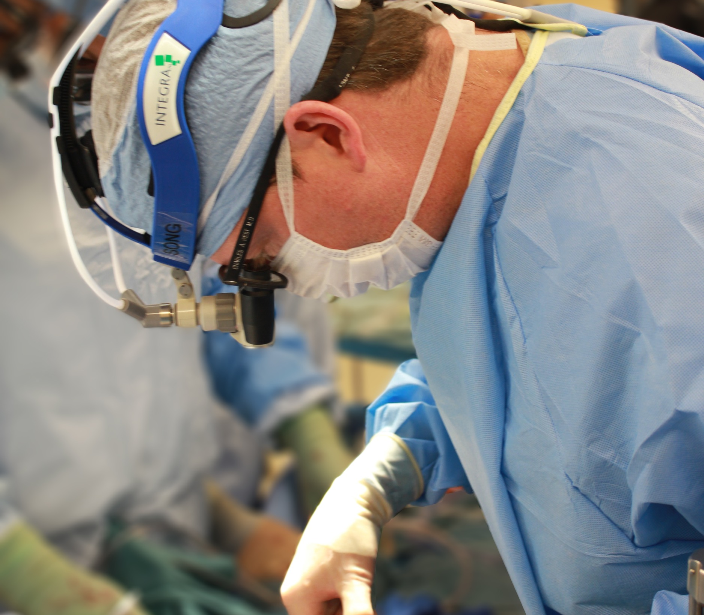
Surgeon Culture
Hard working
Self-sacrifice
Endurance
Maximize efficiency
(Strict regulatory requirements on devices constraining optimal ergonomic design)
Notes:
80% report sx only 30% ask for help, forgo breaks, don’t adjust position. Suck it up/take the pain

Slide 6
ENT Specific Challenges
Requirement for magnification
  Microscope
  Loupes
Small/narrow surgical fields
  Limited access/line of sight
Requirement for personal illumination
  Headlights

Slide 7
Surgeon symptoms, strain, and selections: Systematic review and meta analysis of surgical ergonomics
Chee-Chee H. Stuckya,∗, Kate D. Cromwella, Rachel K. Vossa,1, Yi-Ju Chianga, Karin Woodmanb,
Jeffrey E. Leea, Janice N. Cormiera
Meta analysis 24 studies
5152 surgeon surveys
Fatigue: 71%
Numbness: 37%
Stiffness: 45%
Pain Distributions
  50% back
  48% neck
  43% shoulders
59-99% were unaware ergonomic recommendations exist
Annals of Medicine & Surgery 27, 2018, 1-8

Slide 8
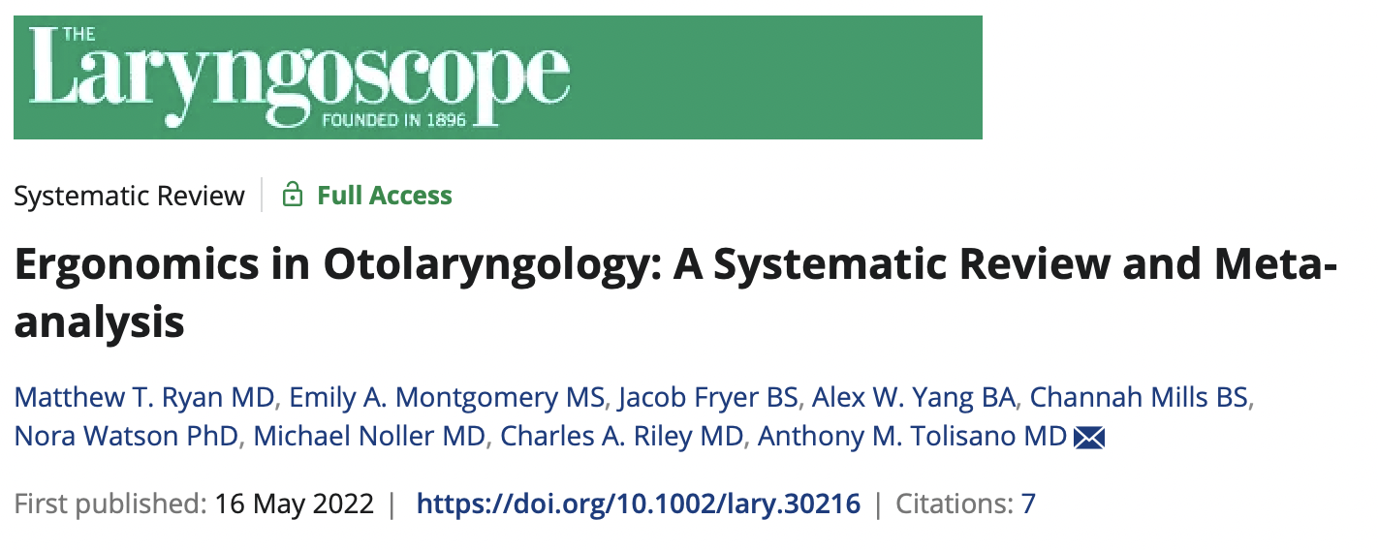
Systemic review/meta-analysis
Determine proportion of otolaryngologists experiencing Work Related Musculoskeletal Discomfort (WRMD)
1121 articles reviewed, 27 met inclusion criteria
Notes:
Versus skilled trade workers e.g. masons and electricians: 78%-82% experience WRMD
Affect 21%-97% otolaryngologists

Slide 9
General Otolaryngologists
  79% Experience WRMD
    54% Neck
    49% back
    33% shoulder
Subspecialities
  Laryngology: 83% WRMD
  Pediatric Oto: 62%
  Otology: 28% WRMD
Notes:
23-84% sought medical tx
5-23% required time off
1-6% eliminated procedures
23-63% WRMD negatively impacted their QOL

Slide 10
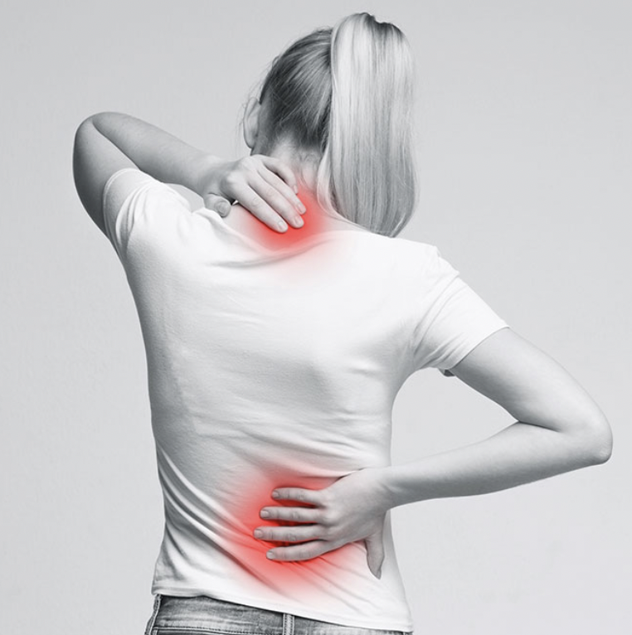
Factors leading to increased risk WRMD Oto
Female
Left-handed surgeons
Increased age
Increased years in practice
Increased surgical case time
Standing vs. sitting
Ryan, et al, Laryngoscope

Slide 11
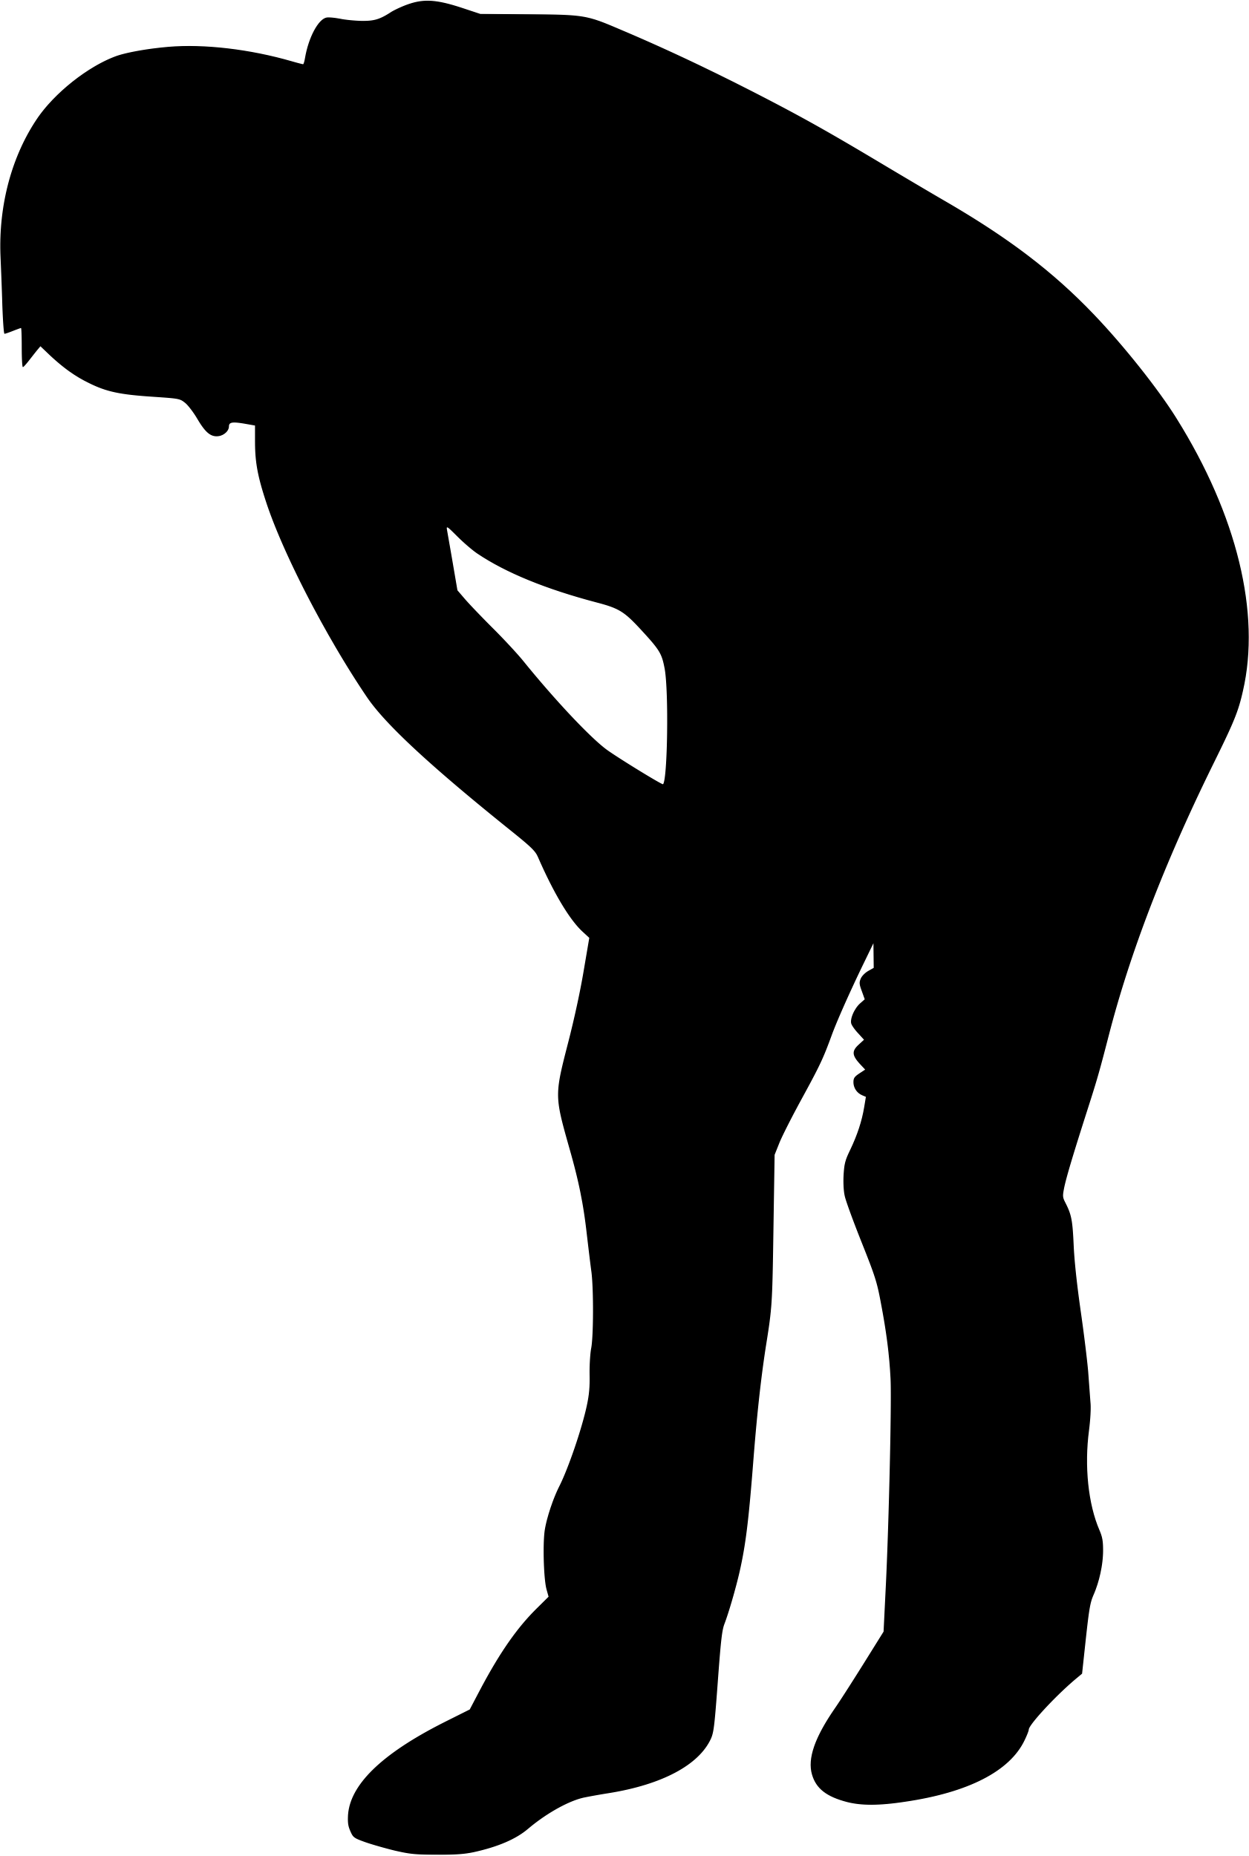
WRMD Impacts
23%-84% sought medical treatment
Surgical treatment: 2.4-28%
PTO: 5-23%
Eliminated OR time: 1-6%
23-62.5% report an overall diminishment in QOL

Slide 12
Resident WRMD
45 resident respondents (68.2%)
91.1% experienced WRMD in 12 months
  Shoulder 64.4% Wrist 33.3%
  Neck 60% Knees/ankles 31%
  Lower back 58% Hips/thighs 29%
Lower back concerns most common reason to seek medical attention.
Dahmash, et al, SQU Med J, 20(2), May 2020

Slide 13
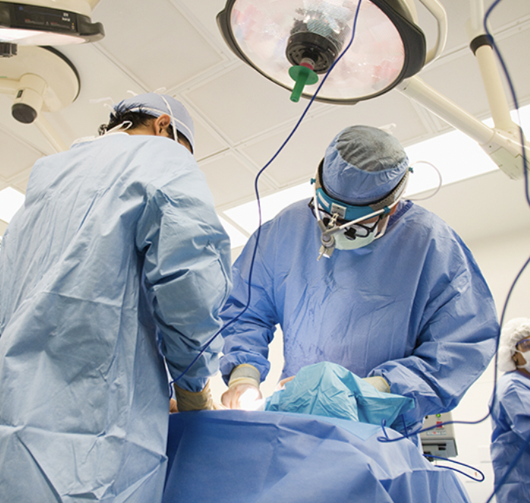
Factors increasing risk of WRMD
Microscope
Headlights
Loupes
Endoscopes
Prolonged sitting or standing
Repetitive fine motor movements
Static unfavorable body positions

Slide 14
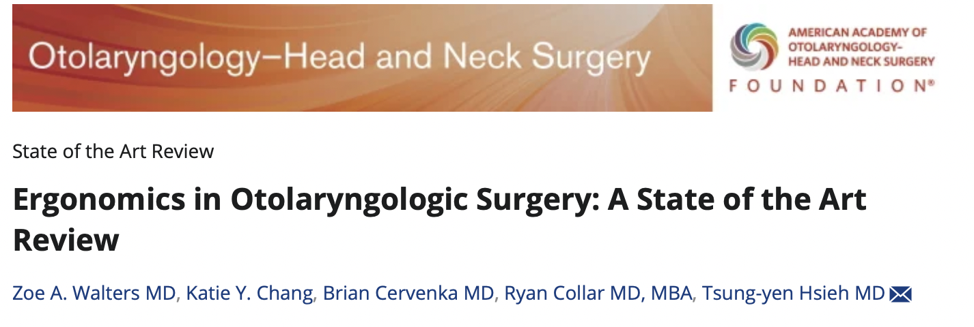
Otolaryngologic literature review
Investigated prevalence, severity, and interventions to decrease WRMD
38 articles included in the study
Notes:
WR musculoskeletal pain

Slide 15
Microlaryngeal surgery
  83% experienced pain
  Decreased muscle fatigue
    Decrease neck flexion to 0-10˚
    Arm supports
    Maintain laryngoscope angle at 40˚ from horizonal
Endoscopic sinus surgery
  Standing:
    Discomfort in back, lower extremities and postural muscles
  Sitting:
    Discomfort in shoulders and upper extremities
Notes:
FESS: position resulted in different patterns of discomfort

Slide 16
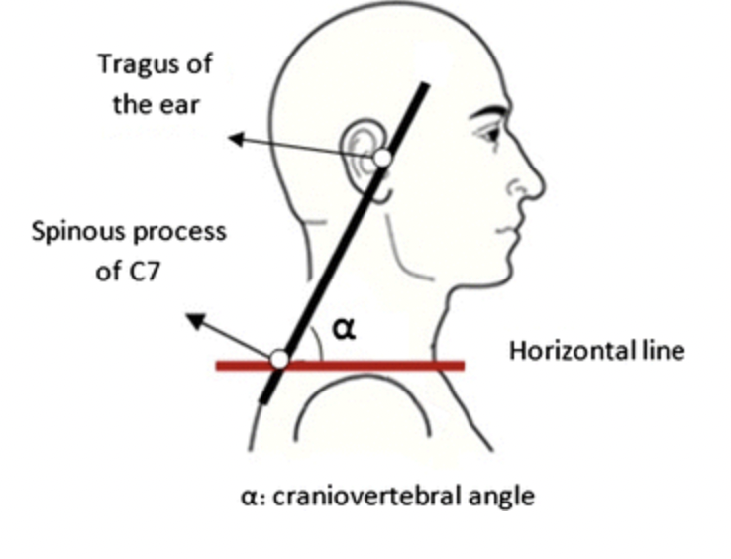
Craniovertebral Angle (CA)
Measures forward head position
Smaller the angle, more strain on the cervical spine and musculature
CA scores < 50˚, increased risk of cervical pain, TMJ and headaches

Slide 17
Craniovertebral Angle (CA)
Assessed CA during tonsillectomy
7 surgeons, 92 posture images
  Mean CV angle 26.0˚ (SD = 11.3˚)
  100% of procedures demonstrated at least one sustained abnormal posture
N Kelly, et al, Using the Craniovertebral Angle to Quantify Intraoperative Ergonomic Risk, Otohns, 167(4), 2022

Slide 18
Rapid Upper Limb Assessment (RULA)
Evaluate workers exposure to ergonomic risk factors to develop upper extremity MSD
Used across multiple industries
Assesses biomechanical & postural load requirements to perform job tasks

Slide 19
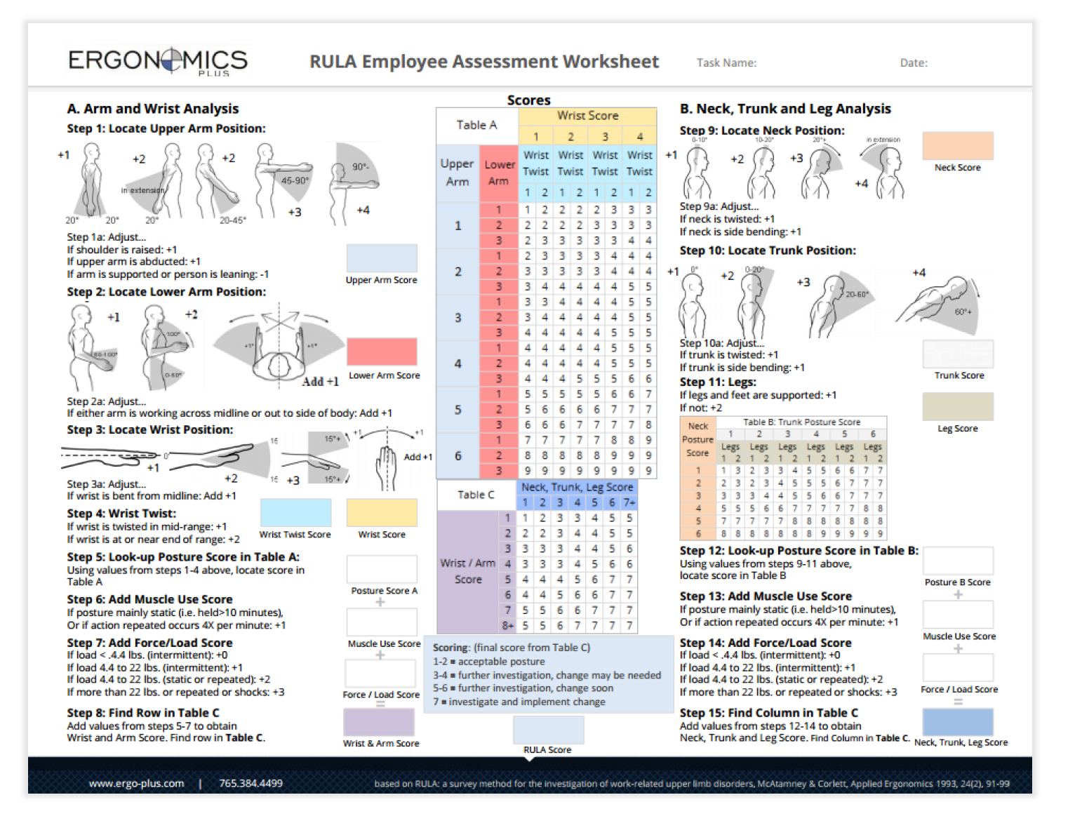

Slide 20
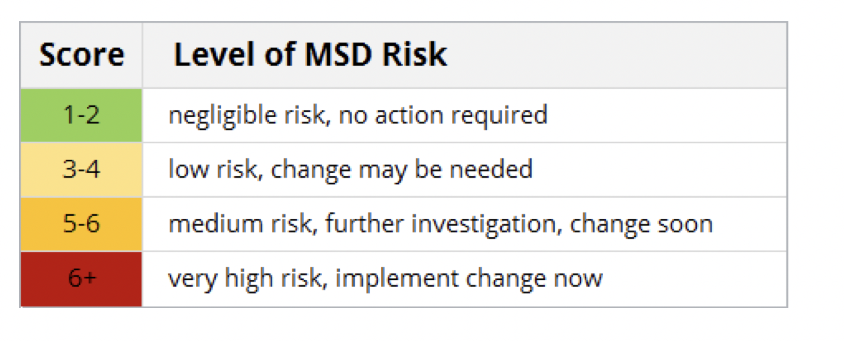
Rapid Upper Limb Assessment (RULA)

Slide 21
RULA in Otolaryngology
16 otolaryngologists
Tonsillectomy, adenoidectomy and Tympanostomy tube placement
RULA:
  0% of surgeons demonstrated negligible risk
  47% demonstrated low risk
  37% demonstrated high risk
  16% demonstrated very high risk
80% experienced MSD within one year of the study
40% experienced pain while operating
C Rodman, et al, Qualit Asses of Surgical Ergonomics in Oto, Otohns, 163(6)

Slide 22
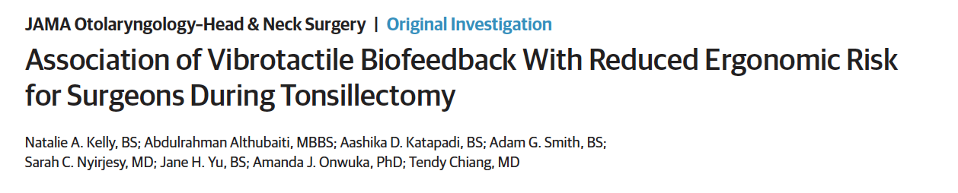
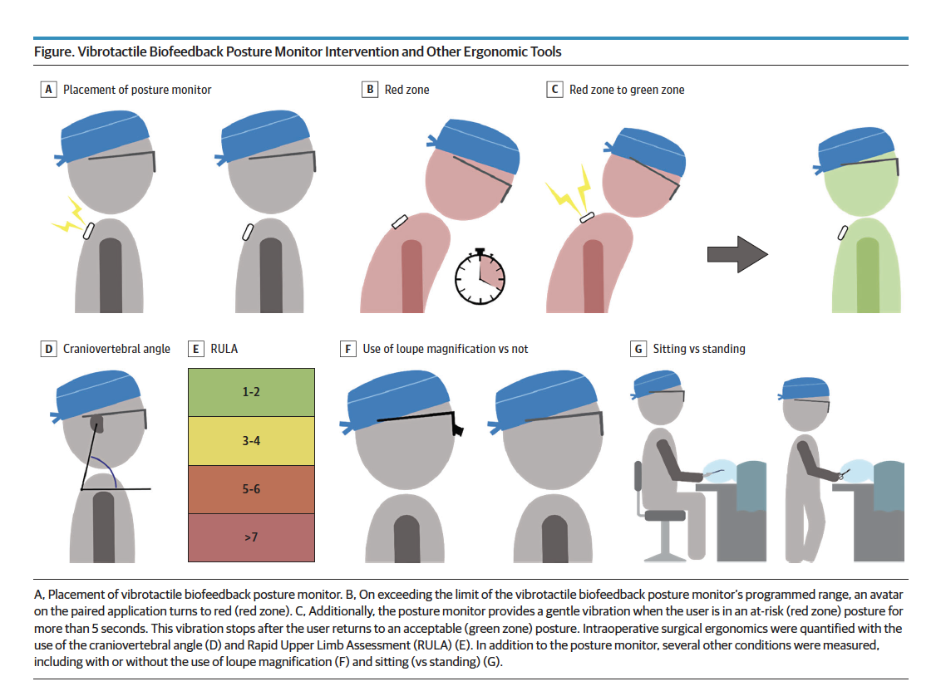
12 Attending surgeons
Tonsillectomy
Wearable posture monitor
Sitting vs. standing
Craniovertebral measurements
RULA
Loupes vs. no loupes

Slide 23
Without vibrotactile feedback: 60% of the procedure time in at-risk posture
Vibrotactile feedback: 20% of procedure time in at-risk posture
Use of vibrotactile feedback device:
  Craniovertebral improvement of 1.9 degrees
  RULA (neck, trunk and leg) improvement of 0.2 points

Slide 24
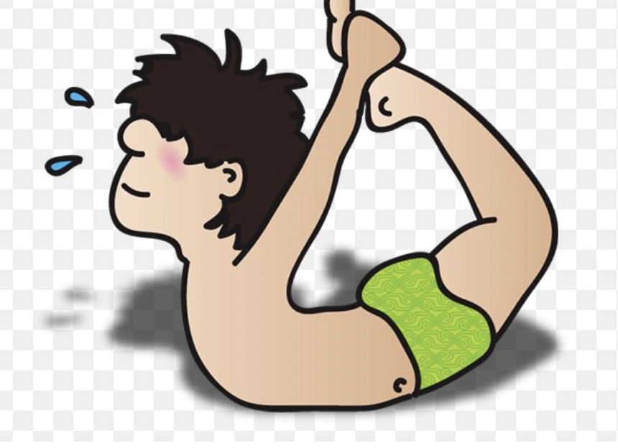
Micropauses
20 second break every 20 minutes of work
Recognized to be beneficial in sedentary professions

Slide 25
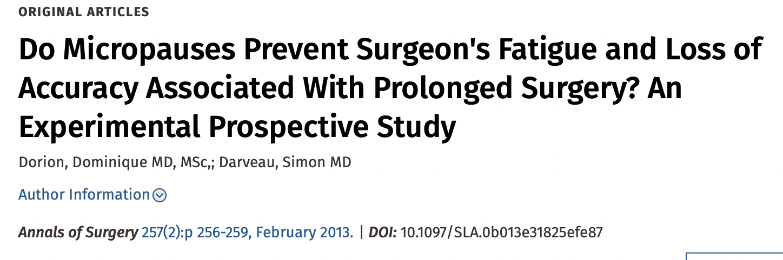
Significant decline in MSD
  Neck
  Back
  Shoulders
  Wrists
  Elbows
7-fold decline in mistakes in simulated surgical tasks
Majority did not incorporate into surgical routine

Slide 26
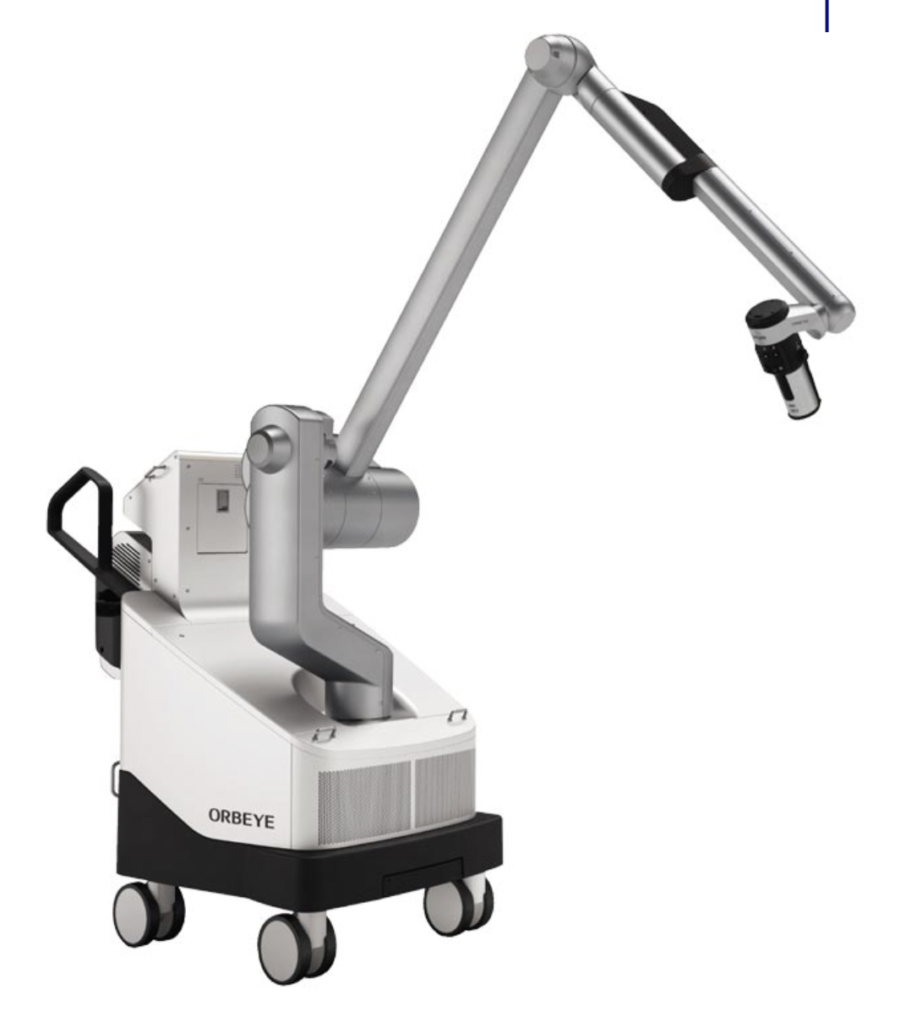
4K 3D Exoscope
Extracorporeal video telescopes
Improved ergonomics via video projection
“Heads up surgery”
Trialed in a variety of oto settings
Limitations
  Costs
  3D requires specific glasses
  Parotidectomy: increased risk of transient nerve palsy
Notes:
Neuro otology (stapes, lateral TB resection, vestibular schwannoma
Thyroid & head and neck, hypoglossal nerve stimulators

Slide 27
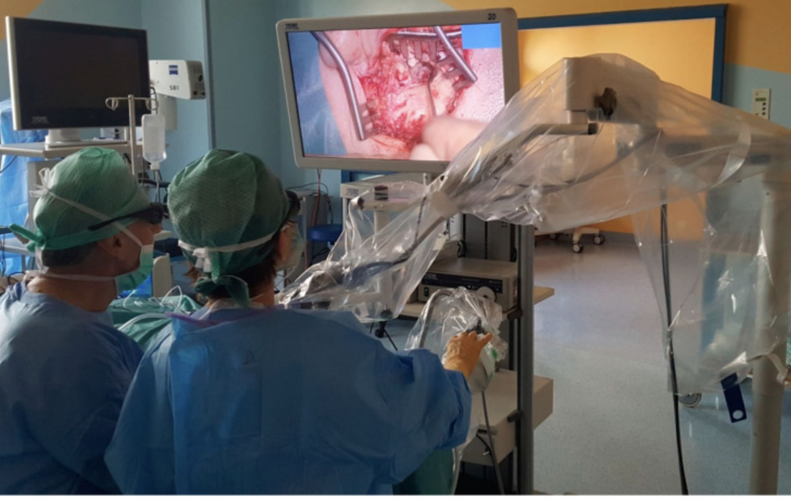
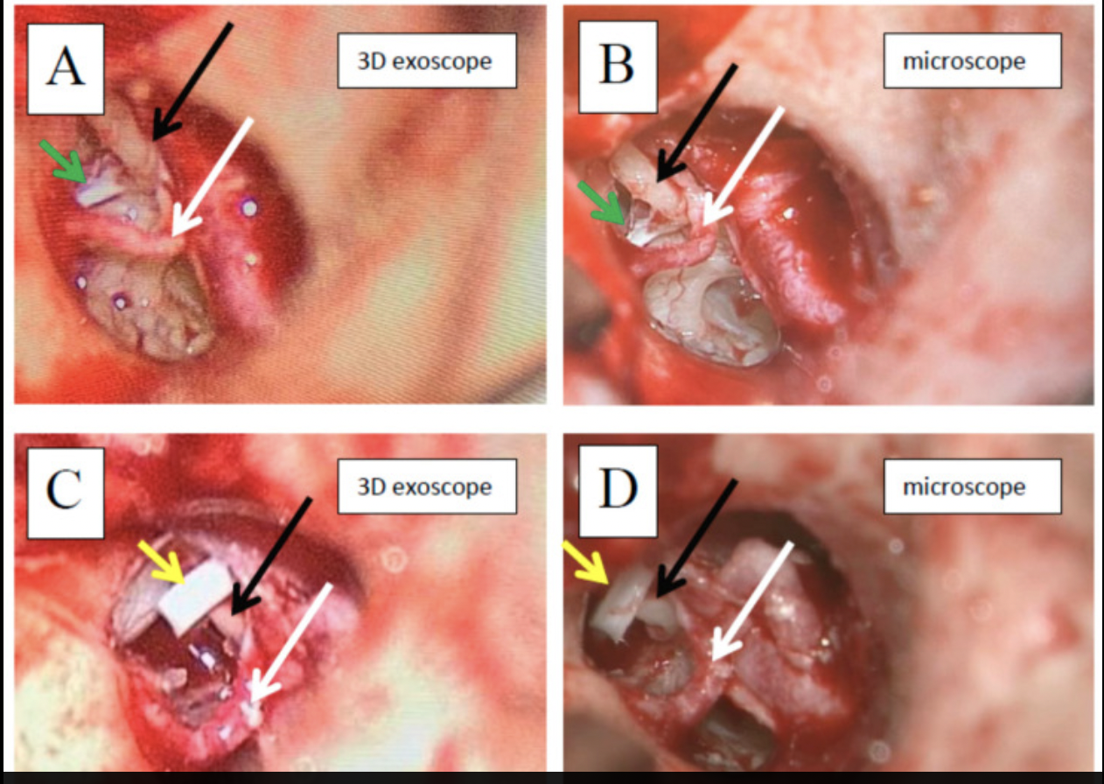
4K 3D Exoscope

Slide 28

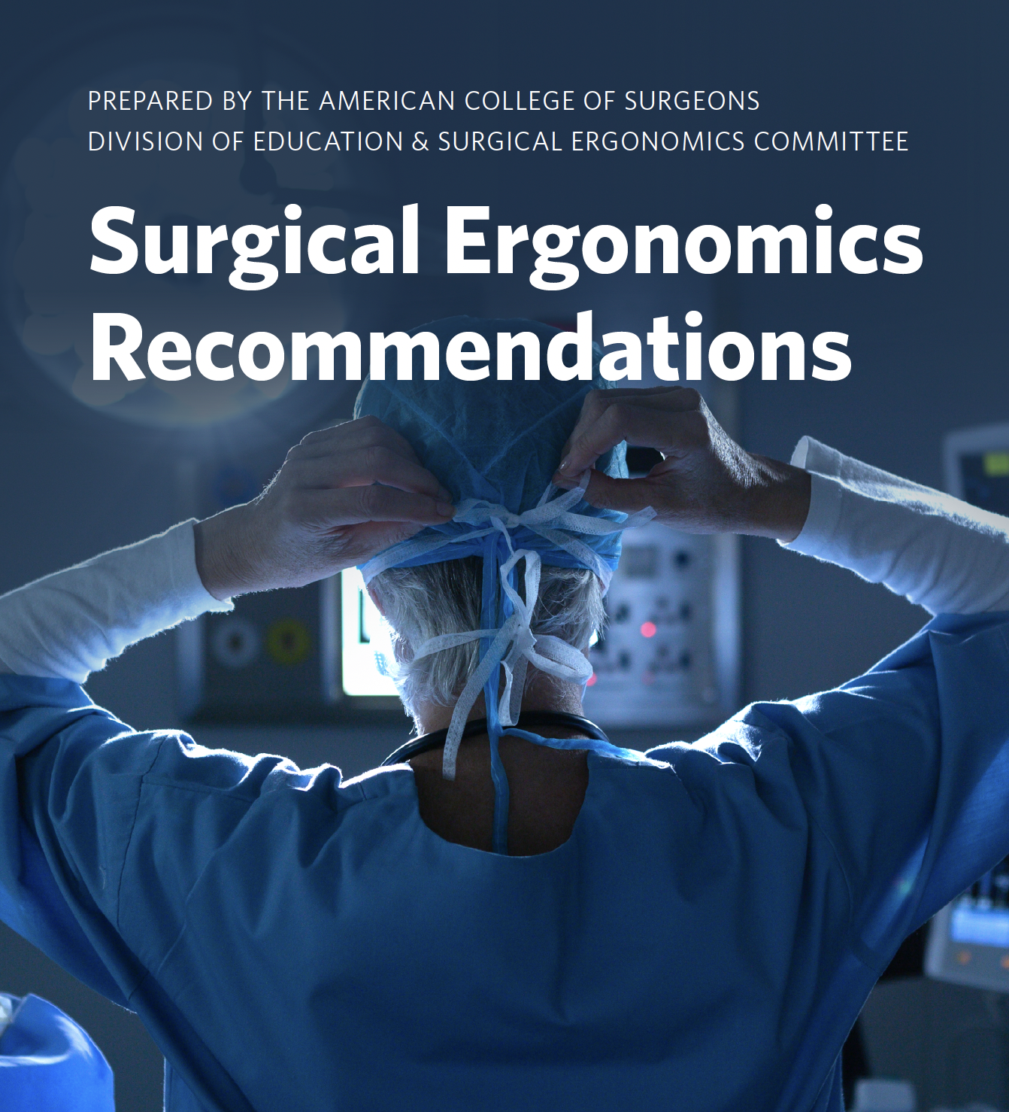

Slide 29
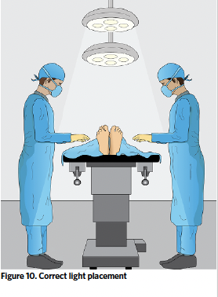
Surgical Lighting
Avoid shadows
Position lighting from variety of directions
Adjust as necessary during procedure

Slide 30
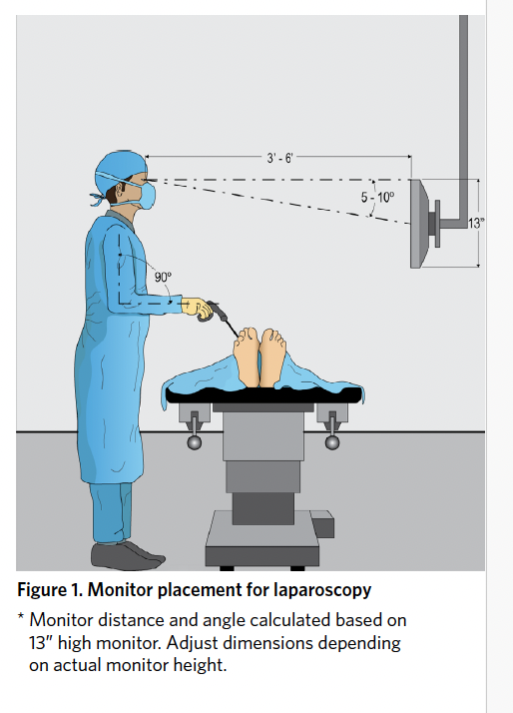
Monitors directly in front of surgeon
Monitor edge at eye level
Arms at 90˚
Micropauses/stretching every 30-60 minutes

Slide 31
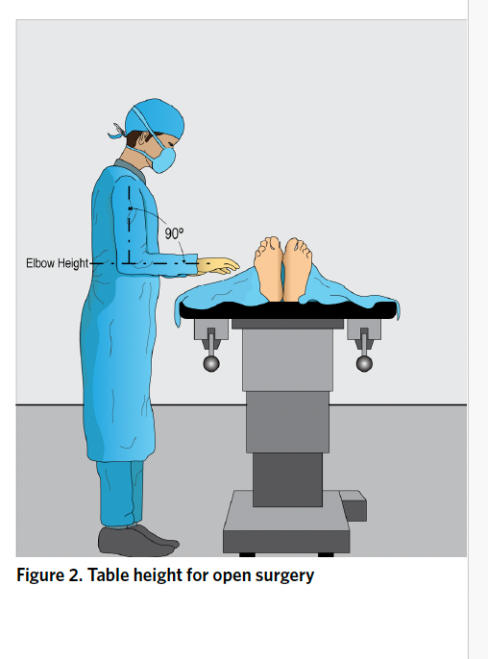
Table height adjusted to facilitate 90˚ angle at elbows

Slide 32
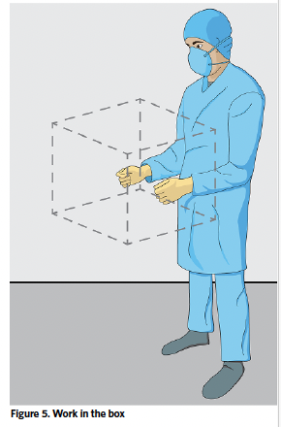
Work in a box:
  Arms at/near 90˚
  Wrists neutral
  Avoid static posture
  Use body supports is available (seats, arm supports)

Slide 33
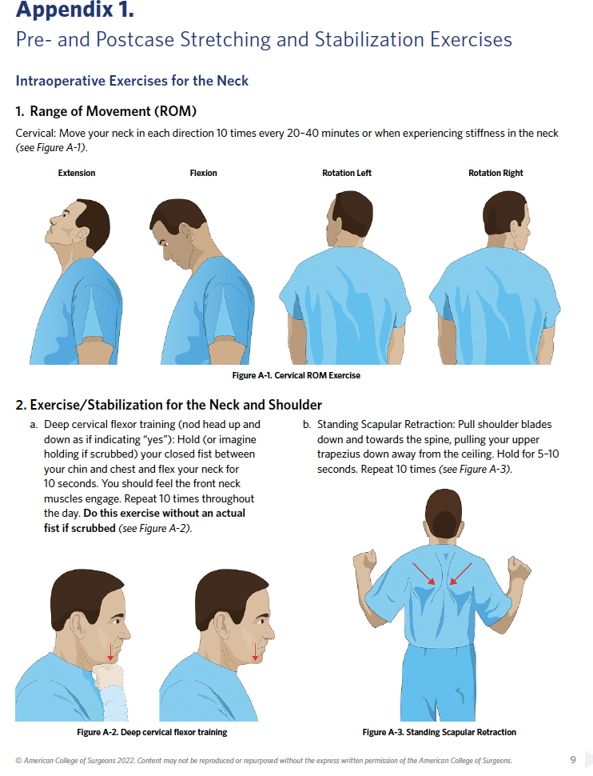
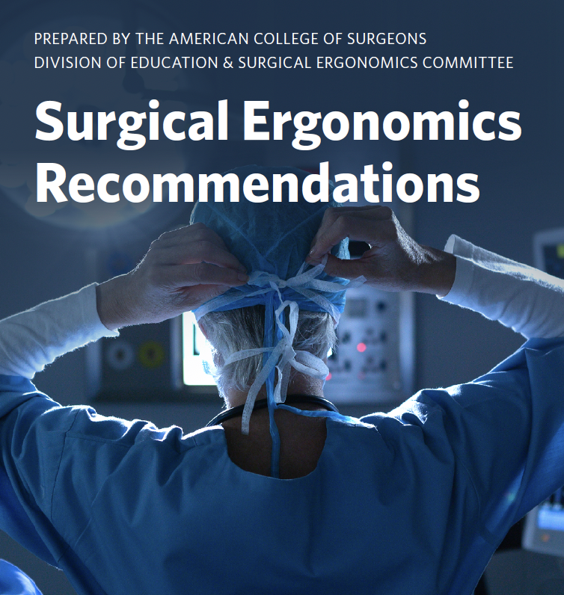
Stretching Exercises

Slide 34
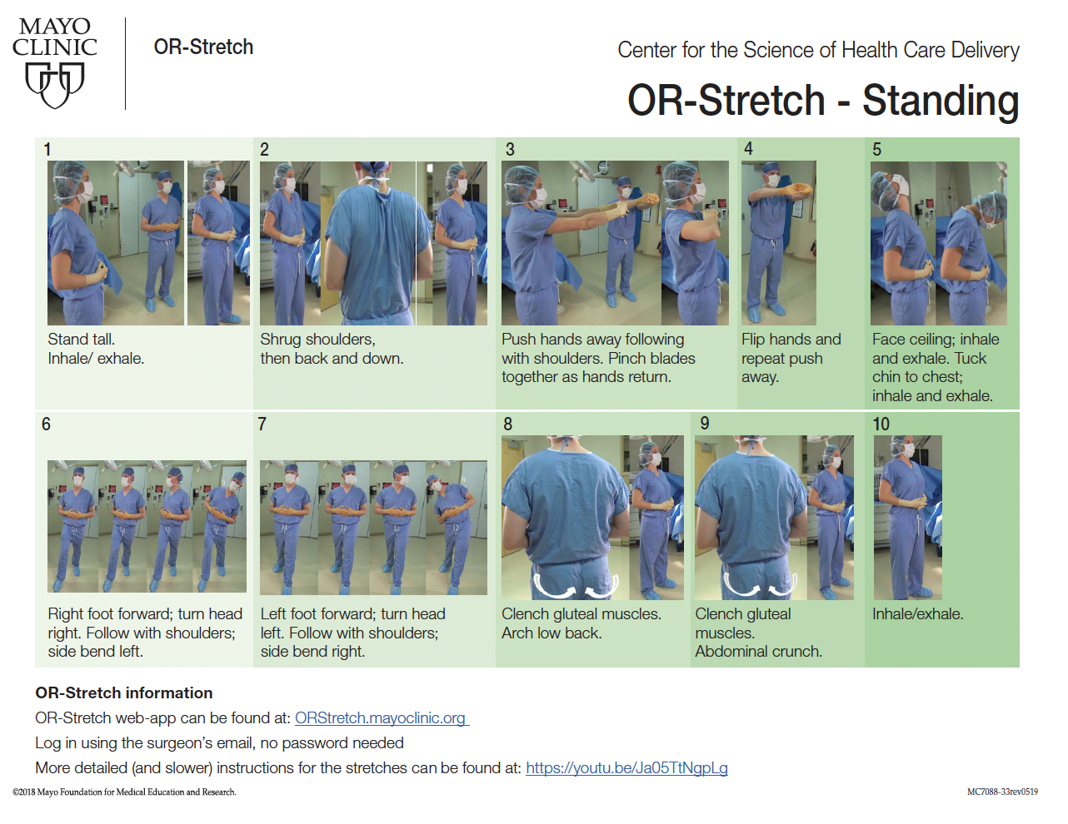

Slide 35
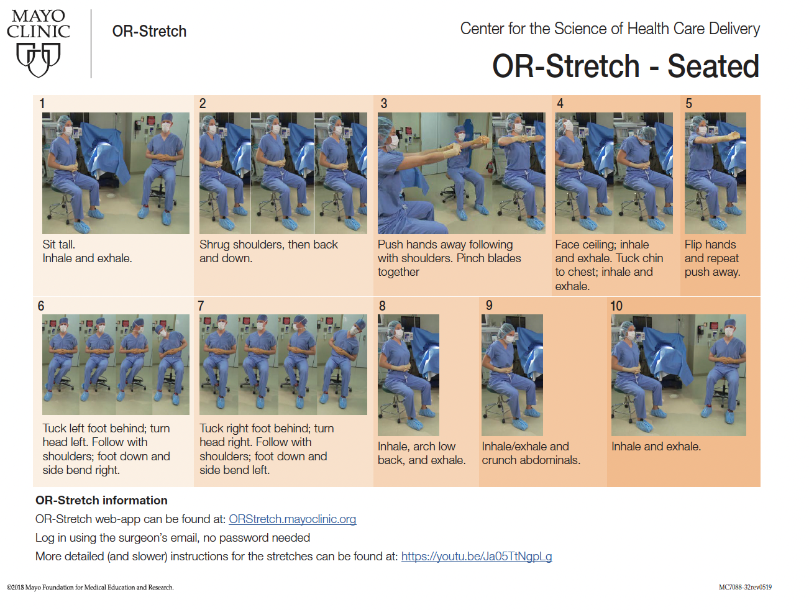

Slide 36
Conclusions

