Slide 1
Sleep and
Cardiovascular Health
Axel Shum
July 29, 2024
Best Evidence ENT

Slide 2
Overview: Topics
Sleep disordered breathing (OSA)
Sleep Duration
  Long
  Short
Sleep ‘quality’
Napping

Slide 3
OSA
OSA has well-established neuro-cognitive and CV sequelae
  Sub-clusters of OSA patients
    Disturbed sleep
    Minimal symptoms
    Excessive daytime sleepiness
Data on reduction of these risks has historically shown mixed results
Recent meta-analyses show:
  Most patients on CPAP have inadequate adherence
  Adequate CPAP adherence lowers risk of MACCEs
  (hazard ratio 0.69, 95% CI 0.52-0.92)
Sánchez-de-la-Torre et al, JAMA (2023)
MACCE: major adverse cardiac and cerebrovascular event

Slide 4
Sleep Duration
Short sleep duration (<6 hrs) in adults (compared to 7-8 hrs)
  Increases risk of MI (prospective study: CAD and sleep duration in women)^{1, 3}
  Associated with all cause mortality^{2, 3} (dose-response relationship)
  Parsed out associations to higher: DM, HTN, CV dz, CAD, obesity³
  Increased cerebrovascular microbleeds⁵
Long sleep duration (>9 hours)
  Associated with higher all cause mortality⁴ (worse than short sleep)
  Associated with >2x risk of stroke⁵ (also worse than short sleep)
  >10 hrs/night even worse
¹Ayas et al, Archives of Internal Medicine (2003)
²Kripke et al, Archives of General Psychiatry (2002)
³Itani et al, Sleep Medicine (2017) – systematic review, meta-analysis/regression
⁴Patel et al, Sleep (2006)
⁵Covassin et al, Sleep Medicine Clinics (2016)
Notes:
It seems almost more important to ask if short sleep is NOT associated with any specific disease – Itani et al did not have sufficient data to show that it definitively worsened HLD
Odds ratios for these at face value tend to be >2, but controlling for other health conditions and demographics etc it lowers to around 1.7

Slide 5
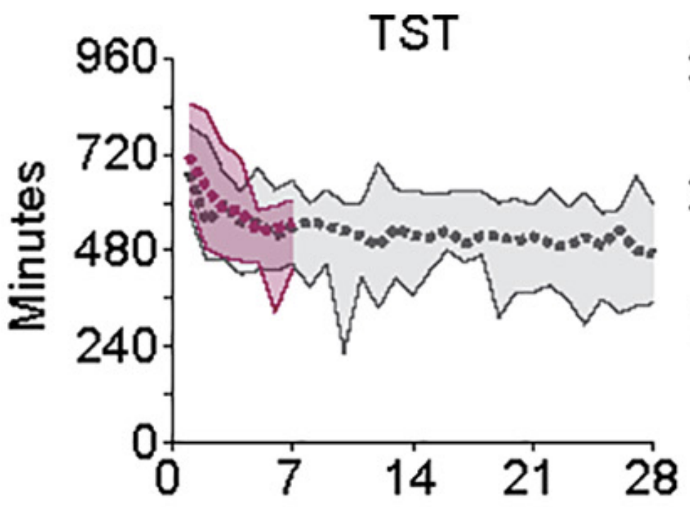
Sleep Duration
Total Sleep Time
14 hour (12 hour in 2nd study--pink) time in bed in lab after 2 weeks of of 8hrs/night sleep (no daytime napping allowed)
8.6 hours of sleep
Days into Study
Klerman et al, Frontiers in Physiology (2021)

Slide 6
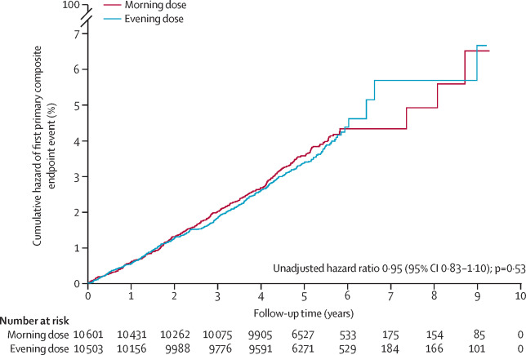
A Note on CV Disease Treatment
RCT
N ~21k people
Outcome: CV mortality or hospitalization for MI
*No effect of time-of-day of BP med administration
Mackenzie et al, Lancet (2022)
*not end of story, see next slide

Slide 7
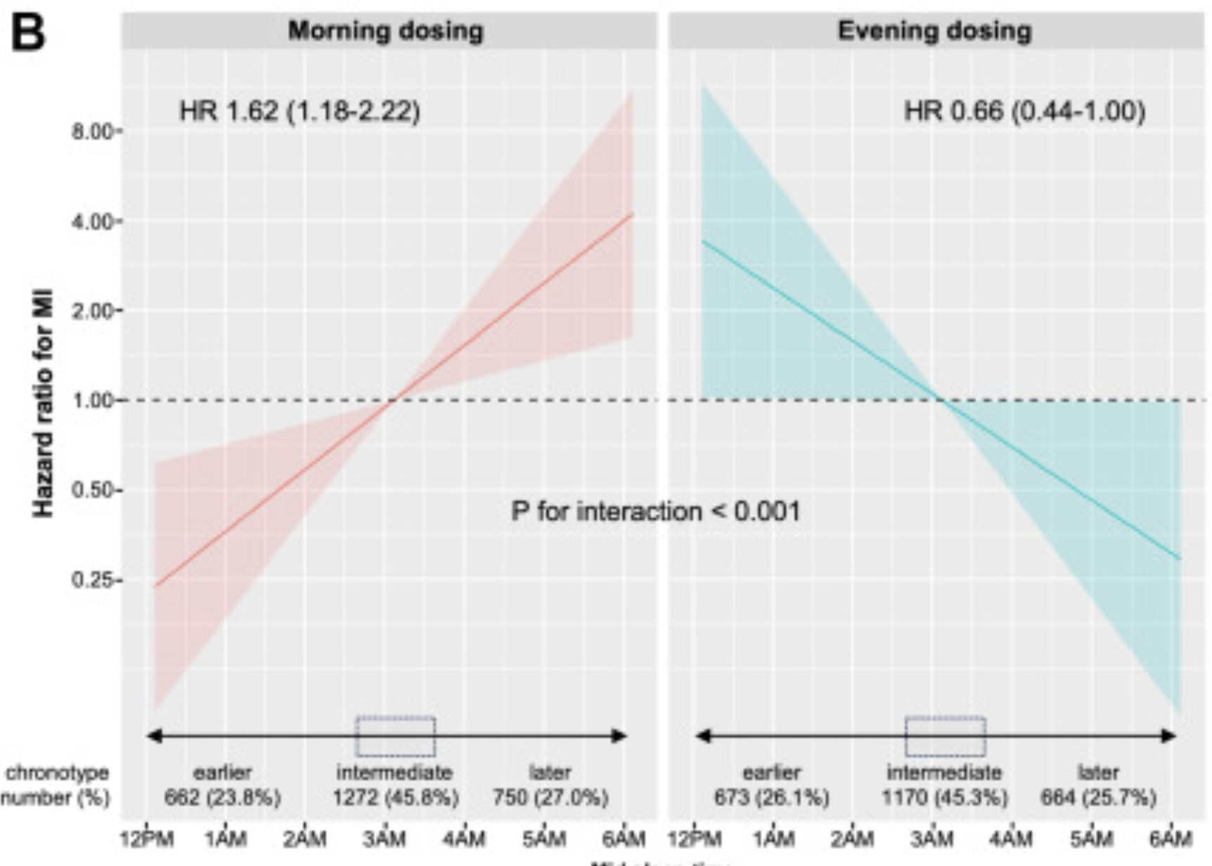
A Note on CV Disease Treatment
Same data as Lancet paper (lead author here is a coauthor of prior data)
Re: hospitalization for MI
Lowest risk medication timing by “chronotype”
Morning people -> AM
Evening people -> PM
Pigazzani et al, EClinicalMedicine (2024)

Slide 8
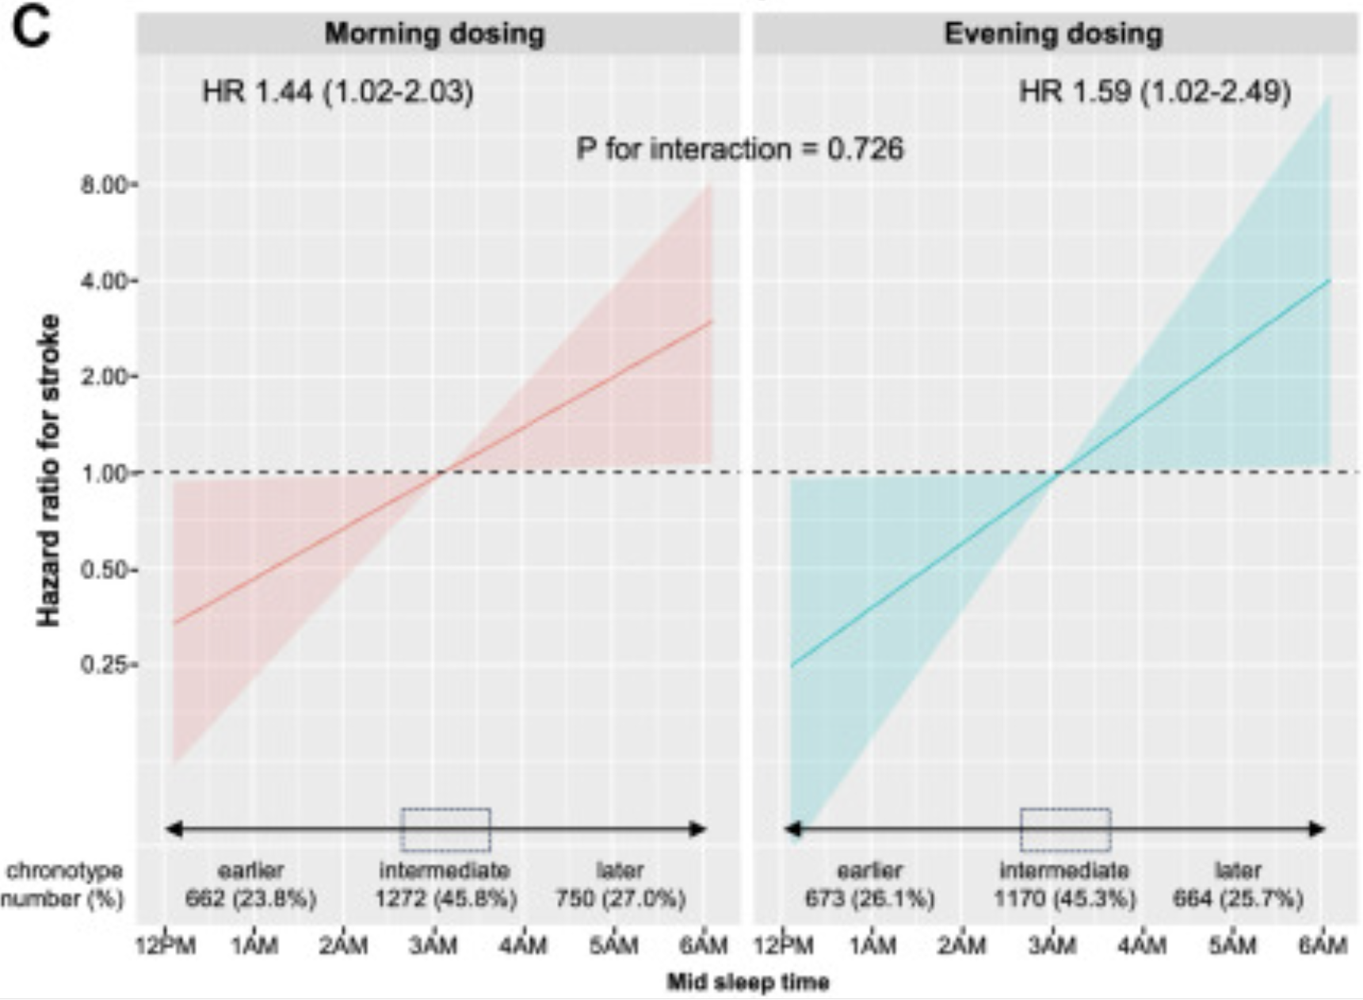
A Note on CV Disease Treatment
Same data as Lancet paper (lead author is also an author here)
Re: Stroke
Lowest risk medication timing by “chronotype”
Med timing no different, morning people less risk
Pigazzani et al, EClinicalMedicine (2024)

Slide 9
Shiftwork
WHO: ”…[there is] sufficient scientific evidence is available from animal and human studies to label shift work with circadian disruption a probable carcinogen.”
  Particularly for breast cancer and prostate cancer
  Multiple mechanisms hypothesized and studied (i.a., melatonin)
Straif et al, Lancet Oncology (2007)

Slide 10
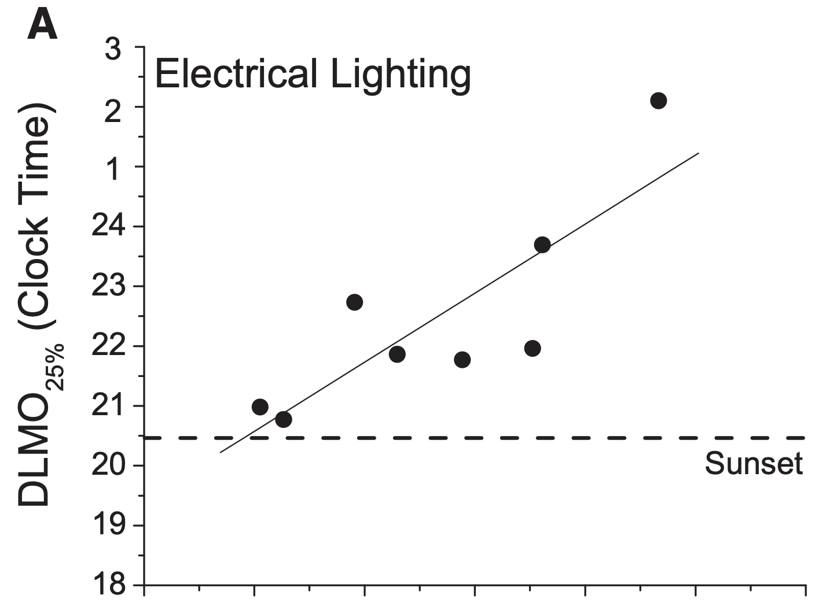
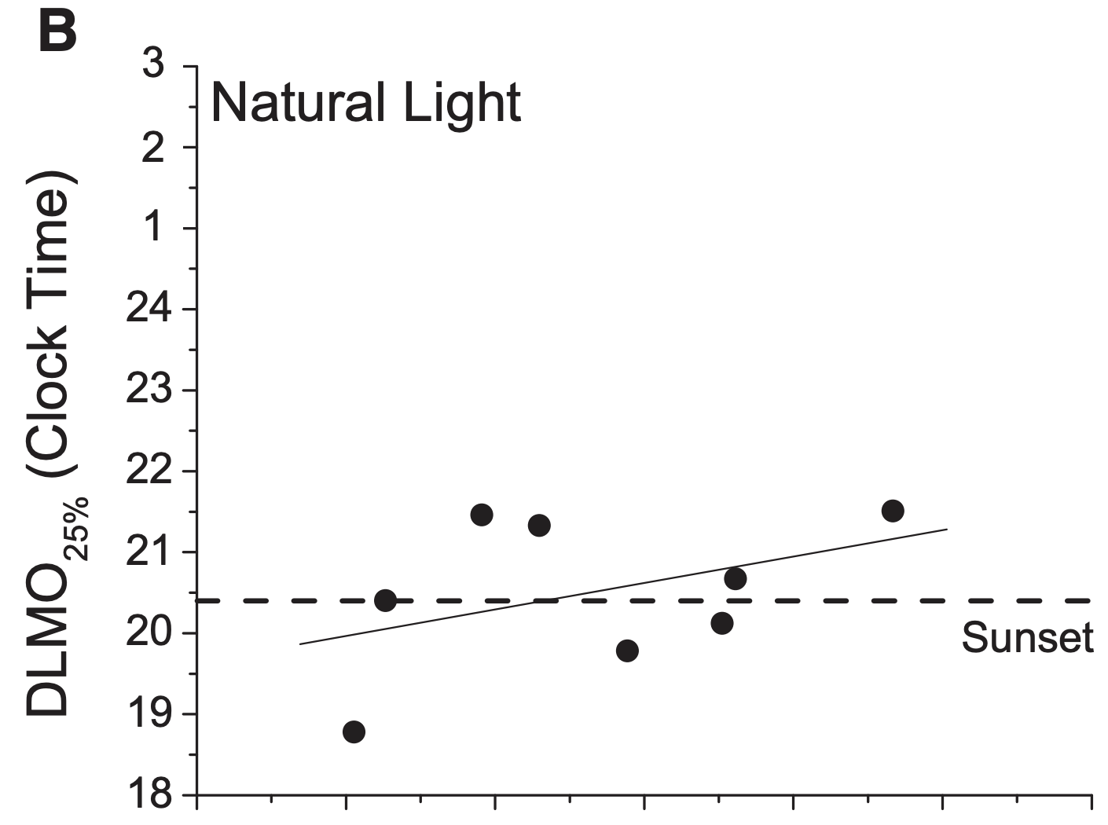
Chronotypes and Circadian Entrainment
Particularly in industrialized society, circadian timings vary
Circadian timing can however be entrained
Wright Jr. et al, Current Biology (2013) – the ”Summer Campers Study”

Slide 11
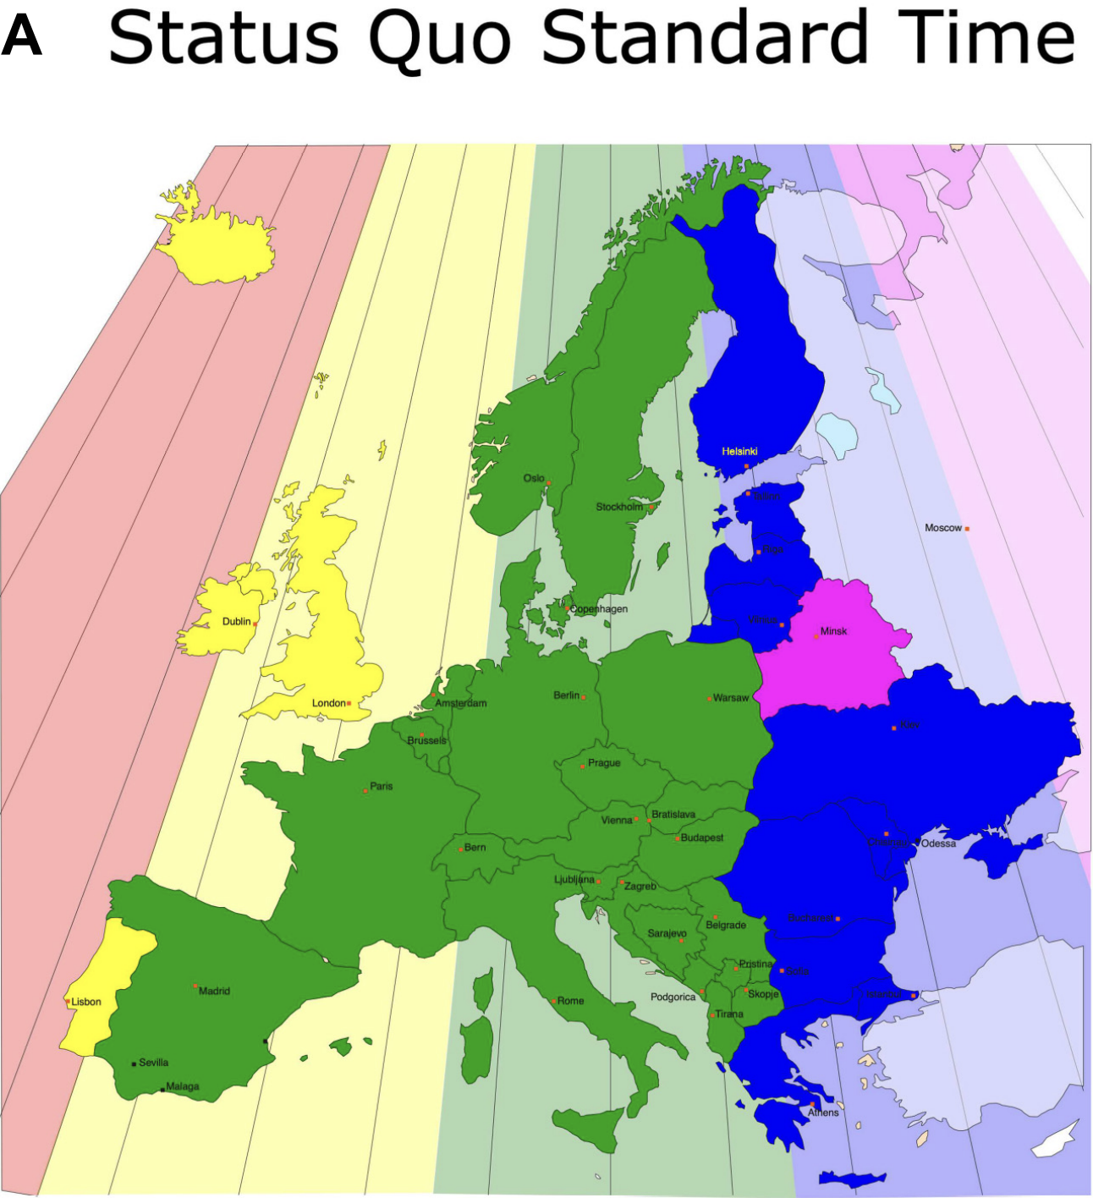
Cultural Chronotypes
Roenneberg et al, Frontiers in Physiology (2019)

Slide 12
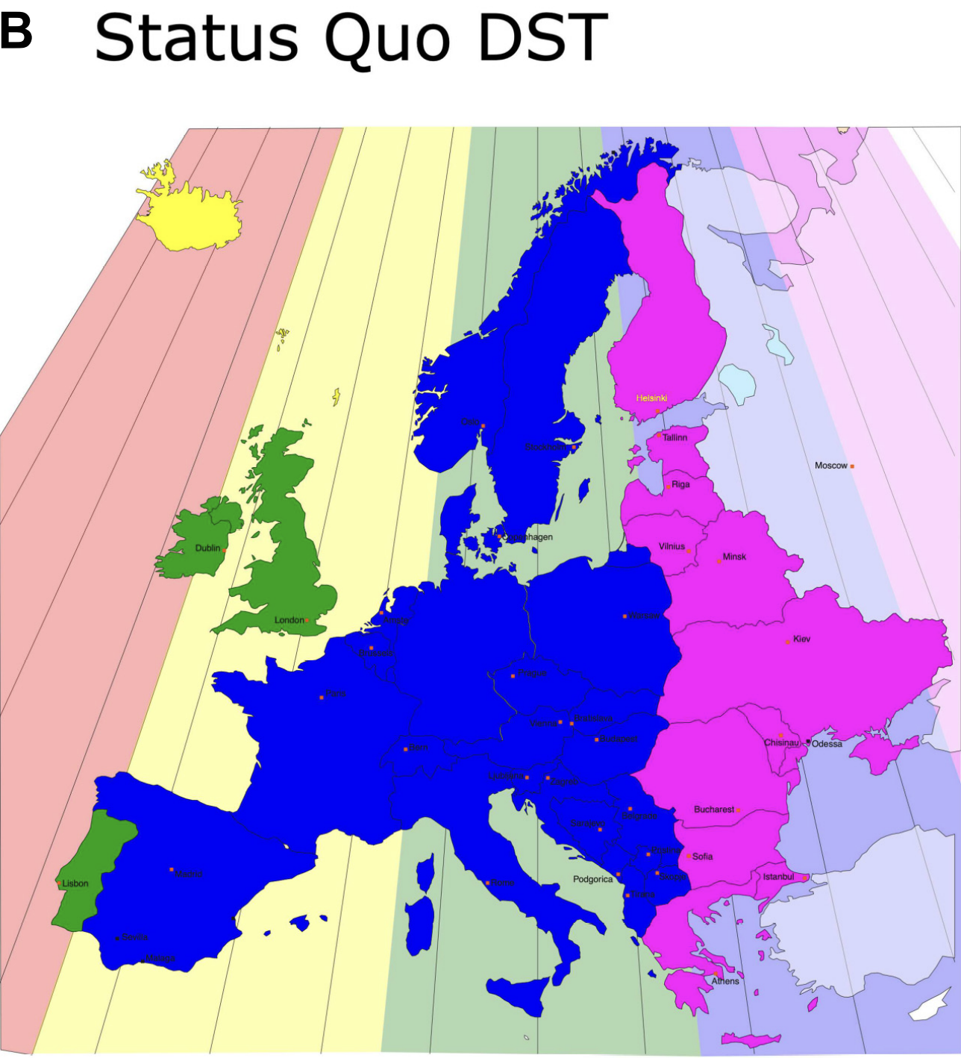
Cultural Chronotypes
Roenneberg et al, Frontiers in Physiology (2019)

Slide 13
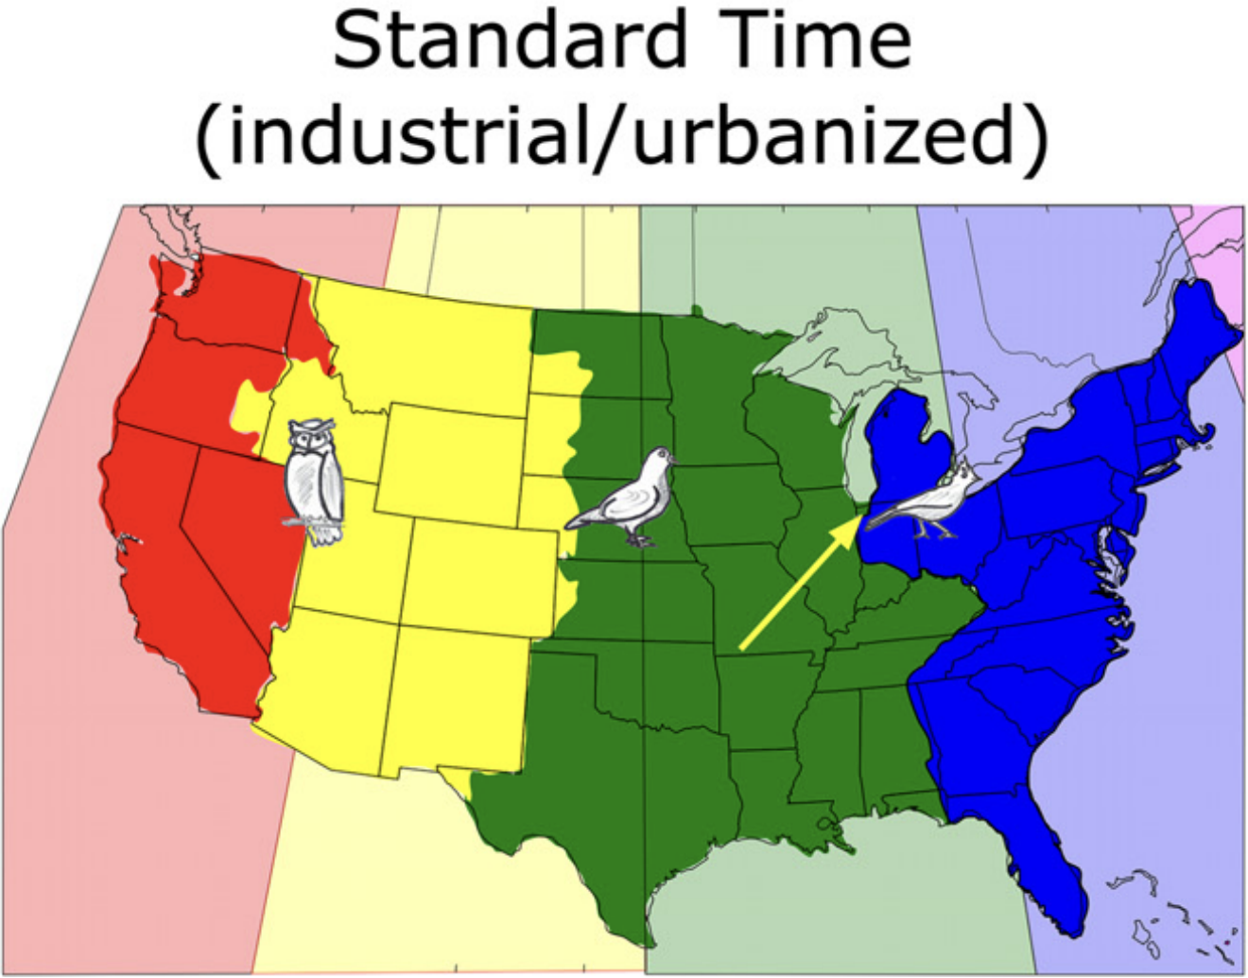
Cultural Chronotypes
Roenneberg et al, Frontiers in Physiology (2019)

Slide 14
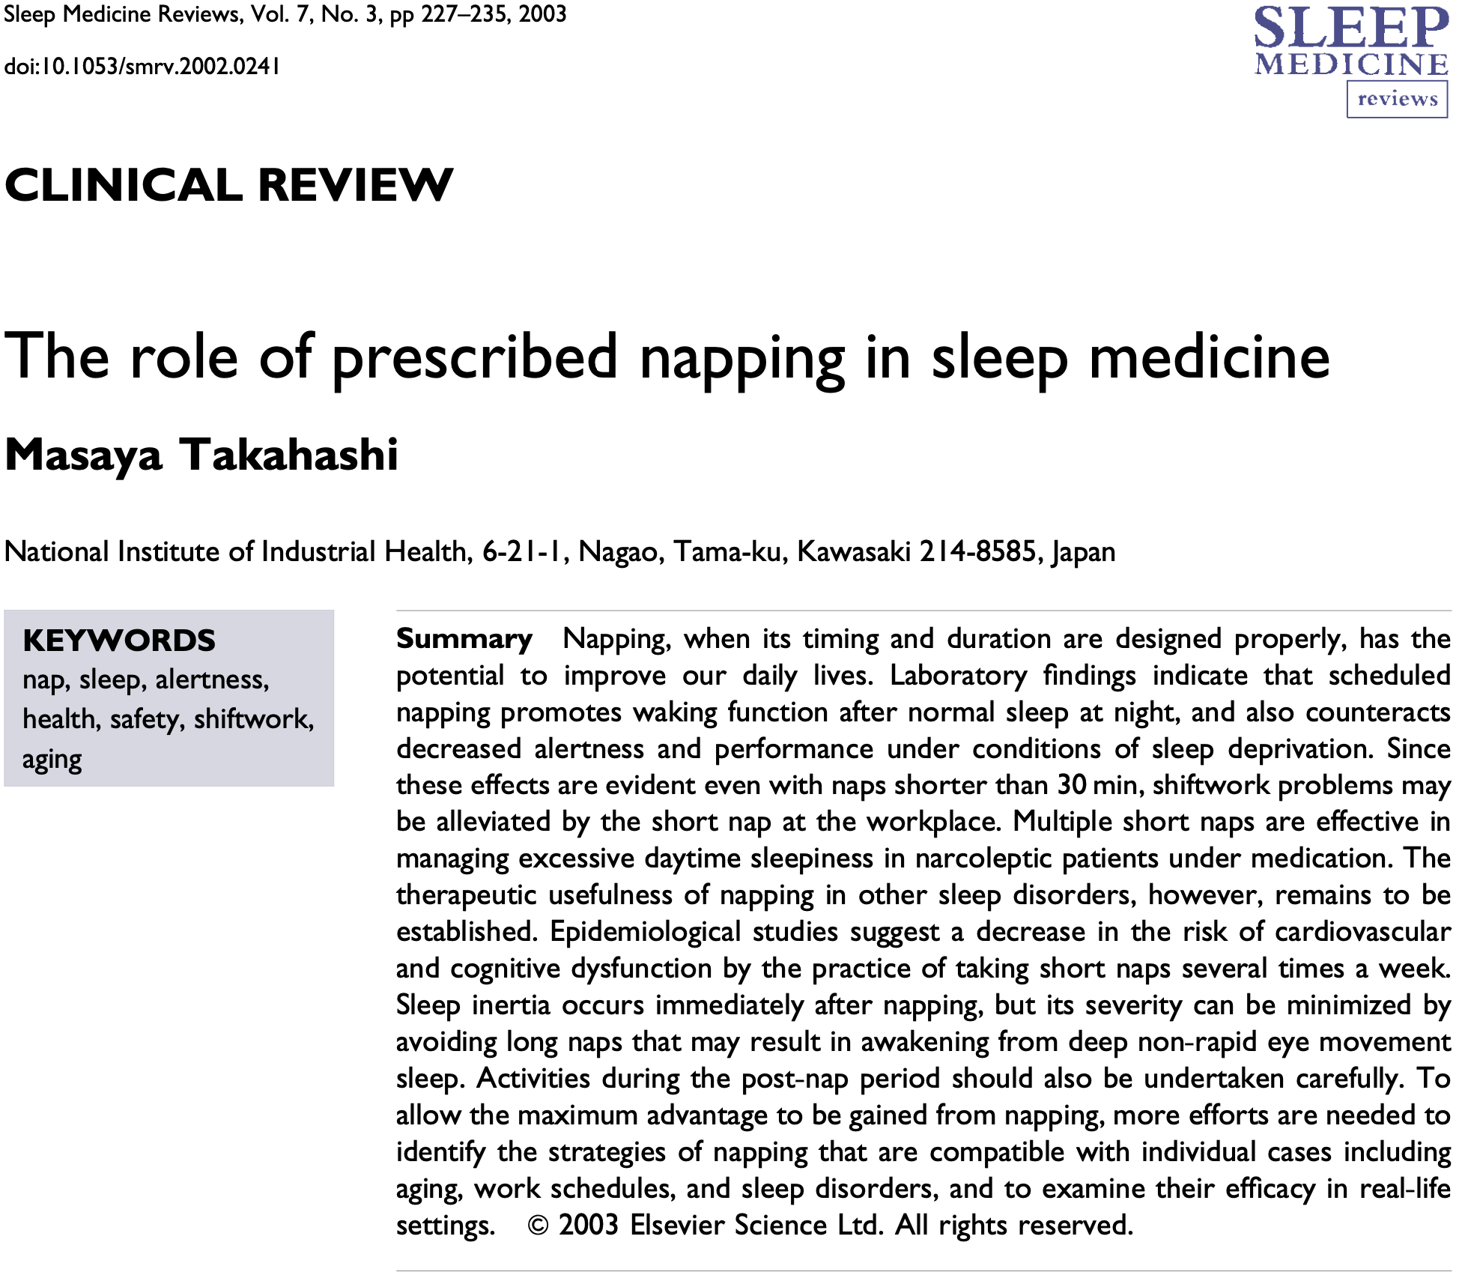
2003

Slide 15
Prescribed Napping in Clinical Practice
Uses
  Promote waking function even after normal sleep at night
  Counteract decreased alertness in setting of sleep deprivation
  Some data on decrease risk of CV and cognitive dysfunction in patients taking several naps/week
  These findings have been observed even in short naps (<30 min)
Concerns
  Sleep inertia follows napping (minimized by short nap)
  Limitations in real-life settings
  Utility is timing/duration/design-dependent
Takahashi, Sleep Medicine Reviews, 2003 (7(3), 227–235. https://doi.org/10.1053/smrv.2002.0241)

Slide 16
Prescribed Napping in Clinical Practice
Shift work – misalignment between circadian phase and work schedule
  15% of US and Canadian employers permit nap during breaktime during shifts outside business hours
  32% same as above as long as nap is “taken discreetly”
4+ hr consistently-timed daily “anchor” nap can stabilize circadian effects
  Reproducible effect but rarely achievable (programmer, EMS, on-call)
  (4 hrs trialed as a best guess, but not compared to other durations)
  Tested on residents during ~40-hour call shifts and in older studies on wakefulness of durations 50-90 hours
Takahashi, Sleep Medicine Reviews, 2003 (7(3), 227–235. https://doi.org/10.1053/smrv.2002.0241)

Slide 17
Prescribed Napping in Clinical Practice
Obstacles
  Sleep inertia (slow cognition during transition from sleep → alert)
    Limits utility of longer naps
    Generally increased if awakened during REM
    Time
      <20 minutes or >90 minutes
    Monitoring
    Delay onset of critical work to allow for full alertness
      Study of athletic performance determined an optimal latency of approximately 30 minutes before training/performance
Takahashi, Sleep Medicine Reviews, 2003 (7(3), 227–235. https://doi.org/10.1053/smrv.2002.0241)
Notes:
Standardized psychomotor vigilance task

Slide 18
Prescribed Napping in Clinical Practice
Obstacles
  Association with health risks
    Frequent nappers age > 65 (most days as opposed to rare/never)
      30% higher 4-year mortality (after adjusting for age, sex, residence, marital status, living arrangements, education, income, cognitive impairment, depressive symptoms, chronic illnesses, activities of daily living, physical activity, gross mobility, BMI, smoking status, and alcohol use)
Takahashi, Sleep Medicine Reviews, 2003 (7(3), 227–235. https://doi.org/10.1053/smrv.2002.0241)
Notes:
Standardized psychomotor vigilance task

Slide 19
Prescribed Napping in Clinical Practice
Obstacles
  Association with health risks
    6.5 year prospective study of 455 Jerusalem residents all age 70
      Daily nap associated with
        2x mortality rate over 6.5 years of study (controlling for sex, BP, smoking, cholesterol labs, DM, exercise, nocturnal sleep duration, CV dz, prior MI, financial hardship)
Takahashi, Sleep Medicine Reviews, 2003 (7(3), 227–235. https://doi.org/10.1053/smrv.2002.0241)
Notes:
Standardized psychomotor vigilance task

Slide 20
Prescribed Napping in Clinical Practice
Controlling for: age, sex, residential location, physical activity level, night sleep, income, education, BP, BMI, lipids, DM, HTN, angina
Obstacles
  Association with health risks
    Case control study
      Costa Ricans
      Mean age 57 years
      Nap n = 548, napless n = 589
      Nap durations
        45 minutes → 28%
        1.5 hours → 66%
        2.2 hours → 40%
Elevation in risk of MI compared to non-nappers
Takahashi, Sleep Medicine Reviews, 2003 (7(3), 227–235. https://doi.org/10.1053/smrv.2002.0241)
Notes:
Standardized psychomotor vigilance task

Slide 21
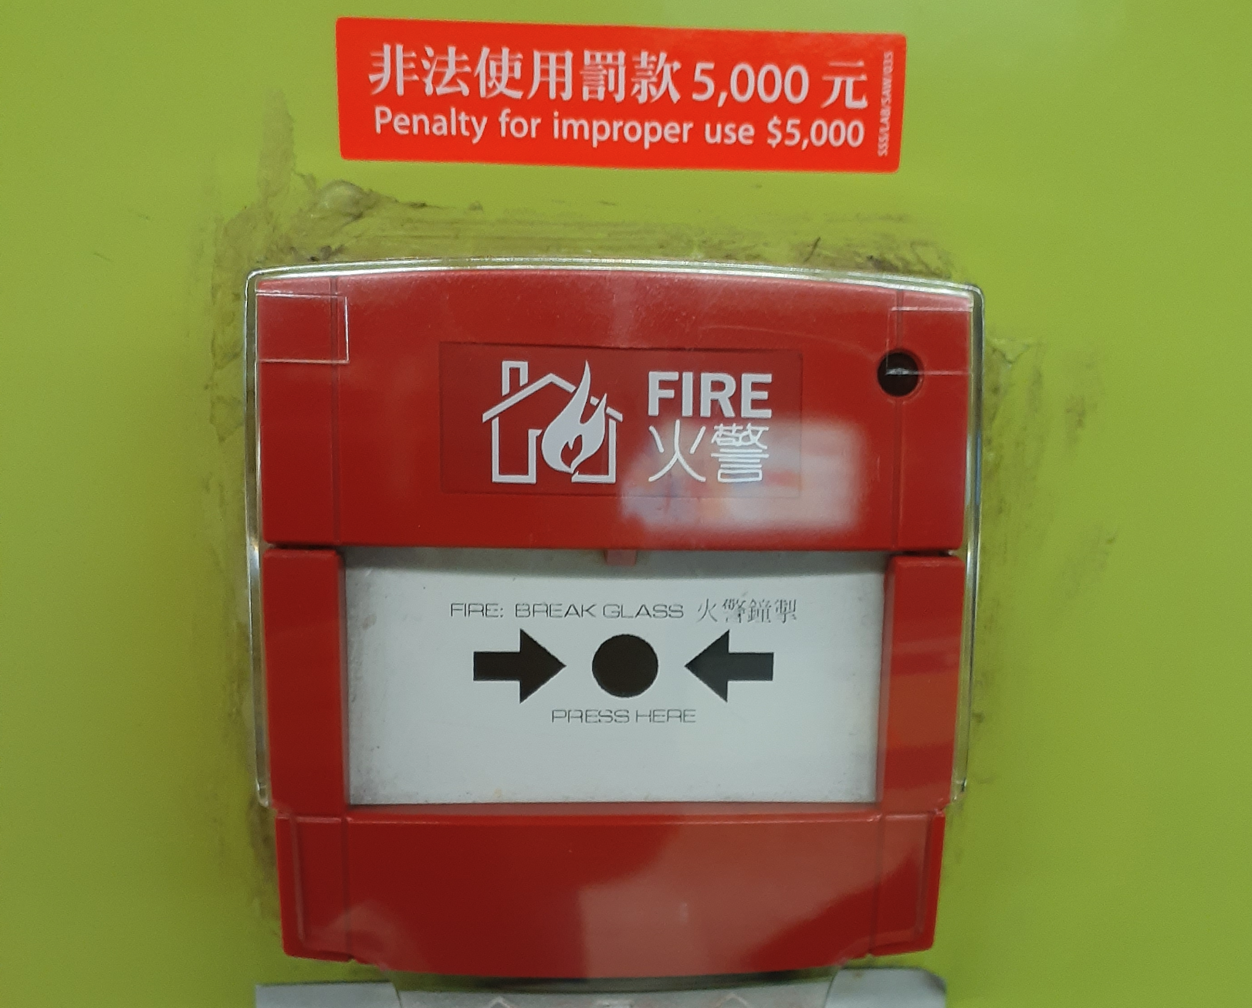
Image reproduced with permission from author Moraedsaim Choramdu under the Creative Commons Attribution-Share Alike 4.0 International license.

Slide 22
Summary
Sleep and sleep quality affect cardiovascular (and general) health
  Treatment of sleep disordered breathing mitigates CV risk
    Sleep/timing should be incorporated into CV disease treatment
    And research
  Sleep duration and timing also affect health
  Naps
    Avoid as able
    When necessary, use appropriately

Slide 23
References
Takahashi M, Sleep Medicine Reviews (2003)
Ayas et al, Archives of Internal Medicine (2003)
Kripke et al, Archives of General Psychiatry (2002)
Itani et al, Sleep Medicine (2017)
Patel et al, Sleep (2006)
Covassin et al, Sleep Medicine Clinics (2016)
Klerman et al, Frontiers in Physiology (2021)
Mackenzie et al, Lancet (2022)
Pigazzani et al, EClinicalMedicine (2024)
Straif et al, Lancet Oncology (2007)
Wright Jr. et al, Current Biology (2013)
Roenneberg et al, Frontiers in Physiology (2019)

Slide 24
Questions & Discussion

Slide 25
Thank you

Slide 26
Auxiliary Slides

Slide 27
Napping research stratification
Age stratification
  <5
  20-50
  >50
Health stratification
  Hypersomnia
  Metabolic disease
  Cognition
  Cardiovascular disease
  Athletes
Cultural considerations

Slide 28
Prescribed Napping in Clinical Practice
“24-hour society”
  Creating a 24-hour culture results in health costs for those participating in and supporting it
    Decreased alertness
    Increased errors/accidents
    Decreased productivity
    Poor quality of life
  Motivation for research into measures to counteract these effects
Takahashi, Sleep Medicine Reviews, 2003 (7(3), 227–235. https://doi.org/10.1053/smrv.2002.0241)

Slide 29
Prescribed Napping in Clinical Practice -Cognition
Young adults (20-30 years)
  15-minute PM nap -> shorter P300 latency, decreased typing errors
    Significantly better than no nap or 45-minute nap
    Effect preserved in “normal” night (~7.4 hrs) and restricted (4 hr)
    Improved alertness persisted x 3 hrs post-nap
    10-mins naps similar to 15-mins effect (better than 30-mins)
  Outperformed other interventions in driving performance
    Cold air to face, loud music, etc.
    (15 minute nap + 200 mg caffeine yielded best performance)
Takahashi, Sleep Medicine Reviews, 2003 (7(3), 227–235. https://doi.org/10.1053/smrv.2002.0241)
Notes:
Event-related potential is a stereotyped waveform in response to a variety of general sensory stimuli, and the latency to the P3b wave or “P300 latency” is a measure of alertness or speed of thought

Slide 30
Prescribed Napping in Clinical Practice
Older Adults
  Short naps -> similar acute effects to those of young adults
  PSG study: 34-minute PM nap yielded 24-minutes of sleep on PSG
  Napping more prevalent (mean 73 yrs, ~4.6/week, mean 38 mins)
  Longer naps (90 minutes) detract from nocturnal sleep
    Affected nocturnal body temperature
    Decreased sleep efficiency
    Longer sleep latency (and later bedtime + earlier wake time)
    Nap did improve evening alertness (at about 7:30PM)
Takahashi, Sleep Medicine Reviews, 2003 (7(3), 227–235. https://doi.org/10.1053/smrv.2002.0241)
Notes:
Event-related potential is a stereotyped waveform in response to a variety of general sensory stimuli, and the latency to the P3b wave or “P300 latency” is a measure of alertness or speed of thought

Slide 31
Prescribed Napping in Clinical Practice
Shift work – misalignment between circadian phase and work schedule
  Cockpit naps for NASA pilots (40-min nap vs. no nap)
    Significantly higher vigilance
      Napless → 20% reduction in vigilance
      30% more lapses of >0.5 seconds to respond to stimulus
      EEG “microevents” were significantly more frequent w/o nap
    Self-assessed subjective alertness did not differ significantly
  Similar findings for 30-minute naps in different fields (air traffic controllers, oil refinery workers, drivers, etc.)
Takahashi, Sleep Medicine Reviews, 2003 (7(3), 227–235. https://doi.org/10.1053/smrv.2002.0241)
Notes:
Standardized psychomotor vigilance task

Slide 32
Prescribed Napping in Clinical Practice
Sleep disorders – Excessive daytime sleepiness (EDS)
  Insomnia
    Higher daytime arousal → challenging to sleep during nap
    Generally have a negative influence
      Sap sleep drive
      Dampen amplitude of circadian influences
    If insomnia + sleep deprivation + naps that do result in sleep
      Shorten and move away from consolidated sleep time
Takahashi, Sleep Medicine Reviews, 2003 (7(3), 227–235. https://doi.org/10.1053/smrv.2002.0241)
Notes:
Standardized psychomotor vigilance task

Slide 33
*Excerpt from Takahashi 2003
“...occupational safety and health staff, in collaboration with sleep specialists, should be responsible for explaining to employers the manageable aspects of sleepiness in workers with narcolepsy, and proposing feasible schedules for napping.”
Takahashi M. (2003). The role of prescribed napping in sleep medicine. Sleep medicine reviews, 7(3), 227–235. https://doi.org/10.1053/smrv.2002.0241

Slide 34
Insomnia
Eliminate napping to help with build up evening sleep drive
If unavoidable
  Move naps further from consolidated sleep onset
  Shorten nap to <1 hour, even <30 minutes

Slide 35
Narcolepsy
As a safety measure
Before driving or other activities
Short naps
  10-20 minutes PRN
  No longer than 1 hour
In addition to other therapies

Slide 36
Sleep Deprivation
Similar to use in narcolepsy
Safety before driving
Some research in setting of shift work
Short preventive naps to decrease risk of unintentional nap
  FAA

Slide 37
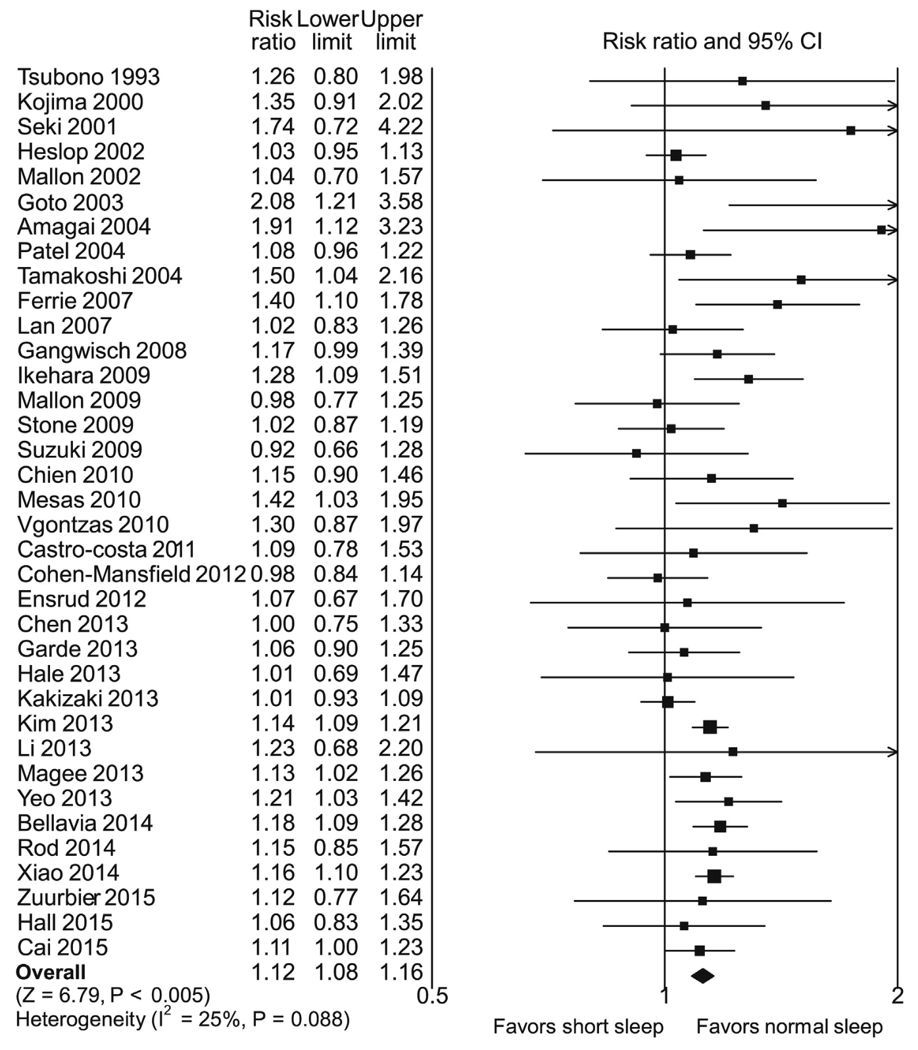
Itani et al. 2017: Short Sleep Mortality

Slide 38
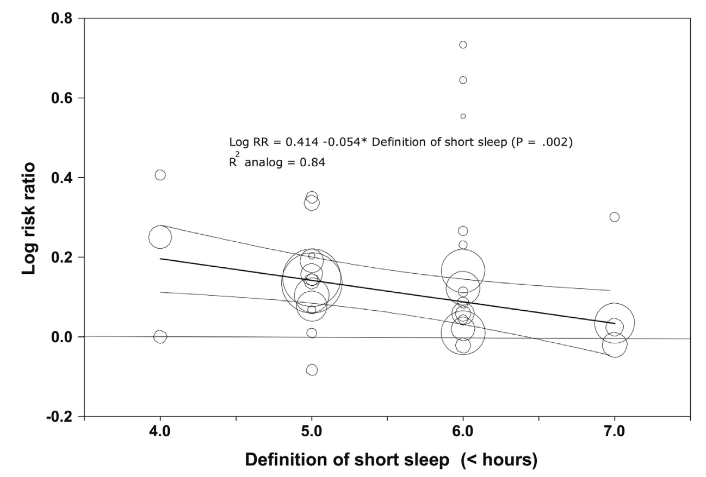
Itani et al. 2017: Short Sleep Mortality

Slide 39
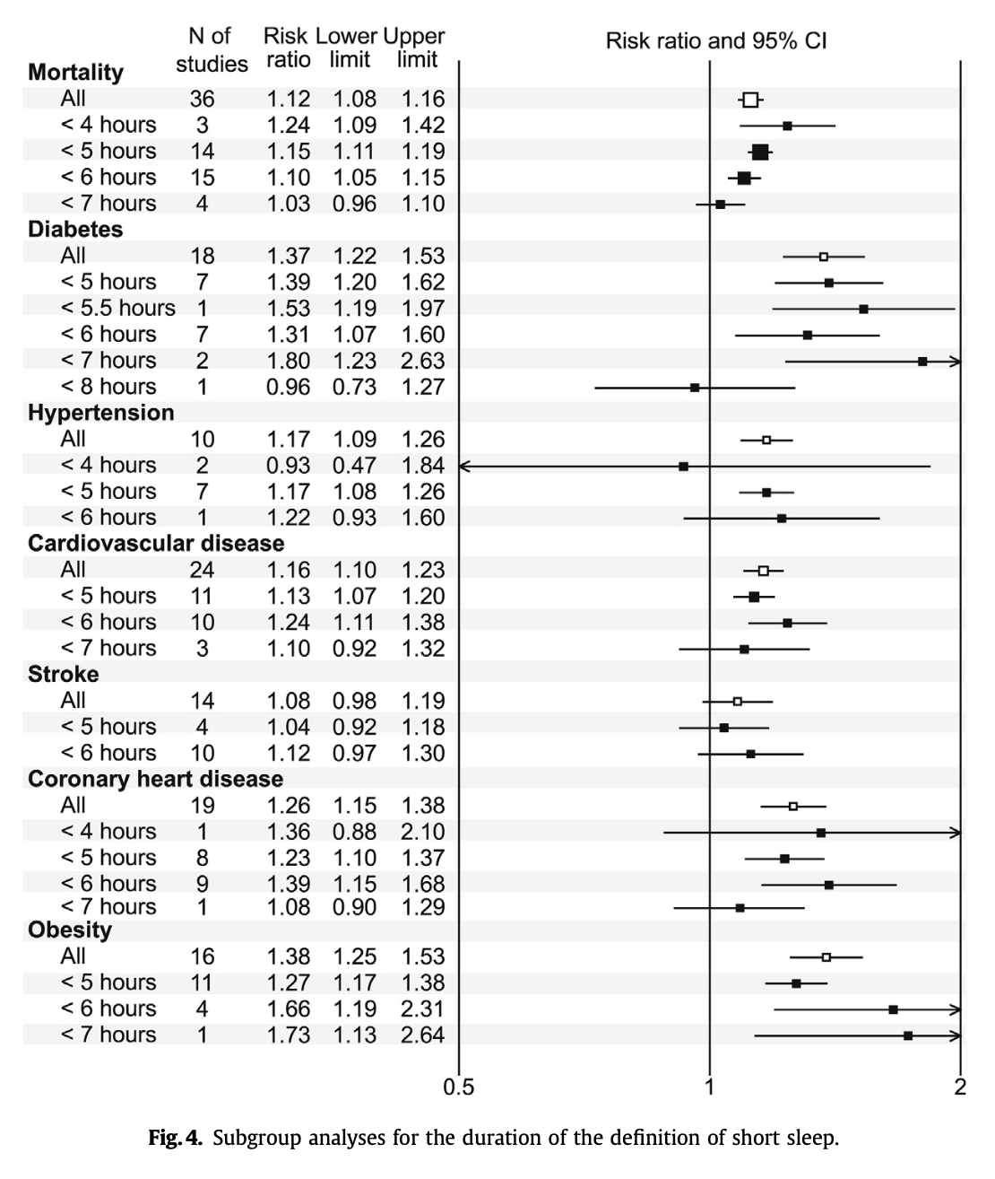
Itani et al. 2017: Short Sleep and Comorbidities

