Slide 1
Integrative Health and Wellness for Patients and Clinicians: The Oral Microbiome
Joseph Zenga, MD
Chief, Division of Head and Neck Surgical Oncology and Reconstruction
Don and Sharyn Blatnik Endowed Professor of Head and Neck Surgical Oncology
Department of Otolaryngology-Head & Neck Surgery

Slide 2
The Oral Microbiome
What exactly is the oral microbiome?
Is it realistic to study?
Signal from noise
Does our oral microbiome influence our cancer risk?
What affects our oral microbiome?
How do we maintain a healthy oral microbiome?

Slide 3
The Oral Microbiome

Slide 4
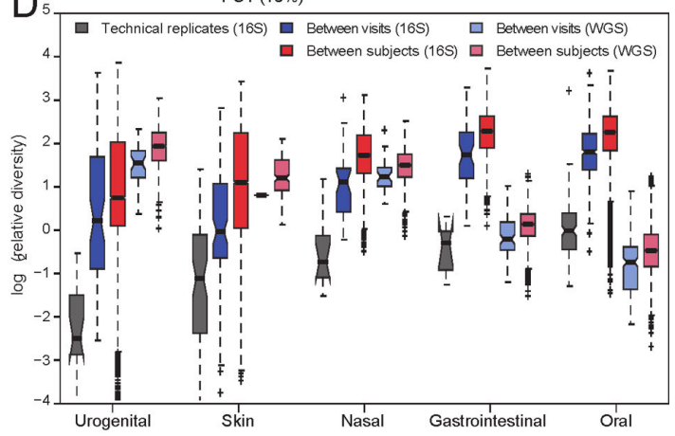
How can we study the oral microbiome?
Hundreds of species of bacteria, archaea, fungi, viruses, protozoa
Many cannot be cultured…
The Human Microbiome Project
2007-2016
4,788 specimens from 242 healthy volunteers
18 body sites
9 subsites oral cavity/pharynx
Patient-to-patient variation
Your microbiome is your own!
Human Microbiome Project Consortium. Structure, function and diversity of the healthy human microbiome. Nature. 2012 Jun 13;486(7402):207-14. doi: 10.1038/nature11234.

Slide 5
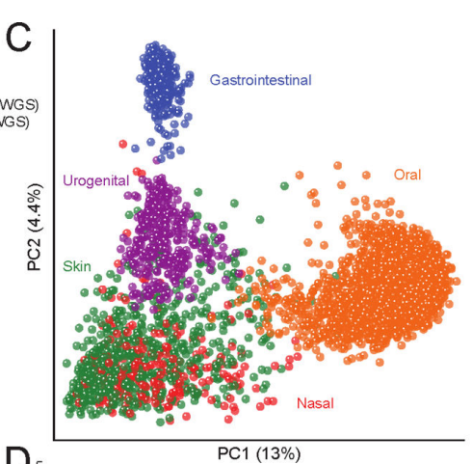
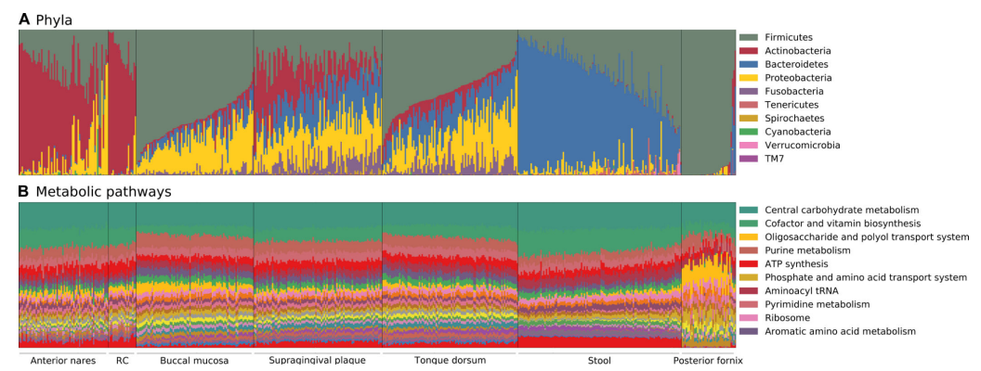
The unique oral microbiome
The Human Microbiome Project
Oral microbiome is unique among body sites
Wide variations in species
Consistency in bacterial metabolism
Human Microbiome Project Consortium. Structure, function and diversity of the healthy human microbiome. Nature. 2012 Jun 13;486(7402):207-14. doi: 10.1038/nature11234.

Slide 6
The Oral Microbiome and Cancer Risk
How can we study effects of the oral microbiome on cancer risk?
Oral Microbiome
HNSCC
Matched controls

Slide 7
The Oral Microbiome and Cancer Risk
American Cancer Society Cancer Prevention Study II Nutrition Cohort (CPS-II)
Prospective longitudinal study: cancer risk factors
2001-2002: Oral wash samples, 70,004 participants
Prostate, Lung, Colorectal, and Ovarian Cancer Screening Trial (PLCO)
Randomized, effects of screening on cancer mortality
1993-2001: Oral wash samples, 52,000 participants
Hayes, et al. Association of Oral Microbiome With Risk for Incident Head and Neck Squamous Cell Cancer JAMA Oncol. 2018 Mar 1;4(3):358-365. doi: 10.1001/jamaoncol.2017.4777.

Slide 8
The Oral Microbiome and Cancer Risk
CPS-II+PLCO
122,004 participants
Oral wash samples, cancer-free at baseline, long-term follow-up
Did any develop HNSCC?
Can we compare microbiomes between patients who developed HNSCC?
Oral Microbiome
HNSCC: 129
Matched on age, sex, race/ethnicity, and time since oral wash collection
Matched controls: 254
Hayes, et al. Association of Oral Microbiome With Risk for Incident Head and Neck Squamous Cell Cancer JAMA Oncol. 2018 Mar 1;4(3):358-365. doi: 10.1001/jamaoncol.2017.4777.

Slide 9
Microbiome: Sequencing
16S rRNA sequencing
Almost all bacteria have 16S ribosomal RNA
Variable regions are species-specific
PCR to amplify this region
Next-generations sequencing of the amplicons
Bioinformatic tools to match amplicons to bacterial species
Metagenomics
Whole genome sequencing of all bacteria within a sample
Provides strain-level detail
Genomes can inform functionality/metabolism
Resource intensive
Hayes, et al. Association of Oral Microbiome With Risk for Incident Head and Neck Squamous Cell Cancer JAMA Oncol. 2018 Mar 1;4(3):358-365. doi: 10.1001/jamaoncol.2017.4777.

Slide 10
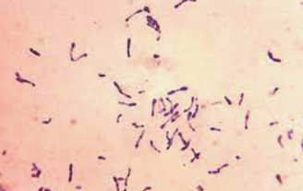
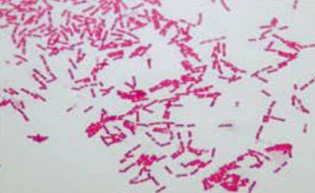
Microbiome: Cancer Risk
129 incident patient cases of HNSCC vs 254 matched controls
No overall difference in species diversity/abundance
No clear causative bacteria in HNSCC patients
Corynebacterium and Kingella enriched in controls
Potential metabolizers of carcinogens
Commensals associated with healthy oral microbiome
Hayes, et al. Association of Oral Microbiome With Risk for Incident Head and Neck Squamous Cell Cancer JAMA Oncol. 2018 Mar 1;4(3):358-365. doi: 10.1001/jamaoncol.2017.4777.

Slide 11
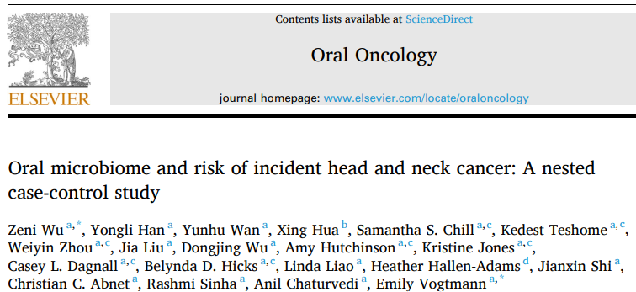
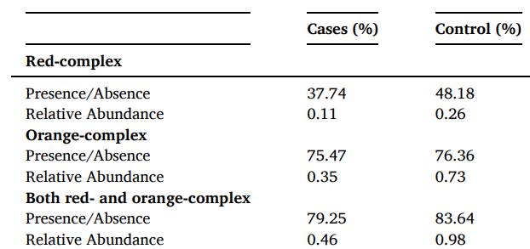
Microbiome: Cancer Risk
Wu, et al. Oral Oncology 2023
NIH-AARP Diet and Health Study
2005: 34,262 oral wash samples
56 HNSCC cases (mean 6 yrs after oral wash sample)
112 matched controls
Higher diversity of commensals = ↓ risk HNSCC
HNSCC risk likely not one specific species
Balance of healthy microbiota
Multiple species with potential to metabolize carcinogens
Zeni Wu. Oral microbiome and risk of incident head and neck cancer: A nested case-control study. Oral Oncol. . 2023 Feb:137:106305. doi: 10.1016/j.oraloncology.2022.106305. Epub 2023 Jan 5.

Slide 12
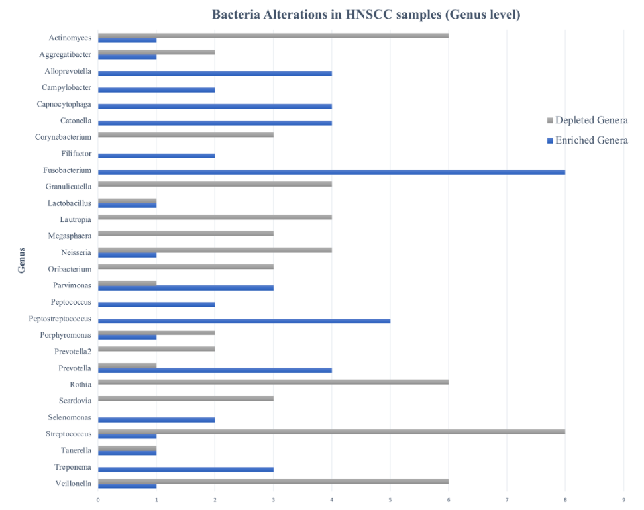
Microbiome: Cancer Risk
Ting, et al. Head and Neck 2023
20 studies
Case-control or case studies
HNSCC risk
Decreased with commensal diversity
Increased with pathogen presence
Complex picture of enriched and deplete species
Ting HSL, et al. Systematic review on oral microbial dysbiosis and its clinical associations with head and neck squamous cell carcinoma. Head Neck. 2023 Aug;45(8):2120-2135. doi: 10.1002/hed.27422. Epub 2023 May 30.

Slide 13
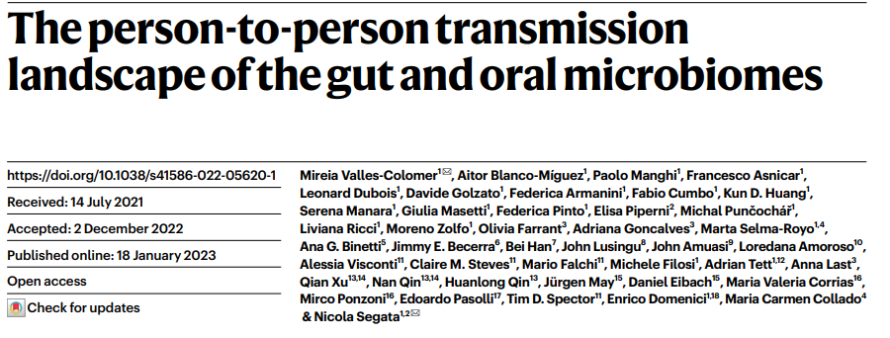
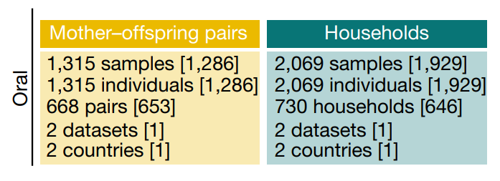
How can we affect our oral microbiome?
Valles-Colomer, et al. Nature 2023
Oral microbiome across families, communities, and countries
2,069 saliva samples
Known household, family, neighborhood relationships
Metagenomics to track specific bacterial strains across individuals
Valles-Colomer, M, et al. The person-to-person transmission landscape of the gut and oral microbiomes. Nature. 2023 Feb;614(7946):125-135. doi: 10.1038/s41586-022-05620-1. Epub 2023 Jan 18.

Slide 14
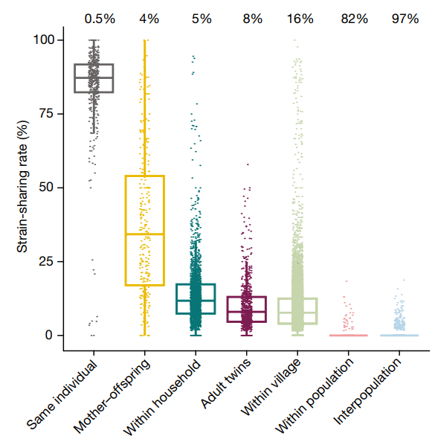
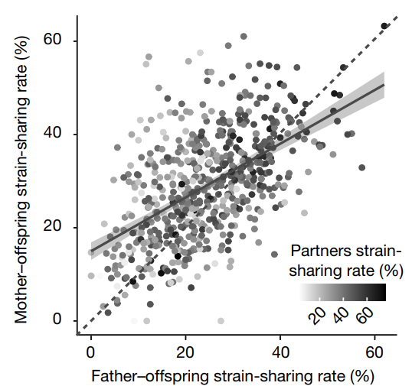
How can we affect our oral microbiome?
Valles-Colomer, et al. Nature 2023.
You are the company you keep!
>30% strain-sharing in co-habitation
More important than age, genetics, diet
Valles-Colomer, M, et al. The person-to-person transmission landscape of the gut and oral microbiomes. Nature. 2023 Feb;614(7946):125-135. doi: 10.1038/s41586-022-05620-1. Epub 2023 Jan 18.

Slide 15
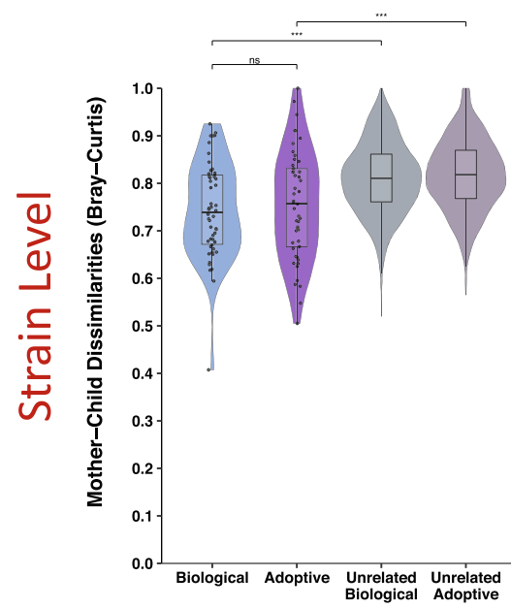
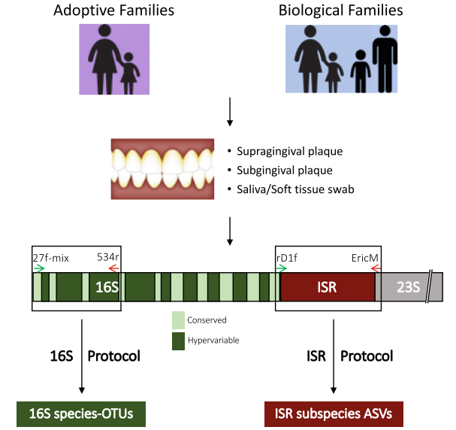
How can we affect our oral microbiome?
Mukherjee, et al. Microbiome 2021.
Biological relationship of mother-offspring doesn’t affect oral microbiome correlation
Mukherjee. C, et al. Acquisition of oral microbiota is driven by environment, not host genetics. Microbiome. 2021 Feb 23;9(1):54. doi: 10.1186/s40168-020-00986-8.

Slide 16
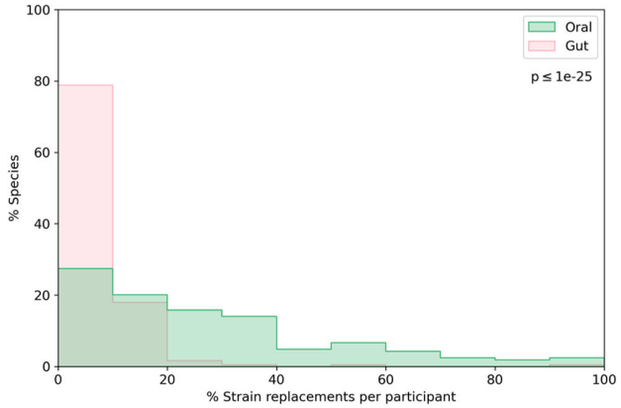
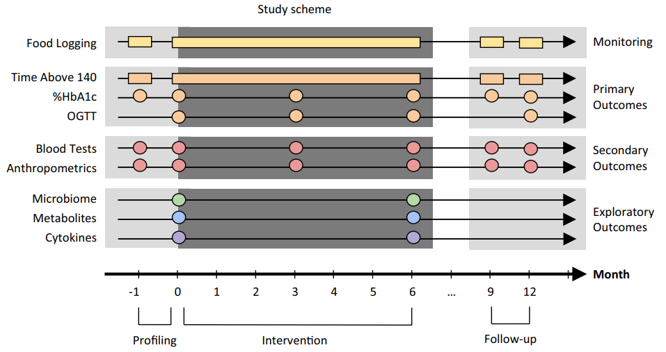
How can we affect our oral microbiome?
Angarita-Diaz, et al. Clin Exp Dent Res 2022.
8 studies, Food Frequency Questionnaire
High-sugar diets significantly associated with lower richness and diversity of oral microbiome
Shoer, et al. Nat Commun 2023
Clinical trial: Healthy diet intervention
Dynamic change in microbiome
Oral > gut
Angarita-Díaz MDP, et al. Does high sugar intake really alter the oral microbiota?: A systematic review. Review Clin Exp Dent Res. 2022 Dec;8(6):1376-1390. doi: 10.1002/cre2.640. Epub 2022 Aug 9.
Shoer S, et al. Impact of dietary interventions on pre-diabetic oral and gut microbiome, metabolites and cytokines. Nat Commun. 2023 Sep 4;14(1):5384. doi: 10.1038/s41467-023-41042-x.

Slide 17
How can we affect our oral microbiome?
Many remaining unknowns: Systematic Reviews and Meta-Analyses
Mouthwash
Probiotics
Dental procedures
do Amaral GCLS, et al. Effects of antimicrobial mouthwashes on the human oral microbiome: Systematic review of controlled clinical trials. Int J Dent Hyg. 2023 Feb;21(1):128-140. doi: 10.1111/idh.12617. Epub 2022 Aug 19.
Inchingolo, F. The Benefits of Probiotics on Oral Health: Systematic Review of the Literature. Review Pharmaceuticals (Basel) . 2023 Sep 16;16(9):1313. doi: 10.3390/ph16091313.
Zhang Y. Using next-generation sequencing to detect oral microbiome change following periodontal interventions: A systematic review. Review Oral Dis. 2021 Jul;27(5):1073-1089. doi: 10.1111/odi.13405. Epub 2020 May 26.

Slide 18
Oral Microbiome: Summary
Scientific gains through large case-control studies
HNSCC appears to be associated with microbiome imbalance
Hypothesis that balanced microbiome controls carcinogens
Major effects on oral microbiome from environment
Household relationships
Diet may be important
Many other unknowns
Current understanding limited by available data
Absence of functional studies: transcriptomics, metabolomics
Many organisms unclassified
Active area of future research

