Slide 1
Nasal Breathing for Better Health

Slide 2
Disclosures
None

Slide 3
Outline
Benefits of nasal breathing
Evolution/Changing facial skeleton
Implications of breathing on health
Impact of surgery
Impact of breathing techniques
Exercises
Notes:
Goal is to paint a picture of the benefits of nasal breathing, the historical and evolutional context that has brought us to so much obstruction, the

Slide 4
Why breath through the nose?
Better temperature matching, mucus trapping, immunity (IgA), olfaction
Associated with sleep disordered breathing
Craniofacial development
Oral Health/Preventing water loss
Mouth breathing ➔ Worsened nasal congestion
Nitric Oxide?
Notes:
Breath Book: Nasal breathing can boost nitric oxide sixfold, proposed to be one of the reasons we can absorb about 18% more oxygen than breathing through the mouth.
Nasal breathing promotes decongestion, decreased nasal breathing (laryngectomy) increases nasal congestion
Inhaled NO acts as a pulmonary vasodilator
BUT – higher in T2 inflammation (Allergic rhinitis/CRSwNP)
Notably lower in most PCD
Svensson S, Olin AC, Hellgren J. Increased net water loss by oral compared to nasal expiration in healthy subjects. Rhinology. 2006 Mar;44(1):74-7. PMID: 16550955.
42% less expired water in nasal compared to oral breathing
Cottle, M.H., 1987. The work, ways, positions and patterns of nasal breathing (relevance in heart and lung illness)
10-20% more oxygenation with nasal breathing with increased resistance
Dallam, G. M., McClaran, S. R., Cox, D. G., & Foust, C. P. (2018). Effect of nasal versus oral breathing on Vo2max and physiological economy in recreational runners following an extended period spent using nasally restricted breathing. International Journal of Kinesiology and Sports Science, 6(2), 22-29.
Nasal breathin 22% more efficient, so more energy efficient.

Slide 5
Dental
Open mouth posturing leads to high arched palate, narrow maxillary arch.
Associated with anterior open bite, posterior cross bite, overjet
Notes:
Tongue aginst the roof of mouth and lingual aspects of teeth
Cross sectional study of 1600 children 3-6y demonstrated mouth breathing associated with anterior open bite, posterior cross bite, overjet
Class 2 occlusion with overjet with adenoid mouth breathing
Increased periodontal disease
Lin, L., Zhao, T., Qin, D., Hua, F., & He, H. (2022). The impact of mouth breathing on dentofacial development: A concise review. Frontiers in public health, 10, 929165.
Harari D, Redlich M, Miri S, Hamud T, Gross M. The effect of mouth breathing versus nasal breathing on dentofacial and craniofacial development in orthodontic patients. Laryngoscope. 2010 Oct;120(10):2089-93. doi: 10.1002/lary.20991. PMID: 20824738.
-- Increased overjet, downward rotation of mandible, higher palatal plane and narrower of alveolar arches. Increased posterior cross bite.

Slide 6
Evolution?
More cooked food -> softer diet with more accessible calories
The expanding brain/cranial skeleton -> smaller facial skeleton
Smaller nose, maxilla, mandible
Descending larynx better for vocalization but lengthened airway
More OSA
Notes:
Advent of farming, big increase in population. Food processing. Start to see smaller mouths and more dental disease, overcrowing
More processed softer foods led to smaller mouths,
Friedman, M., Tanyeri, H., Lim, J. W., Landsberg, R., Vaidyanathan, K., & Caldarelli, D. (2000). Effect of improved nasal breathing on obstructive sleep apnea. Otolaryngology—Head and Neck Surgery, 122(1), 71-74.
--Improved nasal airway improves restfulness and subjective sleep, ~40% improved snoring, no major changes in ahi but all decreased CPAP levels for better tolerance

Slide 7
Breathing and CNS connection
How you Breath can impact the brain
Rate, nasal vs oral and sidedness have been shown to have different impacts on EEG signatures
Notes:
Zaccaro, A., Piarulli, A., Laurino, M., Garbella, E., Menicucci, D., Neri, B., & Gemignani, A. (2018). How breath-control can change your life: a systematic review on psycho-physiological correlates of slow breathing. Frontiers in human neuroscience, 12, 409421.
Systematic review 15 articles on impact of slow breathing techniques (<10 breaths/min)
--Increased alpha and decreased theta brain wave (more alpha suggested to reduce depression, theta more in sleeping/daydreaming)
--fMRI demonstrates increase in activity in prefrontal cortex, motor and parietal cortex in addition to subcortical structiors
--Increased comfort, relaxation, pleasentness, vigor and alertness
--Decreased arousal (ie anxiety, depression, anger and confusion)
Olfactory bulb modulation
Slow breathing techniques increase parasympathetic stimulation (increased HRV)
Inhalational (Tummo) stimulates more sympathetic drive
Niazi, I. K., Navid, M. S., Bartley, J., Shepherd, D., Pedersen, M., Burns, G., ... & White, D. E. (2022). EEG signatures change during unilateral Yogi nasal breathing. Scientific Reports, 12(1), 520.
Zelano, C., Jiang, H., Zhou, G., Arora, N., Schuele, S., Rosenow, J., & Gottfried, J. A. (2016). Nasal respiration entrains human limbic oscillations and modulates cognitive function. Journal of Neuroscience, 36(49), 12448-12467.
--Intracranial eeg data from medicaly intractable epilepsy
Nasal breathing generates more brain activity than oral even in absence of odor, more activity in amygdala and hypocampus
-- Inspiration through the nose has highest cortical activity
Bettern performance on emotional identification and memory tasks with nasal breathing. Memory tasks better with inspiratory phase.

Slide 8
Nasal Obstruction and Quality of Life
Nasal/oral flow analyzer
<95% total airflow though nose = “impaired”
Those with impaired breathing scored lower on SF 36 in all metrics
Those with nasal obstruction vs healthy controls
Nasal obstruction significantly higher anxiety
Notes:
Several studies have demonstrated worse QoL metrics for those with nasal obstruction and higher anxiety
Gałązka, A., Migacz, E., Kukwa, A., Czarnecka, A., Krzeski, A., & Kukwa, W. (2018). Association of breathing patterns and quality of life in patients with nasal obstruction. Polish Journal of Otolaryngology, 72(1), 11-15. - Poland
-181 patients seen in ENT clinic for nasal obstruction, 97 completed all steps for the protocol
-Using nasal oral flow analyzer, patients who spent >95% total airflow through the nose classified as normal and <95 as impaired
-Normal 31, impaired 66
-SF36 is a validated quality of life metric for physical and mental health
-Impaired scored much lower in all metrics
Akkoca, Ö., Oğuz, H., Ünlü, C. E., Aydın, E., Ozdel, K., & Kavuzlu, A. (2020). Association between nasal obstruction symptoms and anxiety. Ear, Nose & Throat Journal, 99(7), 448-452.
--120 patients with nasal obstruction compared to 57 healthy controls
--78 patients with DNS identified, 42 with no otherwise noted nasal pathology
--Those with nasal obstruction had significant higher anxiety scores compared to healthy
--Identical QoL and anxiety metrics identical
Similar anxiety scores between those with DNS and those who feel like they cant breath but do not have increased airway resistance.

Slide 9
Does surgery improve QoL?
8 studies, 444 pts
NOSE in 6 of 8
Improvement in all studies at 36 months
91pts vs 93 control
Snot 20 and VAS
Improvement but not to healthy control baseline
Notes:
Bugten, V., Nilsen, A. H., Thorstensen, W. M., Moxness, M. H. S., Amundsen, M. F., & Nordgård, S. (2016). Quality of life and symptoms before and after nasal septoplasty compared with healthy individuals. BMC Ear, Nose and Throat Disorders, 16, 1-7.
Chicago
91 patients with NAO vs 93 healthy controls. Before and after septoplasty improved QoL as measured by Snot 20 and VAS but did not reach same level as healthy control.
Kais, A., Sinan, M., Crawford, A., Rose, A. S., Gudis, D. A., Ramadan, H. H., & Makary, C. A. (2023, November). Improvement in Quality of Life after Septoplasty in Children: a Systematic Review. In International forum of allergy & rhinology (Vol. 13, No. 11, pp. 2076-2081).
- IFAR systematic review, 8 studies 444 patients
- NOSE most commonly used in 6 of 8 studies, statistical improvement in all 6 at 36 months
Yamasaki, A., Levesque, P. A., & Lindsay, R. W. (2020). Improvement in snoring-related quality-of-life outcomes after functional nasal surgery. Facial Plastic Surgery & Aesthetic Medicine, 22(1), 25-35.
625 patients recruited. Nose and SOS (snoring related quality of life metric) collected, 2 year follow up.
Better outcomes when SRP was combined with ITR for both nose and SOS
SOS better outcome if worse snoring preop

Slide 10
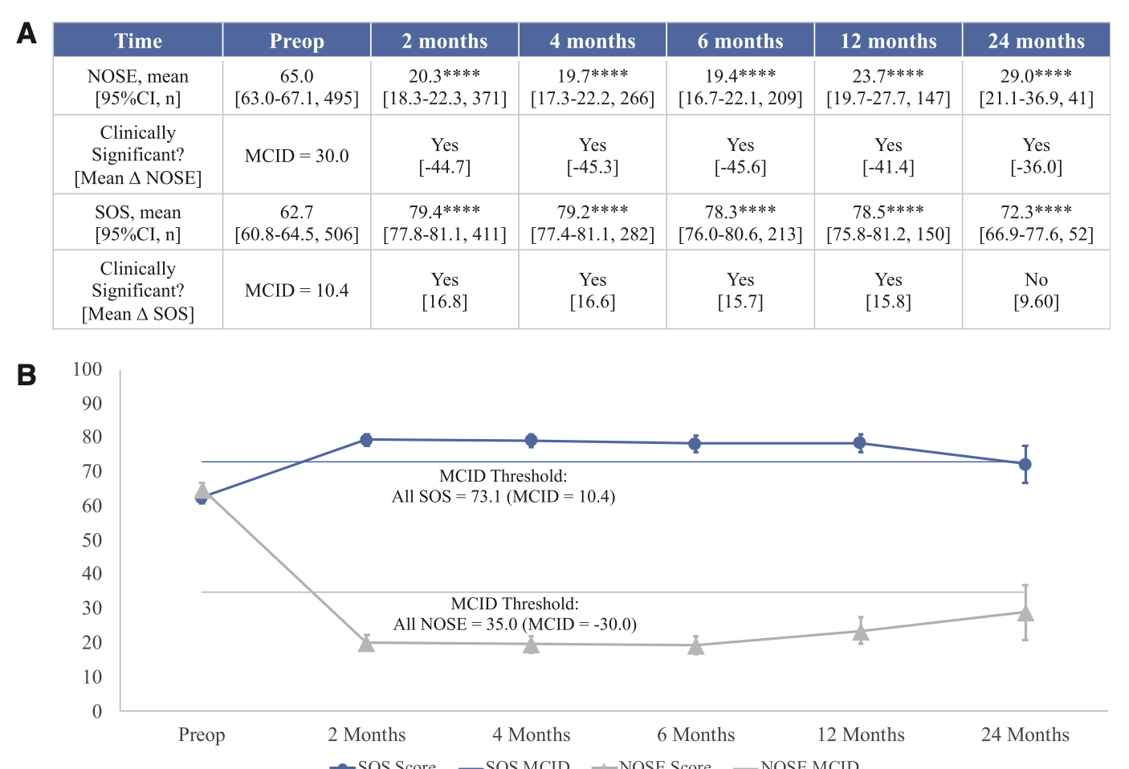
Notes:
Yamasaki, A., Levesque, P. A., & Lindsay, R. W. (2020). Improvement in snoring-related quality-of-life outcomes after functional nasal surgery. Facial Plastic Surgery & Aesthetic Medicine, 22(1), 25-35.
625 patients recruited. Nose and SOS (snoring related quality of life metric) collected, 2 year follow up.
SRP alone, NOSE improvement by 35, with ITR, 52.5
Mean SOS improvement 13 with SRP alone, 16.5 with ITR

Slide 11
20 patients with mild OSA with HST baseline and 1 week after taping
Decrease in AHI from 8.3 to 4.7, especially in supine
Median snoring index improved 47%
Notes:
Lee YC, Lu CT, Cheng WN, Li HY. The Impact of Mouth-Taping in Mouth-Breathers with Mild Obstructive Sleep Apnea: A Preliminary Study. Healthcare (Basel). 2022 Sep 13;10(9):1755. doi: 10.3390/healthcare10091755. PMID: 36141367; PMCID: PMC9498537.
- 20 patients with mild OSA, (Home sleep test with apnealink.baseline and 1 week after taping
- Decrease in AHI from 8.3 to 4.7, especially in supine AHI )9.4 to 5.5).
- Median snoring index improved by 47% (303 to 121 events per hour)
- no difference in mean saturation, but improvements in ODI and lowest o2 (nadir)
- Higher the baseline problem the better the improvement with mouth taping

Slide 12
Structured Breathing Practices
Meta analysis of 12 RTCs, 785 patients
Breathwork associated with lower levels of stress than controls
Similarly decreased self reported anxiety and depressive symptoms
RTC comparing 3 breathwork exercises
All reduced anxiety, improved mood
Cyclic sighing most impactful
Notes:
Can taking a mindful approach to breathing be beneficial?
Fincham, G. W., Strauss, C., Montero-Marin, J., & Cavanagh, K. (2023). Effect of breathwork on stress and mental health: A meta-analysis of randomised-controlled trials. Scientific Reports, 13(1), 432.
- Meta analysis of RCTs (12 total, 785 patients) moderate risk of bias. Breathwork associated with lower levels of stress than controls. Similarly decreased self reported anxiety and depressive symptoms.
Balban, M. Y., Neri, E., Kogon, M. M., Weed, L., Nouriani, B., Jo, B., ... & Huberman, A. D. (2023). Brief structured respiration practices enhance mood and reduce physiological arousal. Cell Reports Medicine, 4(1).
- RC study of 3 different breathwork exercises (1) cyclic sighing, (2) box breathing, (3) cyclic hyperventilation. Primary endpoings improved mood and anxiety and reduced physiological arounsal (resp rate, heart rate, HR variability).
- Daily 5 min breathwork routine over 1 month (especially exhale focous cyclic sighing) produced greater improvement in mood and respiratory rate compared to a 5 minute mindfulness meditation.

Slide 13
Techniques

Slide 14
Cyclic Sigh
Take large slow inhale in from stomach until full, pause, short brief extra inhale on top of previous
Slow exhale

Slide 15
Alternate Nostril Breathing
Nadi Shodhana
Goal is to lower HR and BP
Close right nostril and inhale through left very slowly
Hold Brielfy at the top and switch to close left and open right nostril
Exhale through the right
Alternate 5-10 cycles

Slide 16
Resonant Breathing
Sit up straight, relax shoulders and belly
Inhale softly for 5.5 seconds, expand belly
Without pause, exhale softly for 5.5 seconds
Repeat at least 10 times or more

Slide 17
Buteyko Breathing
Breath in line with metabolic needs – most of the time means breathing less.
All Involve a breath hold
Always do in relaxed state and not when driving or underwater

Slide 18
Control Pause
Sit up straight, pinch both nostrils closed
Exhale fully to natural conclusion
Start stopwatch and hold breath
Soft inhale when potent desire to breathe
Too long if labored inhale

Slide 19
Mini Breatholds
Exhale gently and hold breath for half the time of control pause
Repeat 100-500x per day

Slide 20
Tummo
Activate sympathetic system
Flat on back
30 very deep, very fast breaths into stomach through the nose
At end of 30 breaths, exhale to conclusion and hold breath as long as possible
At limit, take one huge inhale and hold for 15 seconds
Repeat 3x

Slide 21
Box breathing
Inhale 4, hold 4, exhale 4, hold 4
Navy SEALS technique
Longer exhales more parasympathetic response
Inhale 4, hold 4, exhale 6, hold 2
6+ rounds

Slide 22
4, 7, 8
Breath in through nose, exhale through mouth with woosh sound
In for count of 4, hold for 7, out for 8

