Slide 1
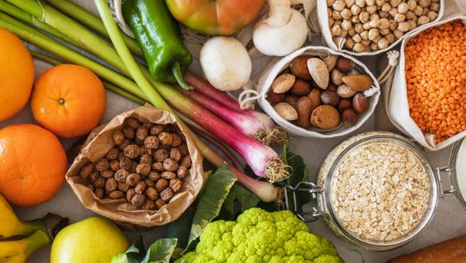
Diet, Lifestyle, and Reflux
Jonathan M. Bock, MD, FACS
Professor
Division of Laryngology & Professional Voice
Department of Otolaryngology & Communication Sciences
Medical College of Wisconsin

Slide 2
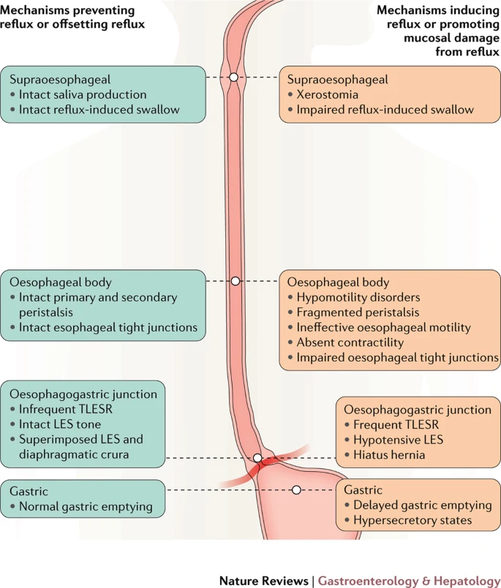
Physiology of Reflux

Slide 3
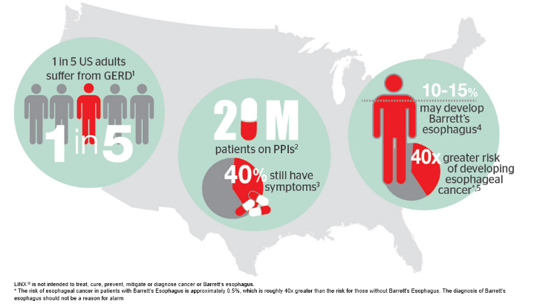
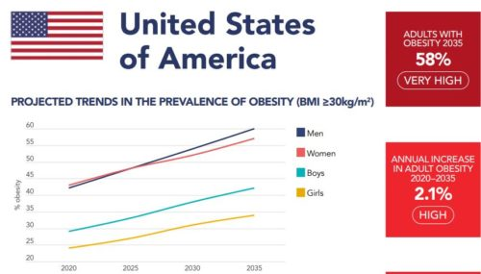
Reflux and Obesity Prevalence

Slide 4
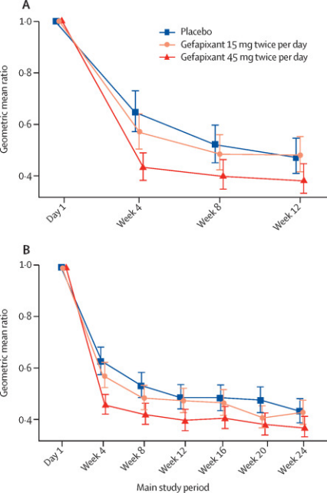
Placebo Response
IT IS REAL – Keep in mind
Gefipixant phase III clinical trials for new chronic cough meds
Barely detectable differences in clinical trials between drug and placebo, over 50% placebo response
The Lancet 399 (10328) 909-923, March 2022

Slide 5
Alternatives to PPI
H2 blockers
Long history, less SFX, less effective? More frequent dosing? Tachyphylaxis?
Gaviscon Advance
Calcium alginate suspension, UK formulation (aka – “non-inferior”)
As effective as omeprazole in non-erosive reflux symptom control
Aliment Pharmacol Ther. 2013 Nov;38(9):1054-64.
Apple Cider Vinegar – (more later)
Papaya Pills (Papain)
“A small study investigating the role of papain in digestive disorders, published in the April 2012 issue of “Biogenic Amines,” reports that 42 participants who received papain experienced improvements in gas and bloating compared to 42 who took a placebo.” – web
No Pubmed data specifically on LPR/reflux
DGL – (Deglycyrrhinized Lycorice)
2 studies from early 80’s showing decreased acid-induced gastric damage
Likely also promotes raft formation
GutsyGumTM (CaCO3, papain & licorice)
1 study showing decreased HB after refluxogenic meal - J Diet Suppl. 2015 Jun;12(2):138-45
Low Acid/Alkaline Water diets
Limited studies supporting, likely low risk – 20 pts assessed with RFS/RSI. 19/20 improved
Koufman, JA Ann Otol Rhinol Laryngol. 2011 May;120(5):281-7.

Slide 6
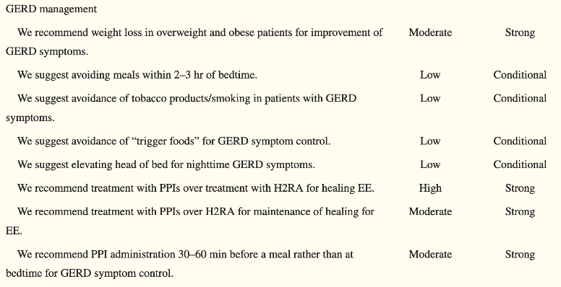
GERD Lifestyle Modification Recs
American College of Gastroenterology recommendations 2023
Moderate rec for weight loss
HOB elevation
Avoid trigger foods
No meals 2-3 hrs before bedtime
Tobacco avoidance
ACG Clinical Guideline for the Diagnosis and Management of Gastroesophageal Reflux Disease. Am J Gastroenterol. 2022 Jan 1;117(1):27-56.

Slide 7
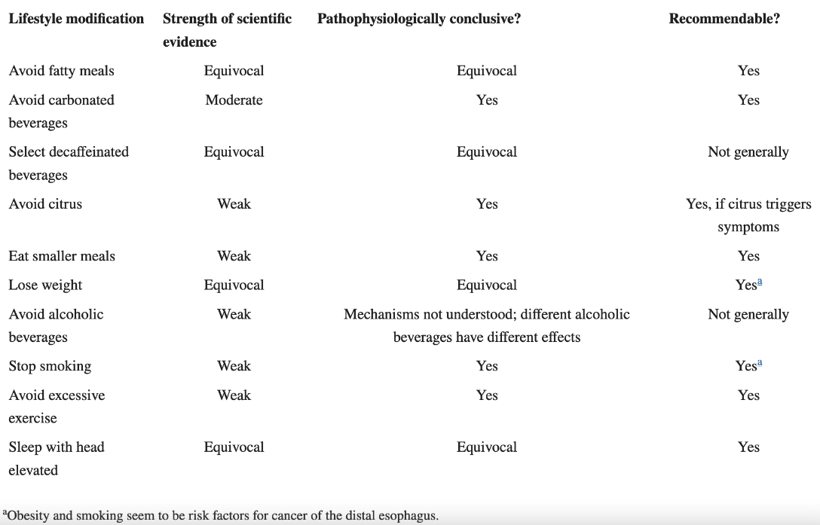
GERD Lifestyle Modification Recs

Slide 8
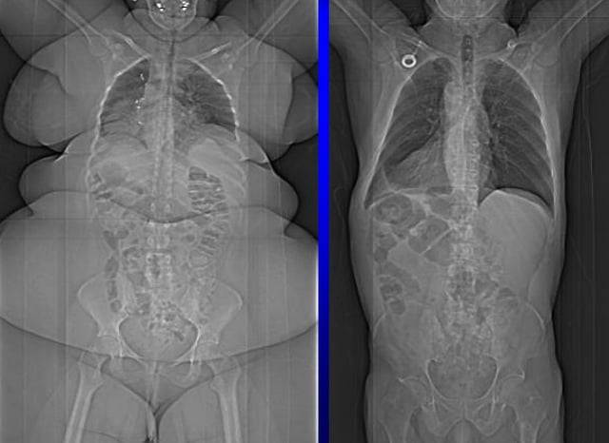
BMI and Reflux
BMI directly correlates with GERD sxs:
Survey of > 10,000 women
22% had GERD sxs
Direct dose-response relationship b/w BMI and GERD sxs
N Engl J Med. 2006 June 1; 354(22): 2340–2348.

Slide 9
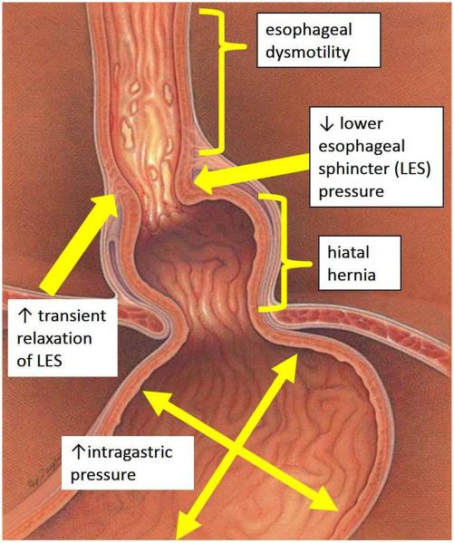
Why does BMI correlate w GERD sxs?
Decreases esophageal motility
Increased transient lower esophageal sphincter relaxation episodes (TLESR’s)
Increased intrabdominal pressure gradient
Higher rates of hiatal hernia/PE hernia
Decreased gastric motility
Due to increased Leptin/decreased Ghrelin

Slide 10
Head of Bed Elevation
Am J of Gastroenterology and Hepatology 27(6): 1078-82 June 2012
20 pts tested in flat sleep and 20cm HOB elevation
pH probe studies done in both positions all night
Sig decreases in total reflux time, acid clearance time, >5 min episodes, and symptom scores
Appears to decrease overall acid exposure and reflux event duration but not total number of events.
$274.99 at Walmart.com

Slide 11
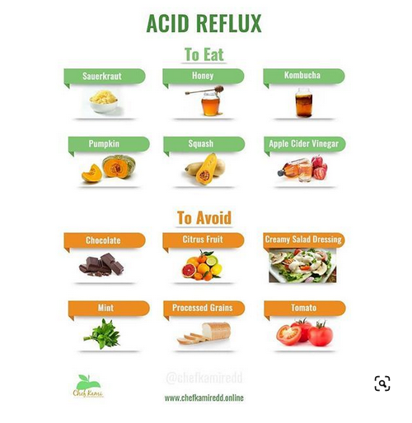
How do specific foods affect reflux?
Some foods increase/worsen stomach acid levels
Citrus, spicy foods, tomato
Some foods slow gastric emptying
Fatty foods specifically
Some foods alter esophageal sphincter closing
Chocolate, red wine, carbonated beverages, tob

Slide 12
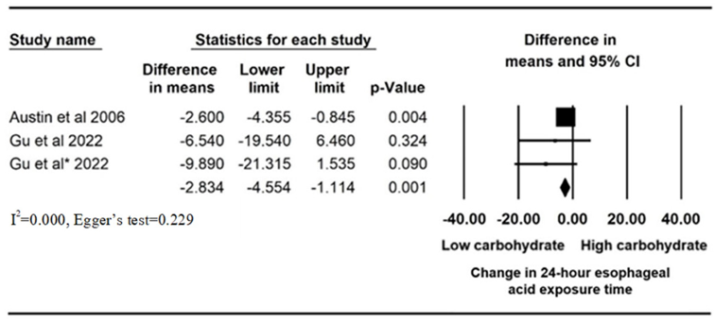
Dietary Modification
Multiple ways to approach - and difficult to study…
Low carb
General trend toward lower esophageal acid with low carb diets
(Low carb = more protein/fiber?)
Low fat
Varying data
Gluten Free
Individual studies show benefit
Eating speed
No difference
Nutrients 2024, 16(3), 464; https://doi.org/10.3390/nu16030464

Slide 13
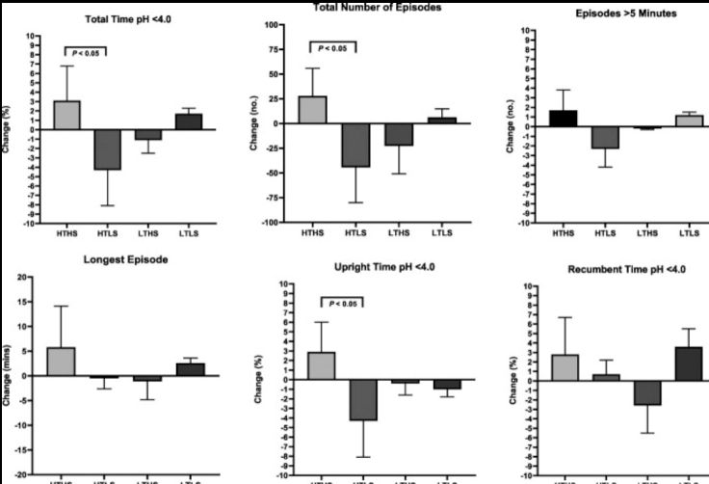
Carbohydrates
Amount and type of carbohydrates seems to make a significant difference:
RCT of 98 Veterans w symptomatic GERD
Assigned to different carb level diets for 9 weeks
Total carb vs simple/complex carbs
High total/High simple carb diet leads to sig higher AET and total reflux episodes compared to High total/low simple
So.. limiting simple sugars seems to make most difference!
Gu C, Olszewski T, King KL, Vaezi MF, Niswender KD, Silver HJ. The Effects of Modifying Amount and Type of Dietary Carbohydrate on Esophageal Acid Exposure Time and Esophageal Reflux Symptoms: A Randomized Controlled Trial. Am J Gastroenterol. 2022 Oct 1;117(10):1655-1667.

Slide 14
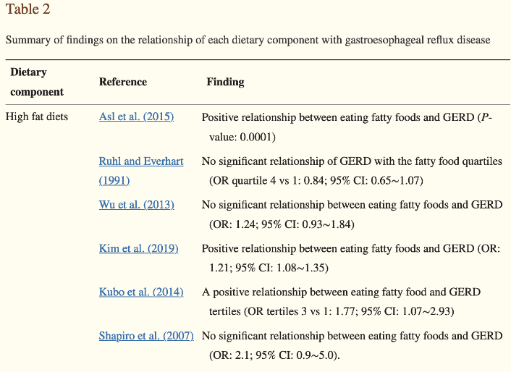
Trigger Foods!!!
Meta-analysis of 1000 studies on diet and GERD, 25 analyzed (w/ positive findings)
High Fat – 2/7 studies
Fast Food 2/4 studies
Cholesterol – 1 of 4 studies
Spicy Foods – 3/6 studies
Fried Food – 2/3 studies
Citrus – 5/5 studies!!!
Fiber – 0/5, 1 negative
Coffee – 2/10 studies
Tea – 3/7 studies
Chocolate – ¼ studies
Carbonated Bevs – 5/9 studies
Alcohol – 0/8 studies
Heidarzadeh-Esfahani N, Soleimani D, Hajiahmadi S, Moradi S, Heidarzadeh N, Nachvak SM. Dietary Intake in Relation to the Risk of Reflux Disease: A Systematic Review. Prev Nutr Food Sci. 2021 Dec 31;26(4):367-379..

Slide 15
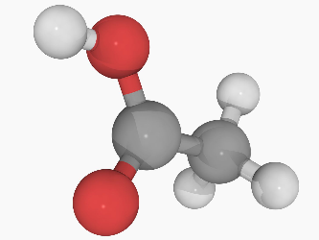
Apple Cider Vinegar – Um, WHY?
How can ingestion of an acidic compound reduce symptoms of acid reflux? A few models, all speculative
One study looked at 130 pts dx with gastritis
Found that restriction of carbohydrates supplemented with acidic foods (lemon juice and fresh tomato) led to improved GERD sxs
Authors speculated that ingestion of acid might downregulate endogenous acid secretion by negative feedback mechanism?
Langella C, Naviglio D, Marino M, Calogero A, Gallo M. New food approaches to reduce and/or eliminate increased gastric acidity related to gastroesophageal pathologies. Nutrition. 2018;54:26–32.
Arguments: Blood sugar control, weight loss, gut health/microbiome changes
NY Times: “Is Apple Cider Vinegar Really a Cure-All” April 9, 2024
General lay conception of corporeal “pH balance” and feeling that reflux symptoms arise from hypochlorhydria – “a faulty intuition that may be reinforced by alternative practitioners and that might lay groundwork for a placebo response”.
Ahuja, A., Ahuja, N.K. Popular Remedies for Esophageal Symptoms: a Critical Appraisal. Curr Gastroenterol Rep 21, 39 (2019).

Slide 16
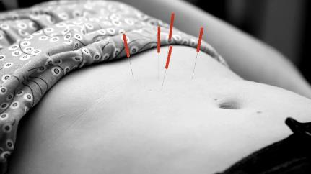
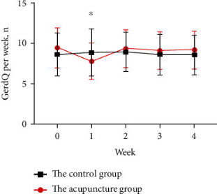
Acupuncture for GERD
Prospective trial - 68 pts with refractory GERD enrolled over 4 years
Randomized to acupuncture or control (sham) groups
Pre and post HRM to assess effects on motility, as well as GerdQ questionnaire
Showed changes in GerdQ answers just at first week
Sig changes in HRM findings for acupuncture pts!
Length of LES
Mean basal LES pressure
Number of fragmented/ineffective contractions dropped sig
Yuming, T et al. Acupuncture Improved the Function of the LES and Esophageal Motility in Chinese Patients with Refractory GERD sxs: A Randomized Trial. Gastroenterolology Research Practice online 2023 May 2024.

Slide 17
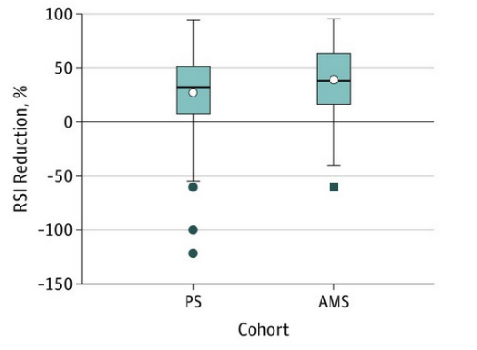
Low Acid Diet/Alkaline Water
Direct comparison of PPI to Mediterranean Diet (90% plant) w alkaline water (pH > 8)
Retrospective cohort study
Both groups recommended standard reflux precautions
PPI group at least Qday PPI, some BID
Diet: 90-95% plant-based, 2-3 meal/week of 3-4 oz meat, minimal dairy
Assessed RSI at 6 weeks after treatment
54% of PPI group achieved > 6pt reduction
62.6% of alkaline water/diet change group had same!
“Our data demonstrate that Rx w PPI is not sig more effective than a wholly dietary approach, with statistically sig greater mean improvement with dietary rx”
Zalvan et al. A Comparison of Alkaline Water and Mediterranean Diet vs Proton Pump Inhibition for Treatment of LPR. JAMA-Oto 2017 Oct 143(10): 1023-29

Slide 18
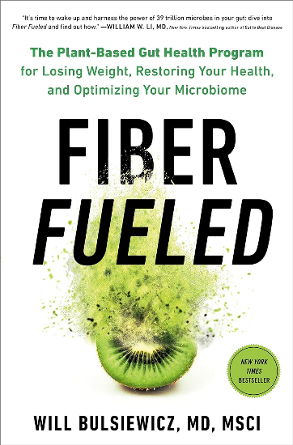
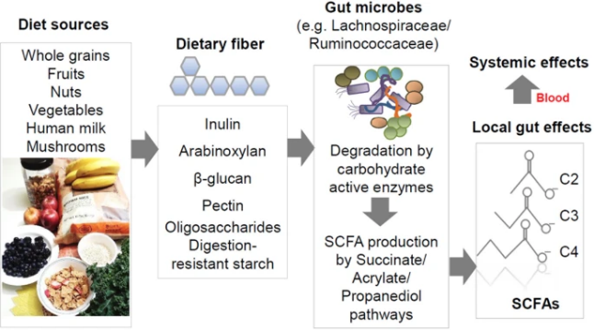
High Fiber Diets
Soluble fiber appears to select for more favorable gut microbiome and diversity
Leads to gut bacteria which ferment fiber and increase production of Short Chain Fatty Acids (SCFA’s) – which directly “tighten” TJ’s
Associated with “leaky gut” repair – decreased IBS?
Decreased food sensitivities – cause of increased food allergies in general?
Effective from fiber supplementation or high fiber dietary consumption
Recommends higher variety of plants and fermented foods to alter gut biome
Supplments: Psyllium husk:
Start 2.5-5g/day, increase to 5g TID over several weeks

Slide 19
Summary
Many diet and lifestyle recommendations appear to have sig benefit for GERD
HOB elevation, weight loss, trigger avoidance, and increasing dietary fiber
Studies are poor quality in general but data continues to evolve
Low risk! Actually, HEALTHY!
Should consider emphasizing more as first-line for our patients?
Specifically plant-based and increased fiber diets seem encouraging

