Slide 1
Vestibular Function Across the Lifespan
David R. Friedland MD PhD

Slide 2
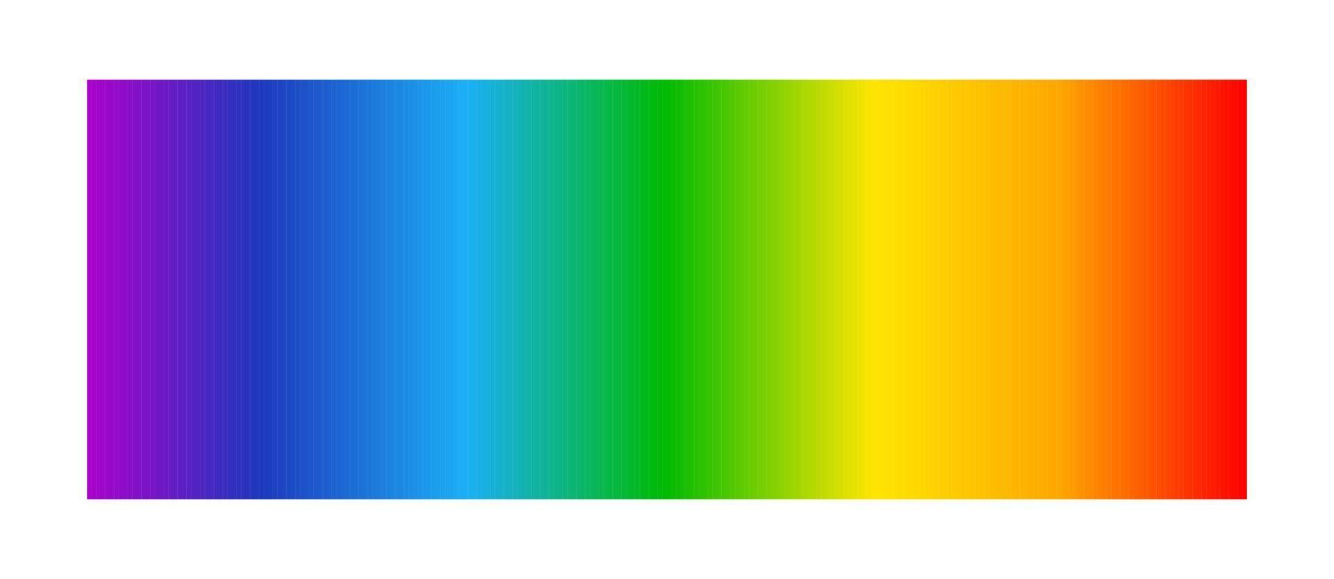
Common Vestibular Disorders*
4 yo
24 yo
54 yo
84 yo
14 yo
34 yo
74 yo
*only two of these are ear-related

Slide 3
Case #1
4 yo
4 year old female brought in by parents due to recurrent episodes of “dizziness.” She will suddenly stop what she is doing, drop to the floor, cry, get pale, and appear frightened. She says things seem to move. Episodes last a few minutes. There are no other symptoms. Child is otherwise healthy.

Slide 4
Case #1
4 yo
BPVC: Benign Paroxysmal Vertigo of Childhood
3-6 years of age; rarely after 9 years
Likely migraine precursor (ICHD: periodic disorders of childhood)
Outgrow in 2 years
No treatment usually needed

Slide 5
Differential Dx
  Epilepsy/seizure, BPPV, recurrent otitis
Testing
  Neurology evaluation
  No oto testing
Treatment
  None needed

Slide 6
Vestibular migraine/ recurrent vertigo of childhood
Vestibular Migraine of Childhood
  At least five episodes with vestibular symptoms of moderate or severe intensity, lasting between five minutes and 72 hours
  Current or past history of migraine with or without aura
  At least half of episodes are associated with at least one migraine feature
Probable Vestibular Migraine of Childhood
  At least three episodes with vestibular symptoms of moderate or severe intensity, lasting between five minutes and 72 hours
  At least criterion B or C from the VMC criteria
Recurrent Vertigo of Childhood
  At least three episodes with vestibular symptoms of moderate or severe intensity, lasting between 1 minute and 72 hours
J Vestib Res. 2020 Dec 29

Slide 7
Case #2
14 yo
14 year old male with multiple episodes of dizziness. They seem to come out of the blue. He describes them as intense dizziness. Usually last hours or at least until he falls asleep. Often associated with nausea and vomiting. He participates on the cross country team and this is interfering with his activity. He notes he gets headaches a couple of times a week.

Slide 8
Case #2
14 yo
Vestibular Migraine
At least 5 episodes with vestibular symptoms of moderate or severe intensity lasting 5 min to 72 hours
Current or previous history of migraine with or without aura according to the International Classification of Headache Disorders (ICHD)
One or more migraine features with at least 50% of the vestibular episodes
  headache with at least two of the following characteristics: one sided location, pulsating quality, moderate or severe pain intensity, aggravation by routine physical activity
  photophobia and phonophobia
  visual aura
Not better accounted for by another vestibular or ICHD diagnosis
Probable is the top bullet and either the 2nd or 3rd bullet

Slide 9
Differential Dx
  Meniere’s dz, panic disorder, cardiac
Testing
  Audiogram
Treatment
  Migraine hygiene (sleep, food, screen time)
  Prophylactic migraine medications

Slide 10
Case #3
24 yo
24 year old male with complaint of chronic dizziness. He notes he was on a cruise three months ago. He did feel seasick initially but adapted. When he got off the boat he noted he never seemed to feel solid. He always feels as though things are swaying or moving. It only seems better when he lies absolutely still. Anytime he gets upright or moves it exacerbates. He also notes recent difficulty scrolling on his phone or using the computer.

Slide 11
Case #3
24 yo
Persistent Postural Perceptual Dizziness
Symptoms of dizziness, unsteadiness, or non-spinning vertigo
Present on most days for three months or more
Exacerbated by upright posture, active or passive movement
Exacerbated by exposure to moving or complex visual stimuli
PPPD may be precipitated by conditions that disrupt balance or cause vertigo, unsteadiness, or dizziness, including peripheral or central vestibular disorders, other medical illnesses, or psychological distress.

Slide 12
Mal de Debarquement syndrome
Non-spinning vertigo characterized by an oscillatory perception ('rocking,' 'bobbing,' or 'swaying') present continuously, or for most of the day
Onset occurs within 48 hours after the end of exposure to passive motion
Symptoms temporarily reduce with exposure to passive motion (e.g. driving)
Symptoms persist for >48 hours
MdDS
  "in evolution" : less than 1 month
  "transient“ : resolves before 1 month
  "persistent" : more than 1 month.
J Vestib Res. 2020;30(5):285-293

Slide 13
Differential Dx
  MDDS, anxiety/panic, POTS
Testing
  Generally, none needed
  Practically, comprehensive vestibular testing
Treatment
  Low dose anti-anxiety medications
  Cognitive behavioral therapy
  Vestibular therapy

Slide 14
Case #4
34 yo
34 year old female with multiple episodes of dizziness. They seem to come out of the blue. She describes them as intense dizziness. Usually last hours or at least until she falls asleep. Often associated with nausea and vomiting. She feels she doesn't hear as well during episodes. She notes she gets headaches most days of the week associated with light sensitivity. She denies having a diagnosis of migraine.

Slide 15
Case #4
34 yo
Vestibular Migraine
At least 5 episodes with vestibular symptoms of moderate or severe intensity lasting 5 min to 72 hours
Current or previous history of migraine with or without aura according to the International Classification of Headache Disorders (ICHD)
One or more migraine features with at least 50% of the vestibular episodes
  headache with at least two of the following characteristics: one sided location, pulsating quality, moderate or severe pain intensity, aggravation by routine physical activity
  photophobia and phonophobia
  visual aura
Not better accounted for by another vestibular or ICHD diagnosis
Probable is the top bullet and either the 2nd or 3rd bullet

Slide 16
Differential Dx
  Meniere’s dz, panic disorder, cardiac
Testing
  Audiogram
Treatment
  Migraine hygiene (sleep, food, screen time)
  Prophylactic migraine medications

Slide 17
Case #5
54 yo
54 year old male with multiple episodes of dizziness. They seem to come out of the blue. He describes them as intense dizziness and his eyes are jittering all over. Usually last three to four hours. Often associated with nausea and vomiting. He complains of right ear fullness and a low rumbling tinnitus. The tinnitus can get quite loud around the episodes. He feels the hearing on that side seems muffled as well.

Slide 18
Case #5
54 yo
Meniere’s Disease
Definite
Two or more spontaneous attacks of vertigo lasting 20 minutes to 12 hours
Audiometrically documented low to mid-frequency SNHL
30 dB difference at 2 contiguous frequencies <2000Hz
Fluctuating aural symptoms in affected ear: hearing, tinnitus or fullness
Within 24 hours of vertigo episode
Other causes excluded
Probable
Two or more spontaneous attacks of vertigo lasting 20 minutes to 24 hours
Fluctuating aural symptoms in affected ear: hearing, tinnitus or fullness
Other causes excluded

Slide 19
Case #6
74 yo
74 year old female with episodes of dizziness. Usually occur in the morning when she tries to get out of bed. Can also occur when she gets into bed. Sometimes happens when reaching or bending to pick something up. She had an episode at the dentist as well. Not sure about occurence when she is still. Some days it's there and sometimes it isn’t. Dizziness is intense and she can feel a little nauseated. Episodes last a few minutes. She denies hearing loss.

Slide 20
Case #6
74 yo
BPPV: Benign Paroxysmal Positional Vertigo
Canalithiasis – PSCC
Recurrent attacks of positional vertigo or positional dizziness provoked by lying down or turning over in the supine position
Duration of attacks < 1 min
Positional nystagmus elicited after a latency of one or few seconds by the Dix-Hallpike maneuver or side-lying maneuver (Semont diagnostic maneuver). The nystagmus is a combination of torsional nystagmus with the upper pole of the eyes beating toward the lower ear combined with vertical nystagmus beating upward (toward the forehead) typically lasting < 1 minute
Not attributable to another disorder

Slide 21
BPPV
Canalithiasis – HSCC
  Recurrent attacks of positional vertigo or positional dizziness provoked by lying down or turning over in the supine position
  Duration of attacks < 1 min
  Positional nystagmus elicited after a brief latency or no latency by the supine roll test, beating horizontally toward the undermost ear with the head turned to either side (geotropic direction changing nystagmus) and lasting < 1 min
  Not attributable to another disorder
J Vestib Res. 2015;25(3-4):105-17

Slide 22
BPPV
Canalithiasis – SSCC
  Recurrent attacks of positional vertigo or positional dizziness provoked by lying down or turning over in the supine position
  Duration of attacks < 1 min
  Positional nystagmus elicited immediately or after a latency of one or few seconds by the DixHallpike maneuver (on one or both sides) or in the supine straight head-hanging position, beating predominantly vertically downward and lasting < 1 min
  Not attributable to another disorder
J Vestib Res. 2015;25(3-4):105-17

Slide 23
BPPV
Cupulolithiasis – PSCC
  Recurrent attacks of positional vertigo or positional dizziness provoked by lying down or turning over in the supine position
  Positional nystagmus elicited after a brief or no latency by a “half Dix-Hallpike maneuver”, beating torsionally with the upper pole of the eye to the lower ear and vertically upward (to the forehead) and lasting > 1 min
  Not attributable to another disorder
J Vestib Res. 2015;25(3-4):105-17

Slide 24
BPPV
Cupulolithiasis – HSCC
  Recurrent attacks of positional vertigo or positional dizziness provoked by lying down or turning over in the supine position
  Positional nystagmus elicited after a brief latency or no latency by the supine roll test, beating horizontally toward the uppermost ear with the head turned to either side (apogeotropic direction changing nystagmus), and lasting > 1 minute
  Not attributable to another disorder
J Vestib Res. 2015;25(3-4):105-17

Slide 25
BPPV
Probable BPPV
  Recurrent attacks of positional vertigo or positional dizziness provoked by lying down or turning over in the supine position
  Duration of attacks < 1 min
  No observable nystagmus and no vertigo with any positional maneuver
  Not attributable to another disorder
J Vestib Res. 2015;25(3-4):105-17

Slide 26
Case #7
84 yo
84 year male with episodes of dizziness. Usually occurs when he gets out of bed. Sometimes happens when reaching or bending to pick something up. Episodes seem to last a few minutes. He can occasionally feel similar symptoms if he is just standing in one place like washing dishes. He denies hearing loss.

Slide 27
Case #7
84 yo
Orthostatic Dizziness
Five or more episodes of dizziness, unsteadiness or vertigo triggered by arising or present during upright position, which subsides by sitting or lying down
Orthostatic hypotension, postural tachycardia syndrome or syncope documented on standing or during head-up tilt test
Not better accounted for by another disease or disorder
Probable hemodynamic orthostatic dizziness/vertigo
Five or more episodes of dizziness, unsteadiness or vertigo triggered by arising or present during upright position, which subsides by sitting or lying down
Generalized weakness/tiredness, difficulty in thinking/concentrating, blurred vision, or tachycardia/palpitations
Not better accounted for by another disease or disorder.

Slide 28
Vestibular DIsorders
Episodic
  BPPV
  Orthostatic dizziness
  Meniere’s disease
  Vestibular migraine
  Recurrent vertigo of childhood
  Superior canal dehiscence
  Vestibular paroxysmia
Chronic
  Presbyvestibulopathy
  Bilateral vestibulopathy
  Mal de Debarquement
  Persistent postural and perceptual dizziness
Singular
  Vestibular neuronitis
  Labyrinthitis
  Acoustic neuroma
  Ramsey Hunt
  Traumatic vestibular loss

