Slide 1
Exercise impact on HN outcomes
Becky Massey, MD
Division of Head and Neck Oncology

Slide 2
Aims
Exercise recommendations in general
Exercise benefit in chronic disease
Exercise benefit in cancer prevention
Exercise benefit in cancer outcomes
Exercise benefit in cancer survivorship

Slide 3
Exercise Recommendations
Healthy Adults:
Aerobic exercise: 150 minutes moderate or 75 min vigorous per week
Strength: 2x/week, all major muscle groups
Flexibility: 2x/week, all major muscle groups
Balance: 3x/week
Notes:
Clear and abundant evidence for associated of PA levels and decreased mortality in general population

Slide 4
Exercise Benefit Chronic Disease
Almost all physiologic systems positively altered by physical activity:
80% CV
90 DM
Bone health, OA
Depression/Anxiety
Fertility
Notes:
Heart healthy benefits highlighted but all helped; daily PA and exercise intervention; increases insulin sensitivity

Slide 5
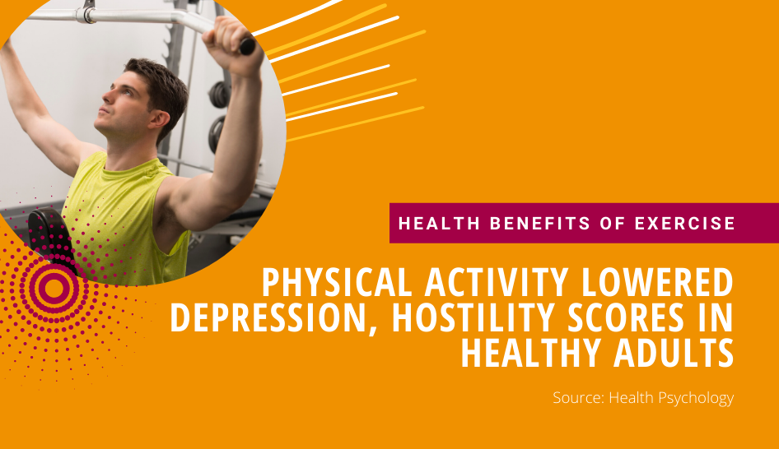
Higher Physical Activity after Chronic Disease=reduced Mortality
Link between physical activity and lower mortality from any cause
Dose-response relationship between post-diagnosis physical activity and mortality:
For every 10 MET-hour increase in physical activity, the probability of mortality decreased:
Type II DM (4%)
COPD (30%)
Breast cancer (22%)
Ischemic Heart disease (12%)
Notes:
In chronic disease, quantifying dose response between high PA and decreased mortality less clear (increase PA, decreased mortality); International Journal of Behavioral Nutrition and Physical Activity; systematic review of 28 articles

Slide 6
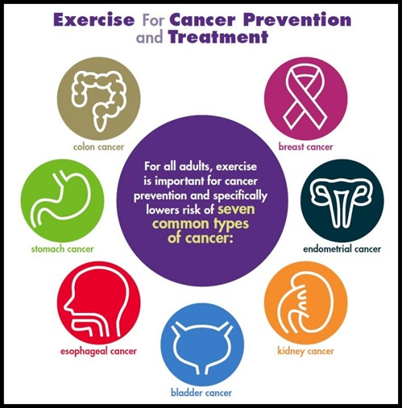
Cancer Prevention
Physical Activity associated with reduced risk of 7 cancers

Slide 7
Better Cancer Outcomes in higher fitness level
People highest fitness group compared to least active peers:
Lung Cancer:
77% decreased risk of having lung cancer
44% lower risk of dying
Colorectal Cancer:
61% decreased risk of having colorectal cancer
89% lower risk of dying
Cancer 2019;125:2594-2601.
Notes:
Stress test between 1991 and 2009, ~70,000 adults, clinical history including smoking,weight; age 40-70; baseline data on cardiorespiratory fitness; grouped in CRF groups; reverse causation; first to include large volume women and large percentage non-white patients

Slide 8
Exercise Prehab
Old recommendation: Get plenty of rest during treatment
New: Avoid inactivity and be as active as ability allows
ERAS-HN prehab recommendations in regard to exercise lacking 2/2 no data
After most surgeries, it's safe to start light, low-impact activities like walking or gentle stretching within a few days to a week.
Including exercise in "prehab" programs before surgery can significantly reduce complications.
Prehabilitation: exercise between diagnosis and first treatment
Exercise can improve health, shorten recovery time, and reduce inpatient stay after surgery.
Rogers et al. 2008,2009:
30.5% met exercise guidelines before their HN cancer, 8.5% after
75% willing to start a program

Slide 9
Exercise During Treatment
Old recommendation: Get plenty of rest during treatment
New: Avoid inactivity and be as active as ability allows

Slide 10
Sarcopenia
Pre-surgical sarcopenia strong negative predictor of 2 year and 5 year OS
Similar concern with CRT
Treatment breaks
Chemo toxicity
Notes:
Loss of muscle mass

Slide 11
Role of full body exercise after HN cancer diagnosis
Supportive Care in Cancer (2023) 31:670
Increase muscle mass and cardiac fitness should improve outcomes, decrease SE
Heterogeneous adherence rates
Severe muscle depletion in population
Resistance only didn’t increase muscle mass
Aerobic exercise may decrease inflammation cancer cachexia
Notes:
Systematic review of 9 trials

Slide 12
Exercise in Survivorship
Exercise Guidelines for Cancer Survivors: Consensus statement from International Multidisciplinary Roundtable
Campbell KL, Winters-Stone KM, Wiskemann J, May AM, Schwartz AL, Courneya KS, Zucker DS, Matthews CE, Ligibel JA, Gerber LH, Morris GS, Patel AV, Hue TF, Perna FM, Schmitz KH. Exercise Guidelines for Cancer Survivors: Consensus Statement from International Multidisciplinary Roundtable. Med Sci Sports Exerc. 2019 Nov;51(11):2375-2390. doi: 10.1249/MSS.0000000000002116. PMID: 31626055; PMCID: PMC8576825.

Slide 13
Cancer Exercise Guidelines

Slide 14
American Cancer Society: Nutrition and Physical Activity Guideline for Cancer Survivors
Avoid inactivity and return to normal daily activities as soon as possible after diagnosis and treatment.
Take part in regular physical activity.
Start slowly and build up the amount of physical activity over time.
Build up to 150-300 minutes of moderate (or 75-150 minutes of vigorous intensity) activity each week.
Exercise several times a week for at least 10 minutes at a time.
Include resistance training exercise at least 2 days per week.
Do stretching exercises at least 2 days each week.

Slide 15
Exercise Barriers
HN specific barriers:
Dry mouth
Fatigue
SOB Weakness
Shoulder pain
Difficulty swallowing
Eur Arch Otorhinolaryngol (2018) 275:169–179

Slide 16
Cancer-informed exercise recovery

Slide 17
Exercise Prescriptions
Strong evidence that an exercise program consisting of a half hour of aerobic exercise three times weekly was sufficient to improve anxiety, depression, fatigue, quality of life, and physical function in cancer survivors.

Slide 18
How to engage the non-exerciser
Talk about it:
Strong evidence that an exercise program consisting of a half hour of aerobic exercise three times weekly was sufficient to improve anxiety, depression, fatigue, quality of life, and physical function in cancer survivors.
PT referrals
Exercise prescriptions
EMR

Slide 19
Take Home Points
Exercise with proven benefits in:
Cancer prevention
Cancer outcomes
Exercise improves treatment-related symptoms
Head and Neck patients with special considerations
Head and Neck patients interested in exercise
Education and recommendations important

