Slide 1
Alternative Therapies for Recurrent Otitis Media & Otitis Media with Effusion
Laurie Newton DNP, RN, CPNP- AC, PC
Assistant Professor
Department of Otolaryngology
Division of Pediatric Otolaryngology

Slide 2
Disclosures
I have no relevant financial disclosures

Slide 3
Objectives
Review common alternative therapies for recurrent otitis media and otitis media with effusion with a pediatric focus
What does the evidence say?
What are pediatric patients/families actually utilizing?
How can we best counsel our patients and families on use of these treatments?

Slide 4
Current Practice in the room?
Do you routinely ask your patients if they are using any complementary or alternative treatments?
If the answer is yes, do you feel like you have a good understanding of the things that are being used?

Slide 5

What does google say?
What will parents find if they search online?
  NIH CAM Treatment Options for OM
  Mayo Clinic
  Dr. Axe??
    Olive oil
    Ginger
    Garlic
    Chiropractics
Notes:
Since we know many patients/families go right to the internet when searching for medical advice, I entered a google search for “alternative therapies for ear infections”. The first thing that comes up is a link to the NIH CAM Treatment Options for OM..

Slide 6
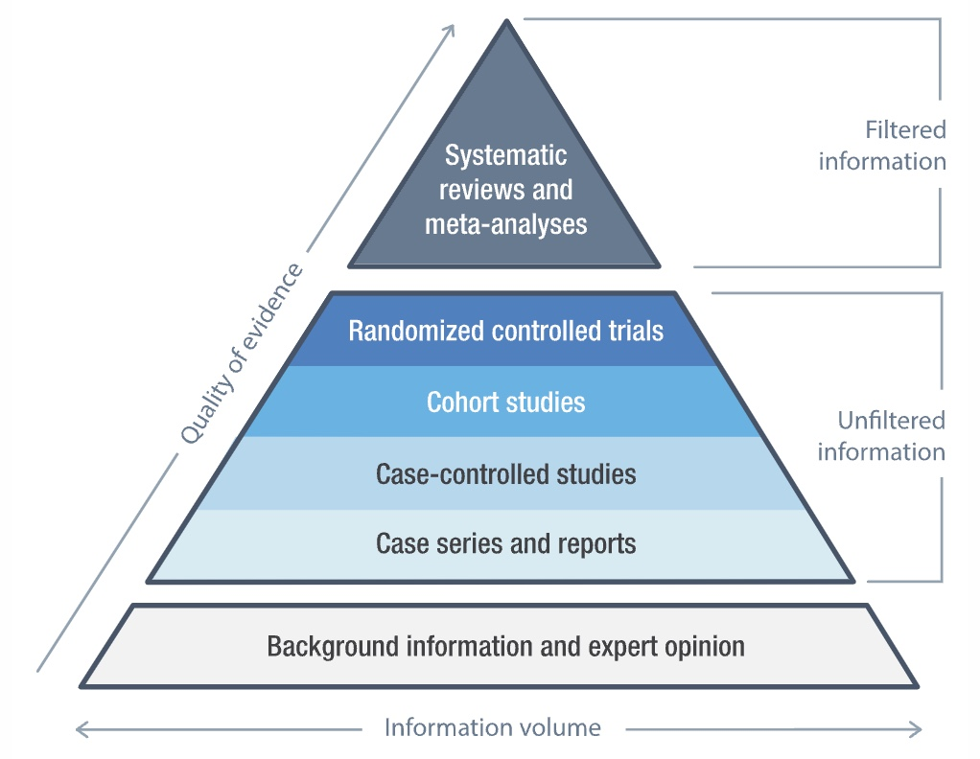
Levels of Evidence
Notes:
Of course as health care providers it is our job to base our recommendations on the best evidence that is available following the classic levels of evidence as our overall guide

Slide 7
Literature Search
Search: ("Complementary Therapies"[Mesh] or "complementary therap*" or "complementary medicine" or "alternative medicine" or "alternative therap*") and ((("Otitis Media"[Mesh] or "otitis media") AND (recurr* or chronic*)) or ("Otitis Media with Effusion"[Mesh] or "otitis media with effusion" or "middle ear effusion*" or "secretory otitis media" or "serous otitis media")) and (pediatric*[tiab] or paediatric*[tiab] or child* or adolescen* or infan* or juvenile)
Notes:
A total of 110 results came back, and when filtering for articles from the last 5 years only 8 results came back. When filtering for systematic review, only 6 articles remain with only one of these being from the last 5 years

Slide 8
Definitions
CAM: Complementary & alternative medicine
Alternative medicine: any practice claiming to possess the healing effects of conventional medicine, but does not originate from evidence-based scientific methods
Complementary medicine: an alternative medicine used in conjunction with conventional medicine-> may be synergistic
Notes:
Interestingly. Complementary integrative medicine is noted in some articles as a preferred term since it is seen as less negative- this is defined as “anything not in the realm of modern or evidence- based medicine” which can include treatments based on historical or cultural traditions or those emphasizing self-treatment and prevention.

Slide 9
Difficulty evaluating efficacy of CAM
Lack of randomization
Language barriers
Conflicting and limited research
Dated studies
Notes:
Many studies on traditional Chinese and Japanese medicine in OM, but the conclusions limited due to language barriers, methodological concerns, and formulation variability

Slide 10
OM & CAM: The Why?
Acute Otitis media (AOM)- one of the most common childhood illnesses
High prevalence → patients ask opinion regarding CAM therapies for pediatric OM
Personalized approach to the sick child
Parents’ disappointment with conventional medicine
Personal or professional recommendations
Parents’ previous experiences
Notes:
Despite significant expenditures on testing CAM, including $124 million spent by the US government in 2014, <5% of therapies were tested in children.

Slide 11
What are families using?
Prevention
Symptomatic Relief
Homeopathy
Chiropractics & Osteopathy
Traditional Chinese & Japanese Medicine
Notes:
So let’s look alittle bit into what families are using and what the evidence says. Broadly speaking, I am going to talk about these categories of alternative medicine for ear infections
Within prevention- we will talk about a few different things, including nutrition, natural health products and probiotics

Slide 12
Prevention
Nutrition
Implicated in pathogenesis of OM
2009 meta-analysis: deficiencies of vitamin A and/or zinc may lead to increased rates of OM
12 RCTs in which placebo was compared with zinc → conflicting reports regarding the efficacy of supplementation
Vitamin D→ not enough evidence
Notes:
While we know numerous risk factors have been identified in OM including increased rates of OM with bottle feeding as compared with breastfeeding, tobacco exposure, large daycare settings, nutrition in general is another area that has been implicated in the pathogenesis of OM. A 2009 meta-analysis supported previous findings that deficiencies of vitamin A and/or zinc may lead to increased rates of OM. However, Abba and colleagues reviewed 12 RCTs in which placebo was compared with zinc and found conflicting reports regarding the efficacy of supplementation.
Lastly, vitamin D- as we all know plays a role in metabolism and calcium homeostatis, but also plays a role in immunity and infection. While several studies have looked at the relationship between decreased vitamin D levels and the increased risk of AOM, there is not enough evidence to support a causative effect of vitamin D deficiency on the development of AOM or to suggest a protective effect of vit D supplementation in children with RAOM- further controlled clinical trials are needed to solve these questions.

Slide 13
Prevention- Natural Health Products
Echinacea
Commonly used to prevent or treat common cold
At least 9 subtypes→ only Echinacea pallidum root and E purpurea leaf have demonstrated efficacy in treating symptoms of URI
Does it help with OM??
2004 RCT found mixture containing echinacea significantly (p<0.001) reduced number of AOM episodes compared with placebo….
2008 RCT found borderline increased incidence of AOM in the echinacea group compared with placebo
Since then- RCTs and a 2015 and 2021 meta-analysis→ significant evidence of protective effects in reducing the risk of URI and associated AOM, with negligible adverse effects.
Notes:
..symptoms of URI although other echineacea products are commonly sold in the US
A 2004 RCT by Coehn and colleagues found that a mixture containing echinacea reduced the number of AOM episodes per child by 68% (p<0.001) compared with placebo among 430 children. Since then, larger RCTs have been performed, as well as a 2015 and 2021 meta-analysis. These studies have added significant evidence of the protective effects of echinacea in reducing the risk of URIs and associated incidents of OM, with negligible adverse effects.

Slide 14
Prevention: Xylitol
A natural sugar found in may fruits & gum
Inhibit growth of S. pneumoniae & attachment of this and H. influenzae to nasopharyngeal cells in vitro
RCT: Xylitol reduced occurrence of AOM by 41% (95% confidence interval: 4.6%-55.4%) with additional benefit of the group requiring fewer antibiotics during the study period
40% reduction of OM with xylitol gum
30% reduction with syrup
20% reduction with lozenge
Ineffective in children with tympanostomy tubes
2016 Cochrane review: Xylitol in five RCTs– it could help reduce risk of AOM in healthy children with no active URI from 30% to 22%
Notes:
Xylitol is a natural sugar found in many fruits and chewing gum and is thought to have preventative properaties in OM. It can inhibit the growth of S. pneumo and the attachment of both S. pneumo and H flu to nasopharyngeal cells in vitro. The first major RCT showed xylitol reduced the occurrence of AOM by 41%-95% CI with the additional benefit that the zylitol group required fewer antibiotics during the study period. The most common side effects were abdominal pain and diarrhea. The same group showed a 40% reduction in OM inpatients receiving xylitol gum, 30% reduction with syrup, and 20% reduction with xylitol lozenge compared with controls. However it was found ineffective in children with tympanostomy tubes. Lastly a 2016 Cochrane review looked at xylitol in fever RCTs and found it could help reduce the risk of AOM in healthy children with no active URI from 30%-22%. This review also noted chewing gum and lozenges to be more effective than syrup, although these are not safe for children < 2 years od who are at the greatest risk of OM

Slide 15
Prevention: Probiotics
Thought to reduce URI colonization with pathogenic bacteria by enhancing the phagocytic activity of leukocytes and stimulating antibody production
Safe in immunocompetent individuals.. have potential to interact with other medications
Can be given orally or trans-nasally
Notes:
Probiotics are microorganisms that can confer health benefits by restoring microbial balance- they are defined as “live microorganisms which, when administered in adequate amounts, confer a health benefit on the host” [. Probiotics are thought to reduce URI colonization with pathogenic bacteria by enhancing the phagocytic activity of leukocytes and simulating antibody production. They are considered safe in immunocompetent individuals but have the potential to interact with other medications. Probiotics for AOM can be given orally or trans-nasally. No study has directly compared these although the evidence somewhat favors trans-nasal

Slide 16
Evidence: Probiotics
Variable efficacy: reduction in OM incidence in treated children was limited
2013 Double blind, placebo controlled trial: compared formula along to formula supplemented with probiotics & prebiotics→no difference in AOM incidence, lower URI incidence, or antibiotics
Similar study found that probiotics did not modify the NP carriage of S. pneumoniae or H influenzae, but increased the carriage of M. catarrhalis
2023 RCT- S. salivarius probiotics= no decrease in AOM
**Evidence limited, low quality studies, potential benefit of nasal probiotic use
Notes:
Data regarding the use of probiotics on OM has showed variable efficacy. In general, the reduction in OM incidence in treated children was limited. Probiotics have been shown to significantly reduce the risk of development of antibiotic associated diarrhea, which of course can be helpful when a child is being treated for AOM. A double blind placebo controlled trial assessed whether follow up formula supplemented with probiotics and prebiotics could reduce the risk of AOM. During the 12 month study period in 224 health infants age 7-13 months, the treatment and control groups did not differe in the incidence of AOM, lower URIs incidence or number of antiiboitc treatment courses, which were. Mainly prescribed for AOM. Additionally another double blind placebo controlled randomized trial found that probiotics…
A 2023 randomized placebo-controlled clinical trial found that the daily use of the S salivarius K12 products for 6 months did not reduce the occurrence of AOM.
A 2020 systematic review noted that The evidence for any effect of probiotics on the prevention of AOM is limited, and the overall low quality of studies makes it difficult to draw definitive conclusions. No serious adverse events were noted, and there is some evidence to suggest possible benefit with nasal probiotic administration.

Slide 17
Trans-nasal probiotics
May be more effective
Initial RCT found preventive effects on AOM and COM
Similar RCT in 2015- no significant differences in the number of AOM episodes or antibiotic treatment compared to control
When sub-group of kids who had been successfully colonized with probiotic flora were compared to those not colonized, they found that the number of colonized kids experienced significantly fewer AOM episodes and were treated with less antibiotics
2021 review: some benefit, need larger studies
Notes:
Promoting balanced flora in the nasopharynx to prevent colonization by pathogenic strains (and subsequent OM) may be better achieved through administering probiotics trans-nasally. This was initially reported in a 2001 RCT who found preventive effects on AOM and COM. In a similar RCT from 2015, there was no significant differences in the number of AOM episodes or antibiotic treatment compared with control. Interestingly, when only the sub-group of children who had been successfully colonized with the probiotic flora- confirmed by nasopharyngeal microbiological analysis- were compoared with those not colonized, they found that the number of colonized children experienced significantly fewer AOM episodes and were treated with less antibiotics.
I lastly looked at a review article from 2021- the authors looked at the effects of probioitcs on a host of ENT diagnoses- specifically, they noted nasal sprays containing Lactobacillus strains appear to confer the greatest resistance to AOM and SOM episodes, but larger studies are required to investigate optimal populations and timing of delivery.

Slide 18
Homeopathy
RCTs, observational, and self-selection prospective trial
Significantly more patients in homeopathic group had normal tympanograms end of study
“Trend toward significance” homeopathy
Significantly less analgesics required in homeopathy with no change in time to recovery
Fewer antibiotics filled in homeopathy group
Notes:
Homeopathy is based on the principle of “like treats like” and uses minute amounts of natural substances to treat disease. Its use includes things such as belladonna, chamomilla. Remedies used for OM are generally regarded as “safe” but there are reports of initial symptoms worsening in 10-20% of patients

Slide 19
Homeopathy & Symptomatic relief
Important to families
Herbal eardrops→ variable compositions
Herbal medicine generally considered safe- unclear efficacy & side effects vary
Homeopathic treatments may decrease pain and may lead to a faster resolution of disease
Fewer patients who used homeopathic eardrop during watchful waiting filled an antibiotic; RCT found homeopathy group less likely to require antibiotics for treatment failure
Notes:
Symptomatic relief of AOM is important to families, especially with watchful waiting recommendations. Warm compresses, steam, saltwarter gargling, and over the counter decongestant nasal sprays may provide relief and be things we are more comfortable with discussing with our patients and famllies. Some families do find herbal eardrops helpful, although their composion s are quite variable. Other things noted to be used and sometimes helpful include garlic, St. John’s wort, lavender to name a few. Many of the studies regarding these remedies, however are observational as opposed to RCTs. In one study, homeopathic treatments were noted to decrease pain and those patients required less analgescs compared to the conventional group. Lastly in a RCT from 2011 that compared homeopathic treatment to “conventional treatment” with antipyretics, analgesics, and anti-inflammatory medications- the homeopathy gropu was less likely to require antibitoics for treatment failure but there was no significant difference in cure rates between the two groups.

Slide 20
Osteopathy
Osteopathic manipulative treatment (OMT)
2013 systematic review:
17 RCTs evaluated the effectiveness of OMT for multiple childhood conditions including OM
Conclusion: OMT should not be recommended for infants and children based on the low quality of supporting evidence
**Difficult to make recommendations due to studies having high potential for bias with small numbers and low quality
Notes:
Manipulative therapies also broadly include osteopathic manipulative treatment and many other forms of manual therapies used to manage a variety of conditions in adults and children.
Overall, it is difficult to make any recommendations about the use of manipulative therpaies in infants and children because most studies had a high potential for bias with small numbers of patients and low methodologic quality.

Slide 21
Chiropractics
Use manipulation to attempt to improve innervation and function of tensor veli palatini→ proposed to help treat or prevent OM
Clinical trials limited & with flaws
3 major noncontrolled clinical trials evaluating its use- look at time to AOM recovery with chiropractics
Children at increased risk of injury; serious adverse events have been reported
Notes:
Chiropractics is something that I am asked about relatively frequently by families looking for an alternative treatment for their child’s ear infections or MEE. Chiropractics studies older- 1996, 1997, and 2004. Unfortunately, clinical trials evaluating the effectiveness of chiropractics in treating AOM are limited and possess significant methodological flaws.
3 major….findings included 93% of AOM improved, 75% within 10 days (could be normal resolution for viral AOM) and another found 95% had return of normal appearing TM and decrease in fevers after 2 weeks
Perhaps most important to counsel pediatric patients about is the increased risk for injury following rapid rotational movements of forces secondary to anatomic immaturity. Serious adverse events have been reports, including paraplegia and death.

Slide 22
Traditional Chinese & Japanese Medicine
Acupuncture & Chinese herbal medicine approved by World Health Organization as therapies to treat AOM and COM
Acupuncture:
May require numerous sessions to judge efficacy
Difficult to tolerate in children
Alternatives- acupressure or laser acupuncture
Effective for acute pain control in children
Notes:
I will be speaking only to acupuncture today
Last point– Acupunctrue has been shown to be effective for general acute pain control in children with minimal side effects (with the most common being dizziness)

Slide 23
Acupuncture
Few studies in humans and none in English
2011 RCT in canines:
Randomized to receive conventional therapy and either ”sham” acupuncture or “directed” acupuncture
Over one year, majority of dogs in acupuncture group were otitis free
Notes:
Instead, alternative modalities such as acuprtressure or laser acupuncture can be used. Although there is little understanding of its mechanism in treating OM, it is theorized that acupuncture has immunomodulatory properties that may play a role in the clearance of MEE.
However, since the reported type of otitis is unclear and given that otitis externa usually affects canines, these conclucsions may not be attributable to humans

Slide 24
Reported CAM Treatment Options of OM
Treatment | AOM | RAOM | OME | Overall Efficacy
Acupuncture | + |  |  | Effective with concomitant antibiotics
Homeopathy | + | + | + | Mild
Herbal medicine | + |  |  | Mild to moderate
Osteopathy | + | + | + | Very few benefits
Chiropractics |  |  | + | Very few benefits
Xylitol | + | + |  | Conflicting results; problematic daily dosing
Probiotics | + | + | + | Encouraging results
Notes:
This table was adapted from one of the articles I looked at and summarizes the alternative treatments I discussed today and the specific treatment options for OM according to OM type, specifically AOM, recurrent AOM and OME.

Slide 25
Key Takeaways
Herbal eardrops may help relieve symptoms
Homeopathic treatments may help decrease pain and lead to faster resolution of disease
Probiotics, echinacea, and xylitol may be beneficial in preventing OM and decreasing antibiotic use
Of all CAM therapies, only echinacea and xylitol have been studied in well-designed, randomized blinded trials
Probiotics and traditional Chinese/Japanese medicine are areas with promising research- need larger well-designed trials to confirm safety and efficacy

Slide 26
References
Bourdillon, A. T., & Edwards, H. A. (2021). Review of probiotic use in otolaryngology. American journal of otolaryngology, 42(2), 102883. Chen, T. Y., Hendrickx, A., Stevenson, D. S., Bird, P., & Walls, T. (2020). No evidence from a systematic review for the use of probiotics to prevent otitis media. Acta paediatrica (Oslo, Norway : 1992), 109(12), 2515–2524.
Coleman, A., & Cervin, A. (2019). Probiotics in the treatment of otitis media. The past, the present and the future. International journal of pediatric otorhinolaryngology, 116, 135–140. https://doi.org/10.1016/j.ijporl.2018.10.023
Fixsen, A. (2018). Homeopathy in the age of antimicrobial resistance: is it a viable treatment for upper respiratory tract infections. Homeopathy, 107, 99-114.
Gerlitz, M., Voitl, P., Voitl, J.J.M., & Diesner-Treiber, S.C. (2022). Non-prescription treatments for childhood infections: an Austrian, monocentric, cross-sectional questionnaire study. BMC Pediatrics, 22(154), 1-9.
Marchisio, P. et al. (2015). Streptococcus salivarius 24SMB administered by nasal spray for the prevention of acute otitis media in otitis prone children. European Journal of Clinical Microbiology and Infectious Disease, 34 (12), 2377-2383.
Marom, T. et al. (2016). Complementary and alternative medicine treatment options for otitis media. Medicine, 95(6), 1-9.

Slide 27
References
Nathan, A.S., Levi, J.R. & O’Reilly, R. (2022). Complementary/integrative medicine for pediatric otitis media. Otolaryngology Clinics of North America, 55, 1055-1075.
National Center for Complementary and Integrative Health, https://www.nccih.nih.gov/
Sarlin, S., Koskela, U., Honkila, M., Tähtinen, P. A., Pokka, T., Renko, M., & Tapiainen, T. (2023). Streptococcus salivarius Probiotics to Prevent Acute Otitis Media in Children: A Randomized Clinical Trial. JAMA network open, 6(11), e2340608.
Sinha, M.N. et al. (2012). Randomized controlled pilot study to compare homeopathy and conventional therapy in acute otitis media. Homeopathy, 101(1), 5-12.
Smith, M.S., Olivas, J., & Smith, K. (2019). Manipulative therapies: what works. American Family Physician, 99(4), 248-252.
Winger, K., Hendriksz, T., Wolf, K., Talsma, J., & Pierce-Talsma, S. (2020). Osteopathic Manipulative Treatment for Pediatric Patients With Otitis Media. The Journal of the American Osteopathic Association, 120(3), e5–e6.

Slide 28
Thank you!
Contact: Laurie Newton
lnewton@mcw.edu

