Slide 1
Hearing Loss in the Era of Personal Listening Devices
Steven A. Harvey, MD, FACS

Slide 2
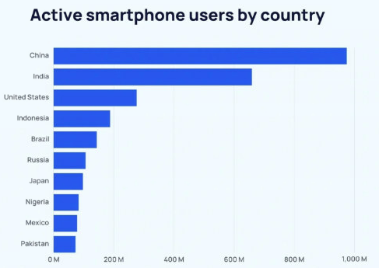
Worldwide use of PLD’s
4.88 billion smartphone users globally
World population 8.1 billion
60% of total population
7.21 billion subscriptions

Slide 3
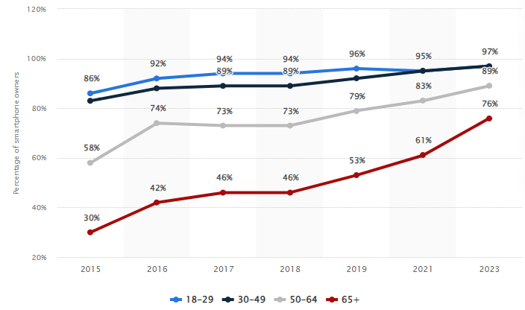
Market Penetration for PLD’s in U.S.

Slide 4
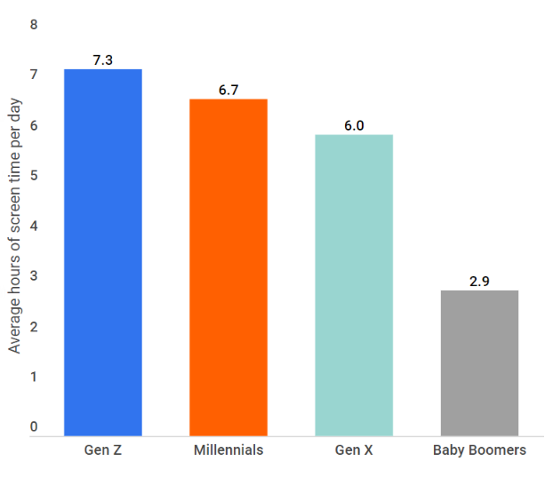
Screen Time by Generation

Slide 5
How Do We Measure the Problem?
Use the dBA scale
Human ear not equally sensitive to all sound frequencies
Range of hearing from 20-20,000 Hz
Most sensitive to 250-5,000 Hz
A-weighted scale gives greater value to frequencies that we are most sensitive to and less to those outside that range

Slide 6
How Do We Measure the Problem?
Must look at the Daily Noise Dose (DND)
Maximum recommended DND defined as time-weighted average of 85 dBA for an 8-hour period (NIOSH)
This constitutes a 100% noise dose
For every 3 dBA increase in noise level, the allowable exposure time is reduced by half
PLD’s are capable of sound levels in excess of 100 dBA

Slide 7
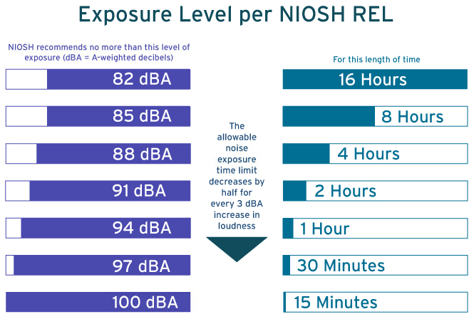
Daily Noise Dose

Slide 8
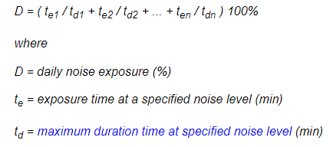
Measurement Considerations
These measurements/standards are applicable in the industrial setting where noise level is relatively constant
Not so in music when sound level changes continuously

Slide 9
Measurement Considerations
Noise dosimetry underestimates intermittency of exposure
Amplified music emphasizes low frequencies vs. flat spectra typical of industrial noise
Must consider frequent pauses between soundtracks with PLD
Volume level chosen with PLD influenced by degree of background environmental noise

Slide 10
What’s the Consensus?
Many studies based only on subject reported volume settings/duration of exposure
Studies are cross-sectional whereas longitudinal tracking is necessary to assess noise-induced hearing loss which is cumulative

Slide 11
What’s the Consensus?
Gilliver, et al. (Semin Hear, 2017)
Australian study based on survey responses from 3,578 PLD users
Calculated DND based on reported volume setting and daily duration of exposure
401 (11%) exceeded DND recommended by workplace noise exposure guidelines based on PLD use alone
No accounting for any additional environmental noise exposure

Slide 12
What’s the Consensus?
Mostafapour, et al. (Laryngoscope, 2009)
Audiometric testing on 50 young adults with history of PLD use > 1 hour/day (estimated lifetime exposure of 2394 hours)
Looked for high frequency notching of 10 dB or greater
Could not identify pattern consistent with clear-cut noise-induced hearing loss (NIHL)

Slide 13
What’s the Consensus?
Kaplan-Neeman, et al. (Int J Audio, 2017)
37 subjects comparing self-reported volume/duration use of PLD with installed smartphone app able to measure DND
Monitored for only 14 days
8 subjects (22%) exceeded 100% DND at least on one day
Poor correlation between self-reported and measured values
Both over- and under-estimation

Slide 14
What’s the Consensus?
Paping, et al. (Otol-HNS, 2021)
314 adolescents with installed smartphone app monitored from 7-40 days (median 33 days)
100% DND exceeded:
29% at least one day of the study
10% for all listening days
2.2% for all days of the study

Slide 15
Conclusions
Small but not insignificant number of PLD users exceed DND guidelines that were designed for industrial setting
May or may not be applicable for PLD use
Need longitudinal studies to determine if cumulative effect over decades leads to measurable NIHL
Would be reasonable to install app to measure daily noise exposure use of PLD’s

