Slide 1
Hearing Loss & Cognitive Decline: Impact of Hearing Rehabilitation & Wellness Implications
Michael S. Harris, MD
Associate Professor
Medical College of Wisconsin
Department of Otolaryngology & Communication Sciences
Chief, Division of Otology, Neurotology, & Skull Base Surgery
Medical Director, Koss Cochlear Implant Program
Medical Director, Clement J. Zablocki VA Cochlear Implant Program
Notes:
Thank you, Dr. Duthie! I appreciate the invitation join you all for grand rounds this morning. I’m Mike Harris from the Department of Otolaryngology & Communication Sciences here at Medical College of Wisconsin (MCW). My clinical and research focus is Otology & Neurotology, which is a subspeciality of Otolaryngology that deals with ear and hearing disorders and pathology of the lateral skull base. This morning, I’d like to discuss the increasingly recognized association between hearing loss and cognitive decline. More has likely been written on this topic in popular media that in peer-reviewed journals, so it’s crucial that we understand this association well as a medical community.
The population is aging rapidly; a historically unprecedented large proportion of the population is becoming seniors as those in the “baby boomer” generation turn 65 years old. Another reason is that longevity has increased, with more people living to older ages, including many who are centenarians.⁹ ¹⁰ ¹¹ Indeed, the most rapid reductions in mortality are occurring in the “oldest old” age group of octogenarians and nonagenarians.¹² Accordingly, in the coming years, audiologists should expect to see more people who are living to older ages and whose needs differ from those of younger adults.

Slide 2
Case
76-year-old male
HPI: Progressive hearing loss, nonpulsatile tinnitus, gave up on hearing aids (“louder” but not “clearer”), “work” of listening exhausting, social withdrawal
Past Medical History: T2DM, HNT, HLD, BPH
SH: remote tobacco; 30+ years factory work, rare hearing protection
Avocational: Hunter
Notes:
To ground this in a clinical context, I’d like us all to consider a 76-year-old patient. Among other issues you’re discussing with him, he relates a history of progressive hearing loss. He’s troubled by nonpulsatile tinnitus. He once used hearing aids but has abandoned hearing aid use because while they make things “louder,” they don’t make things “clearer” for him, and it’s frustrating. His daughter volunteers that she sees him exhausted by the “work of listening,” and they both agree that he’s been withdrawing from his previously robust social life.

Slide 3
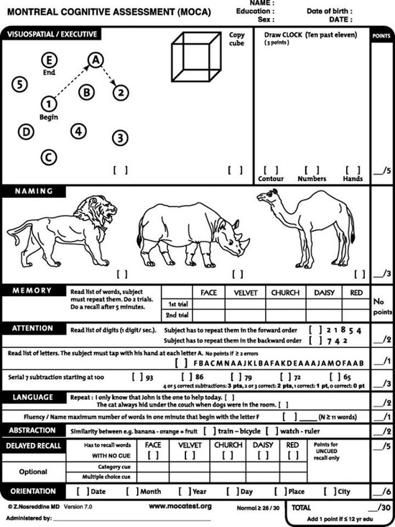
Montreal Cognitive Assessment (MoCA)
26/30
Best Aided Word Recognition –
10% correct right; 2% left
Notes:
You send him for an updated hearing assessment. On the left is a pure tone-audiogram. Frequency, or pitch, is plotted on the x-axis; intensity, or loudness, is plotted on the y-axis. The lower down the symbols appear, the worse the hearing is. Our patient shows a profound sensorineural hearing loss in both ears. Word recognition testing demonstrates that without visual cues, he’s getting only 20% and 12% of the words correct, on the right and left, respectively. It has been our practice for patients within this range of hearing, who might be considering a cochlear implant, to complete a modified version of the Montreal Cognitive Assessment, or MoCA, which is a brief screening measure for cognitive decline. He scores a 26 out of 30, which is just below normal, suggesting possible mild cognitive impairment.

Slide 4
Case
Counsel and hearing rehabilitation
Adapting communication strategies
Continued hearing aids
Cochlear implant
Patient and family questions
What is the relationship between hearing loss and cognitive decline?
Is cognitive decline a barrier to pursuing a cochlear implant?
Can treating hearing loss prevent or restore cognitive impairment?
Notes:
The audiologist refers the patient then to us in ENT. We discuss the options for hearing rehabilitation, principally continued hearing aid use or, surgically, a cochlear implant. The patient and family pose several difficult and important questions. What is the relationship, they ask, between hearing loss and cognitive decline? Is cognitive decline a barrier or contraindication to pursuing a cochlear implant? Can treating hearing loss prevent or delay cognitive decline or restore existing cognitive deficits?

Slide 5
Pichora-Fuller MK et al., 2015
Health has been defined as a state of complete physical, mental, and social well-being…
Not merely the absence of disease or infirmity.
From the perspective of health promotion, health has been redefined as the capacity of people to adapt to, respond to, or control life's challenges and changes.

Slide 6
Hearing loss is associated with aging
~ 1/3 of people >65 years old
Hearing loss results in activity limitations in communication and orientation that affect ability to function in daily life

Slide 7
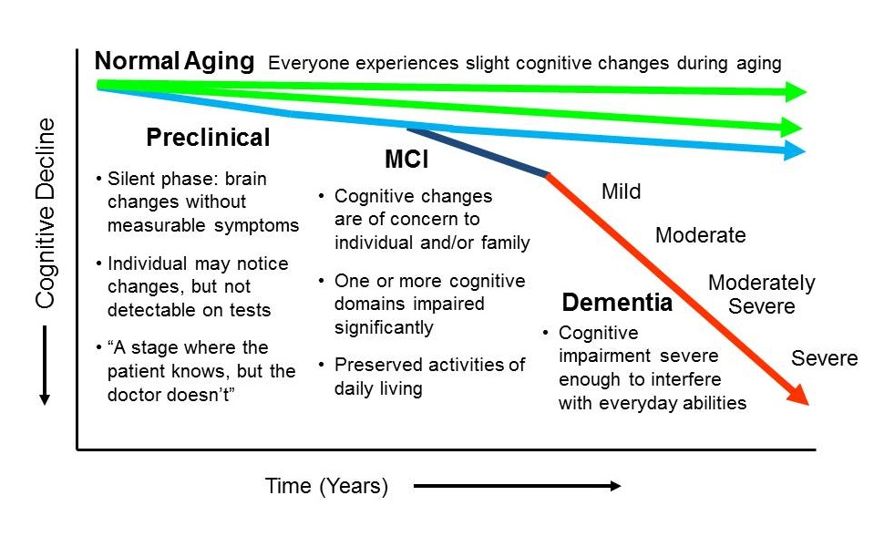
Hearing Loss &
Cognitive Decline
Hearing loss is considered by older adults to be one of the most frustrating and challenging sensory changes associated with aging (second to vision loss)
Crews & Campbell, 2004
Cognitive impairment is cited as the most devastating and feared condition that older adults face
Corner et al. 2004; Morris et al. 2001
Dementia is expected to triple worldwide by 2050
Notes:
As the proportion of older adults increases, conditions associated with aging are being seen more frequently. While not inevitable or universal, a decline from previously attained levels of cognitive function is associated with advancing years. For the studies considered here, mild cognitive impairment suggests preserved functionality through recruitment of other resources or strategies; dementia, on the other hand, denoting a profound decline affecting daily living, social functioning, and independence. Worldwide, the number of people living with dementia is expected to triple by the year 2050. For patients and their families and society, dementia is a very costly and morbid condition. There is a disproportionate impact on low- and middle-income countries, where resources are most limited.

Slide 8
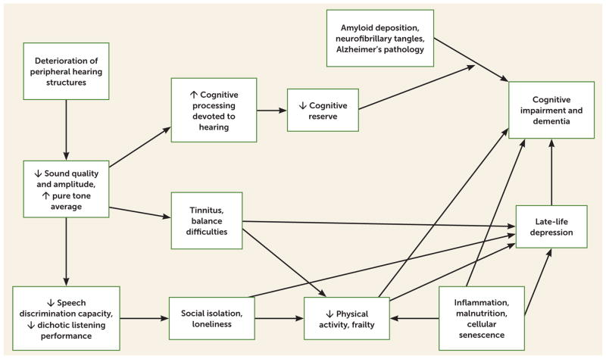
Age-Related Hearing Loss’ Far-Reaching Impact on Wellness
Significant, positive correlations in multiple cultural settings noted between hearing loss and…
Social isolation
Mikkolla et al. 2016
Reduced time spent out of home
Mikkolla et al. 2016
Decline in social engagement
Brink et al., 2007; Pichora-Fuller et al., 2015
Loneliness and Depression
Lee et al., 2010; Gopinath et al., 2009; Contrera et al., 2016
Rutherford et al., 2018
Notes:
Inextricable, Modulating Factors on Cognition
Hearing loss measured either by pure-tone audiometry (and different gradations or definitions), self-report of hearing loss, or hearing aid use.
In the long term, if hearing loss compromises an individual's ongoing lifestyle choices, resulting in reduced engagement in physical, mental, and social activity, then the maintenance of the person's cognitive reserve may be compromised.
Decline in social engagement depletes cognitive reserve, which is known to be protective against cognitive decline

Slide 9
Hearing Loss &
Cognitive Decline
Addressing modifiable risk factors for dementia is a major public health priority
9 risk factors identified
UK National Institute of Health & Care Excellence (NICE)
US National Institutes of Health (NIH) guidelines
Estimated population attributable fraction (PAF) = percentage reduction in new cases over a given time if that risk factor were eliminated
Livingston et al., Lancet Commission on Dementia 2017, 2020
Criticism: PAF pertains to the population risk profiles in the UK and similar high-income countries. Different factors (e.g., smoking; maternal and early life malnutrition) may be more important population-level risks in low- and middle-income countries, where the burden of hearing loss and dementia are projected to be greater….
Notes:
Identifying and addressing risks factors for dementia has become a major public health priority. Shown here, also from the Lancet Commission on Dementia, are a series of 9 risk factors drawn from the UK National Institute of Health and Care Excellence (NICE) and NIH guidelines. These include level of cognitive reserve, indexed by years of education, medical comorbidities such as hypertension, diabetes and hearing loss, and psychosocial factors like social isolation and depression. The population attributable fraction, or PAF, is calculated to reflect the percentage reduction in new cases of dementia over a given time if that particular risk factor were eliminated completely. The relative risk for dementia contributed by hearing loss is estimated to be 1.9, which given its high prevalence of 32%, gives hearing loss the highest PAF, 9.1%, of any recognized modifiable risk factor for dementia.

Slide 10
Hearing Loss &
Cognitive Decline
Notes:
The potential link between hearing loss and cognitive decline is important but incompletely understood. This hasn’t prevented the emerging story from getting out in front of the public in a major way. Many of you have been or will be put in the position to comment or give guidance, in one way or another, on this issue. So, let’s look at this relationship in more detail…

Slide 11
Hearing Loss &
Cognitive Decline
3MS Score Mean (95% CI)
Lin et al., 2013, JAMA Internal Medicine
Long-term, prospective community study Health, Aging & Body Composition (Health ABC) Study
N = 1984 well-functioning adults aged 70-79 years
Audiometric testing at year 5 of study
Pure tone audiometry (PTA) 0.5-4 kHz for better hearing ear
Cognitive testing at years 5, 8, 10, 11
3MS: Orientation, concentration, language, & memory
Digit-Symbol Substitution (DSS) test: Non-verbal test of psychomotor speed & executive function
Study Year
DSS Score Mean (95% CI)
Participants with hearing loss vs. normal hearing (>25 dB pure tone average .5 – 4 kHz for better hearing ear)
32% (3MS)/41% (DSS) greater annual rate of cognitive decline
Study Year
Notes:
Most of the foundational research linking hearing loss and cognitive decline has been epidemiologic and correlative in nature. Several highly influential, frequently-cited studies came from the Johns Hopkins group leveraging the long-term, prospective Health ABC Study. From this larger sample, the investigators examined the data from close to 2000 healthy, community-dwelling adults aged 70-79 years living in Pittsburgh or Memphis. All participants had a Modified Mini-Mental State Exam, or 3MS, at study outset. All had pure tone audiometry at year 5 of the study. Cognitive testing was performed at intervals using the 3MS, which includes spoken instructions, and the digit-symbol substitution test (DSS), which is a nonverbal test of psychomotor speed and executive function.

Slide 12
Hearing Loss & Cognitive Decline:
Well-replicated Independent Associations
2018
Among cross-sectional studies, a significant association was found for cognitive impairment (OR, 2.00; 95% CI, 1.39-2.89) and dementia (OR, 2.42; 95% CI, 1.24-4.72)
Among prospective cohort studies, a significant association was found for cognitive impairment (OR, 1.22; 95% CI, 1.09-1.36) and dementia (OR, 1.28; 95% CI, 1.02-1.59).
Risk of dementia within 11.9 years
Mild hearing impairment: Elevated by 1.89 X
Moderate: Elevated by 3 X
Severe: Elevated by 4.94 X
Notes:
A meta-analysis coming from outside of the Hopkins group looked at 36 unique studies on the association between age-related hearing loss and cognitive function. Show here are forest plots of odds ratios for the development of cognitive impairment, on top, and diagnosis of dementia, on bottom. For both cross-sectional and longitudinal studies, whether the outcome was cognitive decline or a diagnosis of dementia, odds ratios were significantly elevated in the presence of hearing impairment.
To put the effect size into context, the authors calculated that the cognitive reduction associated with a 25-dB loss in hearing was equivalent to the reduction associated with an increase of 7 years in age.

Slide 13
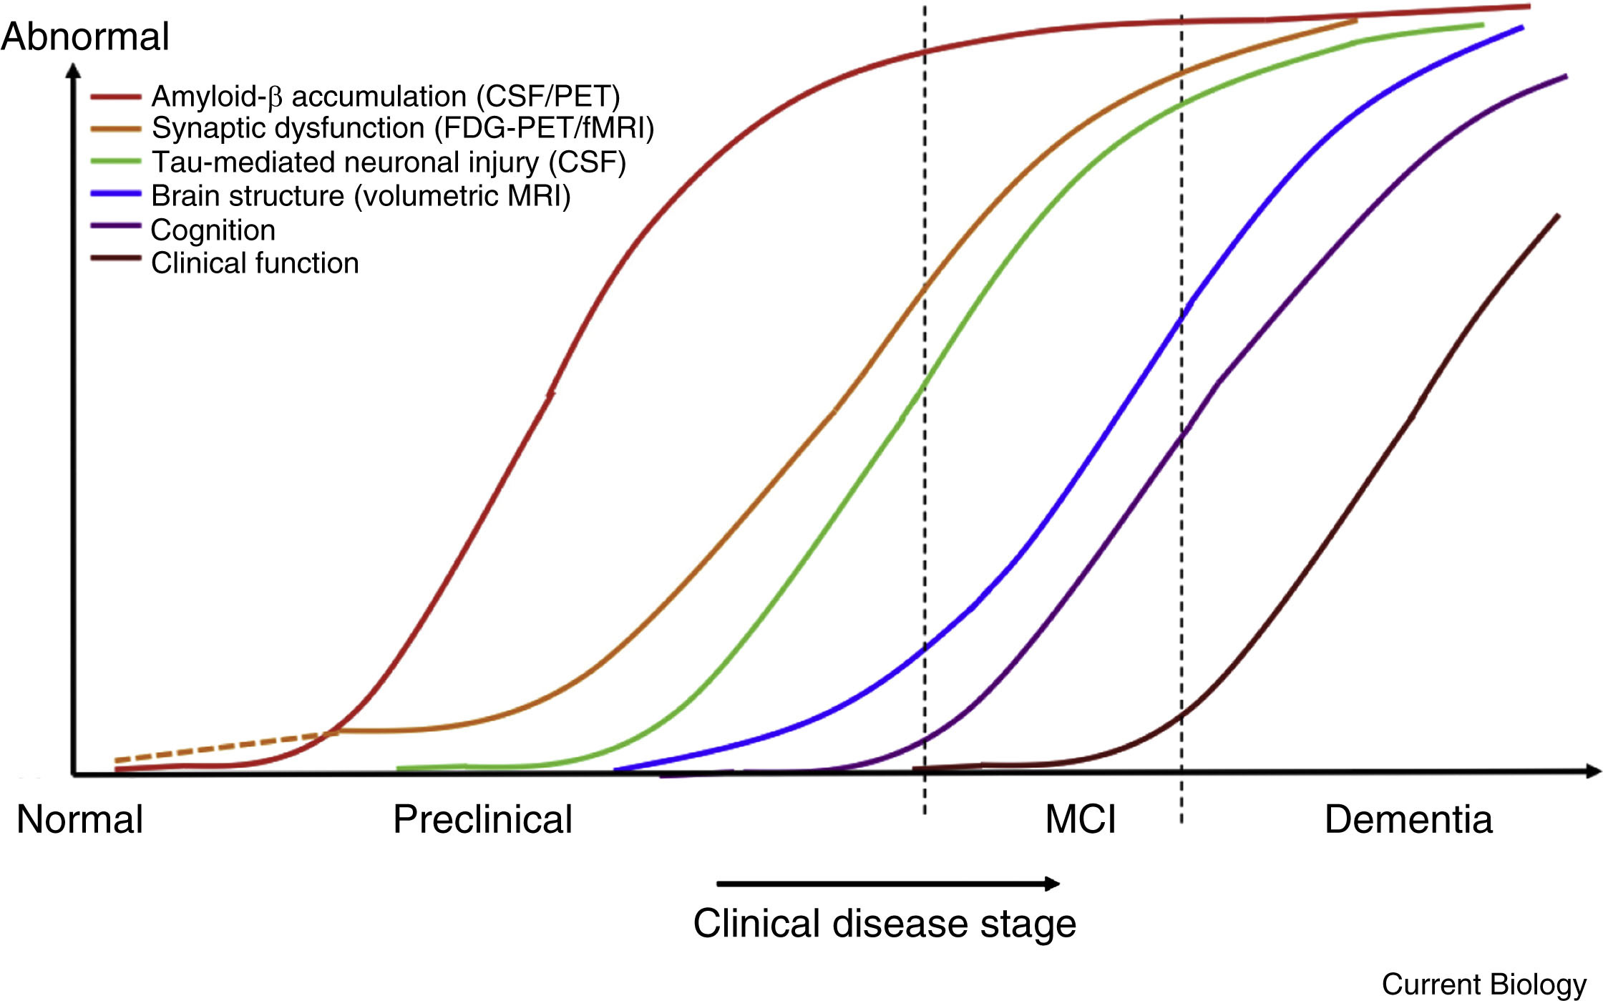
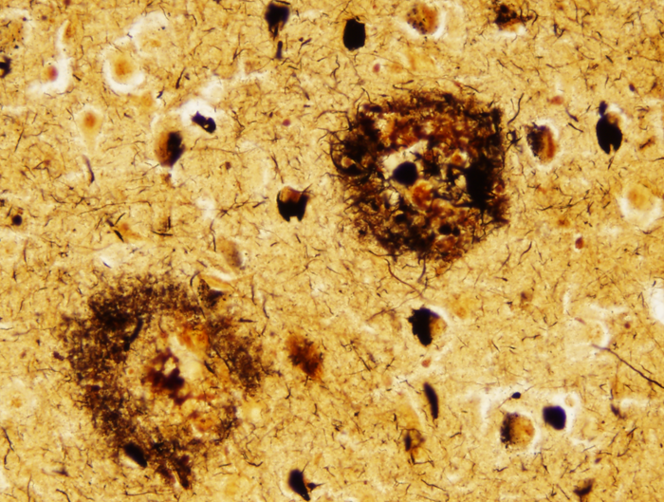
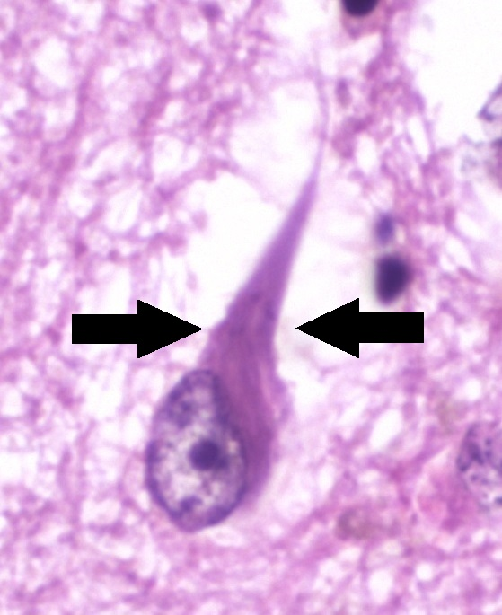
Alzheimer’s Dementia – Neurodegenerative Biomarkers
Key biomarkers
Amyloid-β peptide (senile plaques)
Tau protein (neurofibrillary tangles)
Current biomarkers limited by…
Emergence in relation to clinical disease stage
Expense & invasiveness of testing
Extent of modifiability/treatment
Decades
“Jack Curve” - Model based indicating sequential changes in dynamic biomarkers of Alzheimer’s disease over time. Grontvedt et al., Current Biology, 2018
https://neuropathology-web.org/chapter9/chapter9bAD.html
Notes:
Another, nonepidemiological way of looking at this association, is examining the relationship between hearing loss and know dementia biomarkers. Identifying biomarkers is important because the decades-long process of pre-symptomatic brain changes that lead to cognitive decline may afford a window of opportunity for preventative interventions. Amyloid-β peptide (senile plaques) and tau protein (neurofibrillary tangles) as key actors in the pathophysiology of Alzheimer’s dementia. Current biomarkers, however, are limited by the timing of emergence, expense or invasiveness of testing, and ultimately the extent of modifiability or treatment.

Slide 14
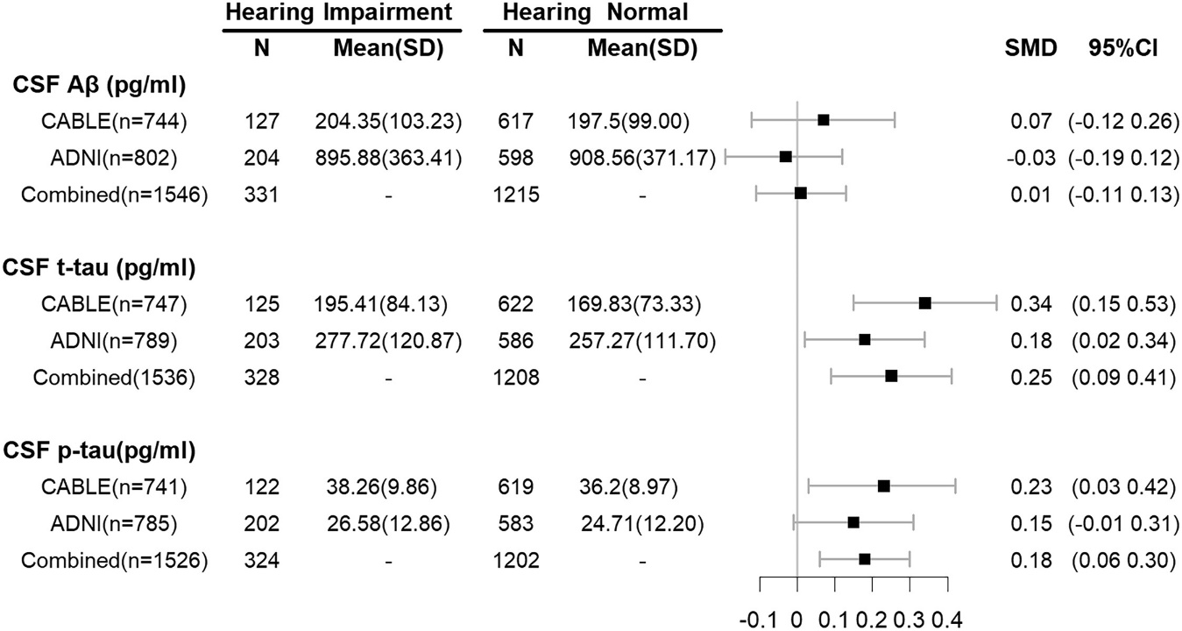
Hearing impairment correlates with higher levels of CSF t- & p-tau protein
ODDS RATIO OF
ELEVATED CSF PROTEIN
CSF Proteins
Hearing Impairment
CABLE & ADNI
Lumbar puncture
Aβ₄₂
p-tau181
t-tau
CABLE & ADNI
Self-report
Chinese Alzheimer’s Biomarker & Lifestyle (CABLE) study (n = 863)
Alzheimer’s Disease Neuroimaging Initiative (ADNI) database (n = 1770)
Cross-sectional
Wang et al., Lancet, 2022
Notes:
The relationship between hearing loss and CSF biomarkers, especially tau-protein and beta-amyloid has been examined. This study drew a large sample from the Chinese Alzheimer's Biomarker & Lifestyle study and the international Alzheimer's Disease Neuroimaging Initiative. They compared CSF amyloid-beta and tau-proteins in study participants with self-reported hearing loss to participants without self-reported hearing loss (self-reporting here is clearly a limitation, here). While the odds ratios for elevated beta-amyloid were not higher in those with hearing loss, for CSF total tau and phosphorylated, or p-tau, they were between about .2 and .3 higher in those with hearing loss.

Slide 15
Summary of Evidence
Most studies show an independent relationship between hearing loss & cognitive decline
Sample sizes large, differences highly significant, but effect sizes are small
Hard to make individual patient predictions
Impossible to infer causal relationship
Notes:
In summary of the current epidemiologic evidence, we can make some preliminary conclusions. Most studies, controlling for potential demographic and medical confounders, show an independent relationship between hearing loss and cognitive decline. This relationship has been demonstrated repeatedly using both verbal and non-verbal test measures and using cross-sectional and longitudinal study designs. An important criticism, however, is that while sample sizes in these studies tend to be very large, like the Health ABC studies, and the differences are highly statistically significant, the effect sizes are very small. In the presence of very small effect sizes, it is hard to make individual patient-specific predictions. It is also impossible to infer causal relationships for correlative data generated by these studies.

Slide 16
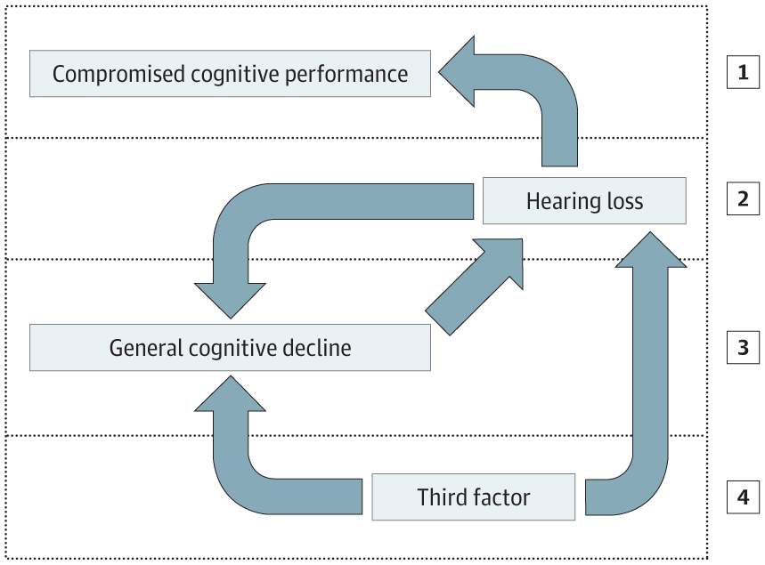
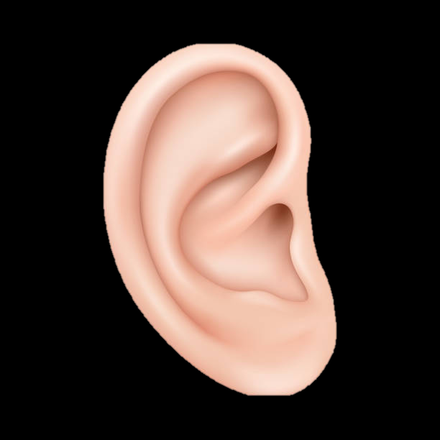
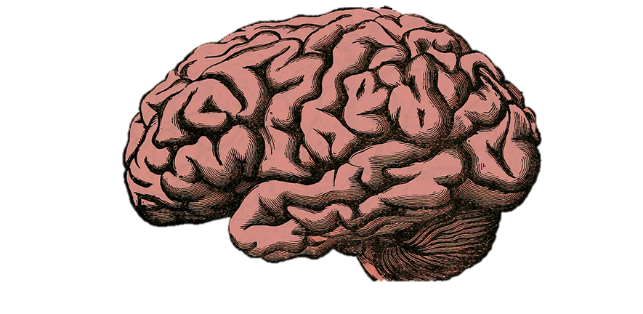
Mechanism
Information (Signal) Degradation Hypothesis:
increased demand on cognitive resources to decipher impoverished input —> higher level cognitive processing compromised as mental resources diverted to perception
Moberly, Doerfer, & Harris, Laryngoscope, 2019
Information degradation hypothesis
Sensory deprivation hypothesis
Cognitive load on perception hypothesis
Common cause hypothesis
Notes:
Four hypotheses have been proposed to understand the mechanism between hearing loss and cognitive decline. The information or signal degradation hypothesis proposes that hearing loss places increased demands on cognitive resources to decipher the impoverished auditory input. Higher level cognitive processing is then compromised because mental resources have been diverted or siphoned away to auditory perception. The visual analogy is the extra attention and working memory it takes to figure out what might be going on outside though a foggy windowpane.
Converging evidence for the information degradation hypothesis is provided by studies showing that effortful listening puts greater demands on executive function and working memory (Wingfield and Tun, 2007). Increased activation in frontal and posterior parietal working memory and attention networks has also been demonstrated with listening in noise (Wong et al., 2009). Importantly, the information degradation hypothesis implies the potential for reversibility, if fidelity of signal is restored.

Slide 17
Mechanism
Sensory Deprivation Hypothesis:
hearing loss —> chronic reallocation of cognitive resources —> permanent neuroplastic changes that disadvantage general cognition in favor of processes supporting speech perception
Moberly, Doerfer, & Harris, Laryngoscope, 2019
Information degradation hypothesis
Sensory deprivation hypothesis
Cognitive load on perception hypothesis
Common cause hypothesis
Notes:
The sensory deprivation hypothesis, on the other hand, proposes that hearing loss leads to a CHRONIC reallocation of cognitive resources, leading to PERMANENT neuroplastic changes that disadvantage general cognition in favor of processes that support speech perception. There is limited evidence for the sensory deprivation hypothesis currently. This explanation seems to be contraindicated by the fact that sensory impairments of young adults typically have negligible effects on overall levels of nonverbal cognitive function. The sensory deprivation hypothesis implies PERMANENT cognitive decline.

Slide 18
Mechanism
Common Cause Hypothesis:
Multiple sensory modalities and cognition decline concurrently through a common neurodegenerative etiology. General slowing of information processing speed.
Moberly, Doerfer, & Harris, Laryngoscope, 2019
Information degradation hypothesis
Sensory deprivation hypothesis
Cognitive load on perception hypothesis
Common cause hypothesis
Notes:
Lastly, the common cause hypothesis suggests that multiple sensory modalities and cognition decline concurrently through an as-of-yet unrecognized common neurodegenerative etiology. There is ample evidence supporting a link between cognitive decline and other sensory deficits including vision loss, gait and vestibular and olfactory dysfunction. Like the sensory deprivation hypothesis, the common cause explanation implies PERMANENT cognitive decline.
“While the temporal precedence of hearing loss and the risk it poses for subsequent dementia in cognitively normal subjects argues for hearing loss causing cognitive decline, it may be the case that degraded hearing influences certain neuropsychological assessments rather than cognition per se or that hearing loss brings older adults to medical attention more frequently, resulting in over-diagnosis of cognitive impairment”

Slide 19
Hearing Loss & Cognitive Decline
If hearing loss is a modifiable risk factor for cognitive decline & dementia…
Can hearing rehabilitation reduce, delay, or reverse cognitive changes?
Notes:
So, the big question is, if hearing loss is a modifiable, independent risk factor for cognitive decline and dementia, can hearing rehabilitation reduce, delay, or even reverse cognitive changes? This is where, as a field, we are in the unique position to make a big impact.

Slide 20
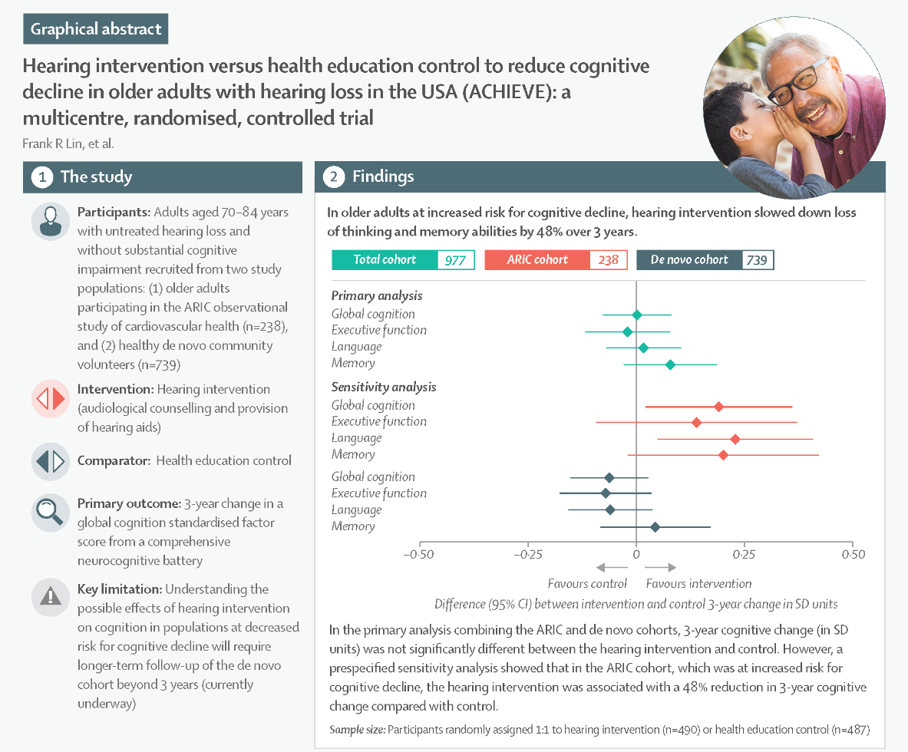
The main finding (primary analysis) was no difference in 3-year change in global cognition between the hearing intervention and the control group.
Secondary analysis: In older adults at increased risk for cognitive decline (ARIC cohort), hearing aids slowed down loss of thinking and memory abilities by 48% over 3 years.
Major criticism:
No interaction between hearing severity and treatment effect
Some aspects of battery were auditory/oral
ARIC cohort less representative of general population
ACHIEVE intervention not just hearing aids but comprehensive, intensive audiological services
Notes:
So, to what extent does treating hearing loss impact cognition? The Aging and Cognitive Health Evaluation in Elders, or ACHIEVE, study was a multicenter randomized trial to determine if treating hearing loss in older adults reduces age-related cognitive decline. Here, adults with hearing loss age 70-84 years WITHOUT cognitive impairment at baseline were followed from two study populations – a group of otherwise healthy community volunteers (the de novo cohort) and a group of participants from an ongoing study on heart health (the ARIC cohort). Participants were randomly assigned to hearing intervention with hearing aids or a health education control. Both groups were followed for 3 years with tests of thinking and memory. Outcomes are depicted by this forest plot, where diamonds to the right of “0” favor intervention and to the left favor control. What is demonstrated here is that in older adults at increased risk for cognitive decline – the ARIC cohort – hearing aids slowed down loss of thinking and memory abilities by 48% over the three-year study period.
Compared with the de novo cohort, the ARIC cohort was older, lower income, had more people with Black ethnic background, higher levels of diabetes, lower baseline cognition, and—oddly—lower hearing aid use among the hearing intervention group.
But a comparison with U.S. population profiles suggests that if anything, the de novo sample is more like the U.S. general population than the ARIC sample, at least in terms of levels of college education, income, proportion of people from Black ethnic background and proportion of men and women
Another finding that raises questions about the reliability of an effect of the hearing intervention on cognitive decline was that there was no interaction between the hearing intervention and hearing loss severity (pure-tone average [PTA] <40 dB versus ≥40 dB) on cognitive decline. One would have thought that any effect of hearing intervention would be greater among those with more severe hearing loss.
ACHIEVE included a battery of 10 neurocognitive tests. Two were reported to be exclusively auditory, the remaining eight had visual stimuli or both auditory and visual stimuli.
Hearing loss is known to affect performance on cognitive tests that include spoken elements (Füllgrabe 2020). It is unclear from the peer-reviewed article whether any benefits of the hearing intervention for the ARIC group may have been due to participants being able to hear the cognitive test stimuli better.
The ACHIEVE intervention is more comprehensive and intensive than is typically provided in usual clinical services, at least in terms of what we are familiar with in Australia and the UK. There were relatively high levels of hearing aid use (average 7 to 8 hr per day) and low levels of nonuse (10 drop-outs out of 588) in ACHIEVE compared with levels of hearing aid use reported in surveys of people who obtained hearing aids through standard care pathways (Dillon et al. 2020). If there were an effect of the hearing intervention in ACHIEVE, it is not clear that this effect would generalize to more typical hearing aid services or if services have the capacity to expand current intervention models.
Sawyer CS, Armitage CJ, Munro KJ, Singh G, Dawes PD. Correlates of Hearing Aid Use in UK Adults: Self-Reported Hearing Difficulties, Social Participation, Living Situation, Health, and Demographics. Ear Hear. 2019 Sep/Oct;40(5):1061-1068.
Atherosclerosis Risk in Communities = ARIC

Slide 21
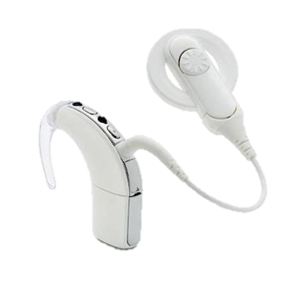
2023
12-month prospective Belgian study
Patients (n = 21) all ≥ 55 years-old (mean = 72)
Specifically recruited participants achieving poor cognitive results preoperatively
Met criteria for MCI based on Repeatable Battery for the Assessment of Neuropsychological Status for hearing-impaired patients (RBANS-H) total score 1 SD below the mean or worse based on normative data (no better than 16th percentile)
8/21 (38%) of sample surpassed cutoff for MCI following cochlear implantation
Education level, sex, depression, anxiety not related to evolution in RBANS-H score in linear mixed-effects models
Reinforces that cochlear implantation is not contraindicated in patients with cognitive decline
Notes:
Lastly, last year, a Belgian group specifically considered patients meeting criteria for mild cognitive impairment. All earlier studies that we’ve looked at intentionally used participants with baseline normal cognitive function. Here, they recruited participants whose performance fell below the 16th percentile on a cognitive battery specifically designed for hearing-impaired test-takers. They found that while 100% of their sample was within the cutoff for MCI before implantation, 38% of the sample surpassed the cutoff following implantation. Education level, sex, depression, and anxiety were not related to evolution in score on mixed-effects modeling. These finds reinforce that cochlear implantation is not contraindicated in patients with known mild cognitive decline and, in fact, should be considered after typical multidisciplinary evaluation.

Slide 22
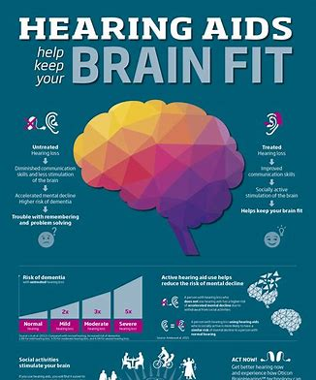
What to Tell Your Patients
Age-related hearing loss does appear to be independently associated with increased risk of cognitive decline
Critically, the mechanism is not yet substantiated
The role of hearing rehabilitation to reverse, slow, or prevent cognitive decline is unclear, but promising
Oticon (Hearing Aid Manufacturer)
Notes:
So, based on what we know, what can we tell our patients? It is clear that both age-related hearing loss and cognitive decline are on the rise with the aging population. Age-related hearing loss does appear to be independently associated with increased risk of cognitive decline, although effect sizes are generally small. The mechanism linking the two is not substantiated. Hearing loss is reventable in many cases and treatment. The role of hearing rehabilitation to address cognitive function is incompletely characterized, but it is promising. We need to know much more.

Slide 23
What to Tell Your Patients
Discuss hearing interventions in the context of healthy living, and how communication is vital in facilitating an active independent, vibrant lifestyle
Preserving autonomy and independence
Enhanced social interaction
Decreased loneliness and depression
Orienting the discussion around hearing interventions as healthy lifestyle choices (rather than stigmatizing medically focused interventions in the context of dementia risk) may encourage uptake of hearing interventions
Oticon (Hearing Aid Manufacturer)
Notes:
So, based on what we know, what can we tell our patients? It is clear that both age-related hearing loss and cognitive decline are on the rise with the aging population. Age-related hearing loss does appear to be independently associated with increased risk of cognitive decline, although effect sizes are generally small. The mechanism linking the two is not substantiated. Hearing loss is reventable in many cases and treatment. The role of hearing rehabilitation to address cognitive function is incompletely characterized, but it is promising. We need to know much more.

