Slide 1
ACE/Resilience workshop evaluation 2021
Friday, September 10, 2021

Slide 2
76
Total Responses
Date Created: Monday, September 13, 2021
Complete Responses: 76

Slide 3
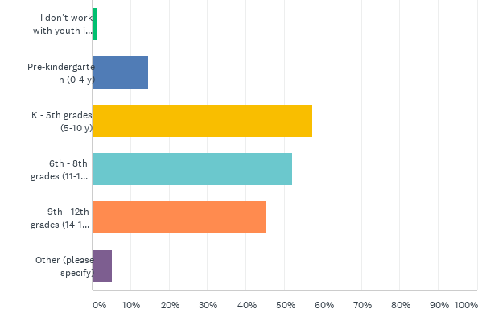
Q4: What ages of youth do you work with in your job? (Check all)
Answered: 75 Skipped: 1

Slide 4
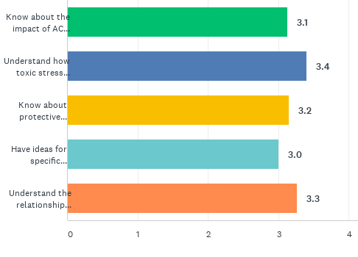
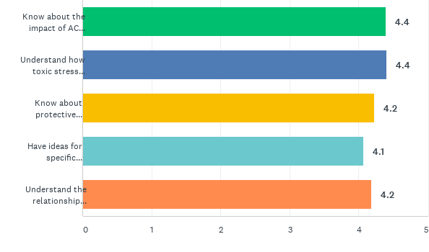
Q5: Before the workshop, did you:
Answered: 76 Skipped: 0
Q6: After the workshop, did you:

Slide 5
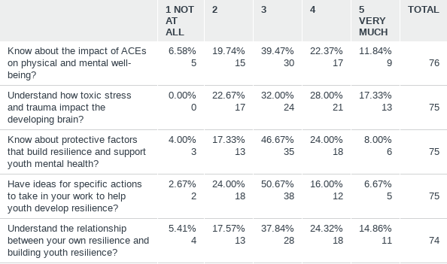
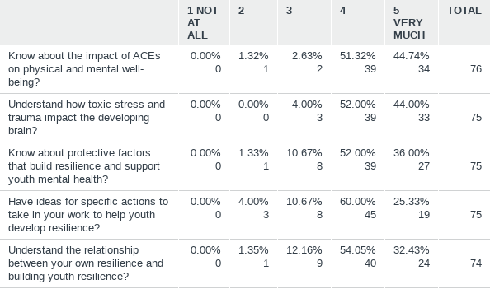
Q5: Before the workshop, did you:
Answered: 76 Skipped: 0

Slide 6
One action you plan to take or one change you will make in your work with youth.
70 responses (out of 76)
Relationship Building / Positive Interactions (45)
Strengthen connections (28)
More conversations
Blue dot activity
Something special for each student
Interact more with the kids
Be more intentional
Listening (10)
Listen to body language
Staying calm and waiting for youth to calm down (9)
Give more time to process reactions
More patience
Use strategies that build resilience (19)
Try general strategies (4)
Use mastery techniques (7)
High expectations (3)
Real Talk (2)
Service to others
Meaningful participation (2)
Other (6)
Be more cognizant of ACE characteristics in youth (2)
Be more understanding of what might be driving behavior (4)

Slide 7
One action you would like to see your organization take
64 responses (out of 76)
Support for staff (14)
Self care for staff (5)
School wide plan with support to implement (5)
Teachers sharing with one another things that have been successful (3)
1 on 1 help
Support for students (14)
Extra support for students with special needs
Staffed space to chill/relax someone there to just listen
Self care
Mental health supports
ACEs training for students and supports to process with their ACEs
Implement resilience strategies (21)
Blue dot activity/connection with all students (14)
Meaningful participation (2)
Real talk (4)
Mastery opportunities
More training (12)
Learn more about resilience strategies
ACE data
Parent/family education (3)
Have this type of training yearly, continue this conversation (6)
Trauma (1)
Hire a behavior interventionist (2)

Slide 8
One thing I heard that I would like to learn more about is…
58 responses (out of 76)
Protective factors & strategies to build resilience (29)
General information on building resilience in students and practical strategies (16)
Tips/strategies for brief interactions
Service to others
High Expectations (3)
How to tip the scale with positive factors (3)
Using a worry box (3)
Cultural identity
Facilitating participation
Addressing trauma (2)
How to be resilient when negative life events happen
Understanding childhood trauma
ACEs; brain science (18)
Brain plasticity and how we can rewire the brain to help students (4)
Affects of ACE’s on health (6)
ACE data and research (8)
Self-care (7)
Resilience in us (6)
Hire a behavior interventionist
Resources (2)
For students
Connecting community resources to students and families
Mental health supports for staff

Slide 9
Comments or suggestions for improving this workshop
23 responses (out of 76)
Positive comments about the workshop (10)
Thank You (7)
Informative
Enjoyed the dialogue with small groups
I really liked the brain information
Suggestions (13)
Too long/Too long breaks (3)
Virtual not the best format (2)
More specific strategies (3)
Can a condensed version of this be required for parents?
Less wordy
Make into a taped version
Perhaps do a pre-survey and tailor
Do not read the slides

