Slide 1
Flip the Switch to Positive Mood: 10 Quick Ways to Buffer Stress
David J. Cipriano, Ph.D.
Associate Professor of Psychiatry
Director of Student and Resident Behavioral Health
Medical College of Wisconsin

Slide 2
Negativity Bias
We humans are more likely to take note of, focus on, and remember the negative than the positive.
This likely aids in threat and risk reduction. But, in our modern world, most negatively valanced stimuli do not actually constitute a threat.
It is even active in our sleep! A bad night’s sleep tends to wipe out our positive memories while leaving negative ones intact.

Slide 3
Positive Emotions
Dr. Barbara Fredrickson’s Work on Positive Emotions
Negative emotions narrow our focus (probably adaptive – it is a good survival strategy to focus on an impending danger).
Positive emotions produce novel thoughts and creative thinking as well as more flexible mindsets.
Cohn, Fredrickson, et al. (2009). Emotion, 9(3), 361-368.

Slide 4
“The negative screams at you, but the positive only whispers...”
Barbara Fredrickson, Ph.D., University of North Carolina at Chapel Hill

Slide 5
Micropractices
When it comes to coping, physicians and other healthcare professionals appreciate “highly actionable tools that require minimal time to learn and implement”
Fessell, D. & Cherniss, C. (2020). Cornoavirus Disease 2019 (COVID-19) and beyond: Micropractices for burnout prevention and emotional wellness. Journal of the American College of Radiology. https://doi.org/10.1016/j.jacr.2020.03.013

Slide 6
10 quick strategies to change and maintain positive mood
Positive mood is a powerful buffer against stress.
In-the-moment positive emotions, over and above general positive evaluations of one’s life, are a key link to wellbeing and resilience.
Cohn, M.A. et al.(2009). Happiness unpacked: Positive emotions increase life satisfaction by building resilience. Emotion, 9(3): 361-368.

Slide 7
1. Minute Mindfulness
Any recurring event or mundane daily task:
Waiting to log on to the computer
Brushing your teeth
Waiting at a red light
Walking from your car to the building
With practice, these will become cues to take a mindful moment, breathe and do a wellbeing self-check.
Fessell, D.F. & Cherniss, C. (2020). Coronavirus Disease 2019 (COVID-19) and Beyond: Micropractices for Burnout Prevention and Emotional Wellness. Journal of the American College of Radiology,

Slide 8
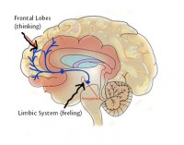
Mindfulness
Opens up synapses between the left prefrontal cortex and the limbic system and between the left prefrontal cortex and the right prefrontal cortex.

Slide 9
Why is this important?
Mindfulness practice has been shown to increase left prefrontal activation. And, people with more left prefrontal activation report more positive affect and have reduced levels of cortisol.
Hall (2008).

Slide 10
Outcomes of Meditation/Mindfulness
2014 meta-analysis of mindfulness meditation programs found moderate evidence of improved anxiety, depression and pain. Effect sizes ranged from 0.30 – 0.38. Goyal, et al. (2014). JAMA Internal Medicine, 174(3):357-368.
For point of reference, average effect sizes for:
- General medicine medications: 0.45
- Psychiatric medications: 0.49
Leucht, S., et al. (2012). Putting the efficacy of psychiatric and general medicine medication into perspective: Review of meta-analyses. The British Journal of Psychiatry, 200, 97-106.

Slide 11
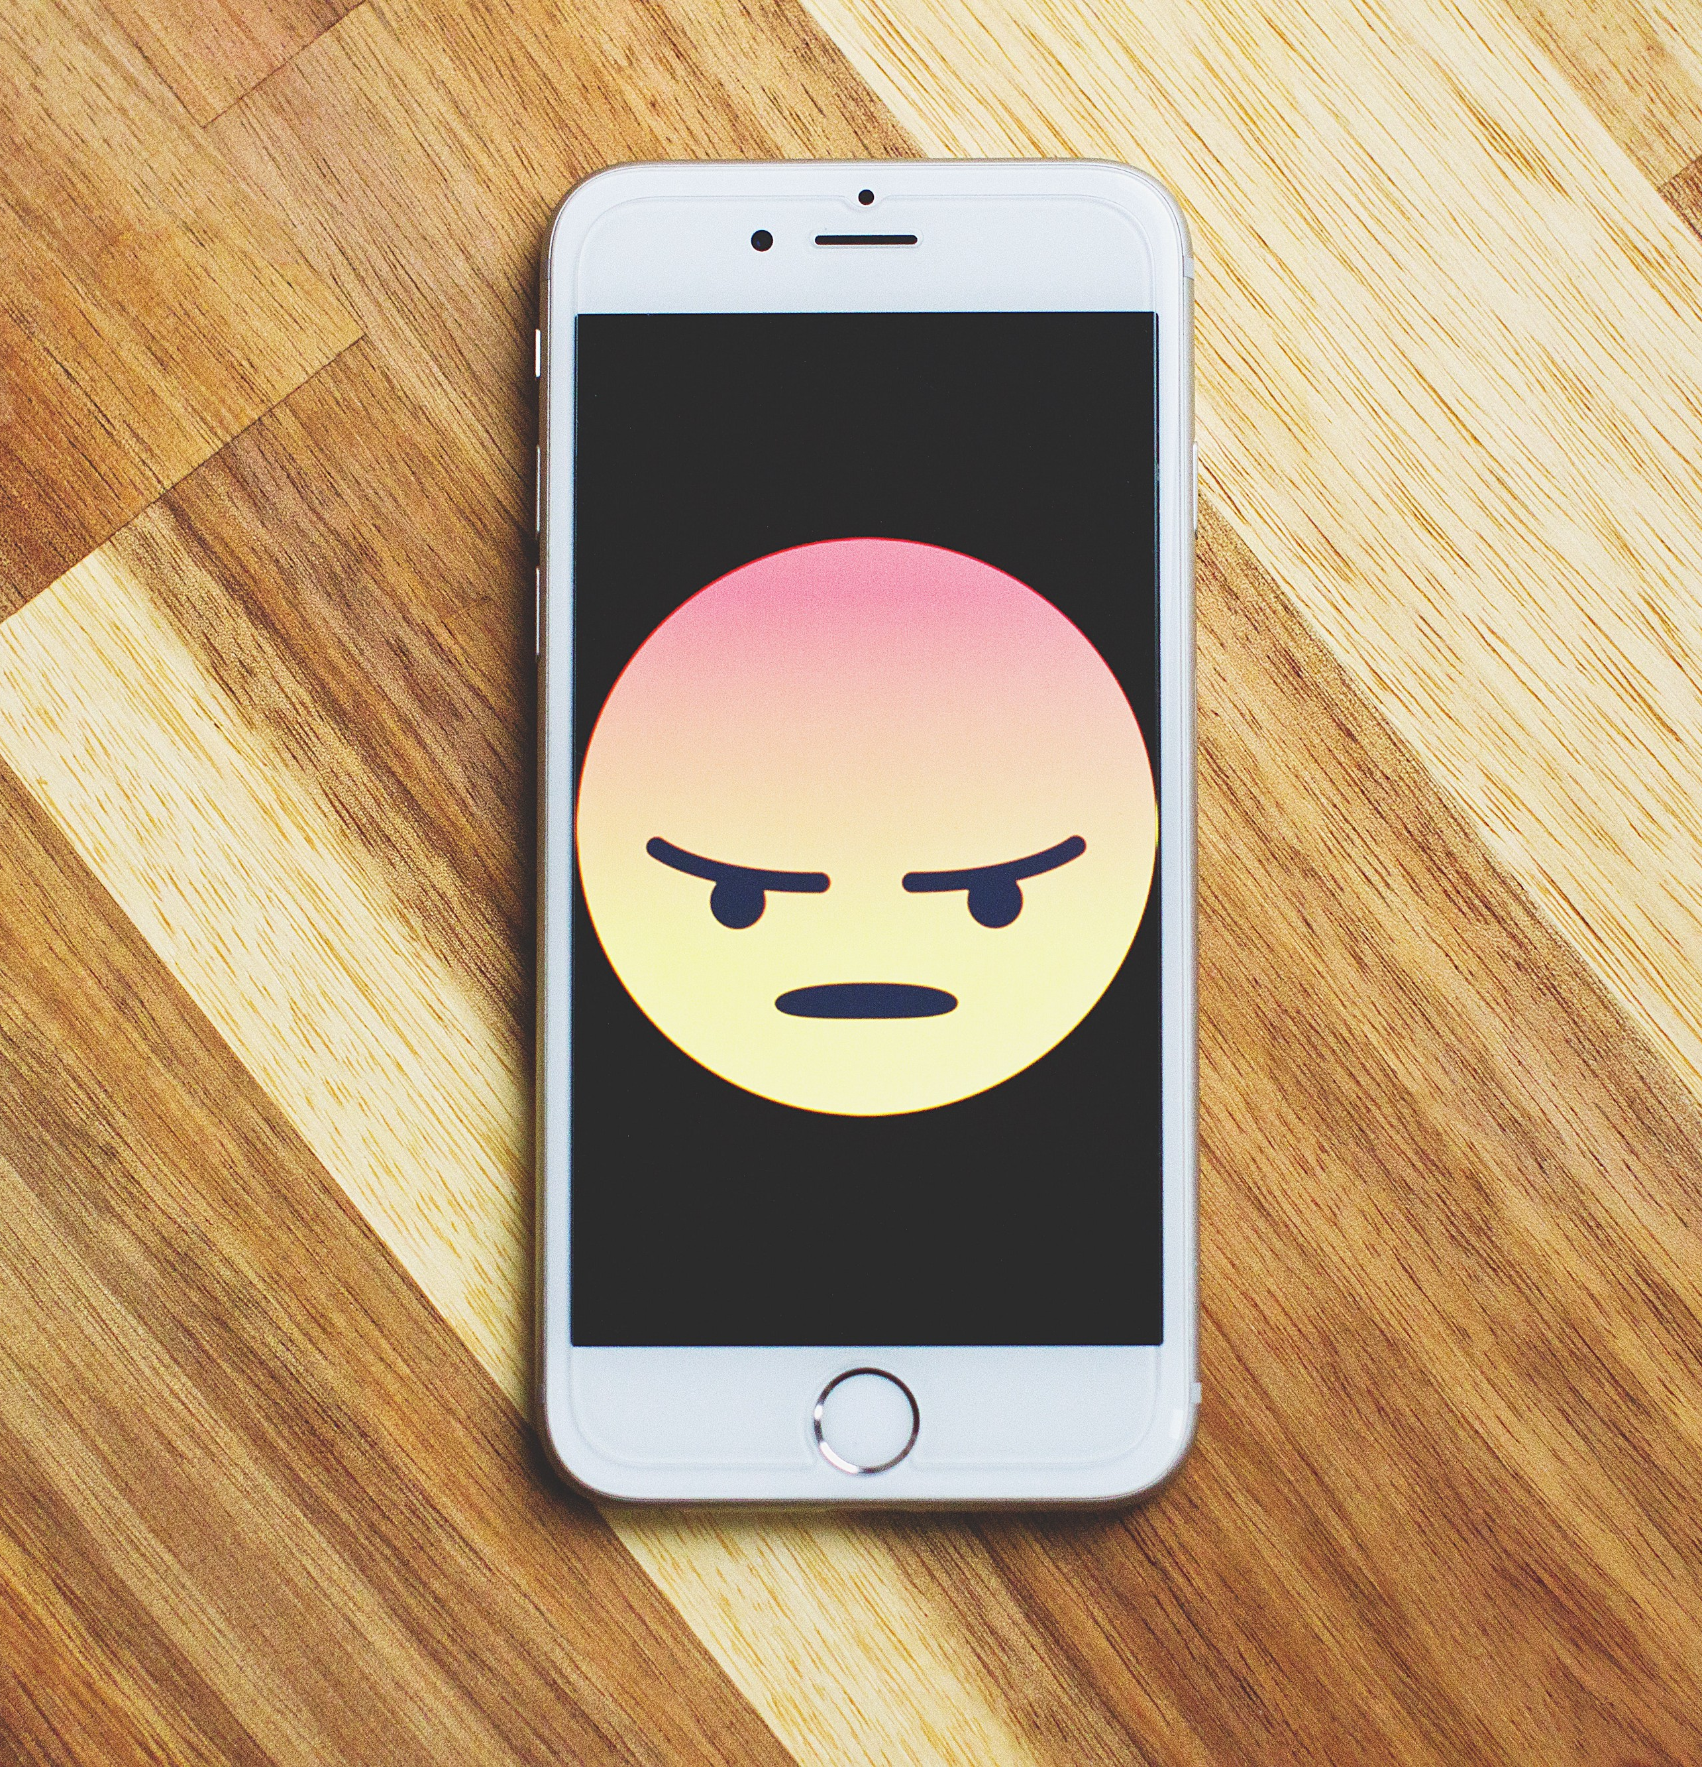
2. Name it and Claim it
Accept what you’re feeling and name it.
Any emotion that is accurately identified and
appropriately expressed will dissipate.

Slide 12
Name it and Claim it
Simply naming your emotion has been shown to shift brain activity from the amygdala to higher-order thinking areas (right ventrolateral prefrontal cortex) bringing a sense of calm and peace.
Lieberman, M.D., Eisenberger, N.I., Crockett, M.J., Tom, S., Pfeifer, J.H. & Way, B.M. (2007). Putting feelings into words: Affect labeling disrupts amygdala activity to afeective stimuli. Psychological Science, 18, 421-428.

Slide 13
3. Gratitude
Documenting 3 things that you are grateful for every day for at least 2 weeks has been found to improve mood, increase various indices of wellbeing (improved diet and sleep, better work-life balance) and decrease burnout among healthcare workers. Most people started noticing improvements in mood after 4 or 5 days. These benefits can last up to 6 months.
Emmons, R.A & McCullough, M.E. (2003). Counting blessings versus burdens: Experimental studies of gratitude and subjective well-being in daily life. Journal of Personality and Social Psychology, 84, 377-389.
Sexton, J.B. & Adair, K.C. (2019). Forty-five: A prospective pilot study of the Three Good Things well-being intervention in the USA for healthcare worker emotional exhaustion , depression, work-=-life balance and happiness. BMJ Open eo22695

Slide 14
4. Futuring
Instead of ruminating on what’s happening, ask yourself what you intend to do.
When we imagine the future, the default network lights up. This is where our brain goes when it is not activated by sensory stimuli and motor responses. It is most active during rest and when engaging in conceptual thinking. Components include: dorsomedial prefrontal cortex and posterior medial parietal cortex.

Slide 15
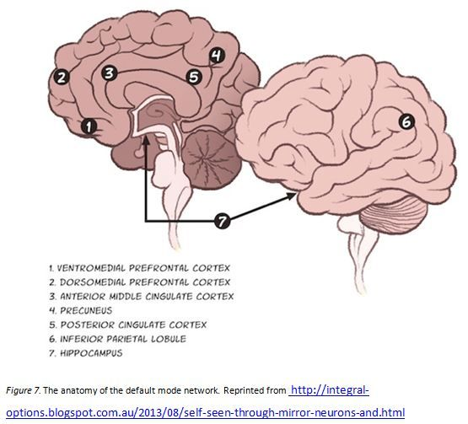
Futuring
Default Mode Network (DMN) is activated in the absence of task demands and is associated with:
Imagining possible scenarios involving
ourself
Recent personal memories
Aspirations for the future
It has been called the neural basis for
the core of the self. It is where our brain
goes during higher-order conceptual
thinking.

Slide 16
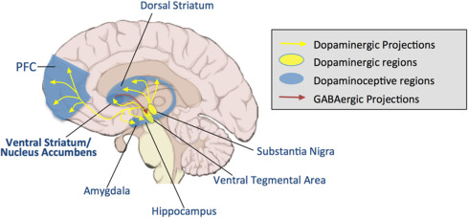
Futuring
Thinking about an upcoming positive reward leads to increased activity in the ventral striatum, a region associated with reward.

Slide 17
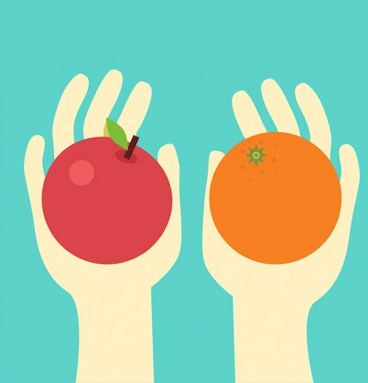
5. Control what you can and have the wisdom to know what you can’t
Think about what is in your control and exercise choice when you can.
There is evidence for the stress-reducing effects of perceived control
Bollini, et al., (2004), The influence of perceived control and locus of control on the cortisol and subjective response to stress. Biological Psychology, 67: 245-260).

Slide 18
Examples of Choice
I choose to use another printer since no one ever seems to reload the paper in this one.
I choose to enter the alley at this end of the block to avoid the high probability that the guy at the end of the street is blocking the other end.
I choose to not take new patients on Mondays since I have no control over which new cases get assigned to me.
I choose to share resources with a colleague whom I had no control over their scheduling patients on my clinic day.

Slide 19
Control = Choice
Control is often operationalized as choice in experimental paradigms.
Choice impacts stress through two avenues:
The experience of control is innately rewarding: there is increased activity in the striatum when choice is exercised.
Control decreases stress by reducing negative affect: we see increased activity in the medial prefrontal cortex (due to interconnectivity with the striatum). Increases in PFC activity result in decreased limbic (i.e., amygdala) activity.
Leotti et al. (2010). Born to choose: The origins and value of the need for control. Trends in Cognitive Science, 14(10): 457-463.

Slide 20
6. Thought-Feeling Connection
Does this thought energize me or paralyze me?
Ask yourself,

Slide 21
If it paralyzes you, chances are you will just avoid it (but that doesn’t make it go away). Instead, think about a coping strategy!
If you feel paralyzed, chances are your Dorsal raphe nucleus (DRN) is involved. It has extensive connectivity with the amygdala. DRN activation leads to helplessness and panic.
Learning coping strategies turns on the ventral medial prefrontal cortex which blocks the DRN!
Amat, J., et al., (2006). The Journal of Neuroscience, 26(51): 13264-13272.
Amat, J., et al., (2008). Neuroscience, 154(4): 1178-1186.

Slide 22
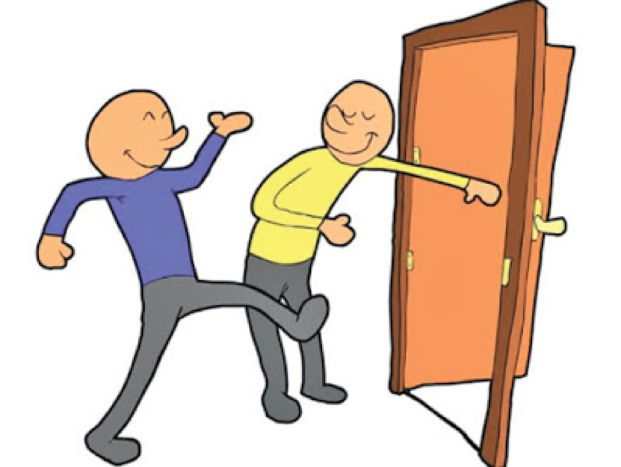
7. Exercise Compassion
Even imagining oneself behaving compassionately toward others improves mood.
Quordbach et al. (2015). Positive emotions: An emotion regulation perspective. Psychological Bulletin. doi.10.1037/a0038648

Slide 23
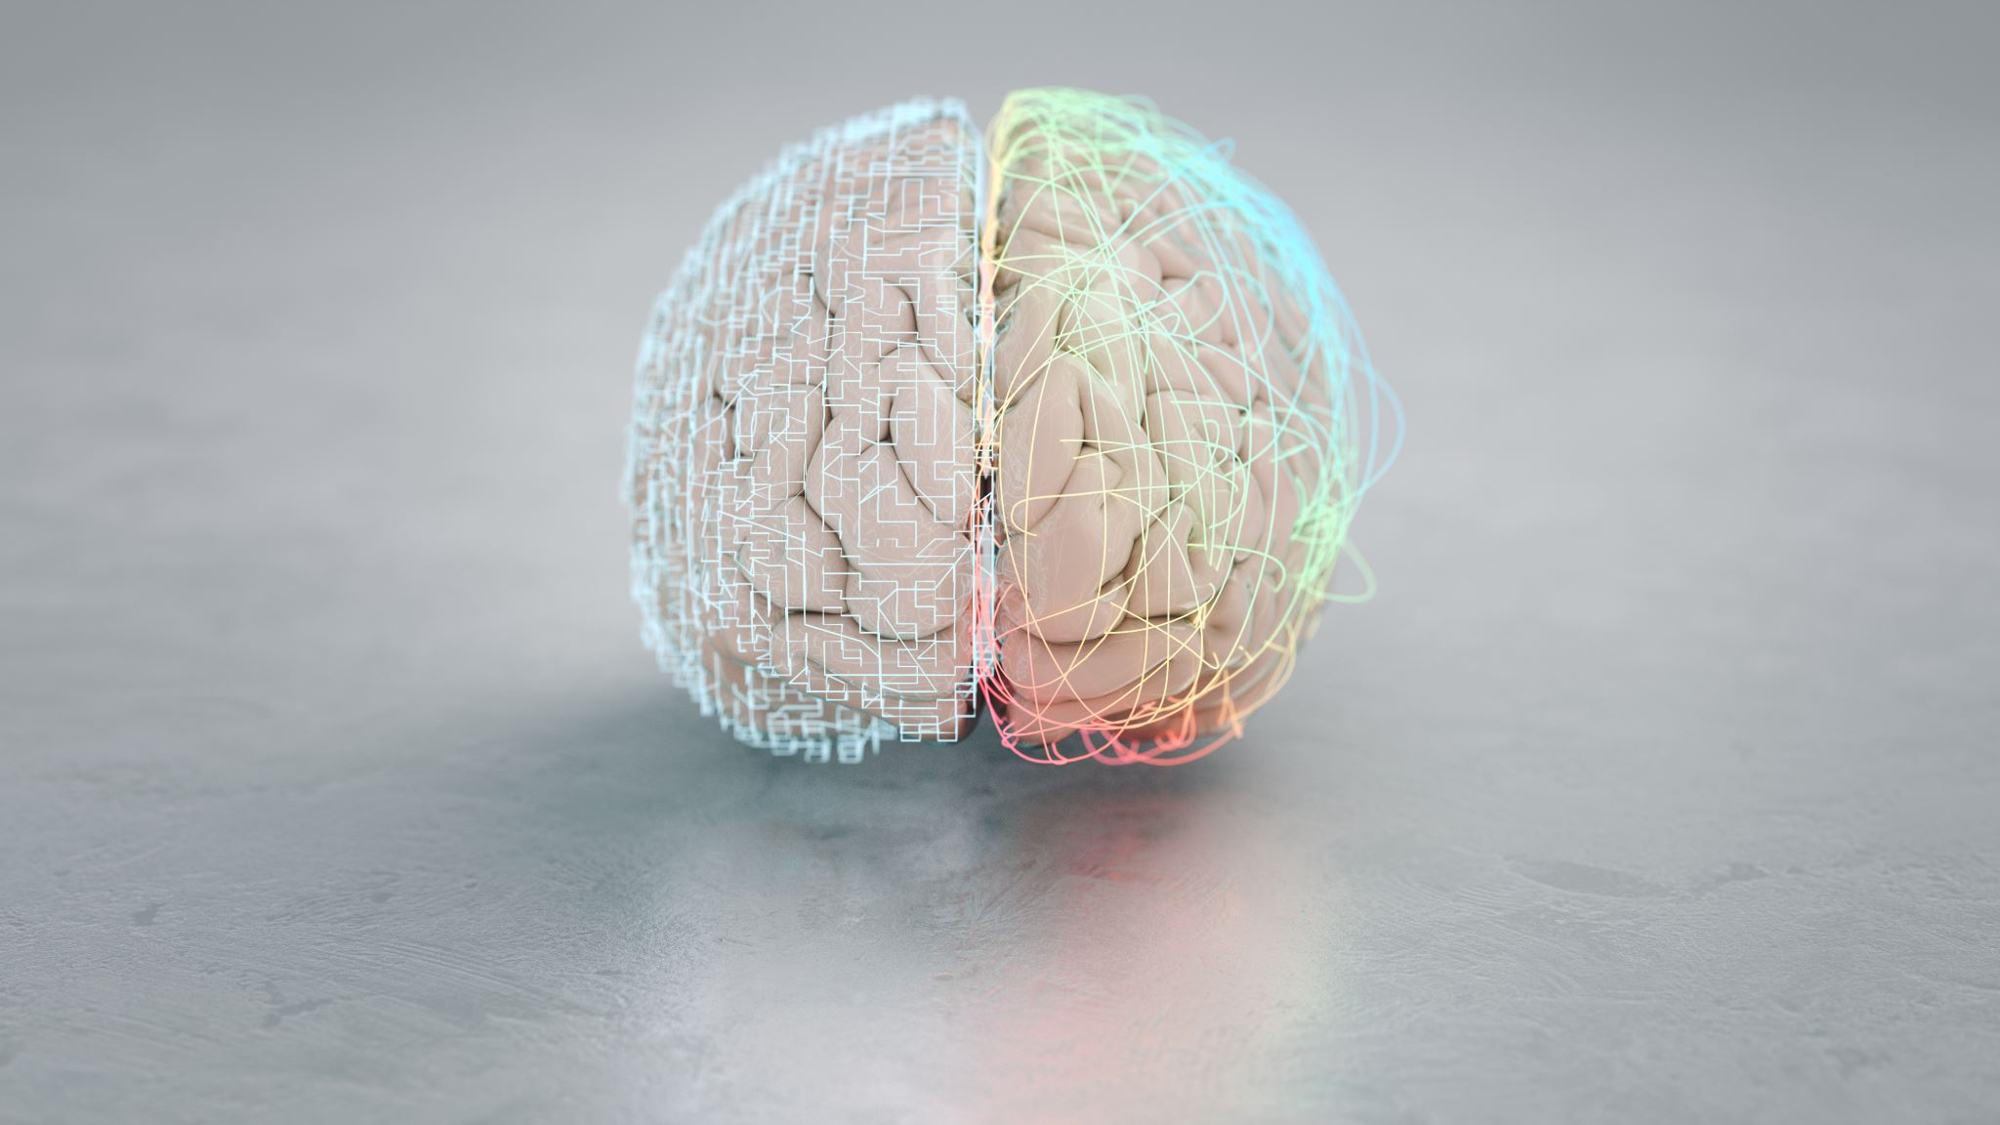
Compassion Brain
Individual acts of kindness release endorphins and oxytocin.
Mathers (2016). British Journal of General Practice, 66, 525-527.

Slide 24
8. Take time for awe and savoring
Savoring the present moment is related to higher levels of positive emotion.
Quordbach et al. (2015). Positive emotions: An emotion regulation perspective. Psycholgical Bulletin. doi.10.1037/a0038648

Slide 25
Build your savoring muscle!
Stay for a moment
Focus on the details: color, line, pattern, sound, melody, harmony, smell (Familiar? What does it remind you of?), the tactile experience, taste.
Focus on the sensations you are experiencing: literally – what sensory receptors are being triggered right now? How bright is that yellow? Does the sand feel warm or cool? Does that slightly sour taste remind you of anything?
If you want to sharpen the experience, tune out the other senses. If you are focusing on the sound of the waves, close your eyes. If you are struck by the sight of a flower, turn off your air pods for a minute.
Express gratitude for the experience.
Congratulate yourself for staying in the moment.

Slide 26
Other benefits of awe and savoring
Lower levels of sympathetic nervous system arousal
Lower levels of interleukin-6 (a biomarker of inflammation)
Increased sense of time-plentifulness as opposed to time-starvation
Bai et al. (2021). J. Pers. Soc. Psychology, 120(4), 837-860.

Slide 27
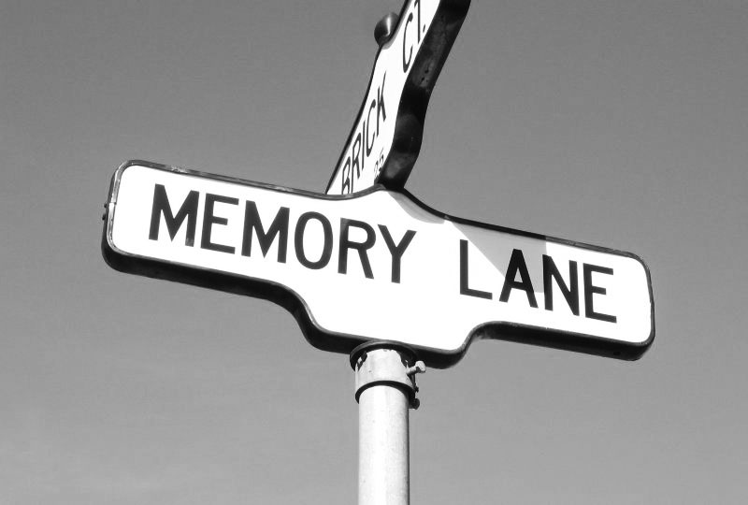
9. Bring up happy memories
Happy autobiographical memories are associated with activation in the left ventrolateral prefrontal cortex (there’s that left PFC again = positive mood!).
Foland-Ross et al. (2014). Recalling happy memories in remitted depression: A neuroimaging investigation of the repair of sad mood. Cognitive, Affective and Behavioral Neuroscience, 14(2): 818-826.

Slide 28
10. Identify Silver Linings
Optimism is mediated in the frontal cortex and dopamine enhances this effect.
Sharot, T., et al. (2012). How dopamine enhances an optimism bias in humans. Current Biology, 22(16): 1477-1481.

Slide 29
What not to do:
Don’t focus on how far you have to go – acknowledge how far you’ve come
Don’t compare yourself to others
Don’t hold grudges – practice forgiveness (remember, forgiveness is a gift for you, not necessarily for the other person)
Don’t assume ill-intent on the part of others
Don’t wait until you ‘feel like it’ – Motivation follows Action! (Fake it until you make it.)

