Slide 1
Optimistic Explanatory Style
David J. Cipriano, Ph.D.
Director of Student and Resident Behavioral Health
Medical College of Wisconsin

Slide 2
How do you handle negative feedback?
Do you take it as a permanent mark on your record, one that you’ll never be able to live down?
Do you assume that this one episode is reflective of your overall incompetence?
Do you believe that this is a fixed ability and out of your control?

Slide 3
We refer to this as our
Explanatory Style

Slide 4
Benefits of Optimism
Decreased rates of depression
Increased problem-focused coping
More likely to engage in healthy behaviors
Increased stress hardiness
More likely to have social support
Tugade, Shiota & Kirby (2014). Handbook of Positive Emotions. New York, NY: Guilford Press.

Slide 5
What optimists do differently
They are more skillful at identifying problems
More likely to see a stressor as a challenge vs. a threat
Quickly identify what they can control or influence
Able to accept what they can not control
More likely to approach a problem rather than avoid it
More likely to seek out information
Tugade, Shiota & Kirby (2014).

Slide 6
The Optimistic explanatory style has to do with how we explain negative events in our lives.
As temporary rather than permanent
Due to a specific thing we need to work on versus our general deficiency or incompetence
As controllable – with some effort we can fix this versus that it is out of our control (e.g., our ability or I.Q.)

Slide 7
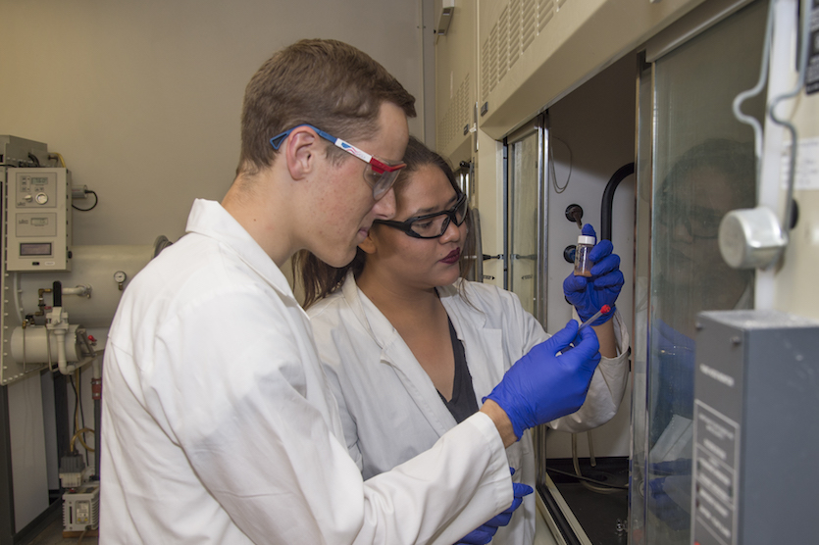
Make optimistic attributions for set-backs or failures.
Temporary vs. permanent
I am learning.
I will get better.

Slide 8
Make optimistic attributions for set-backs or failures.
Specific vs. Global
Don’t generalize. This is not reflective of your overall ability to be a good scientist/pharmacist/doctor. This is one specific skill set.

Slide 9
Make optimistic attributions for set-backs or failures.
Controllable vs. Uncontrollable
What’s controllable is your effort.
What can you do differently next time?

