Slide 1
Welcome to MCW Big Interview
https://mcw.biginterview.com

Slide 2
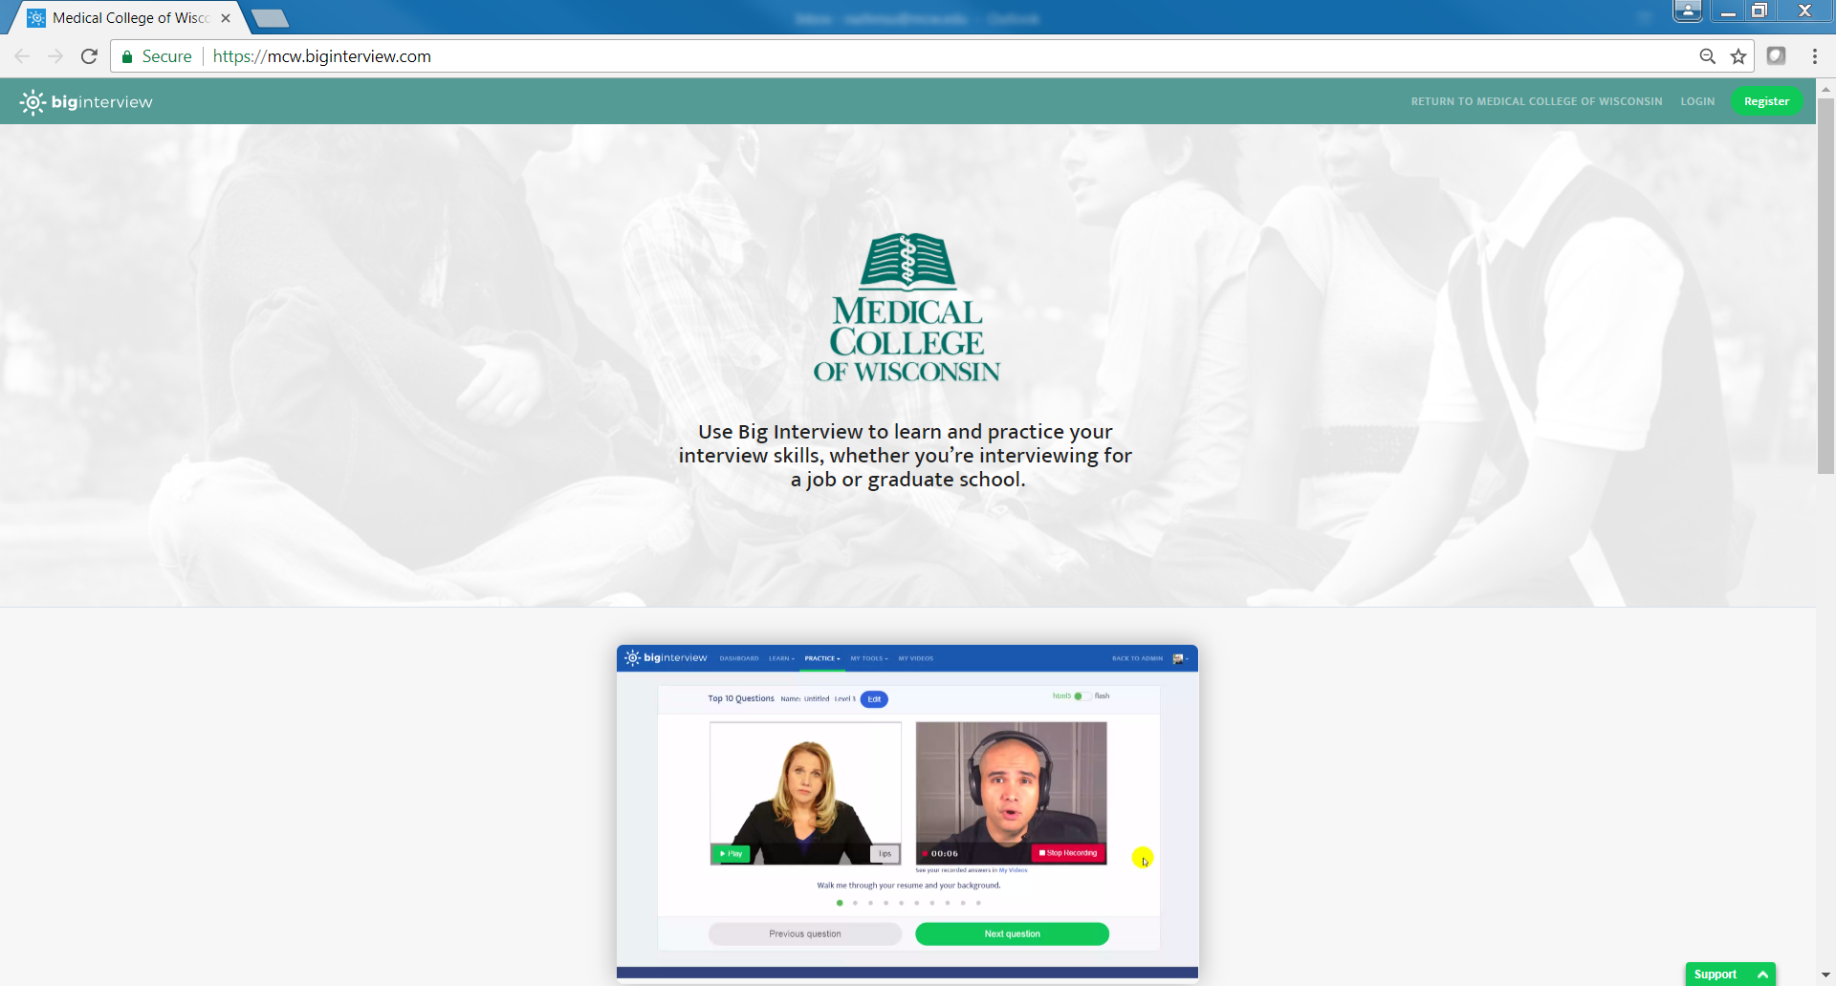
Step 1: Click Register
Step 2: Complete registration process
Step 3: You will receive a confirmation email
at your MCW email address. Click “Verify” in
the email, and you’ll be able to start using Big Interview.

Slide 3
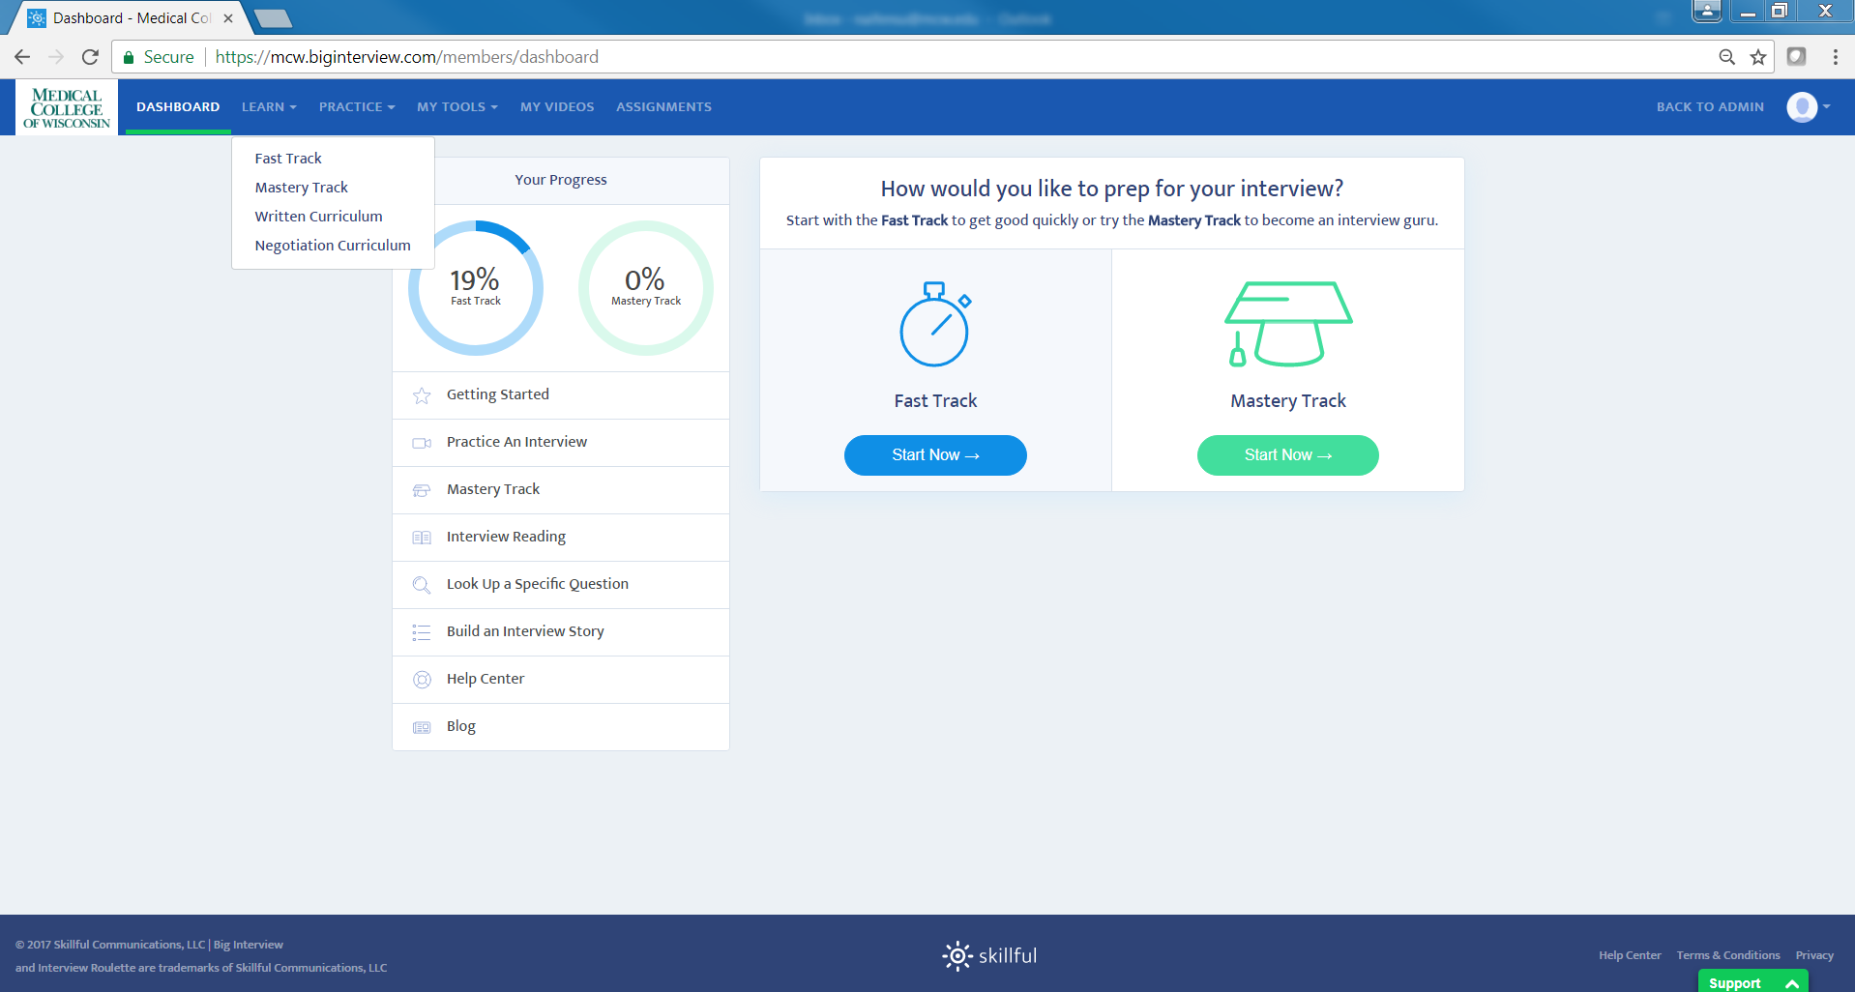
Big Interview provides self-learning online modules. It includes “Fast Track”, “Mastery Track”, “Written Curriculum”, and “Negotiation Curriculum”.
Fast Track is a short online training, including 3 modules.
Mastery Track is a long online training, including 10 modules.

Slide 4
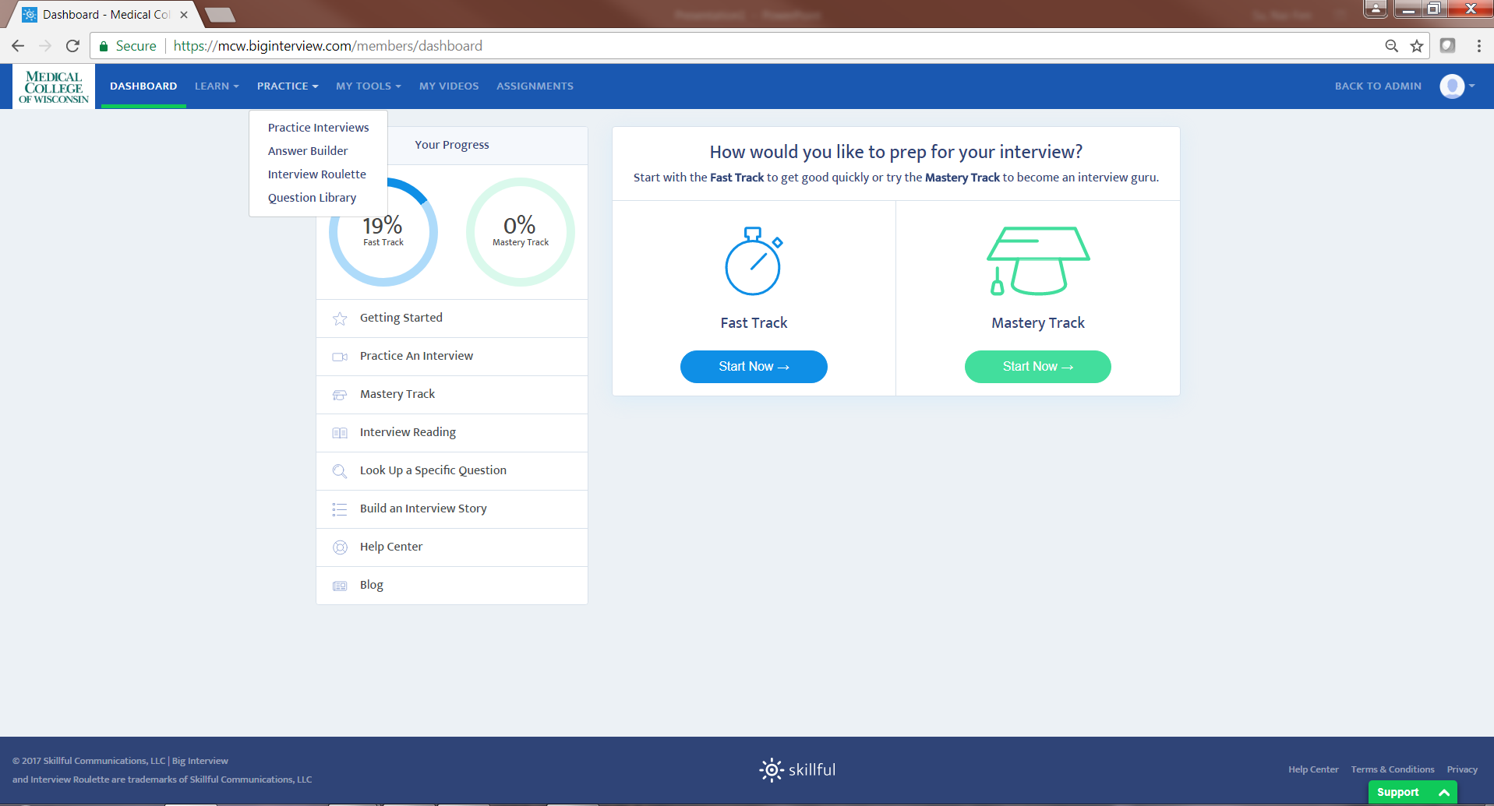
The practice session includes Practice Interviews, Answer Builder, Interview Roulette, and Questions Library.
Please click “Practice Interview” to practice interview questions and record it.

Slide 5
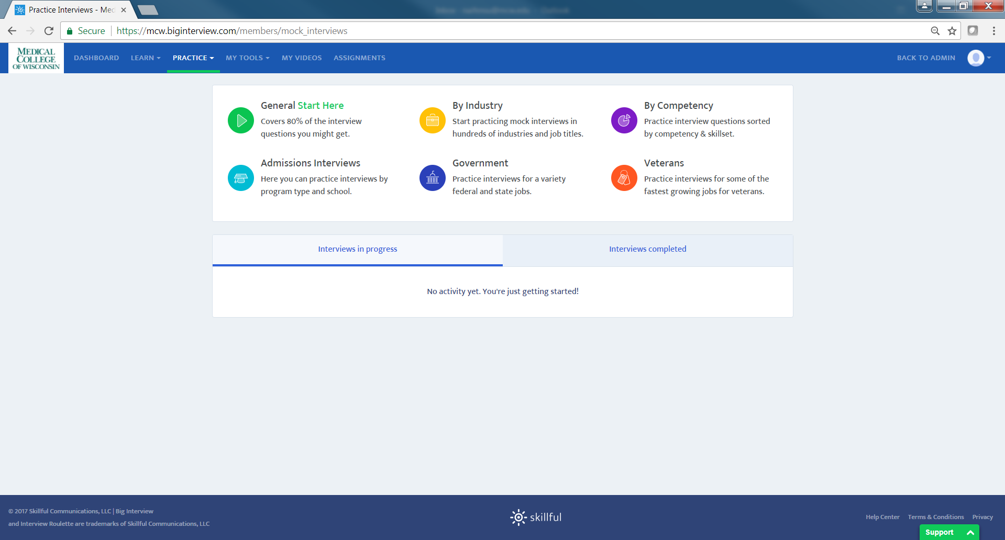

Slide 6
Click Admissions Interview, then you will find Health Care Industry

Slide 7
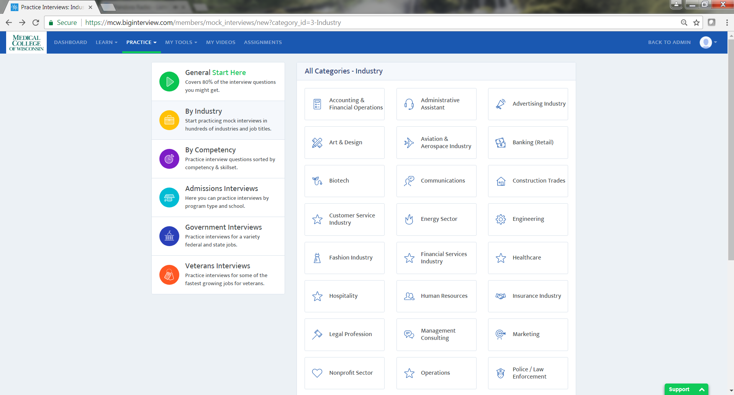
There are 33 categories

Slide 8
If you have any questions, please contact MCW Career Counselor
Dr. Nai-Fen Su
naifensu@mcw.edu | 414-955-4977

